Slide 1
Microcontroller systems 2. Sensors and signals

Slide 2
Practitioner guide 2. Sensors and signals
2

Slide 3

Introduction and overview
2. Sensors and signals | Practitioner guide
These resources help practitioners to deliver the microcontroller systems components of engineering and manufacturing-related qualifications at levels 2 and 3. They introduce the topic and stimulate learners to explore and reflect on key concepts and are designed to complement and enhance practitioners’ own lesson materials and schemes of work.
Resources summary
Prerequisites – it is recommended that learners complete 1. Mechatronic systems and control before starting this resource.
Resource name | Level | PPT slides + notes – practitioner | PPT slides – learner | Activity sheets | Film | Interactive
2. Sensors and signals | 3 |  |  | 2
Delivery
Delivery suggestions for practitioners and suggested answers where appropriate, are in the presenter’s notes for each slide. The core activities in each resource provide around 60 mins learning time, though additional suggestions, including independent learning, can extend this time significantly.
Overarching theme/big questions
What is a mechatronics/automated system?
What is the role of programmable logic controllers (PLCs) in mechatronics?
Overview
The Level 2 resource provides a bridge between Level 2 and Level 3. It helps learners to understand the purpose and features of a mechatronic system, identify examples of mechatronic systems in a range of settings, describe in simple terms how the different components in a mechatronic system work together to control a process, and identify some differences between a microcontroller, PLC and microcomputer, suggesting suitable applications for each.
The Level 3 resources develop learners’ understanding of sensors and actuators before using a series of realistic but simple scenarios to provide an introduction to PLCs and PLC programming. We suggest that practitioners adapt the activities to suit the range of sensors, actuators and PLCs available in their place of learning or which relate to learners’ industrial placements. Practical extension suggestions enable learners to practise PLC programming using your preferred tool, software or simulator and to build a complete demonstration system.
3

Slide 4
Learning outcomes and resource links
2. Sensors and signals | Practitioner guide
Level 3 resource 1
Sensors and signals
Understand the role of signal conditioning and analogue to digital conversion.
Perform calculations to find output voltage and digital outputs.
Select a sensor component to match a functional specification.
Full resource list available for the topic of Microcontroller systems:
1. Mechatronic systems and control (Level 2)
2. Sensors and signals (Level 3)
3. Understanding control processes (Level 3)
4. Pulse width modulation (Level 3)
Links to other supported topics
Sustainability, Robotics, CNC machinery, Renewable energy, Electric machines.
4

Slide 5
Subject coverage
2. Sensors and signals | Practitioner guide
Microcontrollers and PLCs
Mechatronics
Sensors and actuators in automation and control
Programmable Logic Controllers (PLCs)
PLC programming
Applications of PLCs
Control system theory
Process control diagrams
Maths
Using formulas
Communicating
Mathematical diagrams
Including careers
How different engineering sectors use control and automation.
5

Slide 6

2. Sensors and signals
6

Slide 7

Learning outcomes
You will be able to:
Understand the role of signal conditioning and analogue to digital conversion.
Perform calculations to find output voltage and digital outputs.
Select a sensor component to match a functional specification.
Image © Ocado Technology
7

Slide 8



Control systems recap
What is the role of each part of this control system?
What do the arrows represent?
What is the importance of feedback in a control system?
How many examples of input devices or sensors can you name?
Input device
Input
Electronic controller
Output
Output device
Feedback
Sensor
8
Notes:
Practitioner delivery suggestions
The Level 3 resources develop learners’ understanding of sensors and actuators before using a series of realistic but simple scenarios to provide an introduction to planning code routines such as flowcharts and structured text. We suggest that practitioners adapt the activities to suit the range of sensors, actuators and PLCs available in the place of learning or which relate to learners’ industrial placements. Practical extension suggestions enable learners to practise PLC programming using your preferred tool, software or simulator and to build a complete demonstration system.
Starter activity
To recap the concept of mechatronics systems and control:
Ask learners to recall a definition of a mechatronic system. For example, ‘A mechatronic system combines electronics, mechanics and computer control to automate a process or response.’
Learners can discuss each question in pairs or as a group.
Example answers
Input device: Provides the system with a goal, for example a target temperature.
Controller: Compares the current state of the system with the goal to make decisions that reach the goal.
Output device: Controls the mechanical system.
Sensor: Provides information about the state of the mechanical system or its environment, eg temperature.
The arrows represent the flow of information within the control system. This information flows as electrical signals.
Feedback happens when information about the state of a system and its environment are routed back to become inputs into the system. This enables the system to compare the current state with the desired state (from the setting values the input device provides). Without feedback, the system is unable to know what corrective action needs to be taken in order to reach its goal.
Sensors: thermistor, pressure sensor, rotary encoder, proximity switch
Actuators: servo motor, alternating current (AC) or direct current (DC) motor, hydraulic or pneumatic piston, solenoid (relay)
Assessment
Verbal answers
Film
Before completing this activity, learners can watch the Microcontroller systems film.

Slide 9
Sensors and output signals
Input devices and sensors can create a variety of output signals.
On the activity sheet, list some sensors that produce each type of output.
Discuss how you would describe how each output signal changes and what values the signal can have.
On
Max
255
Off
Min
0
Push switch
Variable resistor
Linear encoder
9
Notes:
Practitioner delivery suggestions
Activity
Review the input device or sensor outputs shown on the slide.
Ask learners to describe how each type of output signal varies and whether it is digital or analogue.
Learners can suggest other devices that would give similar outputs.
Activity sheet
Learners write suggested output types and sensor examples on Microcontroller systems - Activity sheet 4: section 4a.
Example answers
Please see the next slide.
Assessment
Discussion
Written answers
Extension
Learners can research 8, 12, 16 bit encoding and the response curves for a range of analogue sensors, which are available in the specifications for online parts.

Slide 10
Sensors and output signals - answers
Push switch
Variable resistor
Linear encoder
On
Max
255
Off
Min
0
Sensors
Sensors
Sensors
Microswitch
Tilt switch
Reed switch
Magnetic switch
Push button switch
Thermistor
Variable resistor
Light-dependent resistor
Flow meter
Rotary encoder
Linear encoder
Accelerometer
Digital temperature
sensor
10
Notes:
Practitioner delivery suggestions
Activity
Review the answers on the slide.
Switches produce an off (low) or on (high) output. They may be momentary or toggle to remain on or off when pushed. Switches can be pushed to make or pushed to break.
Sensors like thermistors or variable resistors produce a continuously variable (smooth) analogue output between a minimum and maximum value. (This can be linear, as shown, or non-linear with a curved response.)
Digital sensors provide outputs with discrete values, for example from 0 to 255 in an 8-bit system, such as encoders.

Slide 11
Analogue signal conditioning
Signal conditioning converts analogue output signals to a common range.
This allows microcontrollers and PLCs to use a standard input circuit.
One common standard is for sensors to produce a current from 4 mA (min) to 20 mA (max).
This can be converted into 1 - 5 V by passing the current through a 250 Ω resistor.
Complete the table on your activity sheet to show:
What output these three sensors will produce across a 250 Ω resistor.
What reading each output current represents.
What digital resolution is possible with 256 steps.
What digital output the ADC would give for each reading.
Identify why a minimum current of 4 mA may be helpful.
Unit | Range | Output current
ºC | 0 to 100 ºC | 12 mA
mm | 0 to 200 mm | 16 mA
Bar | 0 to 1 Bar | 6 mA
E.g. a sensor produces an 8 mA current. 0.008 x 250 = 2 V.
11
Notes:
Practitioner delivery suggestions
This slide and the following slide provide a brief introduction to signal processing and analogue to digital conversion, which you can develop further to suit the needs of your specification.
Activity
Ask learners to think back to the continuously variable output from a sensor or input device like a thermistor or variable resistor. If a microcontroller or PLC is to be able to use a wide range of sensors, what can learners say about the output requirements of these sensors on how they need to be interfaced with the controller?
Review the brief introduction to signal conditioning which converts a range of output signals into a uniform range (conditioning may also filter the signal to remove unwanted noise or interference).
Explore the circuit diagram on the slide; the current from the sensor passes through a 250 ohm resistor and the voltage across this resistor is measured to provide an input voltage.
Review the table with learners, calculating the voltage for each output current, and what each output reading represents.
Activity sheet
Learners add the results of their calculations to Microcontroller systems - Activity sheet 4: section 4b.
Example answers
Output requirements: it’s helpful for sensors to provide an output in a standard range when connected to a standardised power supply..
Please also see the answer slide that follows on the slide after next.
Assessment
Verbal answers
Written calculations
Extension
Link this to learners’ practical work to design and build a simple microcontroller system. What signal processing does their system require, if any?

Slide 12
Analogue to digital converters (ADCs)
After signal conditioning, a sensor’s analogue output voltage may be converted into a digital signal.
The resolution (number of possible digital values) depends on the number of ‘bits’ the ADC uses.
What resolution is possible for the sensors in the table below?
What digital output would the ADC give for each reading?
Discuss why the resolution may not be the same as the sensor’s sensitivity.
Unit | Range | Output voltage
ºC | 0 to 100 ºC | 3 V
mm | 0 to 200 mm | 4 V
Bar | 0 to 1 Bar | 1.5 V
An 8-bit ADC represents 4 to 20 mA or 1 to 5 V as digital values from 0 to 255.
This ADCs digital output for a sensor output aV is
256 x (a-1) 4
12
Notes:
Practitioner delivery suggestions
Activity
Ask learners to suggest why a 1 to 5V signal may need to be converted into digital form.
Introduce, if required, the concept of ‘bits’ and resolution: digital systems communicate using binary and bits are the number of binary digits (1 or 0) that the processor can move in a single time frame or ‘step’.
The resolution (level of detail possible) is given by 2 to the power of the number of bits: 8-bit = 2⁸, or 256, for example.
Review the formula for converting analogue volts into a digital number. The numerator (top) subtracts 1 because the minimum value is 1 V, while the denominator (bottom) is 4 because the range of the voltage output is 4 (5 to 1 V). 256 is the number of possible values in an 8-bit system.
Learners calculate the maximum possible resolution (in units) for each example and the digital number each output will create.
Activity sheet
Learners add the results of their calculations to Microcontroller systems - Activity sheet 4: section 4b.
Example answers
Need for ADC: microcontrollers are digital devices that need data in binary (digital) format.
Please also see the answer slide that follows.
Assessment
Discussion
Written calculations
Extension
Link this to learners’ practical work to design and build a simple microcontroller system. What ADC does their system require, if any?
Learners can calculate the theoretical resolution of 12, 16 and 32-bit ADCs by raising 2 to the power of each bit value.

Slide 13
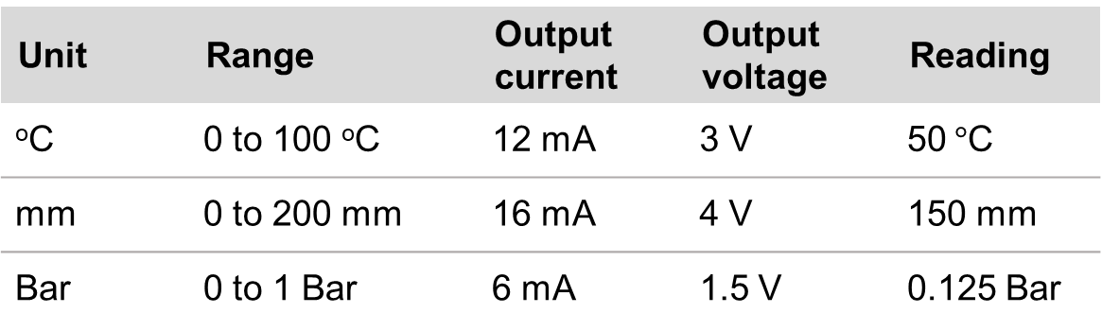

Answers
Analogue signal conditioning
4 mA helps to identify faults, which may produce zero current.
4 mA can also provide power for active sensors.
Analogue to digital conversion
The sensor may only be accurate to less than the ADCs resolution, for example, to the nearest 1$°$C rather than 0.4 $°$C.
Unit | Range | Output current | Output voltage | Reading
ºC | 0 to 100 ºC | 12 mA | 3 V | 50$°$C
mm | 0 to 200 mm | 16 mA | 4 V | 150 mm
Bar | 0 to 1 Bar | 6 mA | 1.5 V | 0.125 Bar
Unit | Range | Output | Resolution | Digital output
ºC | 0 to 100 ºC | 3 V | 0.4 ºC | 128
mm | 0 to 200 mm | 4 V | 0.8 mm | 192
Bar | 0 to 1 Bar | 1.5 V | 0.004 Bar | 32
13
Notes:
Practitioner delivery suggestions
Activity
Review the answers with learners.
Your discussion about the advantages of using a minimum 4 mA current can lead into the final activity where learners can extend their understanding of sensors and consider passive and active sensor examples.
It’s important that learners understand the difference between what resolution an ADC may make possible, and the sensitivity of the sensor providing the data. Learners should only rely on the manufacturer’s specified sensitivity when planning a control system and selecting the right sensor.
Highlight that, in reality, ADCs generally include the necessary signal conditioning and so when specifying components learners just need to ensure that their chosen ADC (if not already built into the microcontroller) provides the necessary interface between the sensor and processor.

Slide 14
Sensor specifications table
Component | Specification | Output signal
Rotary encoder 1 | 0 to 360º, free rotation, 24 steps per revolution, absolute | Digital, 8-bit
Tachogenerator 1 | 9 mV/RPM, 10 mm shaft, +/-3% | 0 to 250 V, analogue
Thermistor 1 | 0 to 100 ºC, 0.5º resolution, steep slope | 1 to 5 V, analogue
IR sensor 1 | 2 uM, 0 to 1000 ºC, 1º resolution | 4 to 20 mA via USB or analogue
Rotary encoder 2 | 0 to 360º, free rotation, 360 steps per revolution, incremental | Digital, 12 bit
Thermistor 2 | 0 to 250 ºC, 0.5º resolution, weak slope | 1 to 5 V, analogue
Tachogenerator 2 | 10 mV/RPM, 10 mm shaft, +/-5% | 0 to 250 V, analogue
IR sensor 2 | 5 uM, 0 to 500 ºC, 0.1º resolution | 4 to 20 mA via USB
Thermistor 3 | 0 to 100 ºC, 0.1º resolution, steep slope | 1 to 5 V, analogue
IR sensor 3 | 5 uM, 0 to 1000 ºC, 0.5º resolution | 4 to 20 mA, analogue
Rotary encoder 3 | 0 to 360º, free rotation, 360 steps per revolution, absolute | Digital, 12 bit
Tachogenerator 3 | 10 mV/RPM, 10 mm hollow shaft, +/-5% | 0 to 250 V, analogue
14
Notes:
Practitioner delivery suggestions
Activity
Briefly introduce this specification table which learners will need in the next activity.
The sensor types are deliberately mixed up.
A rotary encoder provides information about the rotational position.
A tachogenerator provides information about rotational speed.
IR sensors and thermistors both provide temperature information, however, one requires physical contact while the other does not (can learners identify which?)

Slide 15




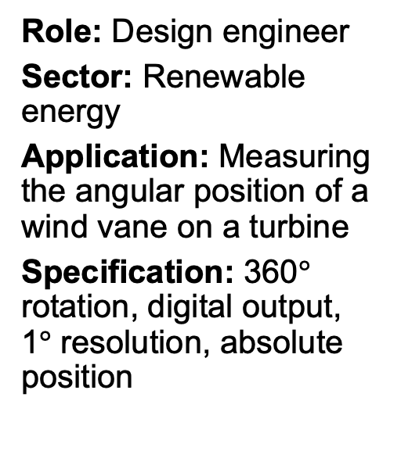
Select the right sensor
Role: Process improvement engineer
Sector: Food production
Application: Detecting whether jars of baby food have reached sterilisation temperature
Specification: Non-contact, 5 µM wavelength, 70 to 120 $°$C, 0.1 $°$C resolution
Role: Design engineer
Sector: Renewable energy
Application: Measuring the angular position of a wind vane on a turbine
Specification: 360$°$ rotation, digital output, 1$°$ resolution, absolute position
Role: CNC maintenance engineer
Sector: Manufacturing
Application: Measuring rotational speed of CNC router spindle
Specification:
10 V/ 1000 RPM,
10 mm hollow shaft, +/- 5% accuracy
Role: HVAC engineer
Sector: Commercial greenhouses
Application: Measuring air temperature so tomatoes can be kept at 21 to 24$°$C
Specification: 0 to 50 $°$C, 0.1 $°$C resolution, steep slope (fast resistance change with temperature)
15
Notes:
Practitioner delivery suggestions
This activity helps learners to explore how engineers match sensor type and range to meet the requirements of their applications. Print copies of the sensor specifications table (previous slide) for learners to use.
You may wish to include additional scenarios relevant to learners’ industrial placements or work experience, for which you will need to add example sensors from which learners can select. The activity does not require a consideration of signal conditioning, but the extension activity suggestions below include this.
Activity
Explain that four engineers need help to select the right sensor for their application. Ask learners to choose from the table of possible sensors on the sensor specifications printable slide to match the sensor to the engineer’s desired specification. The sensors are mixed up in the table, both by type and by specification. Learners should first identify the correct type of sensor for the task and then narrow the selection down to the one that meets the requirements.
Review each role and its requirements (two on this slide and two on the next slide).
Learners can discuss why the requirements are important.
Activity sheet
Learners can complete Microcontroller systems - Activity sheet 5 with their selected sensors, justifying their decisions.
Example answers
Please also see the next slide.
If necessary, help learners by providing the following information, or elicit this through questioning:
Food in jars requires an IR sensor that uses a wavelength that can pass through glass, which is about 5 µM, and the right temperature range and resolution.
The rotational sensor must provide enough resolution to point the blades into the wind for maximum efficiency.
The CNC sensor must be able to measure the high rotational speed of the router spindle.
The temperature sensor must work in the range that’s the optimum temperature for tomatoes.
Assessment
Written work
Discussion
Extension
The specification table includes the signal outputs of each possible sensor which learners can use to identify whether the output meets the specification of your preferred demonstration PLCs or whether signal conditioning is required, for example, to convert to a standard 4-20mV range and in turn a 1-5V analogue input signal.

Slide 16
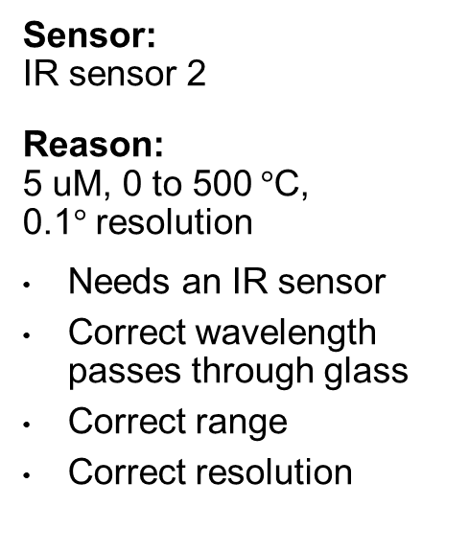
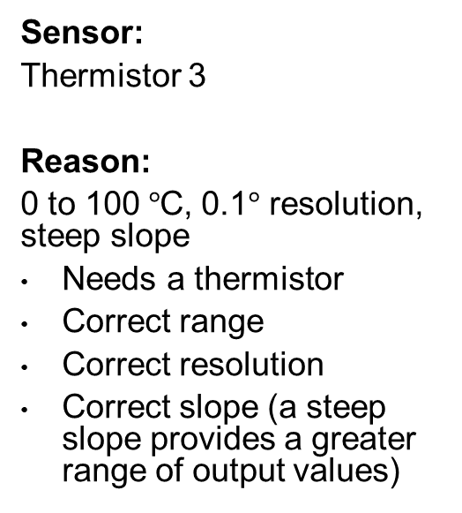
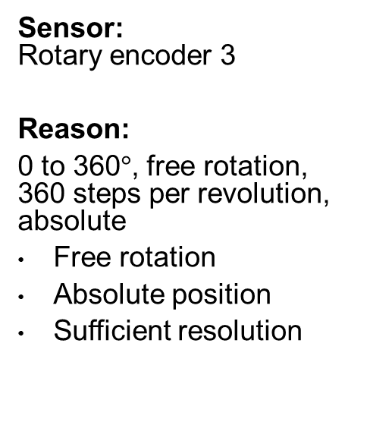
Select the right sensor
Process improvement engineer
Design engineer
CNC maintenance engineer
HVAC engineer
Sensor: IR sensor 2
Reason: 5 uM, 0 to 500$°$C, 0.1$°$ resolution
Needs an IR sensor
Correct wavelength passes through glass
Correct range
Correct resolution
Sensor: Rotary encoder 3
Reason:
0 to 360$°$, free rotation, 360 steps per revolution, absolute
Free rotation
Absolute position
Sufficient resolution
Sensor: Tachogenerator 2
Reason: 10 mV/RPM, 10 mm shaft, +/-5%
Correct shaft diameter
Sufficient accuracy
Correct output
Sensor:
Thermistor 3
Reason:
0 to 100$°$C, 0.1$°$ resolution, steep slope
Needs a thermistor
Correct range
Correct resolution
Correct slope (a steep slope provides a greater range of output values)
16
Notes:
Practitioner delivery suggestions
Activity
Review the answers with learners.

Slide 17

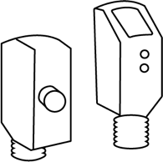
Classifying sensors
Analogue output
Digital output
Passive sensor
(responds
to its environment, so does not require a power source)
Light-dependent resistor (LDR)
Reed switch
Active sensor (requires a power source to emit a signal that is scattered back to the sensor)
3-axis accelerometer chip
Laser distance
17
Notes:
Practitioner delivery suggestions
This activity helps learners to develop their understanding of sensors. Learners will need internet access for research, for example to an electromechanical or electronics supplier website. Alternatively, provide a wide range of example sensors (with their specification sheets) for learners to investigate.
As before, this can link to your demonstration and learner use of specific PLCs (please also see the other Level 3 resources in this module) and signal conditioning. We suggest that practitioners help learners to consider the range of sensors available in your place of learning or which relate to learners’ industrial placements.
Learners can present their findings as a table (as on the slide), as a written report or as slides.
Activity
Review the table with learners.
Learners research or investigate sensors to find 3 to 5 examples for each of the four categories on the slide, organising their results (some learners can focus on just one or two categories).
Assessment
Written work
Extension
Learners can identify the output type and range of each example they find and identify what signal conditioning is required, if necessary, for it to work with your preferred PLC.

