Slide 1
Sustainability
1. Circular lifecycles
and sustainability

Slide 2
1. Circular lifecycles and sustainability
2

Slide 3
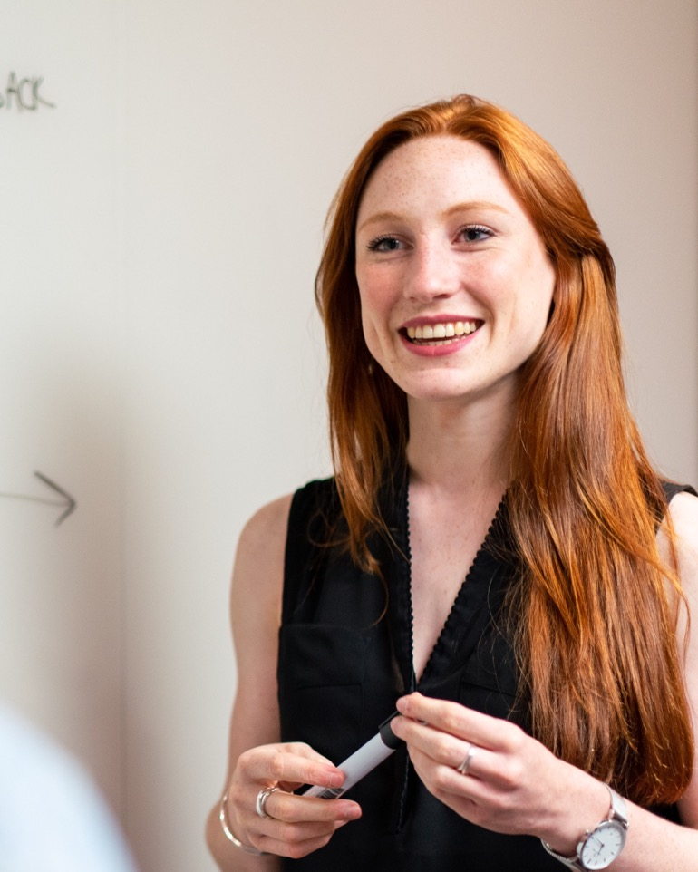

Learning outcomes
1. Circular lifecycles and sustainability
You will be able to:
Define sustainability and describe the 6Rs of sustainability.
Explain how the 6Rs support circular economic models.
Apply all 6Rs to reimagine a product for a circular lifecycle.
Image © This Is Engineering
3

Slide 4





What is sustainability?
1. Circular lifecycles and sustainability
What is sustainability?
What does it mean to ‘be sustainable’?
Use your ideas to create your own
definition of sustainability.
Image © This Is Engineering
4

Slide 5


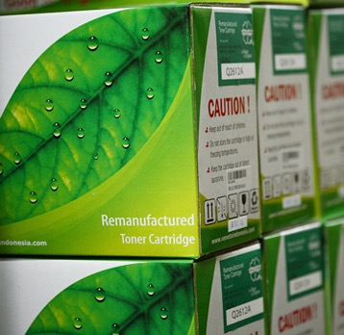
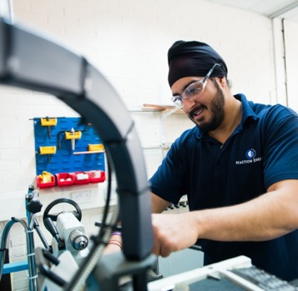
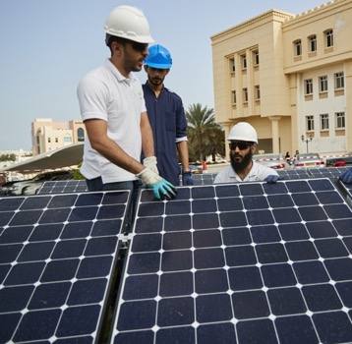
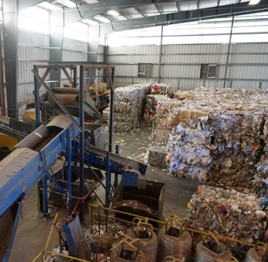
Examples of sustainable practice
1. Circular lifecycles and sustainability
Image © This Is Engineering | Image © Michael Barera | Image © Veneta System
5

Slide 6
What is sustainability? Example answers
1. Circular lifecycles and sustainability
Examples of what it means to ‘be sustainable’
might include:
Saving energy, avoiding food waste, recycling, avoiding single use plastics, buying second-hand items, walking or biking instead of using a car, using less, stop using fossil fuels, preserving nature, not using up natural resources.
Two definitions of sustainability are:
‘Avoidance of the depletion of natural resources in order to maintain an ecological balance.’
In 1987, the United Nations Brundtland Commission defined sustainability as ‘meeting the needs of the present without compromising the ability of future generations to meet their own needs’.
The images represent that:
Solar generation reduces the need for fossil fuels.
Remanufactured toner saves the use of virgin plastic.
Factory recycling reduces waste and reuses raw materials.
Better design reduces materials and can make products easier to recycle.
Better production reduces energy and waste materials.
Other examples of sustainable practice might include:
Use less material to make products.
Waste less and recycle more.
Avoid causing pollution.
Use less energy and use renewable sources of energy.
Make it easier to repair and recycle products.

Slide 7




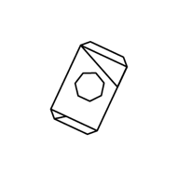


The linear lifecycle
1. Circular lifecycles and sustainability
Raw materials
Oil
Timber
Ores and minerals
Extraction
Drilling
Mining
Forestry and processing
Production
Manufacture into finished products
Consumption
One-time value
Disposal
Material flow is a straight line
Waste
Landfill
Pollution
7

Slide 8

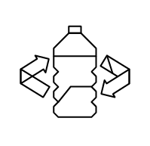




The 6Rs of sustainability
1. Circular lifecycles and sustainability
Design a product so it only uses recyclable materials and can be repaired
Suggest new uses for products when they are no longer useful
Rethink
Sustainability
Reuse
Design products and parts so they are easy to repair or replace
Design out unnecessary parts and materials
Reduced energy demand contributes towards net zero carbon emissions
Refuse
Repair
Design and make products so they are easy to disassemble and recycle each material for zero end-of-life waste
Use less materials for the same performance and safety
Reduced energy demand contributes towards net zero carbon emissions
Reduce
Recycle
8

Slide 9

The 6Rs of sustainability
1. Circular lifecycles and sustainability
Sell spare parts
- Reuse wheel as tables
- Reuse chains as art
Aluminium frame
from recycled cans
Rethink
Reuse
Replace parts
Patch inner tubes
Repair frames
No unnecessary parts
Refuse
Repair
Steel
Aluminium
Plastic
Rubber
Frame tube shape stronger
but uses less material
Reduce
Recycle
9

Slide 10







The circular lifecycle
1. Circular lifecycles and sustainability
3Rs change how we THINK
Repair
Refuse
Rethink
3Rs change how we ACT
Materials flow
in a cycle
that maximises
their value
Recycle
Reuse
Reduce
Raw materials
Extraction
Production
Consumption
Disposal
Waste
Fewer raw materials - less extraction and processing
Remanufacture into same or different products
Product life extended by reuse and repair
Less waste and pollution
10

Slide 11
Applying the 6Rs for a circular lifecycle
1. Circular lifecycles and sustainability
Make all kettle bases identical and buy the base and kettle
parts separately.
Let people reuse parts like the base, handle etc. when other parts break.
Rethink
Electric kettle
Reuse
Don’t use non-recyclable materials.
Make it easy to replace each part safely.
Refuse
Repair
Make the element and thermostat longer lasting so people don’t replace so often.
Make it easy to dismantle. People can return parts by post or to shops.
Reduce
Recycle
11

Slide 12
Examples of the circular economy
1. Circular lifecycles and sustainability
Reuse:
Gomi Design portable speakers
Gomi Design portable bluetooth speakers are made from 100 used plastic bags and are powered by repurposed batteries from damaged rental eBikes.
The company will also offer a
return-for-life repair service to ensure the speakers are never thrown away unnecessarily.
Repair:
Dualit toasters
Dualit toasters are designed to be repairable, and the company makes a range of common spares available, including heating elements and timers.
The company also offers refurbished small appliances that have been refurbished to ‘as new’ condition after being returned under warranty.
Recycle:
Veolia drug platinum recovery
Veolia’s Hazardous Waste Services Laboratory is able to recover precious platinum from a cancer drug that must be destroyed at the end of its short shelf life.
The high-quality platinum can be reprocessed into new cancer drugs or smelted into other goods, including platinum rings, bracelets and earrings.
12

