Slide 1
Innovation and emerging technologies 2. Innovation and change

Slide 2
2. Innovation and change
2

Slide 3

Learning outcomes
2. Innovation and change
You will be able to:
Give examples of how innovations can have both a positive and negative impact on society, the economy and the environment.
Identify how innovation and emerging technologies are changing the engineering and manufacturing environments.
Suggest how engineers can shape innovation to contribute to a better future.
Use your ideas to identify the importance of ethics in innovation.
3

Slide 4



Innovation and emerging technologies
2. Innovation and change
The internal combustion engine (ICE) is one of the most influential inventions.
How did people’s lives change as a result of ICE vehicles?
What new value have ICE vehicles created?
What problems have ICE vehicles caused?
Modern vehicles are the result of decades of collaboration, ideation and successful implementation.
4

Slide 5
Emerging technologies, innovations and impacts (1/3)
2. Innovation and change
Internet of things (IoT)
IoT devices can sense, process and exchange data with other IoT devices and with more complex systems.
Home assistants
Home automation
Monitoring arrays
Healthcare
Transport
Artificial intelligence (AI)
AI replaces human cognition with machine processes that can process complex information to solve problems and build knowledge.
Visual recognition
Speech recognition
Gaming non-player characters
Web search
Recommendation engines
Decision-making systems
5

Slide 6
Emerging technologies, innovations and impacts (2/3)
2. Innovation and change
Augmented reality (AR)
AR creates an enhanced experience of the real world by overlaying interactive information as graphics, text, audio or haptic (tactile) feedback.
AR games
Digital instructions and manuals
Industrial design
Visitor experiences
Surgery planning
Virtual reality (VR)
VR is a simulated experience of the real or an imaginary world, delivered via 3D headsets and immersive audio.
Gaming
The ‘metaverse’
Business meetings
3D design visualisation
Training simulations
6

Slide 7
Emerging technologies, innovations and impacts (3/3)
2. Innovation and change
‘Big data’
Big data refers to extremely large datasets that, with novel forms of data processing software, allow new patterns, trends or correlations to be identified.
Process optimisation/quality improvement
Predictive maintenance
Preventative healthcare
Retail
Social media/streaming
Autonomous systems
Autonomous systems combine elements of IoT, AI, robotics and other emerging technologies to respond to unforeseen events in complex operating environments.
Warehouse automation
Self-driving vehicles
7

Slide 8





Emerging technologies, innovations and impacts
2. Innovation and change
How might IoT devices make a manufacturing workplace safer
and smarter?
How might AR improve a skilled machine operator’s career?
How might big data help make products more reliable?
How might AI improve an engineering company’s ability to innovate?
How might VR transform how engineering products are designed?
How might autonomous systems change manufacturing?
8

Slide 9
Emerging technologies, innovations and impacts
2. Innovation and change
IoT devices might remotely monitor machine safety and performance, raw material feed, cutting head wear, motor speed and temperature, or check that a safety guard is in place (in addition to the machine’s built-in safety switches and sensors).
AI can model and design structures that use minimal materials while retaining strength. AI helps to extract useful information from complex data and rapidly iterate designs, speeding up development and optimising the solution.
AR might enable an operator to see machine performance and upcoming tasks, or access maintenance and operation manuals to rapidly diagnose and solve problems. AR could train operators without disrupting production.
VR can help engineers to see and manipulate their designs in 3D and to explore them at different scales, more easily spotting potential problems or areas for improvement.
Big data software can identify trends and patterns that predict potential faults before they occur by spotting predictive patterns in performance, improving maintenance efficiency.
Autonomous systems can reduce the need for human intervention in manufacturing or engineering production by spotting predictive signs of failure before they occur. They can then automate the response by using robots to replace defective parts quickly and safely.
9

Slide 10

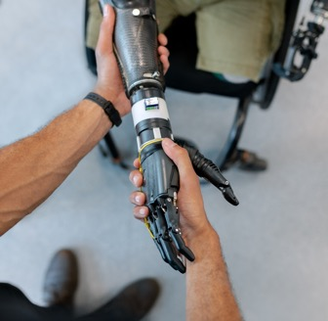
2. Innovation and change
Emerging technologies and manufacturing
Many innovations and emerging technologies have made it possible to 3D print artificial limbs that the user can control using their muscles or nerve endings.
What materials might be used to make the limb and its control systems?
How might the main components be made?
How might each emerging technology help in the design and manufacture of the limb?
What collaborations make this limb possible?
What key ideas have been brought together?
What value does the limb create?
Materials
Processes
Emerging technologies
Image © This Is Engineering
10

Slide 11






2. Innovation and change
Emerging technologies and manufacturing
Despite their extraordinary benefits, prosthetic limbs have a limited lifespan, especially for younger users.
Materials
ABS or carbon fibre frame
Silicone fingertips
Aluminium or titanium joints
Flexible polymer PCBs
Processes
3D printing
Carbon fibre forming
CNC milling or additive manufacturing
Emerging technologies
AR design visualisation
3D printing
Additive manufacturing
IoT device control
Collaborations
Materials engineer
Design engineer
Prosthetic healthcare
Electronics/control engineers
Manufacturing process specialists
Key ideas
Personalised fit
Human - machine interfaces
Biomimicry
Values
Mobility Independence Contribution to family life Earning potential Psychological wellbeing
What end-of-life considerations might the engineers need to consider?
How could you apply the 6Rs of sustainability to a prosthetic limb design?
Rethink
Refuse
Reduce
Repair
Reuse
Recycle
11

Slide 12
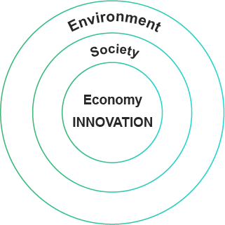
Emerging technologies and sustainability
2. Innovation and change
Innovations create change.
Their impacts spread out to affect the economy, society and the environment.
For example, 6-axis robot arms have transformed manufacturing.
How do you think robot arms have affected the economy, society and the environment?
Identify one positive and one negative possible impact on each.
12

Slide 13


Emerging technologies and sustainability
2. Innovation and change
Economy
Society
Environment
Greater productivity
Fewer industrial accidents
Less waste through mistakes
Positives
Negatives
Large investment cost
Some job losses
Climate impact of energy use
Choose one emerging technology and identify some possible positive and negative impacts on the economy, society and environment.
Based on your ideas, identify some principles or guidelines that might ensure this technology has a net positive impact on sustainability.
Because of this, do you think engineers have a duty to consider what value they create and the ethics of their innovations?
13

Slide 14
Innovation and ethics
2. Innovation and change
Ethics are the ‘moral principles that govern a person’s behaviour or the conducting of an activity’.
The Royal Academy of Engineering jointly created a statement of four ethical principles to guide engineers:
1. Honesty and integrity 2. Respect for life, law, the environment and public good 3. Accuracy and rigour 4. Leadership and communication
Two issues for engineers
IoT devices can make a home or workplace safer.
IoT devices could be used to gather personal information.
BUT
How do principles 1 and 2 in particular help you to resolve the two issues described on this slide?
How do the principles guide where an engineer might choose to work?
How do the principles guide how an engineer might choose to apply their skills?
AI can be used to improve medical diagnoses.
AI can be used to discriminate against groups of people.
BUT
14

Slide 15
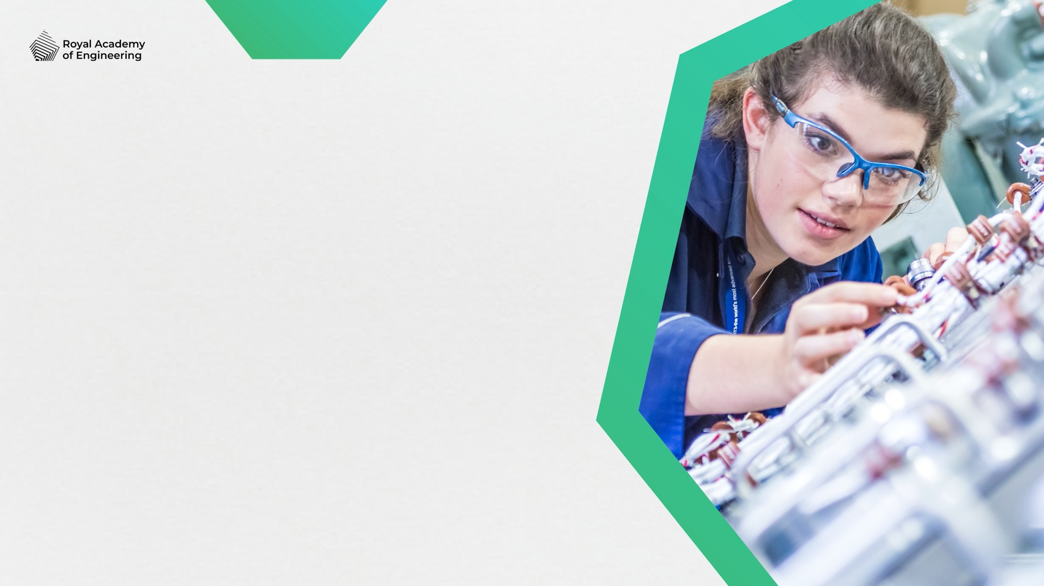
2. Innovation and change
Innovation, careers and the future
Farming
Manufacturing
Energy
Healthcare
Transport
Homes
How do you think each sector will change or grow?
What engineering career options might these developments create?
Image © This Is Engineering
15

Slide 16
Learning outcomes
2. Innovation and change
You will be able to:
Give examples of how innovations can have both a positive and negative impact on society, the economy and the environment.
Identify how innovation and emerging technologies are changing the engineering and manufacturing environments.
Suggest how engineers can shape innovation to contribute to a better future.
Use your ideas to identify the importance of ethics in innovation.
16

