Slide 1
Battery
technologies
2. Cell chemistry

Slide 2
Practitioner guide
2. Cell chemistry
2

Slide 3

Introduction and overview
2. Cell chemistry | Practitioner guide
These resources help practitioners to deliver the batteries components of engineering and manufacturing-related qualifications at levels 2 and 3. They introduce the topic and stimulate learners to explore and reflect on key concepts and are designed to complement and enhance practitioners’ own lesson materials and schemes of work.
Resources summary
Prerequisites – It is recommended that learners complete 1. Introducing battery technologies before starting this resource.
Resource name | Level | PPT slides + notes – practitioner | PPT slides – learner | Activity sheets | Film | Interactive
2. Cell chemistry | 3 |  |  | 2
Delivery
Delivery suggestions for practitioners, and suggested answers where appropriate, are in the presenter’s notes for each slide. The core activities in each resource provide around 60 mins of learning time, though additional suggestions, including independent learning, can extend this time significantly.
Overarching theme/big questions
How can we design batteries to fulfil a wide range of applications?
How can batteries become more sustainable and contribute to a net zero carbon economy?
Overview
The Level 2 resource introduces some key ideas in battery technology: selection criteria for batteries, capacity measured in Ah and Wh, and transitioning batteries towards a circular economy that minimises waste.
The Level 3 resources explore cell chemistry and novel cell technologies, combining cells in series, parallel and arrays to design batteries, and the role batteries will play in home and grid storage as the UK transitions towards a net zero carbon economy.
3

Slide 4
Learning outcomes and resource links
2. Cell chemistry | Practitioner guide
Level 3 resource
Cell chemistry
Describe the parts of a basic electrical cell.
Describe how a simple electrical cell produces electricity.
Explain the difference between primary and secondary cells.
Identify how primary and secondary cell discharge characteristics vary, linking this to applications.
Analyse the energy density of different cell types and use this to explain their relative advantages.
Full resource list available for the topic of
Battery technologies:
1. Introducing battery technologies (Level 2)
2. Cell chemistry (Level 3)
3. Battery design and performance (Level 3)
4. Batteries and energy storage (Level 3)
Links to other supported topics
Electrical machines, Innovation and emerging technologies, Renewable energy.
4

Slide 5
Subject coverage
2. Cell chemistry | Practitioner guide
Batteries
Cell structure and chemistry
Primary v secondary cells
Discharge characteristics
Energy density
Maths
Working with data
Including careers
Examples of careers related to current
and emerging battery technologies
5

Slide 6
2. Cell chemistry
6

Slide 7


Learning outcomes
2. Cell chemistry
You will be able to:
Describe the parts of
a basic electrical cell.
Describe how a
simple electrical cell produces electricity.
Identify how primary
and secondary cell discharge characteristics vary, linking this to
applications.
Analyse the energy density of different cell types and use this to explain their relative advantages.
Explain the difference between primary and secondary cells.
7

Slide 8



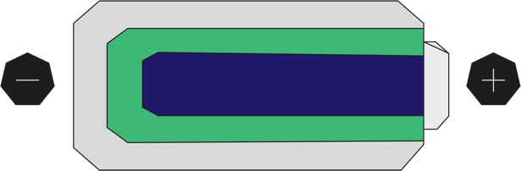
What happens in a cell?
2. Cell chemistry
8
A cell converts stored chemical energy into electrical energy.
Any simple cell includes a cathode, anode and electrolyte.
The cathode and anode are made of different metals, for example manganese and zinc.
The use of different metals creates a potential difference (voltage) across the cell.
The electrolyte is a solution or paste that can conduct electricity.
What happens
when a cell is connected in a complete circuit, for example, to an LED?
Given your answer, what do you think must happen inside the cell?
Can what happens inside the cell continue indefinitely, and what evidence supports your answer?
Anode
Cathode
Electrolyte
8
Notes:
Practitioner delivery notes
This resource explores the basic principle of cell chemistry before introducing secondary cells that can be recharged. Learners plot a chart to investigate the relative discharge characteristics of primary and secondary cells and then analyse how the energy densities of secondary cell types varies, before considering two case studies of novel cell technologies that may enhance how batteries can provide safer and more efficient long-term energy storage for renewables.
Note that the difference between a cell and a battery is not formally introduced until the next resource, but you may wish to do so in qualitative terms when talking about one of several cells in a lead-acid car battery.
Starter activity
Explain that this is a simplified diagram of the structure of a cell. (Strictly speaking the arrangement of anode and cathode describe the flow of conventional current during the discharge of the cell.)
Review how the use of different metals for the cathode and anode produces a voltage across the cell - if the same metal is used for both cathode and anode, no voltage will be produced (see also the extension suggestion below).
Activity sheet
Learners complete Battery technologies - Activity sheet 3.
Example answers
Please see the next slide.
Assessment
Written work.
Extension
Learners can research the reactivity series of metals in relation to the voltage produced in a simple cell.

Slide 9
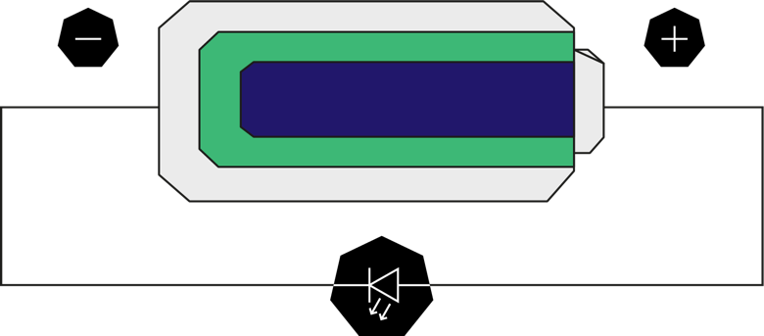
What happens in a cell?
2. Cell chemistry
9
When the cell is connected in a complete circuit a current flows through the wire and the LED lights up.
This means that the current must also flow within the cell. The electrolyte enables this to happen.
A reaction takes place within the cell between the anode and cathode, which releases the cell’s stored chemical energy. This reaction can’t continue indefinitely. The cell only works until the stored chemical energy is used up and the reaction stops.
9
Notes:
Practitioner delivery notes
Activity
Review the answers on the slide.
Ask if learners can name any specific types of cell that they use in everyday devices.
Example answers
Please see examples on the next slide.
Assessment
Discussion and verbal answers.
Extension
Learners can research different commercially available cell types in a component catalogue or using an internet search.

Slide 10


Examples of cells
2. Cell chemistry
10
Zinc
Alkaline
Nickel metal
hydride (NiMH)
Nickel cadmium
(NiCad)
Lithium ion (Li)
Long life
NiCad
NiMH
Li
Which of these cell types are familiar to you?
Can you use your real-life experiences to divide them into two types of cell?
What difference explains your choices?
10
Notes:
Practitioner delivery notes
Activity
Ask learners to divide the examples into two groups and explain their classification.
Note that some learners may describe some lithium cells using their codes, eg 14500, 18650, 26650 - these describe the dimensions of the cell and learners should note that the voltages of these cells are all the same (3.7 V nominal).
Example answers
Please see the next slide.
Assessment
Discussion and verbal answers.
Film
Learners can watch the Battery technologies film after this slide.
Extension
Learners can research general safety guidance for using lithium batteries in consumer and small electronic devices, including drones.

Slide 11
Primary v secondary cells
2. Cell chemistry
The difference is whether the cells are used once or can be recharged.
In any cell a voltage and electric current will be produced until the reaction can no longer continue. The cell is discharged.
When a zinc or alkaline cell is discharged it can’t be recharged: this is
a primary cell. A NiCad, NiMH or lithium ion cell can be recharged: this is a secondary cell.
Zinc or alkaline cells use one-way
chemical reactions to produce electricity. What kind of reaction do you think happens inside secondary cells?
What does it therefore mean to recharge a cell?
What energy source provides this ability to recharge?
11
Notes:
Practitioner delivery notes
Activity
Remind learners that they were able to classify cells as single-use or rechargeable. Classify these as primary or secondary cells.
Answer the questions as a group, asking learners to think in terms of the chemistry and energy transformations taking place.
Example answers
The chemistry inside secondary cells is a two-way or reversible reaction - it can happen in reverse when energy is added. (Learners may have studied reversible reactions as part of GCSE chemistry).
Hence to recharge a cell means to add energy and make the reaction go in the reverse direction.
This process uses electrical energy, which is converted back into stored chemical energy.
Assessment
Discussion and verbal answers.

Slide 12

Characteristics of primary v secondary cells
2. Cell chemistry
An engineer wants to know whether to use a lithium or alkaline cell to power
a handheld measurement device. They carry out an investigation to find out how each type of cell discharges over time. They connect each type of cell to an identical load and measure the voltage across the load every 10 minutes.
The table shows how each cell’s voltage declines over time. Note that this is as a percentage of the maximum value. The engineer knows that rechargeable cells can have a lower terminal voltage, for example rechargeable AA cells are 1.2 V instead of 1.5 V, which can limit certain uses.
Load voltage as % of maximum
Time mins | Lithium % | Alkaline %
10 | 98 | 95
20 | 96 | 82
30 | 92 | 70
40 | 89 | 58
50 | 86 | 45
60 | 82 | 33
70 | 74 | 18
80 | 0 | 0
Plot a line graph to compare how each cell discharges
over time.
Describe the difference and suggest how an engineer might use this information when selecting cells to power a device.
Would you use lithium or alkaline cells to power a TV remote or cordless drill? Justify your answers.
12
Notes:
Practitioner delivery notes
Activity
Explain that an engineer was curious why lithium and alkaline cells would power a handheld measurement device differently and wants to know which type of cell is best to use. The chart shows the result of connecting each cell across a test load and measuring the voltage across the terminals over time. Both cells were fully discharged in 80 minutes.
Learners plot a chart to compare the two discharge rates
Learners write down answers to the questions on the slide.
Activity sheet
Learners use the slide data to complete the chart and answers on Battery technologies - Activity sheet 4.
Example answers
Please see the following slide.
Assessment
Written work and chart.
Extension
Learners could complete a practical activity to generate their own data instead of using the data on the slide, using a voltmeter or data logger.

Slide 13

Characteristics of primary v secondary cells
2. Cell chemistry
The graph shows that lithium cells retain a much higher working voltage as they discharge, while alkaline cells lose voltage steadily.
Lithium cells are suitable for devices where it is important to always provide as close to the working voltage as possible, for example when powering a DC motor.
Alkaline cells are suitable for non-critical applications like a TV remote.
Lithium cells are more suitable for critical or motor applications like cordless drills, drones, electric vehicles (EVs) or autonomous guided vehicles.
Lithium
Alkaline
100
75
% of maximum Voltage
50
25
0
0 20 40 60 80
EV batteries need to output a consistent voltage
to maintain speed, but what cell factor will affect the
range of the vehicle?
How does this link to the overall design of the vehicle?
Time (mins)
13
Notes:
Practitioner delivery notes
Activity
Explain that the chart shows how lithium cells retain their maximum terminal voltage for the majority of their discharge time. This falls sharply towards the end of the discharge period. The terminal voltage of an alkaline cell drops gradually over the discharge time. Remind learners that the maximum voltage for lithium may be different to that for alkaline as noted on the previous slide.
Review the answers on the slide before asking learners to consider the two questions under the chart.
(Note that in fact the drop in voltage for a primary cell is due to the build-up of internal resistance within the cell, which takes place over a single use cycle. The internal resistance of a lithium-ion cell does not noticeably change over a single charge-discharge cycle but instead builds up slowly over time and is an indication of the overall health and age of the cell. The next resource helps learners to measure and calculate internal resistance and consider its effect when driving high and low resistance loads.)
Example answers
The range of the vehicle depends on the storage capacity of the battery packs - effectively how many cells the battery pack contains.
Battery packs are a large and heavy component that need to be integrated into the vehicle design. A smaller battery pack that enables the same range allows for greater internal space for the same size chassis. This criteria is the energy density of the battery pack.
Assessment
Discussion and verbal answers.
Extension
Learners can research the ‘skateboard chassis’ design of electric vehicles and what this means for vehicle manufacture, design and safety, for example at: www.wired.co.uk/article/electric-car-design-engineering

Slide 14

Energy densities of secondary cells
2. Cell chemistry
A key innovation in secondary cells has been to increase their energy density, measured as the energy available
per unit of mass or volume.
This matters for EVs as better energy density delivers more range, and more energy-dense battery packs take up less volume within the car.
Lithium polymer
Lithium phosphate
250
200
Nickel cadmium
Lithium ion
150
Describe how the energy density
of lead acid, nickel metal hydride and lithium polymer cells differs.
Why do you think nickel metal hydride cells have replaced nickel cadmium cells?
In total, roughly how much more
energy-dense is a lithium polymer cell per litre, compared with a lead-acid cell?
Watt-hours/kilogram
Lead acid
100
Nickel metal hydride
50
0
0
50
100
150
200
250
300
350
400
450
Watt-hours/litre
14
Notes:
Practitioner delivery notes
Activity
Ask learners to interpret the energy density diagram on the slide. What two types of energy density do the x and y axes represent and in qualitative terms, what is changing as you move left or right, up or down in the diagram?
Learners use the diagram to answer the questions on the slide.
Before moving to the next slide, ask learners to identify some drawbacks to using lithium cells to store large amounts of energy over long periods, for example when used for grid storage applications for energy supply.
Example answers
As you move right along the x axis, the energy density increases per litre of volume. As you move up, the energy density increases per kilogram.
Lead acid cells have a relatively low energy density per litre and per kilogram. Nickel metal hydride cells have high energy density per litre, but low energy density per kilogram - they can be more compact but remain heavy. Lithium polymer cells have high energy density both per litre and per kilogram - they are much lighter and compact compared with lead-acid cells.
Nickel metal hydride cells have replaced nickel cadmium cells because they offer greater energy density per unit volume - the same size of cell can last longer. (This assumes the costs of each are broadly similar.)
A lead acid cell has an energy density per litre of about 75 Watt-hours, whereas for lithium polymer this is about 300, or 4 times as much. Per kilogram, this is about 25 and 175, or 7 times as much. In total, lithium polymer cells offer about 28 times more energy density based on this data.
Assessment
Discussion and verbal answers.

Slide 15


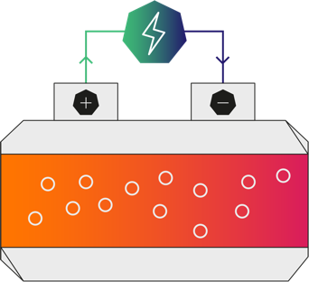

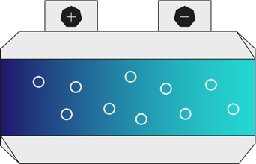
Case study: freeze-thaw cell chemistry
2. Cell chemistry
A new freeze-thaw cell technology may make long-term, seasonal energy storage possible.
The cell’s electrolyte is a type of salt that is liquid at 180 °C but solid at room temperature.
The cell is heated before being charged. When the cell cools the electrolyte solidifies, effectively ‘locking up’ the energy until needed. When needed, the cell is heated to allow
a current to flow.
The technology is at an early stage of development but in laboratory tests
a freeze-thaw cell has retained 92% of its capacity for three months.
What do you think happens to the electrolyte ions during the
freeze-thaw process?
How might this type of cell make renewable energy more available over seasonal periods
of time?
15
Notes:
Practitioner delivery notes
Introduce two case studies that explore novel battery chemistries and designs.
Activity
Review the case study and ask learners to answer the questions.
Example answers
When the solution solidifies the ions are more or less unable to move. This is what largely prevents the cell from discharging over time.
These cells could store renewable energy produced when it is at seasonal maximums, for example most solar energy is available during the summer months. The energy could be used in winter when less solar energy is available. The cells could also be transported from where renewable energy is available (like wind or hydro power) to where it is needed.
Assessment
Discussion and verbal answers.
Extension
Learners can find out more at:
www.sciencedaily.com/releases/2022/04/220405084551.htm#:~:text=Scientists%20have%20created%20a%20battery,it%20in%20another%2C%20like%20autumn
www.sciencedirect.com/science/article/pii/S2666386422000911

Slide 16
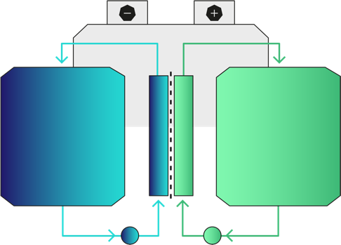
Case study: flow batteries
2. Cell chemistry
Flow batteries store energy in tanks of liquid electrolytes made of iron salts.
To store energy inside the cell, one electrolyte is pumped past a positive electrode, depositing iron, and the other past a negative electrode, gaining electrons. This can store large amounts of chemical energy over long periods.
To produce electricity, the direction of the pumps is reversed so the electrolytes flow in the reverse direction past the electrodes, producing a current.
These cells have low energy density but use much safer chemistry than lithium-ion cells. Because the energy is stored in the electrolyte, to increase a flow battery’s storage capacity, engineers just increase the size of the electrolyte storage.
Anolyte tank
Catholyte tank
What applications might benefit from this
form of energy storage?
Can you suggest how this concept might one day be adapted for electric vehicles?
Pump
Ion-selective membrane
16
Notes:
Practitioner delivery notes
Activity
Review the case study and ask learners to answer the questions. Learners can visit the web links about flow battery technology if access is available:
www.technologyreview.com/2022/02/23/1046365/grid-storage-iron-batteries-technology/
en.wikipedia.org/wiki/Flow_battery
Example answers
This could store large amounts of energy more safely in urban environments where large quantities of lithium cells might be a safety risk. Tanks of ‘charged’ electrolytes could be brought in and connected to the cells that release the energy when required.
The concept could replace how vehicles currently use liquid fuels, although this would need differing chemicals that offer energy densities closer to that of petrol or diesel, which have exceptionally high energy densities compared with electrical cells.
Assessment
Discussion and verbal answers.
Extension
Learners can find out more at:
www.technologyreview.com/2022/02/23/1046365/grid-storage-iron-batteries-technology/
en.wikipedia.org/wiki/Flow_battery

Slide 17
New cell technologies and engineering
2. Cell chemistry
Henry
EV technician
I convert classic cars from petrol to EV systems.
Katrina
Maintenance engineer
I maintain the automated warehouse vehicles in a busy warehouse.
How might each engineer’s role be changed
as new cell technologies come to market?
Samira
Power engineer
I design the systems that respond to
short-term peaks
in demand.
Vicky
Recycling engineer
I develop new ways to recycle precious materials, including the rare earth metals used in modern secondary cells.
Jamal
Home renewables
I install home solar power generation and storage.
17
Notes:
Practitioner delivery notes
This final activity supports an open-ended discussion of career opportunities related to battery technologies, and how developments in this area might affect all engineers. You may wish to link this to learners’ planned industry placements, work experience or employer visits.
Activity
Discuss how each engineer might come across or use novel battery technologies and how these might change workplaces and everyday lives.
Assessment
Discussion and verbal answers.

Slide 18
Learning outcomes
2. Cell chemistry
You will be able to:
Describe the parts of
a basic electrical cell.
Describe how a
simple electrical cell produces electricity.
Identify how primary
and secondary cell discharge characteristics vary, linking this to
applications.
Analyse the energy density of different cell types and use this to explain their relative advantages.
Explain the difference between primary and secondary cells.
18

