Slide 1
Electrical
machines
1. Introducing electric motors

Slide 2
Electrical
machines
1. Introducing electric motors
2

Slide 3
Learning outcomes
1. Introducing electric motors
You will be able to:
Name some
different types of direct
current (DC) and alternating current (AC) motors.
Describe the differences between the field and armature windings in
series and shunt-wound
DC motors.
Suggest an appropriate motor to use for a range
of applications based on its qualitative characteristics.
Image © This Is Engineering
3

Slide 4
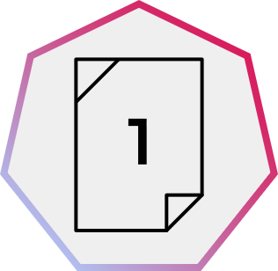

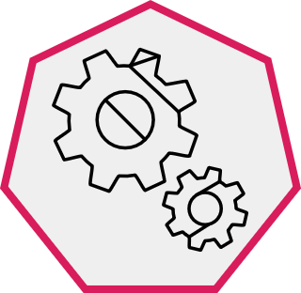

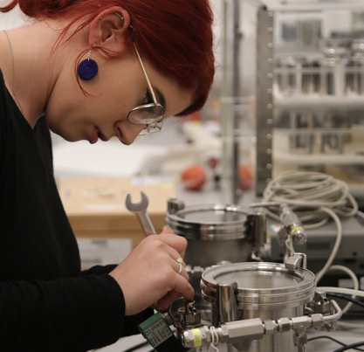
Electric motors around you
1. Introducing electric motors
Think about where you
might find electric motors at home and in an engineering workplace.
List some examples of what equipment or appliances these motors might power, or arrange your ideas as two concept maps (one for the home and one for an engineering workplace).
What type of electrical power supply are these motors most likely to be connected to?
Image © This Is Engineering
4

Slide 5
Electric motors around you – example answers
1. Introducing electric motors
Each motor is connected to lower-voltage DC, mains AC or, in the workplace, a higher-voltage 3 phase AC supply:
Electric bike
26 V DC battery
Cordless drill
18 V DC battery
Electric toothbrush
1.2 V DC battery
CNC spindle
230 V AC
Game console fan
12 V DC
Forklift
48 V DC battery
In the workplace
At home
Microwave oven 230 V AC
Water pump
230 V AC
Washing machine
230 V AC
2 tonne hoist
3-phase 415 V AC
How else could you classify the different motors above?
Can you think of any other types of electric motor that you could add to your classification?
5

Slide 6
Classifying electric motors – DC and AC motors
1. Introducing electric motors
Permanent magnet
Coiled wire
Electrical connection
Axle
Every electric motor uses electromagnetism to create torque (rotating force). Electric motors operate on a DC or AC supply. The way in which this current is supplied to the motor and how the current is used to create torque is different in different motors.
Direct current (DC)
Alternating current (AC)
Brushed
Brushless
Induction
Synchronous
DC
AC
- Coils on rotor
- Magnets or coils around outside create a fixed magnetic field
- Brushes touching commutator rings supply current to rotor coils
- Magnets on rotor
- Coils on outside create a fixed magnetic field
- Coils on outside create a changing magnetic field
- The changing field induces a current in the rotor
- AC coils on outside create a changing magnetic field
- Slip rings connect a separate DC current to the rotor
Describe how the differences in each type of motor’s connection(s) can help you to distinguish between them.
6

Slide 7
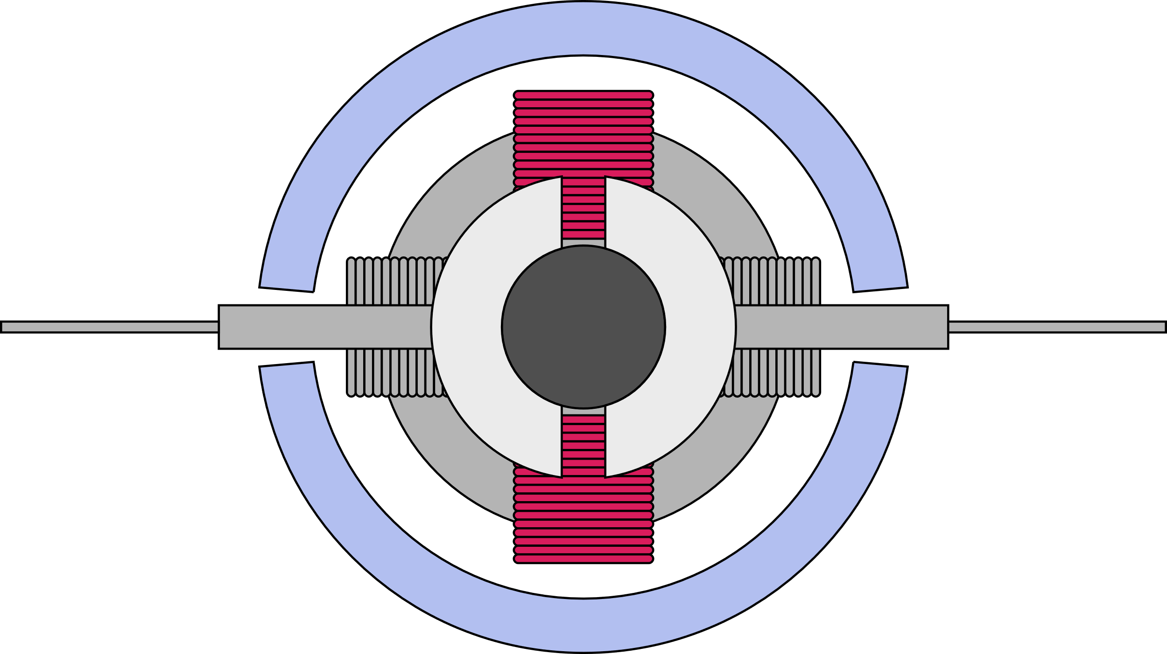
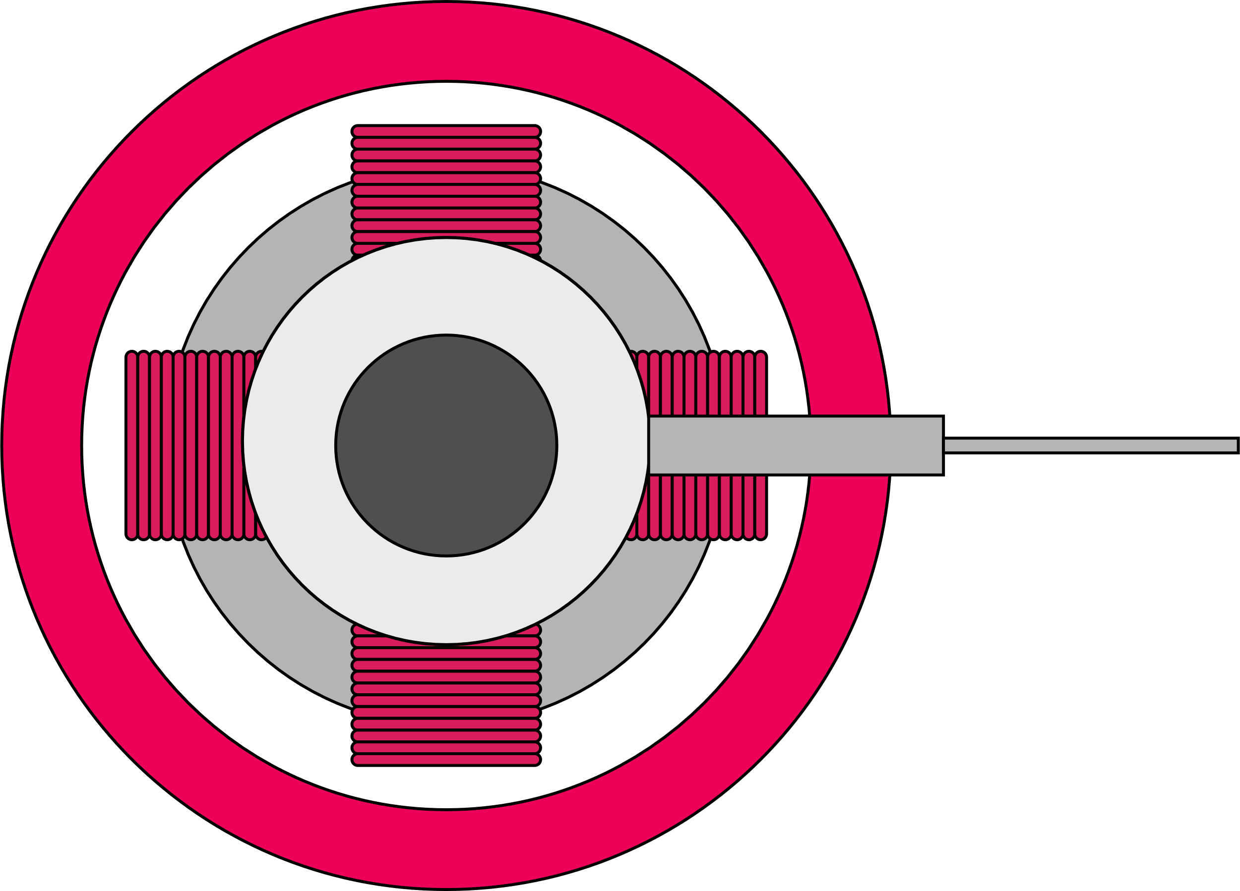
Commutators v slip rings – visual differences
1. Introducing electric motors
The rotor coils in a brushed DC motor need to always experience a turning force in the same direction.
Commutators are split connectors on either side of the axle that reverse the current every half turn, to allow this.
Conductive brushes press on each commutator during each half of a rotation. A gap briefly interrupts the current to stop the rotor ‘sticking’ when the coils align with the magnetic field.
In a synchronous AC motor the magnetic field changes direction with the AC current through the field coils. The
rotor coils need a constant DC current that always flows in the same direction.
Two slip rings (one is hidden behind the other in the diagram below) provide this constant connection, again with conductive brushes pressing against them. There is no gap in slip rings.
Magnets
Field coils
Rotor coils
Rotor coils
Brush
Brush
(another is hidden behind)
Commutator
Axle
Axle
Gap
Slip ring
(another is hidden behind)
7

Slide 8
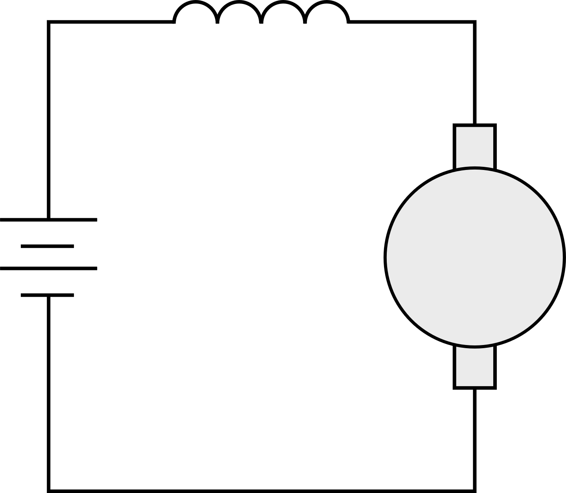
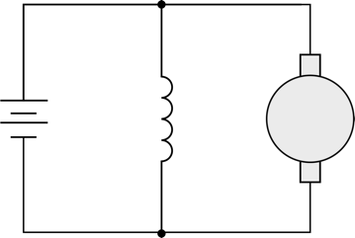
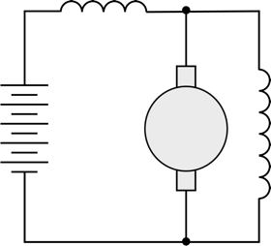
Brushed DC motors – series, shunt and compound
1. Introducing electric motors
Brushed DC motors can have stationary field coils around the outside instead of permanent magnets, to create the magnetic field (‘excitation’).
The coils wound around the rotor create the torque (rotating force). These are also called the armature coils.
The field coils can be wound in series with the armature coils, in parallel, or a combination:
Use your understanding of voltage and current in series and parallel circuits to suggest why series and shunt field coils need to use different types of coil winding.
Series
Shunt
Compound
Series field
Series field
+
+
+
Shunt
field
Shunt
field
-
Armature
-
Armature
-
Armature
- Field coils are in series
with the armature coil
- Few, thick coils
- The same current flows through the field and armature coils
- Field coils are in parallel
with the armature coil
- Many, thin coils
- The current from the supply is split between the field and armature coils
- Many, thin parallel coils with few, thick series coils on top
- All of the current from the supply flows through the series field coils and then is split between the shunt field and armature coils
8

Slide 9
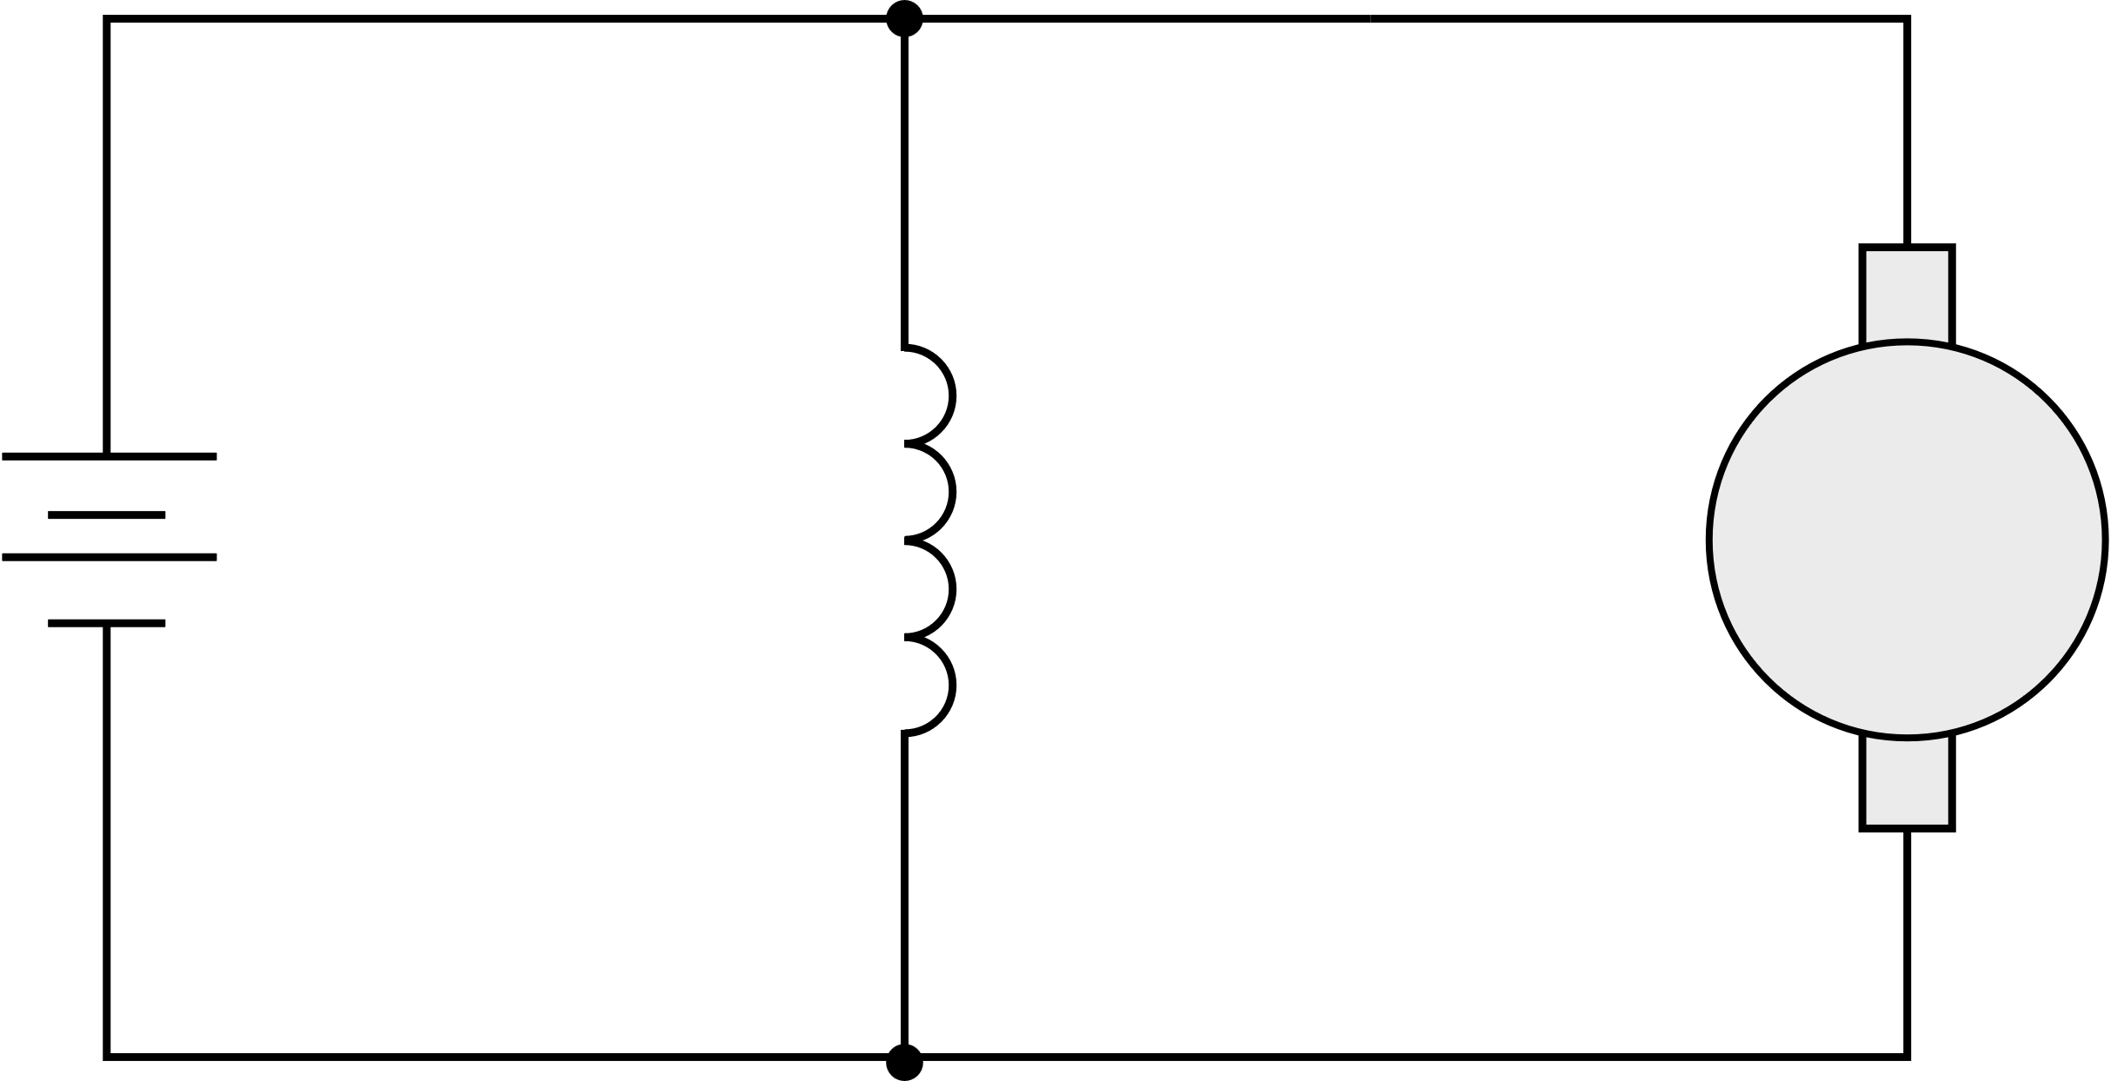

Voltage, current and resistance in DC motors
1. Introducing electric motors
The current through the armature coils makes them turn in the magnetic field. This turning induces a voltage across the coils, called the back emf E. (emf = electromotive force.)
The back emf acts in the opposite direction to the input voltage V. This reduces the current flowing through the armature coils.
At the motor’s operating speed, enough current flows to overcome mechanical and electrical losses, and to power the mechanical output. This is a lower current than was needed to start the motor.
Engineers need to understand how the input voltage creates a current through the field and armature coils, and how this differs in series and shunt-wound DC motors:
Examine
the circuit diagrams again. Remember that the field (f) and armature (a) coils each have resistance R and
a current I flowing through them.
Use V=IR to
help you verify
the formulas by discussing the formulas linking voltage, current and resistance.
Series-wound:
V = E + IR_{a} + IR_{f}
Shunt-wound:
V = E + I_{a}R_{a}
V = I_{f}R_{f}
R_{f}
I
I_{f}
I_{a}
+
+
R_{a}
E
Shunt field
R_{f}
R_{a}
E
-
-
9

Slide 10
Key characteristics of AC and DC motors
1. Introducing electric motors
The unique construction of each type of motor gives them different characteristics.
DC |  |  |  | AC
Brushless | Series wound | Shunt wound | Compound wound | Synchronous | Induction 230 V Single phase | Induction 400 V 3 phase
High speed High torque Wide range of speed control | High starting torque Good for traction (motive force) applications | Lower starting torque Good for constant speed applications | Reasonable starting torque and speed regulation - midway between series and shunt | Constant speed as load varies Best for low speed applications | Simple, rugged Limited speed control | Simple, rugged Limited speed control High power capacity
Discuss your ideas for applications when speed control might
be more important than torque characteristics, and vice versa.
10

Slide 11
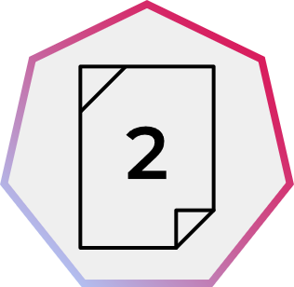
Choose the right type of motor
1. Introducing electric motors
Power tool
A cordless power tool motor needs to provide a wide range of speed and torque.
Forklift
A warehouse forklift truck needs very high starting torque for moving and lifting loads. It runs on a 48 V DC battery.
HVAC fan (heating, ventilation,
air conditioning)
The extraction fans in a workshop will operate in a narrow speed range.
Clock
A factory wall clock needs a low-speed motor that runs off mains electricity.
Hoist
A high-load hoist needs a motor with very high power output.
Conveyor
A conveyor in a food processing plant must move at a consistent speed.
Apply what you have learned about the characteristics of DC
and AC motors to choose the best type of motor for each application.
Give a reason for your choice.
11

Slide 12
Choose the right type of motor – example answers
1. Introducing electric motors
Power tool
Brushless DC
The motor will run from a DC battery and provide a wide range of speeds and torques.
Forklift
Series-wound brushed DC
The motor provides high torque and can run off the truck’s 48 V battery.
HVAC fan
230 V single phase AC
Simple and rugged.
Clock
230 V AC synchronous
Performs well at low speed.
Hoist
400 V 3 phase AC induction
Can provide very high output power.
Conveyor
Shunt-wound brushed DC
This maintains speed under varying loads.
Discuss what other considerations could help to minimise the energy needed to power electrical motor-driven systems.
12

Slide 13
When might you need to select or use the right motor?
1. Introducing electric motors
Machine tools
Powered
hand tools
Ventilation or extraction
Heating or cooling
Automation
Vehicles
What engineering or manufacturing environments might you visit for an industry placement or job?
Identify what motor applications make the activities in this environment possible.
13

Slide 14
Learning outcomes
1. Introducing electric motors
You will be able to:
Name some
different types of direct
current (DC) and alternating current (AC) motors.
Describe the differences between the field and armature windings in
series and shunt-wound
DC motors.
Suggest an appropriate motor to use for a range
of applications based on its qualitative characteristics.
Image © This Is Engineering
14

