Slide 1
Sustainability
2. Sustainability and my career

Slide 2
2. Sustainability and my career
2

Slide 3


Learning outcomes
2. Sustainability and my career
You will be able to:
Analyse a real-world example of applying the 6Rs and identify how this supports social, economic or environmental sustainability.
Give reasons why health and safety need to be at the heart of any approach to sustainability.
Formulate career ideas that emphasise sustainability within engineering or manufacturing.
Image © This Is Engineering
3

Slide 4



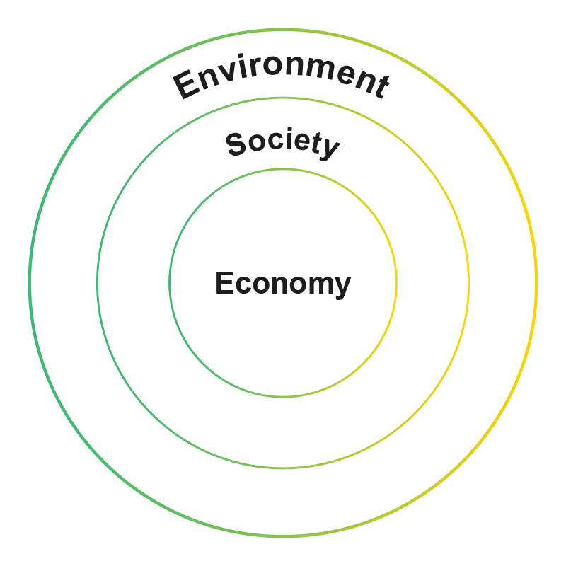
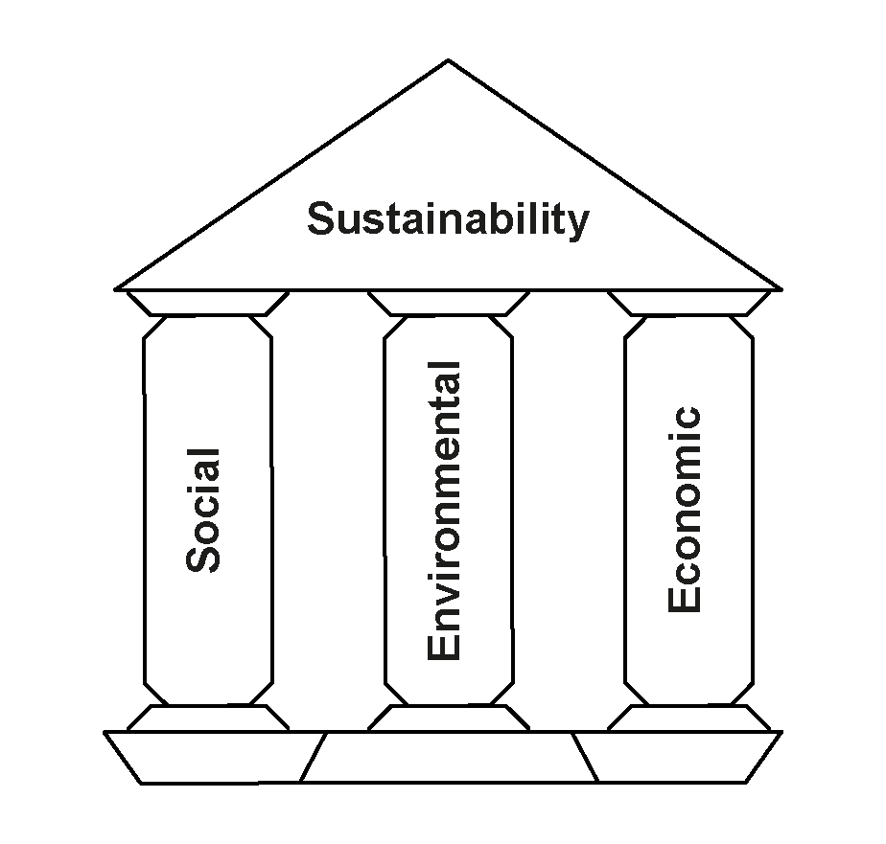
Engineering, manufacturing and sustainability
How can the 6Rs and circular lifecycles change how engineering and manufacturing impacts the three pillars of sustainability?
4

Slide 5





Recap: rethink, refuse, reduce
Rethink:
What real need does this product satisfy?
What benefits do we need to deliver?
How could the product do the same thing, differently?
How can we reduce our resource use and waste and contribute to zero end-of-life waste and net zero carbon emissions?
Refuse:
What materials are usually used in products like this?
What materials are used in parts we don’t really need?
Do any materials harm the environment?
What less harmful materials can we use instead?
Reduce:
How can the design be simpler than existing products?
How can it use less materials, while still being safe and fit for purpose?
What features don’t people need?
Think about:
Use, Design, Recovery, Production
5

Slide 6

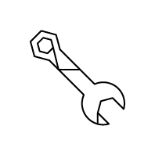

Recap: reuse, repair, recycle
Reuse:
Can the whole product be
used for something else
at the end of its life?
Which parts could be reused
at the end of the product’s life?
How will the product be
taken apart?
How might someone reuse
each part?
Repair:
What parts of our design
might break or wear out?
How could these parts be
repaired or replaced?
How can the design make it
easier to disassemble and repair?
Who might do this, and where?
Recycle:
Which parts or materials can
be recycled at the end of the product’s life?
How would these products
be recovered?
How might they be remanufactured into the same product again?
How might they be reprocessed
into new things?
Think about:
Use, Design, Recovery, Production
6

Slide 7
Engineering, manufacturing and sustainability example answers
Company and product:
Ocado Technology - 600 Series Bots
Situation:
Ocado Technology designs and builds robotic warehouse systems for picking and packing online grocery orders. They wanted to make their main robot design lighter and more efficient to operate.
R(s) used in solution:
Rethink and Reduce
Action:
Ocado engineers used ideas from aerospace manufacturing to redesign the robot frame so it could be made using additive manufacturing and 3D printing so the frame is smaller and uses much less material. This used computer simulations of the stress on the frame.
Environmental, social, economic impact:
The 600 Series Bot is the world’s lightest and most efficient warehouse robot, takes less material to make and smaller motors to operate, uses less energy to run – so has a lower impact on climate change. The lighter robot imparts lower inertial forces on the storage grid that it runs upon, allowing future grid structures to be designed with lower density materials.
7

Slide 8

Health, safety and sustainability
2. Sustainability and my career
How can the 6Rs include health and safety within sustainability?
Rethink
Design for safer products and safer production.
Refuse
Social impacts
Safer employees and communities.
Economic impacts
Reduced costs from fewer accidents.
Environmental impacts
Cleaner ecosystems.
Design out unsafe materials and features.
Hazards
Reduce
Limit the use of environmentally unfriendly substances.
Reuse
Make sure reused items are safe and fit for purpose.
Repair
Keep machinery in good working order.
Recycle
Recycle polluting substances to keep them out of landfill and ecosystems.

Slide 9

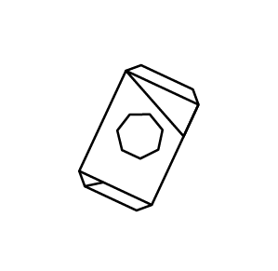
Sustainability careers: what might your role be?
    Aisha identified a recyclable alternative to existing plastics in a product, helping to minimise material requirements while maintaining strength.
    Jade redesigned a product to make it easy to disassemble and make parts that wear out easy to replace.
    Materials engineer
Repair
    Design engineer
Goals:
Net zero new resource use
Net zero carbon emissions
Zero end-of-life waste
    Hannah explored how customers use a product to find ways to ‘design out’ unnecessary parts and make it easier for them to repair and recycle, for zero end-of-life waste.
    Kevin redesigned a production process
    to use less energy, reduce material
    waste and recover waste materials
    for remanufacture.
Recycle
Reuse
    Manufacturing systems engineer
    Product designer
    Rahim helped to design a factory building to reduce energy use, include solar generation, and create a wildlife habitat.
    Noah ensured the factory’s solar panels are efficient, to maximise contribution towards net zero carbon emissions and helps the factory schedule some processes for when energy is cheapest.
    Sustainability consultant
Consumption
Production
    Energy engineer
9

Slide 10
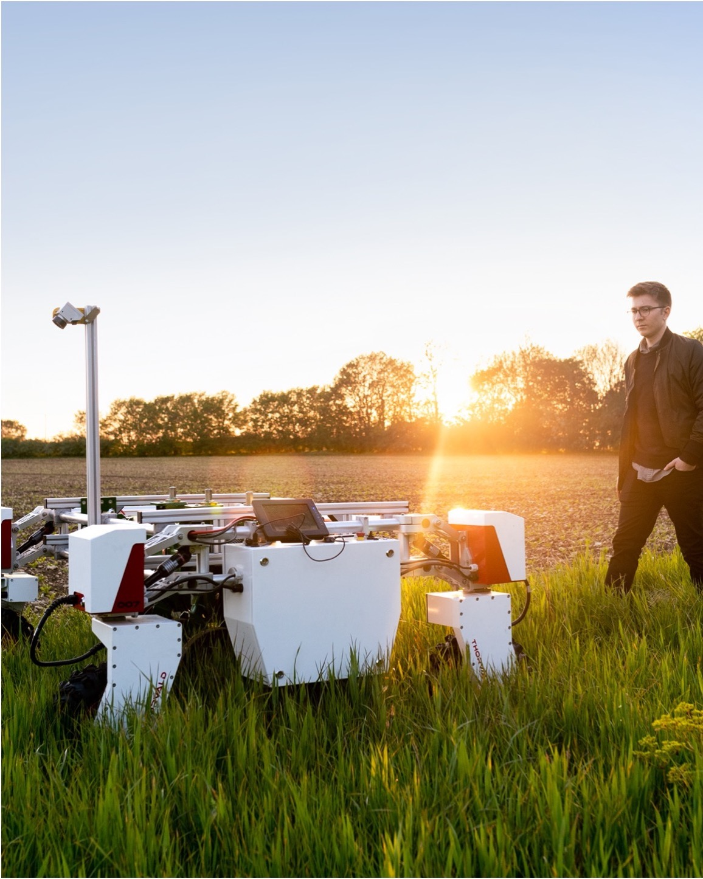

Sustainability: over to you
How can you
apply the 6Rs as
you develop your occupational skills?
How could you
contribute to greater sustainability in
your future career?
Image © This Is Engineering
10

Slide 11
Sustainability: over to you - example answers
Here’s one example of how an engineer could apply the 6Rs and contribute to greater sustainability:
Occupational specialism: CNC machine operator
Career aspiration: Production engineer
Rethink: Find ways to build using 3D printing etc. rather than mill from blocks or sheets.
Refuse: Work with CAD team to simplify designs.
Reduce: Improve layouts to get more parts from one block or sheet. Use efficient tool paths for less energy use.
Reuse: Find ways to machine small parts from sheet skeletons or waste blocks.
Repair: Redesign parts so they can be removed and replaced.
Recycle: Create a closed loop with material suppliers to return waste raw materials for reprocessing.
11

Slide 12
Learning outcomes
2. Sustainability and my career
You will be able to:
Analyse a real-world example of applying the 6Rs and identify how this supports social, economic or environmental sustainability.
Give reasons why health and safety need to be at the heart of any approach to sustainability.
Formulate career ideas that emphasise sustainability within engineering or manufacturing.
Image © This Is Engineering
12

