Slide 1
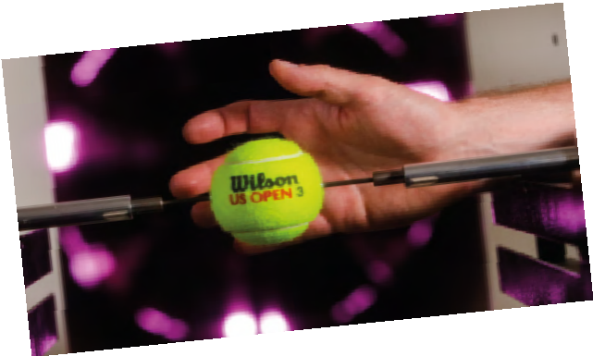
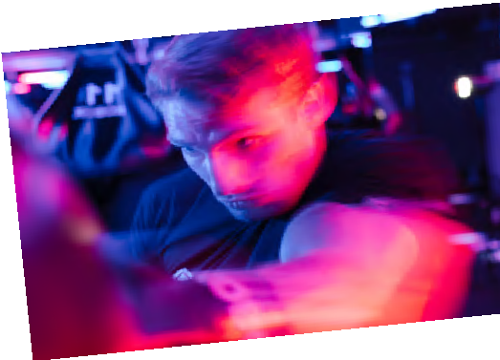
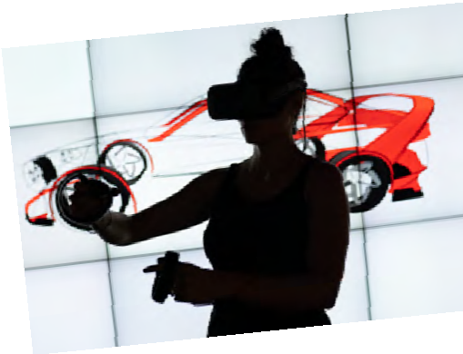
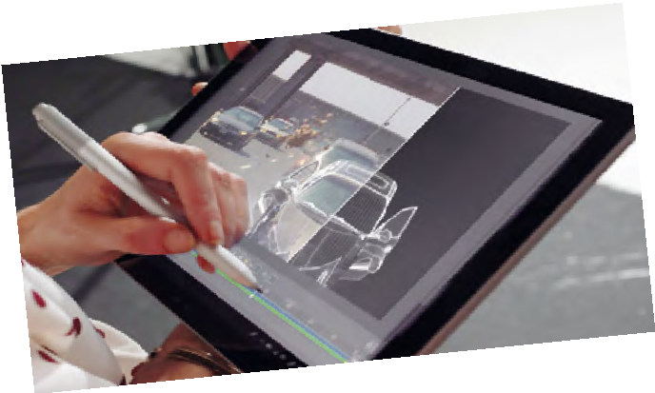
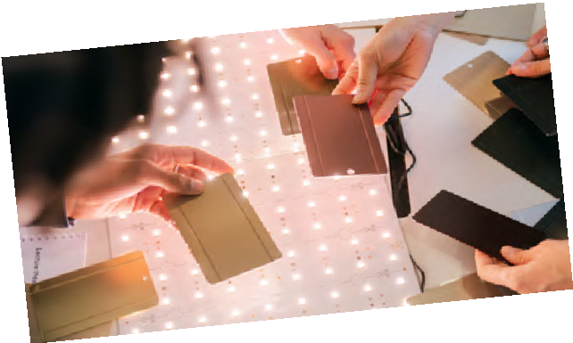
Engineering is at the cut^{ting edge:}
from artificial intelligen^{ce and}
gaming, to advanced sp^{orts}
equipment and creating ^{the future}
of film and music.
Find stories of inspiring ^{engineers}
and bring the work that ^{they do}
into your home or classr^{oom.}

Slide 2
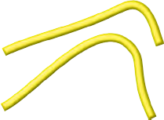
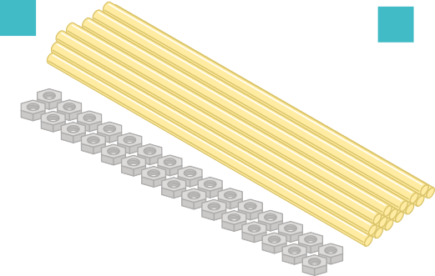
Introduction
What’s in the pack?
Engineering is at the cutting edge: from machine leaning, artificial intelligence and gaming, to advanced sports equipment, CGI, designing
hi-tech sets and materials, and
music production.
Engineers create incredible devices, software and systems that make the impossible possible.
A
B
C
A
Bumble Beep
Croc leads x two Coin cell battery
Light dependent resistor
R G Bug
Perspex sheet
B
C
D
D
E
E
F
F
Whether you’re into phones, apps, games or virtual reality, you can be part of how technology shapes the future.
_{G} Dowels x 15 and
B
nuts x 30 (approx.)
R
H Game tokens x six
Find stories of inspiring engineers who followed what they love into engineering, each with different passions and different journeys.
G
G
H
Whatever you’re interested in, whatever your background, choose engineering and choose to be the difference in the world.
Visit thisisengineering.org.uk
2 THIS IS ENGINEERING: ENTERTAINMENT

Slide 3
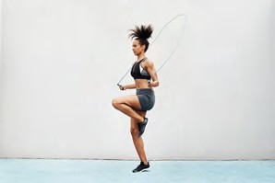
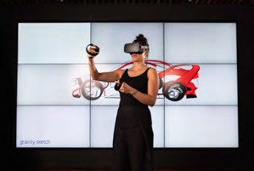
Choose your challenge
Sports and engineering
Track your skip
Page 8
Sporting data
Page 11
VR gaming and engineering
Computer always wins
Page 19
Enter the fourth dimension
Page 16
Broadcasting and engineering
All about the sound
Page 25
Synthetic beats
Page 27
Lighting and engineering
Setting the mood
Page 30
Visual effects and engineering
Creating a horror scene
Page 33
The full production
Page 35
THIS IS ENGINEERING: ENTERTAINMENT 3

Slide 4
Engineering habits
Engineers make ‘things’ that work or make ‘things’ work better. But they do this in particular ways.
The ‘engineering habits’ describe the way engineers think and act.
But remember, results are not fixed! If you take the quiz several times, you might find that different engineering habits are stronger depending on the type of activity or challenge you are doing.
How do you think and act like an engineer?
Take the quiz at This is Engineering: Entertainment to discover your ‘engineering habits’.
Engineering is all about having a diverse group of people and skills so having different engineers with different habits of mind in any team is always important!
I am good at…
Creative problem-solving
Improving
Problem-finding
Adapting
Visualising
Systems thinking
Coming up with lots of new and good ideas
Making what I have done better
Thinking about the world around me and how it could be better
Deciding how something could be done differently
Thinking out loud when I am being imaginative
Using ideas from one subject in another
Working successfully in a group
Experimenting with things just to see what happens
Finding out why something does not work
Explaining how well I am doing to my teachers and friends
Making a plan before I start work
Putting things together to make something new
Find the full quiz on the ‘This is Engineering: Entertainment’ page on our STEM resource hub.
4 THIS IS ENGINEERING: ENTERTAINMENT

Slide 5
STEM Badges
How to collect
STEM Badges reward you for your commitment to STEM.
Complete NINE
challenges
For each activity you complete from this booklet, think about which engineering habits you are using and mark this out on the STEM badge record sheet.
you have been using on the following page.
Show and tell your teacher what challenge you have been working and answer these questions:
What problem did you solve?
Which engineer or area of engineering does this challenge relate to?
What did you discover by working on this challenge?
Which engineering habits did you use?
Did you work in a team or independently?
What worked well?
How could you improve this?
Once you have completed enough of the activities and challenges, cash them in for your STEM badges!
Complete SIX
challenges
The badges are digital so you can link them to your online profiles and applications and you can’t ever lose them.
Complete THREE
challenges
How to collect your badges For each challenge, mark out up to three ‘engineering habits’
Tell us what you think...
Take our short survey for a chance to win £500 of robotics/coding equipment for your school.
Scan the QR code on your phone, or go to stemresources.raeng.org.uk/student-survey
THIS IS ENGINEERING: ENTERTAINMENT 5

Slide 6
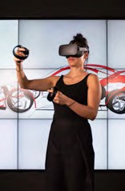
STEM BADGE Tracker
Name:
Track your skip Sporting data
Enter the fourth dimension
Computer always wins
All about the sound
Synthetic beats
Setting the mood
Creating a horror scene
The full production
6 THIS IS ENGINEERING: ENTERTAINMENT

Slide 7
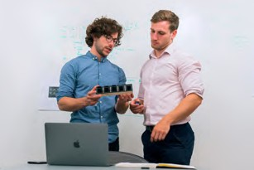
About me
Charles is a mechanical engineer and an entrepreneur. He combined his passion for sport and engineering to invent a boxing app, helping top athletes improve their game.
“Engineering means you learn skills that could be used to solve anything and lets you build your passions into a career.”
His invention of wearable technology provides performance feedback to athletes and coaches in combat sport training. The sensors measure speed, power, type of punch, and work rate, and let athletes track and improve their performance.
Charles’s mission is to help people from all skills levels, to assist athletes from grassroots sport to high-performance elite competition.
Find out more about Charles by visiting the This is Engineering website
Charles
Workout Hacker
THIS IS ENGINEERING: ENTERTAINMENT 7

Slide 8
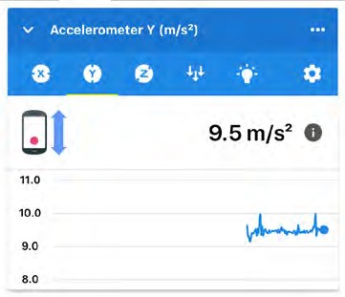
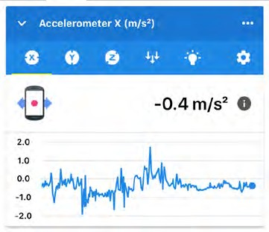
Track your skip
CHALLENGE
Materials
Smartphone
Different length skipping rope, or rope that can be used at different lengths
Monitoring and tracking your data has become a huge part of the sporting industry.
We can measure how many steps we take each day, how far we have run, cycled or swam, and we can view this data on our phones using different apps, making it easy for us to track our progress, set goals and share with friends.
Accelerometers are devices that measure acceleration. They are found in smartphones and game controllers to give them motion control.
Skipping is a great example of acceleration and it’s great
exercise! Professional boxers do it
to improve their coordination and to improve their endurance.
Did you know? The most skips in one minute is 203 and was achieved by Zorawar Singh in Delhi, India, in November 2019.
Approximately how many skips is this per second?
8 THIS IS ENGINEERING: ENTERTAINMENT
Challenge
Do you think the length of the rope might change how many jumps you could make in one minute?
Getting started
Download the ‘Science Journal App’ on your smartphone. You can use the app without creating an account.
Find a way to secure the phone to yourself – a hip bag would work well or a tight pocket. Make note of whether your phone will lie vertically (upright) or horizontally
(on its side).
Decide which direction accelerometer (either X or Y) you would like to use. Test out each one and try moving your phone in different directions to see what happens.
VERTICAL Horizontal
Use this if your phone is sitting upright.
Use this if your phone is on its side.

Slide 9
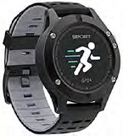
Time to track
Start a new experiment on the Science Journal App.
Select either the X or Y accelerometer to take your measurement depending on the direction you will be able to secure your phone.
Press the record button and attach the phone to your body.
Start skipping. Try and skip for a full minute. Once you have
finished, press the record button
again to stop recording.
Use the ‘crop’ feature to
shorten your data to a length of exactly one minute. Make sure you crop off the parts at the beginning and end of the data while you were handling the phone, which may look irregular or spiky on the graph.
Look at the graph of your acceleration. The graph should be periodic (the same pattern repeats over and over). Each repetition of the same pattern, or period, represents one complete jump.
Each peak on your graph is one
jump. Count the number of peaks in one minute.
Repeat this process using three different length ropes.
Repeat with different people.
With which length rope did jumpers find they could skip the fastest/slowest?
Did this change for different jumpers? Did their height have an impact?
Did the length of the rope impact endurance (how long jumpers could continue skipping)?
Height of person Length of rope Skipping time Number of skips
Skips per second
 | 1m
 | 1m
 | 1.3m
 | 1.3m
 | 1.6m
 | 1.6m
THIS IS ENGINEERING: ENTERTAINMENT 9

Slide 10
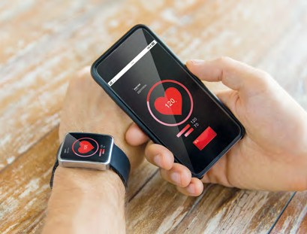
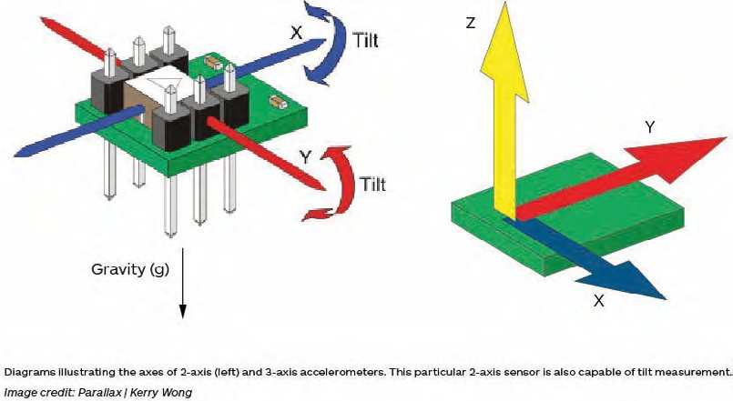
Design an app using this data that generates personalised skipping fitness plans.
What will the personalised fitness plans look like to your users?
Do you need to collect more data or carry out more
research so you have the best information to create the fitness plans?
How will your app work? What is the user journey?
What information will you need to collect from users?
Find a template for your app design on the This is Engineering: Entertainment page on our resource hub.
Mini-glossary
Acceleration is change of velocity.
Velocity is change of distance over time (m/s).
An accelerometer is an electromechanical device that will measure acceleration forces. These forces may be static, like the constant force of gravity pulling at your feet, or they could be dynamic, caused by moving or vibrating the accelerometer.
Most smartphones will have an accelerometer sensor.
Visit Science Buddies to experiment with the accelerometer in the Science Journal App.
10 THIS IS ENGINEERING: ENTERTAINMENT

Slide 11
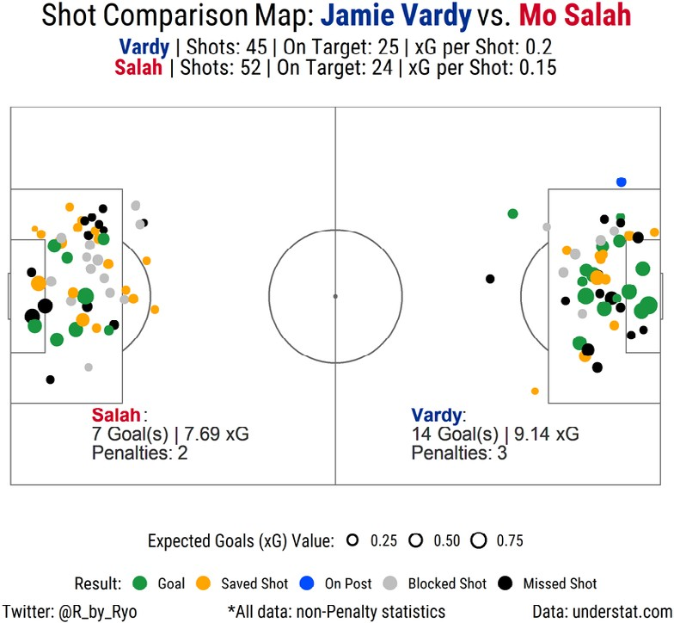
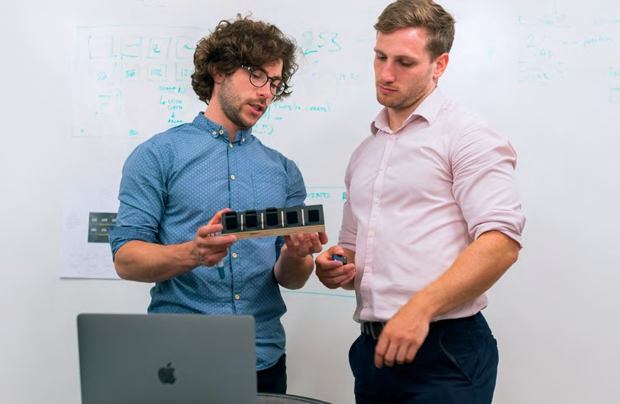
Sporting data
Shot comparison map: Jamie Vardy vs. Mo Salah
CHALLENGE
Sports statisticians, trainers, competitors or competition organisers use different tools to visualise and represent data.
This can help them analyse performance, inform training programmes, improve motivation, and plan sporting events.
challenge
Have a go at using the graphics to answer the questions about the different sporting events.
Leicester City
F.C. goalie
Liverpool
F.C. goalie
How many goals did Salah score?
How many did Vardy score?
Who saved the most shots?
Who has missed the most shots?
How do they differ in positions from where they take shots?
What do you think works well in this graphic?
What could be improved?
Graphic taken from Ryo Nakagawara Reddit
THIS IS ENGINEERING: ENTERTAINMENT 11

Slide 12
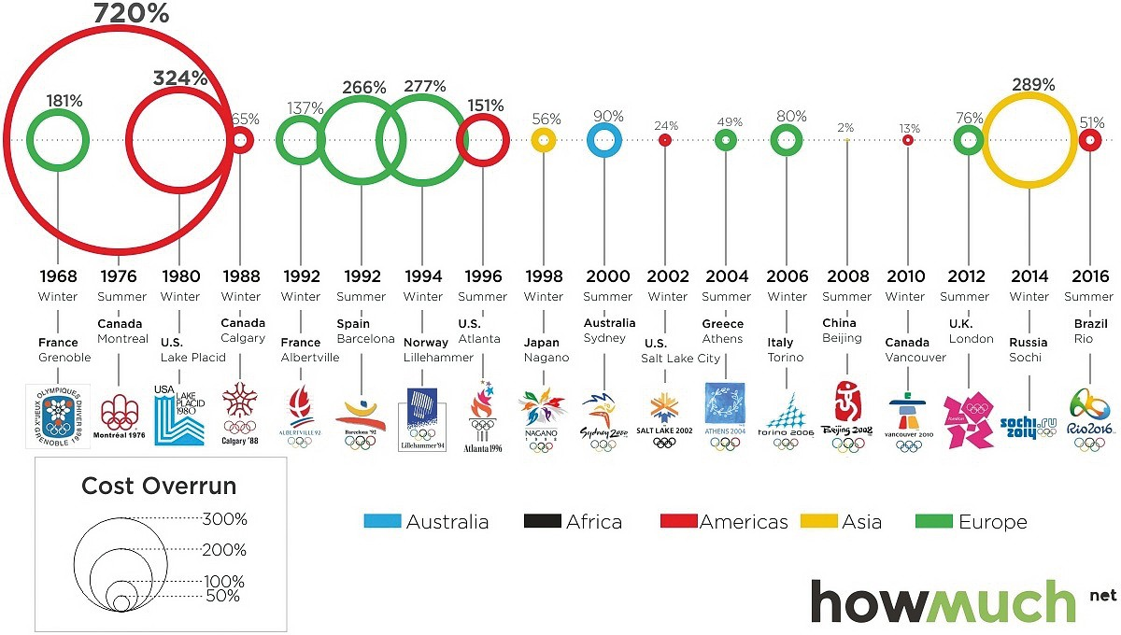
Sporting data
CHALLENGE
Graphic showing how much over budget countries spent during their Olympic games.
Which country had the highest cost overrun?
Which country was almost on budget?
In which continent have most of the Olympic games taken place?
In which continent have the least Olympic games happened?
What else might you be able to tell from this graphic?
What can you not tell from this graphic?
What do you think is good about
this graphic?
What do you think could be better?
Graphic taken from Visual Capitalist, Rio Games Success – 51 % overbudget
12 THIS IS ENGINEERING: ENTERTAINMENT

Slide 13
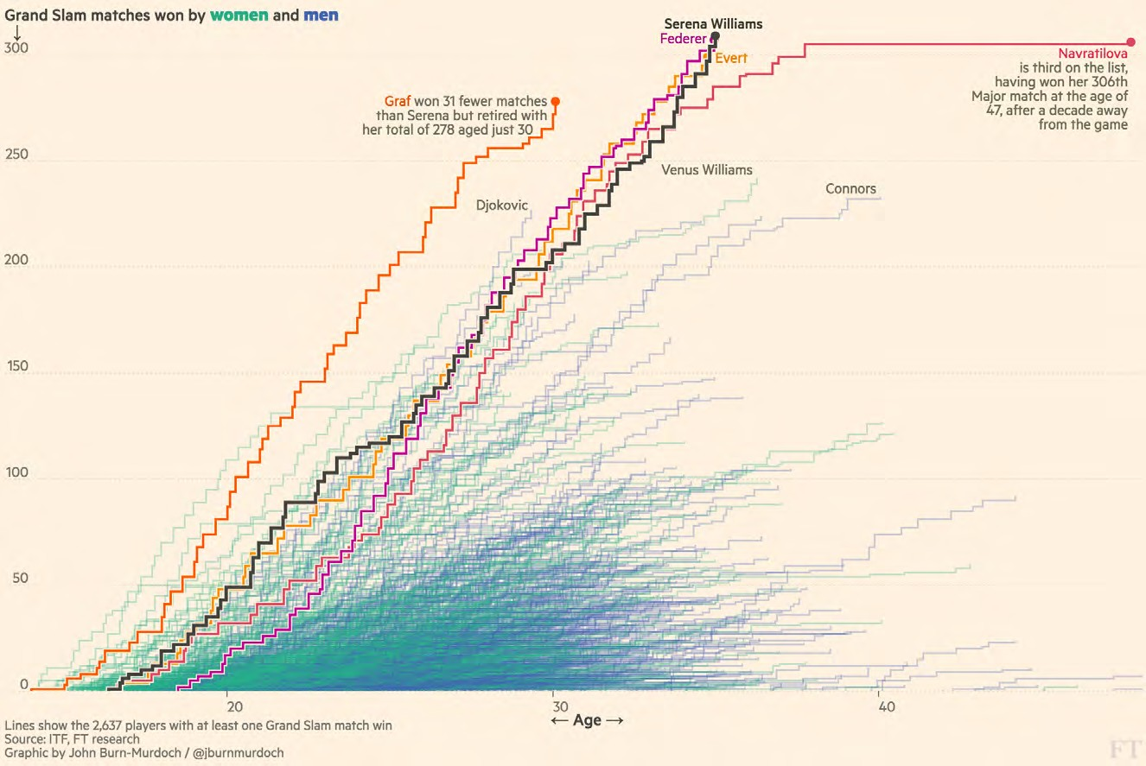
Graphic showing the number of Grand Slams
Image taken from
Financial Times Sport, A visual history of women’s tennis
Who is the oldest player to win more than 300 Grand Slam matches?
Approximately how old was Serena Williams when she won her first Grand Slam?
Who was the youngest player to reach 200 Grand Slams?
How many players have won more than 250 Grand Slams?
What other information can you tell from this graphic?
What is difficult to decipher from this graph?
What do you think is good about this diagram?
What do you think could be better?
THIS IS ENGINEERING: ENTERTAINMENT 13

Slide 14
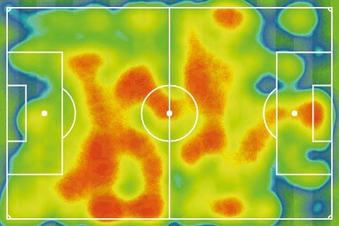
Sporting data
CHALLENGE
Heat map showing the position of players in one team in a football match
Which direction was the team playing?
Did this team spend more time attacking or defending?
Where was much of the action of the game focused?
What formation was this team using in this match?
What strategy do you think the team was using in this game?
What strategy do you think the opposing team might have been using?
What do you think an ideal heat map would look like for the opposing team (what strategy might they use against this team)?
Image and questions taken from Nrich Maths, Charting Success
Direction of play
What next?
Have you found any good (or bad) examples of representations of sports data? What makes them good (or bad)?
14 THIS IS ENGINEERING: ENTERTAINMENT

Slide 15
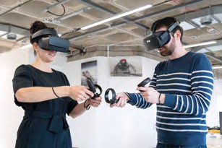
About me
Daniela is creative, an engineer, an innovator and a businesswoman. Problem-solving, art and design were her passions from a young age, and she realised she could bring her art and design ideas into reality through engineering.
“Engineering means magic. You can change how people do things in
their everyday lives.”
She now runs Gravity Sketch, her own company, which empowers designers to create in the most intuitive way by sketching in 3D using virtual reality (VR).
By understanding how things were built and how they worked, Daniela can make her ideas come to life and challenge how they were made. Engineering opened the door for her to come up with crazier and more innovative ideas for the world.
Find out more about Daniela by visiting the This is Engineering website
Daniela
Wonder Maker
THIS IS ENGINEERING: ENTERTAINMENT 15

Slide 16
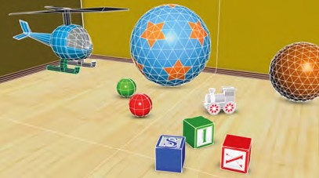
CHALLENGE
Materials
Straight biodegradable straws
Pipe cleaners
Bubble mixture (or soap)
Water
Bucket
Entering the fourth dimension
TIME TO MAKE
Tetrahedron
Cut your straws so you have six equal pieces.
Thread your pipe cleaner through one end and bend one end to secure it in place.
Add two more pieces of straw and twist the pipe cleaner to secure it in place.
Add more pipe cleaner by twisting more on to one of the loose ends.
Add two more straw pieces and bend it back to one of the joints.
Secure the loose end of the pipe cleaner in place by threading it through the straw that will form the adjacent edge.
Attach the final straw piece so the two vertices (corners) meet it.
Extend the pipe cleaner to form a handle.
Daniela has developed software that empowers game designers to create in the most intuitive way by sketching in 3D using VR.
Most 3D objects used in game design are made up of usually regular polygons.
Regular polygons are 2D shapes where every edge is the same length and every angle is the same size (such as a square or equilateral triangle).
Exploring platonic solids Platonic solids are a special type of polyhedron (3D shape) with special properties.
There are only five solids that have both these properties:
Describe the platonic solids.
What do you think the special properties are?
Tetrahedron Hexahedron
16 THIS IS ENGINEERING: ENTERTAINMENT
Octahedron
Dodecahedron
Icosahedron

Slide 17
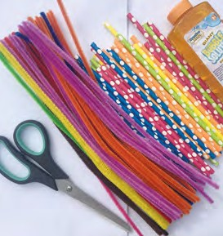
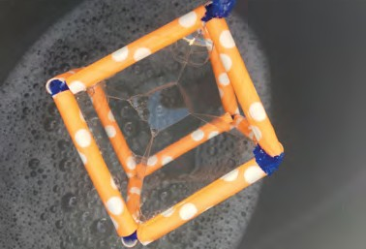
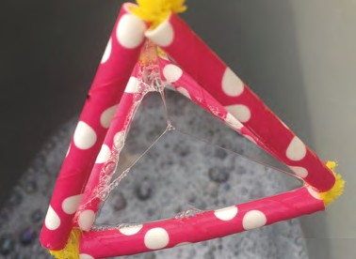
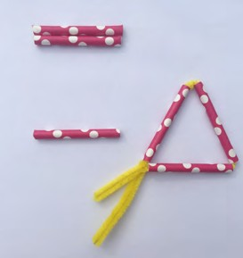
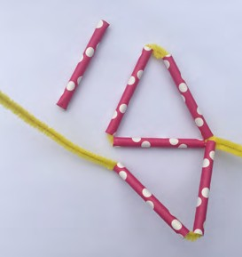
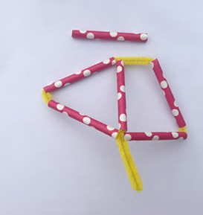
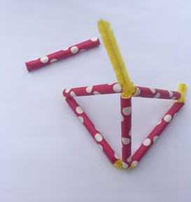
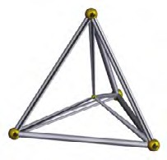
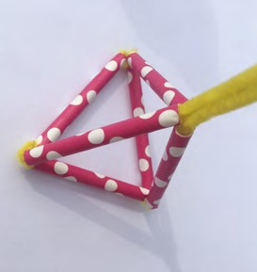
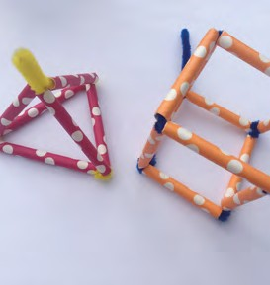
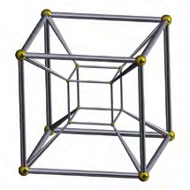
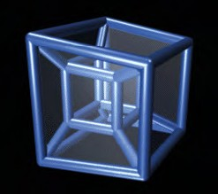
a
Making platonic solids
How many pieces of straw would you need for a hexahedron (cube)?
How many pieces of straw would you need for a dodecahedron (the table on the next page might help you)?
Have a go at making a hexahedron and octahedron using straws and pipe cleaner. Write a set of instructions for someone else to follow so they can make their own.
Stretch and challenge
Challenge yourself to make a dodecahedron. What about an icosahedron?
Into the fourth dimension
What is the fourth dimension and does it exist? The fourth dimension is related to the other three dimensions by imagining another direction through space; just as
the dimension of depth can be added to a square to create a cube, the fourth dimension can be added to a cube to create a tesseract.
Add water and bubble mixture to a bucket or large bowl.
Dip your tetrahedron into the bubble mixture.
Dip your hexahedron into the bubble mixture.
What do you notice?
Try this with the other straw and pipe cleaner platonic solids you have made.
Platonic solids dipped in bubbles
b
c
Two-dimensional representations of four- dimensional shapes
d
e
A four- dimensional tetrahedron is known
as a 5-cell.
A four-dimensional cube is known as a tesseract.
f
g
Check out this moving animation of a tesseract projected in two dimensions: en.wikipedia.org/wiki/ Four-dimensional_space#/media/ File:8-cell-simple.gif
THIS IS ENGINEERING: ENTERTAINMENT 17

Slide 18
ENTERING THE FOURTH DIMENSION
CHALLENGE
Investigating platonic solids and other 3D shapes
Although the properties of polyhedra (3D shapes) are still used in game development,
the relationship between the number of vertices (corners), edges and faces was discovered by Leonard Euler in 1758.
Name Sketch of shape Vertices Edges Faces
Tetrahedron
Hexahedron (cube)
Dodecahedron
Square-based pyramid
Choose your own solids to investigate
Choose different 3D solids and complete a record to show your results. Find a relationship between the numbers.
18 THIS IS ENGINEERING: ENTERTAINMENT

Slide 19
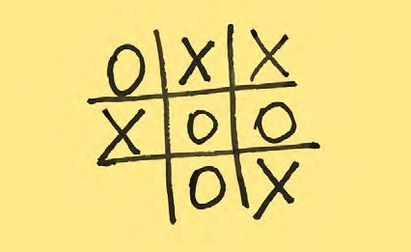
The computer always wins
CHALLENGE
If you have ever played a video game, you have interacted with artificial intelligence (AI).
Write a computer program so the computer always wins if it plays first. Is this possible?
Write a computer program so the computer does not lose if it plays second. Is this possible?
We have started some games for you below. What could happen next?
What might be some of the issues with developing video games where the computer always wins?
The most common role for AI in The aim of the game is to get
video games is controlling non- either three noughts or three
player characters (NPCs). Designers crosses in a line. often use tricks to make these
NPCs look intelligent. One of the most widely used tricks, called the Finite State Machine (FSM)
algorithm, was introduced to video
game design in the 1990s.
How to play?
Draw a three by three grid
First player draws a cross in an empty section of the grid.
The second player draws a nought in an empty section of the grid.
Repeat this process until either player has three crosses or three noughts in a row OR all the spaces are full and no-one has three in a row.
Play several games taking it in turns to play first and second.
What do you notice?
Write a set of instructions to play noughts and crosses for a computer to follow.
Rules and instructions that we give to computers are called algorithms and a collection of instructions is a computer program.
In an FSM, a designer generalises all possible situations that
AI could encounter, and then
programs a specific reaction for each situation. Basically, an FSM AI would promptly react to the human player’s action with its pre- programmed behaviour.
Route one | Route three
Computer: Draw a cross on one of the corners | Computer: Human:
Human: Draw a nought in the centre Computer: | Computer:
 | Route four Computer:
Route two
Computer: Draw a cross on one of the corners Human: Draw a nought on the opposite corner | Human: Computer:
Computer:
Computer vs human — noughts and crosses
You might have played noughts
and crosses against friends or family members.
Do you have any strategies to win? Is it best to go first or second?
THIS IS ENGINEERING: ENTERTAINMENT 19

Slide 20
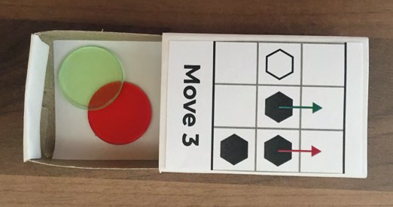
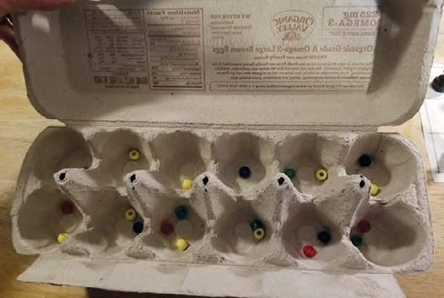
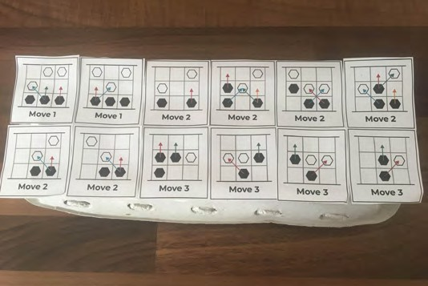
Computer vs human — Hexapawn
Moves
Taking it in turns, each player can move one counter forward if there is nothing in that space OR
Take the opponent’s piece that is in a diagonal space.
Starting positions
After playing several rounds of noughts and crosses and learning from your experience, you wrote a ‘computer program’ that responds to any move that the human plays. This idea of responding to players’ moves is the basic principles of how game developers use AI.
Hexapawn is another game that you can build to respond to players’ moves and eventually becomes unbeatable.
How to play
Draw a three by three grid.
Place three counters of the same colour on either side of the board.
Each player plays with one colour.
Winning
Getting a piece onto the last row.
Blocking your opponent so they cannot play.
Taking all your opponent’s pieces.
Have a go at playing a few rounds with a friend or family member.
Are there any strategies that help you win? Does it help to go second or first?
Build an unbeatable hexapawn computer game
Ideas for game set-up
The colour of the arrows needs to match the colour of the tokens under each compartment of your game.
Materials
24 small boxes or two 12 egg cartons.
Try playing hexapawn online
At least four different coloured tokens (you could use sweets, beads or counters). You’ll need a large number of each.
A blank three by three board.
Two different playing pieces (these are included in your pack or make your own). Three of each.
A copy of the 24 board positions that are on pages 22 to 23. There is also a copy in your box.
Coloured pens and pencils the same colour as your tokens.
20 THIS IS ENGINEERING: ENTERTAINMENT

Slide 21
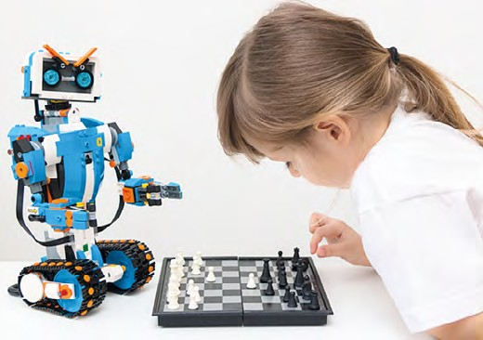
Building your hexapawn computer game
Copy and cut out the 24 images of the board.
Stick one on each box or on top of every egg holding space on your carton. These represent every move that the ‘computer’ will be
able to make.
Colour all the arrows so that they match the colours of the tokens you have (we have used red, green, blue, and orange).
Fill each box or space in your egg carton with tokens with the colours that match the arrows.
Playing your hexapawn computer game
Decide on the colour for the ‘human’ player. They will always play first.
All the moves the machine can make are shown on the 24 image of the board.
The ‘human’ player makes the first move.
Look for the image that shows the same move the ‘human’ player has made (human is white and computer is black).
Take out one of the tokens at random from under this image.
The ‘computer’s’ token moves according to the direction of the arrow that is the same colour as the token pulled out.
The ‘human’ player makes their second move.
Look for the image that shows the same move the ‘human’ player has made.
Take out one of the tokens at random from under this image.
The ‘computer’s’ counter moves according to the direction of the arrow that is the same colour as the token pulled out.
Repeat this sequence until the ‘human’ or the ‘computer’ have won.
Learning to become unbeatable
Each time the ‘computer’ loses a game, remove the token that corresponds to the last move it played.
If they win, make no changes.
What happens? How does the ‘computer’ become unbeatable?
Can you adapt the computer game to increase the chance that the computer will win?
Can you adapt the computer game to decrease the chance that the computer will win?
Stretch and challenge
How many games does it take for the computer to learn how to play a perfect game?
Does this number change depending on how well the ‘human’ plays?
Develop a system to record and show your results.
Move 1
Move 1
Choose the image that shows the move the ‘human’ has made.
The coloured token should match one of the coloured arrows on the image.
This will tell you what move the ‘computer’ will make.
THIS IS ENGINEERING: ENTERTAINMENT 21

Slide 22
Copy and cut out the images of the hexapawn boards
Each board represents the moves the computer could make.
Move 1
Move 1
Move 2
Move 2
The colours of the arrow represent the coloured tokens in the box under the image.
Move 2
Move 2
Move 2
Move 2
The arrows represent the different moves that the computer will make depending on which colour token is selected.
Move 3
Move 3
Move 3
Move 3
A PDF version of the game moves can be found on the This is Engineering:
Entertainment page on
our resource hub.

Slide 23
Move 2
Move 2
Move 2
Move 2
Move 2
Move 3
Move 3
Move 3
Move 3
Move 3
Move 3
Move 3

Slide 24
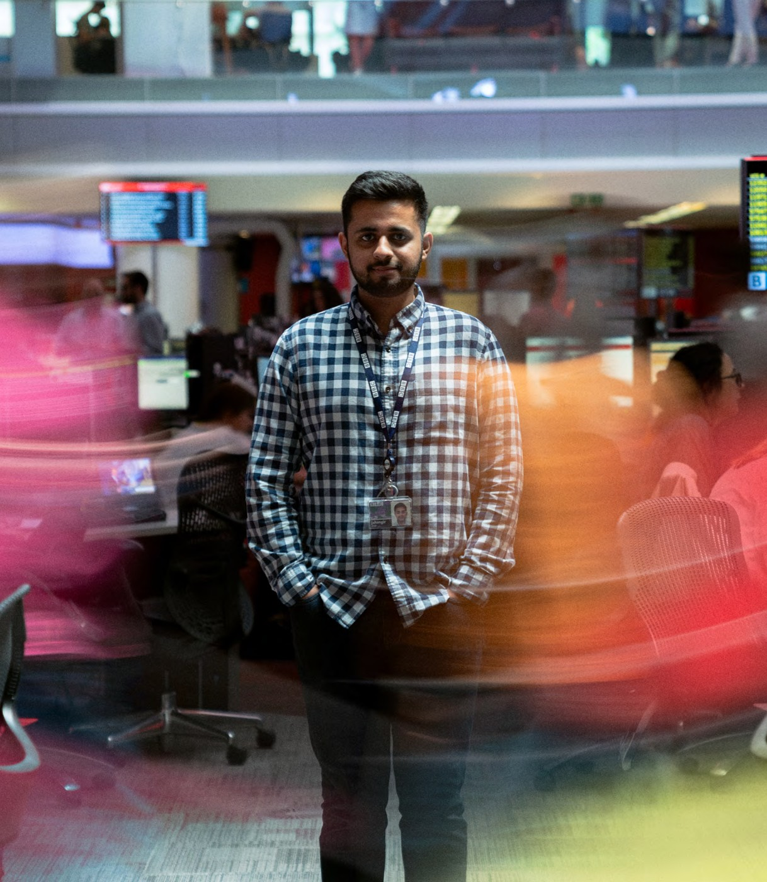
About me
Jahangir grew up making cardboard cameras and pretending he was behind the scenes. This led to his work keeping programmes on air for the BBC and Sky.
“Engineering is creative. You have to think differently and approach problems in a different way.”
From music festivals to political debates, he is there with the action and makes sure everyone watching doesn’t miss a moment.
A big part of the job is working as a team to bring the shows together successfully and every new show, whether it’s Glastonbury or the BAFTAs, brings a whole new team of different people to learn from.
Find out more about Jahangir by visiting the This is Engineering website
Jahangir
BROADCAST Hero
24 THIS IS ENGINEERING: ENTERTAINMENT

Slide 25
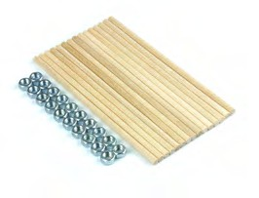
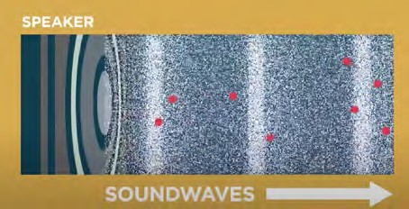
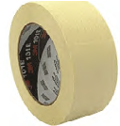
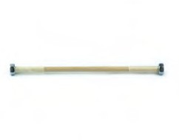
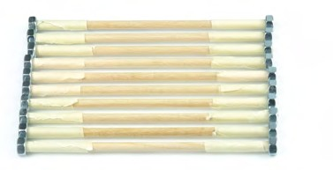
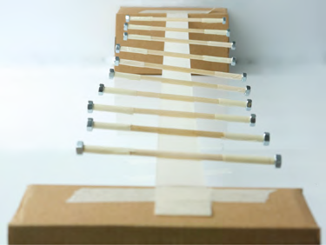
All about the sound
CHALLENGE
Materials
Sticks (included in pack)
Sound plays a big part in both TV and Radio broadcasting
Nuts (included in pack)
Masking tape
What is sound?
Sound is a way that energy can be transferred when things vibrate.
How does sound travel? Sound waves travel as longitudinal
Sound must travel through a waves, which means that the
Somewhere to attach the wave demonstrator
medium. It travels approximately vibrations travel backwards and
343 m/s (metres per second) forwards in the same direction as
If you bang a drum, you make the tight skin vibrate many times per second, this makes the air around it vibrate and as the air moves it transfers energy out from the drum in all directions.
through the air and faster through the wave moves. liquids and solids. The waves
transfer energy from the source
of the sound to its surroundings. Your ear detects soundwaves when vibrating air particles cause your ear drum to vibrate. The bigger the vibrations, the louder the sound.
_{TIME TO MAKE} Time to make your own wave machine to show the properties of waves.
A
B
C
D
E
A Wrap each end of a stick with one or two loops of tape.
This will give the nut a surface to bite into.
B Thread a nut onto end of the stick.
C Repeat this for all the sticks.
D Stretch a piece of tape sticky side up between two supports (wall, chair or even two boxes) and
E If you are doing this activity and don’t have the sticks and nuts then skewers and jelly babies/ marshmallows also work well!
tape down the ends. Place the sticks across the tape, evenly spaced.
Give one end of the skewer a 90° twist. What happens?
THIS IS ENGINEERING: ENTERTAINMENT 25

Slide 26
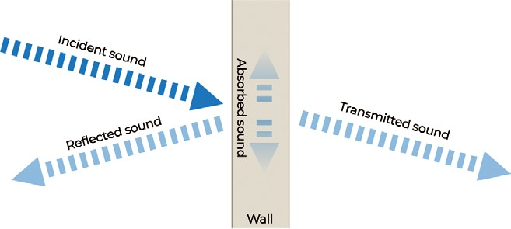
All about the sound
Longitudinal waves
CHALLENGE
Amplitude
Expansion
Time to investigate
We can look at some of the behaviours of soundwaves using transverse waveforms. We can use this to show the pitch, volume of noise and how it behaves when it meets a solid object.
Amplitude shows us the height of each wave. The greater the amplitude of a wavelength, the louder the noise.
Wave frequency (number of waves that pass a point in a given time) shows us the pitch. The greater the frequency, the higher the pitch.
Your wave machine will show how a wave travels.
Use your wave machine to show:
a change of volume/amplitude
a change in pitch/frequency of sound.
Soundwaves travel faster underwater. Use your wave machine to show a change in the speed in which the waves are travelling half way across your machine.
Handy hint: Try removing the nuts from half of your sticks. What happens? What do you think this shows?
Source
Direction
Wavelength
Compression
Transverse waves
Source
Direction
Amplitude
Wavelength
Soundwaves are reflected back when they meet certain objects (think about echoes you might hear) or are disturbed through other objects (such as a wall).
Use your wave machine to show how waves are not transmitted but reflected upon meeting a solid object.
Use your wave machine to show what happens when soundwaves are partially transmitted and partially reflected through an object.
26 THIS IS ENGINEERING: ENTERTAINMENT

Slide 27
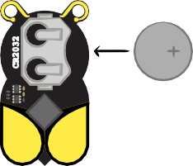
synthetic beats
CHALLENGE
Some electronic music you will have listened to will use synthesizers.
Synthesizers are electronic keyboards that can generate or copy virtually any kind
of sound, making it mimic the sound of
a traditional instrument, or create brand new sounds.
The Bumble Beep contains two oscillators that can be activated by connecting different materials between either the bee’s antenna or the wings.
The frequency of the oscillator will depend on the electrical conductivity of the material connected. The oscillator powers a small piezo speaker so we can hear it.
Find out how music from Doctor Who revolutionised the world of orchestral and electronic music.
What sounds can you invent?
Oscillators form the core of many synthesis
systems. They make sound by vibrating at a
Sine
steady rate, known as its frequency (or pitch). Getting started
First insert the CR2032 coin cell to power
As synthesizers mimic the sound of virtually any other instrument, they have a number of different voices or oscillators, which produce waves of different shapes. Different types of sound will produce different types of waveforms. It can combine waves to make complex sounds and release to make the sounds mimic existing instruments like pianos.
the Bumble Beep.
Square
Triangle
Bumble Beep
In your packs there is an oscillator to produce synthetic sounds called the Bumble Beep.
Sawtooth
THIS IS ENGINEERING: ENTERTAINMENT 27

Slide 28
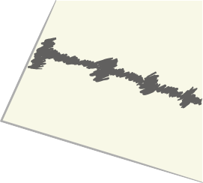
SYNTHETIC BEATS
CHALLENGE
Sound conductor
Did you know that you conduct electricity?
Try holding the bee’s antenna between your thumb and finger; one in each hand. The bee should start making a sound.
What do you notice about the pitch (or frequency) if you squeeze harder? Do you hear a change? If so, why do you think that is happening?
The more electricity that flows (between the antenna or between the wings) the higher the frequency the oscillator runs at and we hear a higher-pitched sound.
The oscillator connected to the wings has a lower sensitivity to allow a range of different materials to be investigated with Bumble Beep.
What sound effects can you make with just your fingers?
Light theremin
Let’s try connecting a component called a light dependent resistor (LDR) to make a musical instrument you can control by simply moving your hand around in the air!
Because the LDR is a relatively good conductor in daylight, we will connect it to the wings with
crocodile clips as shown in the image on the right.
28 THIS IS ENGINEERING: ENTERTAINMENT
You should hear a tone play. Try moving your hand closer to the LDR. What happens to the pitch?
Can you play a tune by moving your hand carefully enough?
Pencil organ
Graphite, used in pencils, also conducts electricity, even when it’s drawn onto paper! We can make our own variable resistor by simply drawing a continuous line onto paper. You may need to experiment with different pencils. Softer pencils work best, but coloured pencils might not work as well as they contain wax, which is an insulator.
Draw a long rectangle and fill it in with a few layers of pencil. Connect the crocodile clips to the bee’s antenna and try touching them to various points. You can clip one lead to the edge of the paper to make this easier.
Can you tune your drawing by modifying the shape or amount of colouring to make a paper organ?

Slide 29
About me
Pavlina loves travelling and is passionate about fashion and expressing her own style.
As a lighting engineer, Pavlina has designed lighting for fashion shows, museums and art galleries.
“Engineering gave me the chance to combine my two passions:
science and art.”
She collaborates with fashion designers to create lighting effects for their shows at events, including Paris Fashion Week, as well as working with museums and art galleries to create the perfect environments for their exhibitions.
Find out more about Pavlina by visiting the This is Engineering website
PAVLINA
LIGHT PAINTER
THIS IS ENGINEERING: ENTERTAINMENT 29

Slide 30
SETTING THE MOOD
CHALLENGE
What do you think?
Where have you seen lighting effects used?
Correct. When we talk about ‘material colours’, like the ones used by painters, then red, blue and yellow are the primary colours. If we are talking about physics and light, then the primary colours are red, blue and green!
How can different types of lighting make us feel? How is lighting used in, for example, gigs/horror films/stage productions?
When selecting a different colour for your text or images on a computer you can make your own colours using ‘red’, ’green’ and ’blue’ sliders.
Myth-buster:
Many people are taught that a rainbow is made of seven colours: red, orange, yellow, green, blue, indigo, and violet. Actually, there are an almost infinite range of colours in a rainbow as they all mix into each other (there is no hard edge between the colours). There is also a type of light that is invisible to humans, called ultraviolet light.
What is the maximum number of intensities available for each colour?
Colour mixing
There are only three colours of light needed to create any colour you can imagine! These are called
‘primary colours of light’ and are red,
green and blue.
“But this is different to the primary colours I use for painting?”
A hex colour code is a six digit number to represent a colour in RGB format.
30 THIS IS ENGINEERING: ENTERTAINMENT

Slide 31
RGBug
Each colour can be set to five different intensities: 0%, 25%, 50%,
Red Green Blue
Colour
The RGBug has an LED (light emitting 75% and 100%. diode) on its tail that can emit each of
the three primary colours of light: red, That’s five levels for each colour.
0% | 0% | 25%
75% | 0% | 25%
 |  |  | Yellow
 |  |  | Orange
 |  |  | White
 |  |  | What other colours can you find?
green and blue (RGB). The RGB LED is actually three separate LEDs that have been packaged together.
What is the total number of different colours the bug can create?
By mixing different intensities of the three primary colours, we can cause the human eye to perceive many more colours.
Modern screens commonly use 256 different levels for red, green and blue, giving a huge 16,777,216 possible colours!
Getting started
First insert the CR2032 coin cell to power the bug.
Finding colours
Let’s explore the colour spectrum.
The visible spectrum is the portion of the electromagnetic spectrum that is visible to the human eye.
Look at the table (right) and use the RGB values in the first two rows. What colours do you get?
Wavelength in nanometres
700
600
580
550
CR2032
Radio waves
Microwaves Infrared
What happens to the colour output if you double the intensity of the RGB colours?
Visible
light
B
475
Ultraviolet
R
White light is the complete mixture of all of the wavelengths of the visible spectrum.
450
X-rays
G
400
Gamma rays
Check out our other resource – Light saver – to find out more about the visible light spectrum.
Can you predict what combination would make white light and test your prediction with the bug?
Turn the bug over and place on a
white surface, like a piece of paper, so
that we can see the glow from the tail. Light sequences
Press the play button on the bug
Try increasing the intensity of one of and watch the LED cycle through the the colours by tapping spectrum.
THIS IS ENGINEERING: ENTERTAINMENT 31

Slide 32
About me
Sonya loved drawing and making up stories as a child, and also loved maths.
“Engineering brings my ideas in film to life.”
Bringing together these two interests seemed impossible until she completed a degree in engineering and computer science, and landed her first job working for Disney Animation as a visual effects artist.
Engineers in special effects are presented with seemingly simple problems like how to create digital fires, or water that looks realistic but is actually animated.
Using creativity, technical skills and attention to detail, Sonya brought ideas like these to life on the screen.
Find out more about Sonya by visiting the This is Engineering website
Sonya
Dream Maker
32 THIS IS ENGINEERING: ENTERTAINMENT

Slide 33
Creating a horror scene
CHALLENGE
Visual effects in the film industry have come a long way with computer-generated imagery (CGI) playing a big part in film production.
Lit stage
However, before CGI, film-makers and engineers found all sorts
of creative ways to enhance
film-making through innovative approaches to visual effects.
Whitney Houston’s hologram tour bringing her back to life even after she has passed away.
“Ghost”
Glass
How does it work?
It is all about the properties of light.
Horror films in particular have always been at the forefront of visual effects since the early days of film – you can’t show zombie corpses, ghosts, ghouls and gore without some visual trickery.
The illusion involves placing a piece of glass at an angle between a brightly lit ‘stage’ room in which viewers look straight ahead, and a hidden room, kept dark, that holds a ‘ghostly’ scene.
Stage setup for Pepper’s Ghost during a theatre show. To the audience, it appears as if the ghost is on stage.
Audience
One of the oldest visual effects used is known as ‘Pepper’s Ghost’. It is an illusionary technique that creates transparent ghostly images that can appear to talk, move, hold objects, or even fight!
Mini-glossary
An incident ray is a ray of light that strikes a surface.
Reflection is when light bounces off an object. If the surface is smooth,
like glass, it will reflect at the same angle as it hit the surface.
Most of the light rays from the lit stage are transmitted through the glass toward the audience, while some of the incident
rays from the hidden room
are reflected by the glass. The images in the two rooms both reach the audience, creating the Pepper’s Ghost illusion.
Modern versions of this are still used today including in Disney’s Haunted Mansion ride and at
Image of the dancing ghosts in the ballroom in Disney’s Haunted Mansion.
THIS IS ENGINEERING: ENTERTAINMENT 33

Slide 34
CREATING A HORROR SCENE
CHALLENGE
Setting up your Pepper’s Ghost illusion
Recording your video
Use a dark/black background.
Make sure the subject (thing you’re filming) is well lit and in focus.
Film as steadily as possible – prop up your camera if you can.
If you can’t record a video, an image with a black background and lit subject will work too or you can find pre-made versions on YouTube.
Making your stage
Use card to make the basic shape.
Fix clear plastic (you can find this in the pack) at 45° to the phone.
The projected image will appear distance in the room as it is from your phone screen.
Keeping the area around your phone dark will help with the illusion.
Side view
of illusion set-up
Projected image
Plastic
Phone
34 THIS IS ENGINEERING: ENTERTAINMENT

Slide 35
The full production
CHALLENGE
Knowledge of light and sound effects is a crucial element of every film production.
Especially now, when special effects are getting more popular and sophisticated by the day. And people behind these achievements are none other than engineers, among other members
of the crew.
Make sure the light is good. What lighting effects could you create with the RGBug?
Keep your subjects in the camera frame.
Take care of what angle you are filming at.
Editing
Download OpenShot. It is a free video editing tool. Or you might be able to use inbuilt apps on your phone or tablet.
Working from a storyboard might help to
shoot the film in several parts.
Remember continuity when you put them together.
Bring together the skills and tools you have used in this challenge booklet from the mixing colours activity and the synthetic sounds activity to create your own short horror film.
Story
Keep it simple – don’t try and cram too much into 60 seconds!
Give it a beginning, a middle and an end.
Use what’s around you – everything in your life can be part of the film.
You don’t have to tell a story. A
sequence of images or montage can also make fascinating films.
Sound
Sound is a crucial part of horror films and is often what makes them scary!
Recording the sounds separately might
make your film look more professional. This way you don’t pick up any background noise when you are filming the visual shots.
Use the Bumble Beep to create your
own sounds.
Directing
Create a storyboard and use this to add in when you will include special effects.
Keep your camera steady.
Watch this one minute short horror film
The Familiar for inspiration.
THIS IS ENGINEERING: ENTERTAINMENT 35

Slide 36
The Royal Academy of Engineering is harnessing the power of engineering to build a sustainable society and an inclusive economy that works for everyone.
In collaboration with our Fellows and partners, we’re growing talent and developing skills for the future, driving innovation and building global partnerships, and influencing policy and engaging the public.
Together we’re working to tackle the greatest challenges of our age.
What we do
Talent & diversity
We’re building global partnerships
that bring the world’s best engineers from industry, entrepreneurship and academia together to collaborate on creative innovations that address the greatest global challenges of our age.
We’re growing talent by training, supporting, mentoring and funding the most talented and creative researchers, innovators and leaders from across the engineering profession.
We’re developing skills for the future by identifying the challenges of an ever- changing world and developing the skills and approaches we need to build a resilient and diverse engineering profession.
Policy & engagement
We’re influencing policy through the National Engineering Policy Centre – providing independent expert support to policymakers on issues of importance.
Royal Academy of Engineering Prince Philip House
3 Carlton House Terrace London SW1Y 5DG
Tel: +44 (0)20 7766 0600
www.raeng.org.uk
Registered charity number 293074
Innovation
We’re driving innovation by investing in some of the country’s most creative and exciting engineering ideas and businesses.
We’re engaging the public by opening their eyes to the wonders of engineering and inspiring young people to become the next generation of engineers.

