Slide 1
Battery
technologies
3. Battery design and performance

Slide 2
Practitioner guide
3. Battery design and performance
2

Slide 3

Introduction and overview
3. Battery design and performance | Practitioner guide
These resources help practitioners to deliver the batteries components of engineering and manufacturing-related qualifications at levels 2 and 3. They introduce the topic and stimulate learners to explore and reflect on key concepts and are designed to complement and enhance practitioners’ own lesson materials and schemes of work.
Resources summary
Prerequisites – It is recommended that learners complete 1. Introducing battery technologies and 2. Cell chemistry before starting this resource.
Resource name | Level | PPT slides + notes – practitioner | PPT slides – learner | Activity sheets | Film | Interactive
3. Battery design and performance | 3 |  |  | 2
Delivery
Delivery suggestions for practitioners, and suggested answers where appropriate, are in the presenter’s notes for each slide. The core activities in each resource provide around 60 mins of learning time, though additional suggestions, including independent learning, can extend this time significantly.
Overarching theme/big questions
How can we design batteries to fulfil a wide range of applications?
How can batteries become more sustainable and contribute to a net zero carbon economy?
Overview
The Level 2 resource introduces some key ideas in battery technology: selection criteria for batteries, capacity measured in Ah and Wh, and transitioning batteries towards a circular economy that minimises waste.
The Level 3 resources explore cell chemistry and novel cell technologies, combining cells in series, parallel and arrays to design batteries, and the role batteries will play in home and grid storage as the UK transitions towards a net zero carbon economy.
3

Slide 4
Learning outcomes and resource links
3. Battery design and performance | Practitioner guide
Level 3 resource
Battery design and performance
Make calculations for cells in series, parallel and in an array.
Calculate the internal resistance of a battery and predict its effect on battery performance when connected to high and low resistance loads.
Apply your understanding to consider an electric vehicle (EV) battery pack design and identify important safety considerations.
Full resource list available for the topic of Battery technologies:
1. Introducing battery technologies (Level 2)
2. Cell chemistry (Level 3)
3. Battery design and performance (Level 3)
4. Batteries and energy storage (Level 3)
Links to other supported topics
Electrical machines, Innovation and emerging technologies, Renewable energy.
4

Slide 5
Subject coverage
3. Battery design and performance | Practitioner guide
Batteries
Cells in series and parallel
Cells in arrays
Internal resistance
EV applications of batteries
Health and safety
Maths
Working with units
Working with formulas
Including careers
Examples of careers related to current and emerging battery technologies
5

Slide 6
3. Battery design and performance
6

Slide 7


Learning outcomes
3. Battery design and performance
You will be able to:
Calculate the internal resistance of a battery and predict its effect on battery performance when connected to high and
low resistance loads.
Apply your
understanding to consider an electric vehicle (EV) battery pack design and identify important safety considerations.
Make calculations for cells in series, parallel and in an array.
7

Slide 8


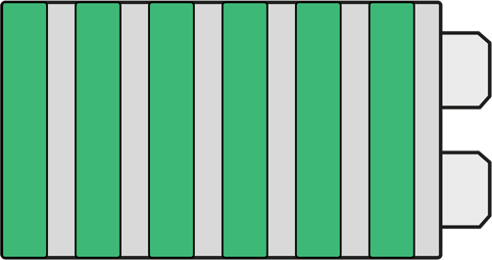

Cells and batteries
3. Battery design and performance
A battery is a group of cells connected in series (one after the other) to create a higher voltage.
Give
examples of
where else you might find a battery rather than a cell and explain why.
Can you name some common cell types used to make up battery packs?
A cordless tool battery contains lithium cells.
9 V batteries contain six 1.5 V cells.
8
Notes:
Practitioner delivery suggestions
This Level 3 resource reviews learners’ understanding of how cells can be connected in series and parallel before combining both approaches to create battery arrays and investigate internal resistance. Learners apply their understanding to design battery arrays for the battery modules and pack for an EV, before considering some safety considerations around EV energy storage.
Starter activity
Ask learners to consider a 9 V battery and cordless tool battery and review the questions on the slide.
Remind learners that the voltage between a cell’s cathode and anode is dependent on them being different metals (some learners may be able to relate this to the metals’ relative positions in a reactivity series. Can learners apply this understanding to their ideas?
Example answers
You might find a battery where a device needs a high voltage to operate, for example to produce a brighter light or to drive a more powerful motor. Connecting cells in series to form a battery is the most effective way to produce this higher voltage, rather than trying to create different cell chemistries that produce different voltages. (As learners will also discover, adding cells in parallel increases the capacity of the battery, which prolongs the operating time of the device.)
Common cells used to create batteries include AA or AAA alkaline or NiMH (rechargeable) cells and 18650 Lithium cells.
Assessment
Discussion.
Verbal answers.
Extension
Learners can do an image search for open 9 V batteries to view how cells are arranged inside.

Slide 9

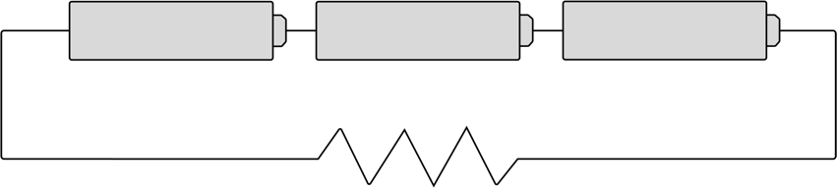
Understanding cells in series
3. Battery design and performance
9
What is the total
voltage across the three cells before they are connected to the resistor?
Using V=IR, what current would you expect to flow through the resistor?
When measured, the current through the resistor is 0.39 A.
Using V=IR, what voltage would you expect to measure across the
10 Ω load resistor?
What is the internal resistance within each cell?
Three AA cells have been connected in series. Their voltages are added while their overall capacity is the same as a single cell.
1.5 V
1.5 V
1.5 V
10 𝛀
9
Notes:
Practitioner delivery suggestions
This activity reviews learners’ understanding of connecting cells in series. You may wish to use circuit sets to include a practical element. The activity introduces the concept of a cell’s internal resistance.
Activity
Review the circuit: three cells are connected in series with a load resistor. Point out that while in everyday language people will talk about 'AA batteries' this is incorrect. Each one contains a single anode and cathode and so is an AA cell.
You may wish to review that voltmeters are connected in parallel across part of a circuit, while ammeters are connected in series within the circuit.
Learners work through the questions on the slide and activity sheet.
Review the answers below. The lower than expected current suggests that there is another source of resistance in the circuit. This reduces the current and therefore the voltage across the load resistor. This is the cells’ internal resistance.
Learners will calculate internal resistance later in this resource, but you may wish to discuss possible calculation strategies.
Activity sheet
Learners complete their calculations on Battery technologies - Activity sheet 5: section 5a.
Example answers
Please see the slide that follows.
Assessment
Written answers and discussion.

Slide 10
Understanding cells in series – answers
3. Battery design and performance
10
The expected total voltage
before the circuit is complete would be 4.5 V.
Using V=IR the expected current is
4.5 V = 0.45 A.
10 Ω
With a current of 0.39 A the voltage across the load resistor would be 0.39 x 10 = 3.9 V.
4.5 V = total resistance of 11.53 Ω.
0.39 A
Subtracting the load resistance of
10 Ω from 11.53 Ω suggests that each cell has an internal resistance of 0.51 Ω (to 2dp).
1.5 V
1.5 V
1.5 V
10 𝛀
10
Notes:
Practitioner delivery suggestions
Activity
Review the answers on the slide.

Slide 11

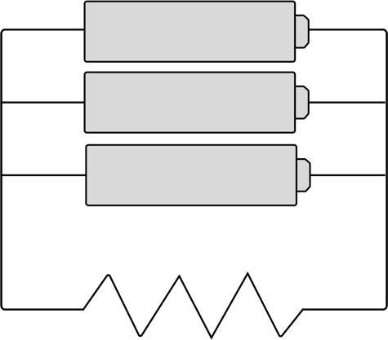
Understanding cells in parallel
3. Battery design and performance
11
What voltage would
you now expect to measure across the three cells connected in parallel before they are connected to the resistor?
The total resistance R_{T} of resistors connected in parallel is given by
1 1 1 1
R_{T} R₁ R₂ R₃
Using the value you calculated for each cell’s internal resistance, calculate the expected current through the 10 𝛀 load resistor and the voltage across it.
The three cells are instead connected in parallel. Their voltage is the
same as a single cell while their capacities are added.
1.5 V
1.5 V
= + + + …
1.5 V
10 𝛀
11
Notes:
Practitioner delivery suggestions
This activity reviews learners’ understanding of connecting cells in parallel.
Activity
Ask learners to describe how current flows around the new circuit on the slide.
Learners work through the questions on the slide and activity sheet.
Activity sheet
Learners complete their calculations on Battery technologies - Activity sheet 5: section 5b.
Example answers
Please see the next slide.
Assessment
Written answers and discussion.

Slide 12
Understanding cells in parallel – answers
3. Battery design and performance
12
The voltage across all three cells will
be 1.5 V.
Using the formula, the total resistance R of all three cells of resistance 0.51 Ω is given by
1 1 1 1 3
R_{T} 0.5 0.5 0.5 0.5
R_{T} = 0.5 = 0.166 Ω
3
The total resistance in the circuit is
10 Ω + 0.166 Ω = 10.166 Ω.
The expected current is 1.5/10.166 = 0.148 A and the voltage across the load resistor is 1.48 V.
1.5 V
1.5 V
= + + =
1.5 V
10 𝛀
12
Notes:
Practitioner delivery suggestions
Activity
Review the answers on the slide.

Slide 13
When does internal resistance matter?
3. Battery design and performance
The internal resistance of a cell or battery affects the current it can drive through a load.
Primary cells have relatively high internal resistance that increases during discharge.
Secondary cells have relatively low internal resistance that remains constant during discharge.
What can you say about how internal
resistance might matter in these scenarios?
An EV motor
A TV remote
A carbon monoxide monitor
A photography drone
A car jump starter
An Internet of Things (IoT) room sensor
13
Notes:
Practitioner delivery suggestions
Activity
Briefly review the information on the slide.
Learners suggest whether internal resistance is an important factor in each scenario.
Learners can relate their answers to the fact that secondary cells such as Li-ion have low internal resistance - this matches their applications for EV, drone and jump starter packs.
Example answers
EV motors, drones and car jump starters have high power requirements and since P=VI this suggests that these applications need batteries with low internal resistance. The other examples have a low power draw and so batteries or cells with higher internal resistance will suffice.
Assessment
Discussion and verbal answers.
Extension
Learners can research the current draw in EV motors, drones and car jump starters.

Slide 14

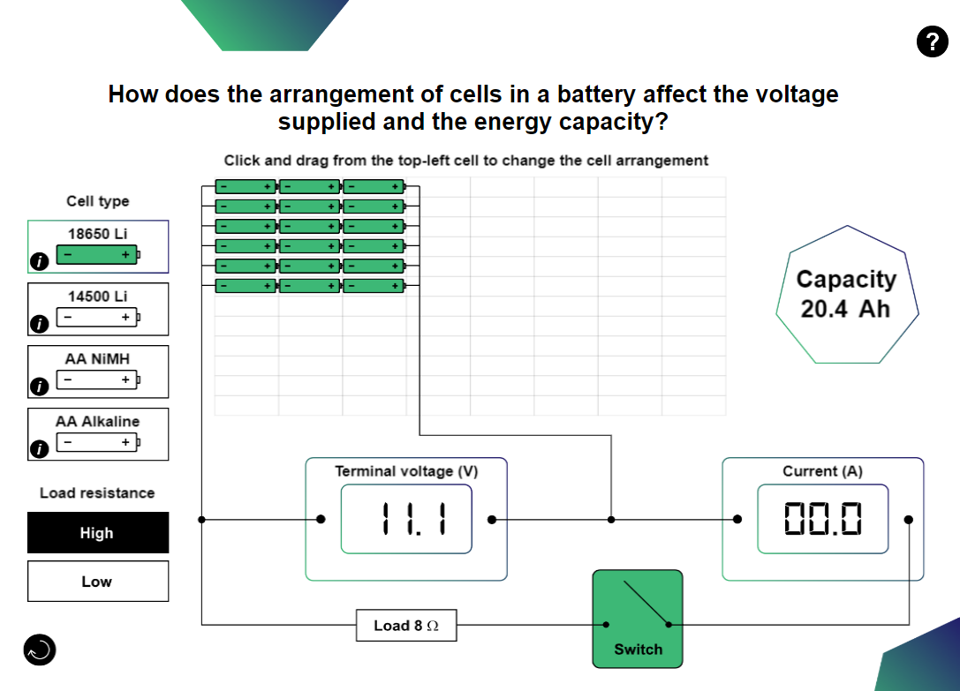
Understanding cells in an array
3. Battery design and performance
In which direction does adding cells increase the voltage?
In which direction does adding cells increase the storage capacity?
What happens to the terminal voltage when you close the switch to connect the load?
How does this effect vary as you add cells in series or in parallel?
How does this effect qualitatively vary depending on whether this is a high or low resistance load?
The Battery technologies interactive tool lets you select a cell type and then build an array of cells.
Explore how to create different arrays that give a desired combination of voltage and storage capacity.
14
Notes:
Practitioner delivery suggestions
This activity uses the Battery technologies interactive tool, for which learners will need internet access.
Activity
Introduce learners to the Battery technologies interactive tool and ensure they understand how to select a cell type and then expand or reduce their array in each direction.
Learners use the interactive tool to answer the questions on the slide.
Example answers
Increase the voltage by adding cells (or groups of cells in parallel) from left to right in series.
Increase the capacity by adding cells (or series of cells) from top to bottom in parallel.
The terminal voltage reduces when the switch is closed due to the internal resistance of the array. The effect becomes more pronounced as learners add cells in series. However, it will not appear to change if the array has few columns (cells in series). This is because the terminal voltage drop is greater when the internal resistance of the battery array is high relative to the load resistance, eg it is greater for low resistance loads. Adding columns to an array (cells in series) will increase the overall internal resistance, while adding rows will reduce it. Hence the change in terminal voltage will tend to be greater when an array includes more columns/cells in series (eg is higher voltage).
As learners will later notice, the meters in the interactive are only sensitive to 0.1 V which is insufficient to detect very small drops in terminal voltage.
Assessment
Discussion and verbal answers.

Slide 15
Designing battery arrays
3. Battery design and performance
In the interactive add eight alkaline cells in series.
Find the voltage when under load when the high load resistance is connected.
Use your result and the formula to calculate the internal resistance of all eight cells, and then divide by eight to find the internal resistance of one single cell.
Does your answer change if you use the low load resistance instead?
Use the interactive to design the following battery arrays. Calculate the average internal resistance
of each array under high and low loads. Suggest
a reason for any slight anomalies you find.
The internal resistance of a battery array is found using:
(
V_{NL}
(
R_{int} =
- 1
R_{L}
V_{UL}
V_{NL} is the no-load voltage
V_{UL} is the voltage under load
R_{L} is the load resistance
For example, three 1.5 V cells are connected in series with
a 5 Ω resistor. The voltage under load when connected is 4.02 V.
R_{int} = x 5 Ω = 0.119 x 5 Ω
R_{int} = 0.6 Ω for all three cells, which equates to 0.2 Ω per cell.
(
)
18650 cells | 14.8 V | 20.4 Ah
14500 cells | 22.2 V | 5.6 Ah
AA NiMH cells | 3.6 V | 7.2 Ah
AA Alkaline cells | 4.5 V | 5.0 Ah
4.50 V
4.02 V
-1
15
Notes:
Practitioner delivery suggestions
This activity uses the Battery technologies interactive tool, for which learners will need internet access.
Activity
Review the formula for calculating internal resistance. Help learners to relate this to the voltage information they can read from the interactive before and after they close the load switch.
Learners first use the interactive and the formula to calculate the internal resistance of one alkaline cell.
Add eight cells in series.
Write down the value of the voltage when under load when the high load resistance is connected.
Using the correct load resistance and voltage under load value, calculate the internal resistance of all eight cells, and then one single cell.
Learners use the briefing information to create suitable arrays using the interactive. They use the formula and the value for the load resistance (using high or low is OK) to calculate the internal resistance of each array.
Example answers
Please see the next slide.
Assessment
Calculations.
Discussion.

Slide 16
Designing battery arrays - answers
3. Battery design and performance
For eight AA alkaline cells in series:
R_{int} = x 8 Ω
= 0.25 x 8 Ω​
​
​ = 2 Ω for eight cells,
which is 250 mΩ per AA alkaline cell.​
As expected, the result is the same when calculated using the low resistance load.
Cell type | Cells in array (series x parallel) | Average total internal resistance
18650 Li | 4 x 6 | 55 mΩ
14500 Li | 6 x 7 | 69 mΩ
AA NiMH | 3 x 4 | 29 mΩ
AA Alkaline | 3 x 2 | 37 mΩ
Discuss whether or not you
think it makes sense to build very large single arrays of cells.
What alternative approach could make managing large quantities of cells more efficient?
What other factors might an engineer consider when designing large battery arrays?
What might happen to an array’s output if one cell fails?
(
)
12.0 V
9.6 V
-1
Any differences between the high and low load resistance answers for internal resistance are rounding errors introduced by the resolution of the meters, which are limited to 1dp. It’s important to always test using the correct range and sufficient resolution.
16
Notes:
Practitioner delivery suggestions
Activity
Review the answers on the slide.
In groups, learners consider the questions then discuss as a class.
Example answers
It does not make sense to build arrays too large because the complexity makes failure points more likely.
One solution (which learners will explore next) is to build arrays into modules that are then connected into packs. Modules can be replaced if they develop a fault and are of a more manageable scale to fault-find and repair.
Battery arrays store energy and the main issues are to do with safe energy management: cooling, to avoid battery overheating which can lead to electrolyte leaks or explosions, and electrical safety around very high stored charge, voltages and currents. Encasing battery modules and packs to make them safe also enables them to play a structural role in EV chassis design.
If one cell fails in an array this will ‘knock out’ one set of cells in parallel. The user will see the capacity of the array drop, but not the voltage. If the array construction permits, they would first identify which series of cells is shorted and then which cell is the cause of the problem.
Assessment
Calculations.
Discussion and verbal answers.

Slide 17




How is an EV battery pack organised?
3. Battery design and performance
An EV battery contains individual cells connected in battery modules,
which are then connected to form battery packs. These packs increasingly
play a structural role in the chassis design of EVs.
Discuss what you think an
EV’s range and power requirements suggest about the voltage and current a pack must provide, and as a result, how the cells are arranged in series and parallel.
What can you say about the desirable internal resistance, given that the motor requires a high current?
Use the information on activity sheet 6 to estimate how many 18650 cells are in a typical EV battery pack, the pack’s total energy capacity and what the cells might weigh.
Cell
Module
Pack
The battery packs use high-quality common
Li-ion cells such as the 18650:
Nominal voltage 3.7 V
Capacity 3400 mAh
Cells are arranged in series and parallel arrays within a battery module to meet a desired voltage and capacity specification.
Modules are connected to provide a desired total voltage and capacity.
The pack must deliver high power to the drivetrain and have a long range.
17
Notes:
Practitioner delivery suggestions
Activity
Review how cells are organised to form EV battery modules and packs. Help learners relate this organisation to their learning about designing battery arrays.
Discuss the questions as a class.
Review the information on the activity sheet. Learners complete the calculations to plan the battery pack for an EV.
Learners should remember to convert from Ah to Wh by multiplying the cell/module/pack capacity in Ah by the total voltage V.
Activity sheet
Learners complete their calculations on Battery technologies - Activity sheet 6.
Example answers
Range requires high capacity, which requires many cells in parallel.
Power requires high voltage, which requires many cells in series.
High power suggests that a low internal resistance (as provided by secondary cells like Li-ion) is desirable.
Learners will calculate the total number of 18650 cells their EV pack will contain.
Please also see the next slide.
Assessment
Discussion and verbal answers.
Written calculations.
Extension
Learners can research EV battery packs using online resource and image searches.

Slide 18
How is an EV battery pack organised? Answers
3. Battery design and performance
Module
Pack
First, calculate how many 3.7V cells in series deliver 22.2V:
22.2 V = 6 cells in series deliver the required voltage.
3.7 V
First calculate how many packs are needed to deliver at
least 350 V and then multiply to find the number of cells:
350V = 15.76, which rounded up gives 16 modules.
22.2V
16 x 450 cells per module = 7,200 cells in the pack.
To find the total energy capacity:
16 packs x 22.2 V = 355.2 V
Since each module has a capacity of 255 Ah:
355.2 V x 255 Ah = 90,576 Wh
= 90.6 kWh per pack
Finally, calculate the weight of the cells:
16 packs x 450 cells x 0.05 kg = 360 kg of cells per pack.
Then calculate how much power capacity these six cells provide:
3400mAh = 3.4Ah 3.4Ah x 22.2V = 75.48Wh
This lets us calculate how many rows of six cells provide the required 5.6kWh (5600Wh) total capacity:
5600Wh = 74.19 rows, which we round up to 75 rows of cells.
75.48Wh
We finally multiply these together to find the total number of cells in one module:
75 rows x 6 cells = 450 cells in one module.
18
Notes:
Practitioner delivery suggestions
Activity
Review the answer calculations on the slide.
Explain to learners that as of mid-2022 there are an estimated 477,000 pure electric vehicles on UK roads (there are also about 790,000 plug-in hybrids.)
Ask learners to discuss and estimate, based on 7,200 cells per EV: approximately how many cells do these 477,000 EVs contain?
Example answers
The EVs contain about 3.43 billion cells. Relate this to the pressing need to improve how secondary cells can be reused and recycled (learners explore this in the Level 2 resource, 1. Introducing battery technologies, in this module).
Assessment
Calculations.
Discussion and verbal answers.

Slide 19
Safety and electric vehicles
3. Battery design and performance
What tests do you think must be
carried out on an EV's battery pack to ensure the vehicle is safe to drive?
What safety precautions do you think
a maintenance engineer must take when inspecting or maintaining an EV’s battery pack or powertrain?
19
Notes:
Practitioner delivery suggestions
This final activity explores some safety implications of EVs and battery packs and creates links to the Electrification Skills Framework (warwick.ac.uk/newsandevents/pressreleases/new_national_electrification/).
Activity
Discuss what tests might need to be carried out to certify that a battery pack design is safe for on the road. What potential accidents might happen, for which protection needs to be provided?
Example answers
Tests include leak/corrosion resistance, impact resistance, immersion, electrical insulation.
Safety precautions might include locking away the keys so the vehicle cannot be started, wearing suitable PPE for a high-voltage environment, following the manufacturer’s instructions for disabling or disconnecting high-voltage cables and safe discharge of any charged components, and for safely reconnecting and testing the system before starting the vehicle.
Assessment
Discussion.
Verbal answers.
Extension
Learners can research careers and qualifications in EV maintenance and repair using the link from the Electrification Skills Framework page (warwick.ac.uk/newsandevents/pressreleases/new_national_electrification/).

Slide 20
Learning outcomes
3. Battery design and performance
You will be able to:
Calculate the internal resistance of a battery and predict its effect on battery performance when connected to high and
low resistance loads.
Apply your
understanding to consider an electric vehicle (EV) battery pack design and identify important safety considerations.
Make calculations for cells in series, parallel and in an array.
20

