Slide 1
Robotics
1. Introducing robotics

Slide 2
2. Introducing robotics
2

Slide 3


Learning outcomes
1. Introducing robotics
You will be able to:
Identify some
advantages and disadvantages of robotics and suggest how future innovations in robotics might overcome one
or more limitations.
Understand a definition
of robotics and suggest some examples of industrial robots.
Describe what robots need to work and how they move.
Image © This Is Engineering
3

Slide 4




What is a robot?
1. Introducing robotics
4
When you think of a robot, what do you imagine, and why?
Sketch and label how you imagine
a robot.
Share and explain your sketch.
Discuss why you chose this type of robot.
Then, share a definition of a robot - try to think like an engineer.
4

Slide 5

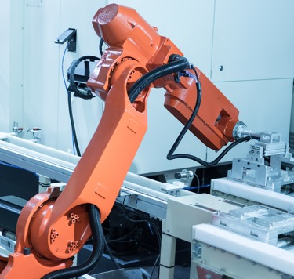
Robots replace human effort
1. Introducing robotics
A robot is a programmable machine that can carry out complex actions with speed and precision and without the need for human intervention.
What complex actions might
this robot carry out?
What programming might this
robot require?
Why do speed and precision matter
in industry?
How might this robot avoid the need for human intervention?
5

Slide 6

What do robots need to work?
1. Introducing robotics
Robots can replace human effort through, for example:
Complex actions:
Lift, move and manipulate an object or tool.
Mill a shape from a block of material.
Programming:
Sequence of movements.
Decisions depending on inputs.
Safety responses.
Speed is important for productivity.
Precision is important for quality and functionality.
Human intervention can be limited by effective programming
and use of input sensors that enable the robot to respond to
‘most likely’ scenarios, for example to sense that the object
to be worked on is in the correct position, that the tool is correct
and calibrated, that the machine is safe etc.
Industrial robots move, manipulate and process pieces of work. They need to obtain and process information about their position, state and environment.
What features would
allow the robot to move, manipulate, process an object and obtain information about its position, state and environment?
6

Slide 7

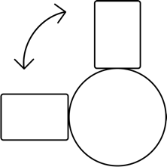

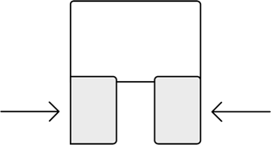
What do robots need to work?
1. Introducing robotics
Robots can replace human effort through, for example:
Actuators for movement
Sensors for information
Examples:
Position
Angle
Proximity or touch
Force
Vision
End effectors for manipulation and processing
Examples:
Tool holder (gripper, paint, weld, drill, mill)
Gripper
Pin
Suction
Imagine you
are a production engineer considering robotic automation. List some advantages and limitations you might identify.
Examples:
Linear
Rotational
7

Slide 8
Advantages and limitations of robotics
1. Introducing robotics
In terms of human
abilities, what weaknesses can robotics successfully replace or improve, and what strengths do robotics currently fail to replace?
Discuss what innovations you think will help robotics to replace or improve these human strengths.
Advantages
Fast
Tireless
Accurate
Consistent
Can work in hazardous
environments
Limitations
Expensive
Complex
Employee safety
Limited decision-making
Limited dexterity
8

Slide 9
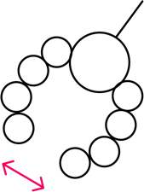
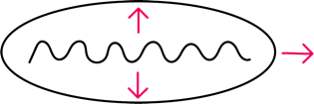
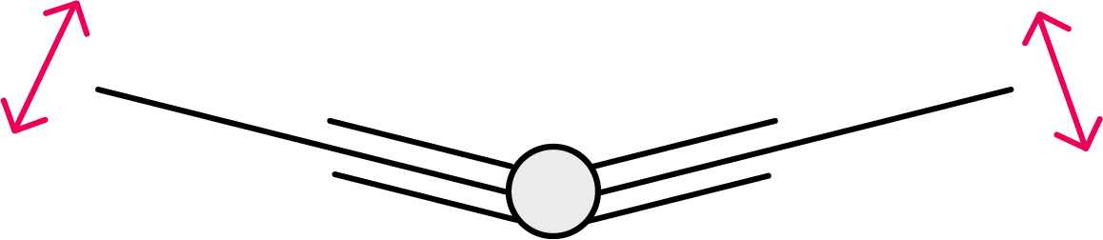
Emerging technologies, innovations and impacts
1. Introducing robotics
Discuss
how each of these innovations might have a useful industrial application.
Soft robot
Inflatable silicone pouches expand with air then contract
so soft ‘limbs’ move and grip.
Swimming robot
Sequential actuators ‘undulate’ wings, like how a cuttlefish swims and can move on land.
Flying robot
Electrostatic ‘muscles’
contract and relax when stimulated. A high-frequency signal enables rapid ‘flapping’.
9

Slide 10

Careers and robotics
1. Introducing robotics
Design engineer
Creates the overall
design solution for
a robotics task.
Electromechanical engineer
Designs how the robot will use sensors, actuators and end effectors.
Mechanical
engineer
Designs the moving
parts of the robot.
Software engineer
Writes the software
and algorithms for the
control systems.
Automation
engineer
Plans, implements
and monitors factory automation.
Sales engineer
Helps clients
choose the right
robotics product
for their needs.
10

Slide 11

Design a future robot
1. Introducing robotics
We can only engineer what we imagine. When we reimagine what
a robot can look like, we create new possibilities.
Design a future robot that overcomes
one limitation you identified.
Identify what your robot needs to do, how it might sense its environment and how it will move and manipulate things.
Include one of the innovations you’ve seen, or ideas of your own.
How does this reimagine what an industrial robot
can be?
How might your robot incorporate AI?
Image © This Is Engineering
11

