Slide 1
CNC
machinery
3. Programming CNC machines

Slide 2
Practitioner guide
3. Programming CNC machines
2

Slide 3

Introduction and overview
3. Programming CNC machines | Practitioner guide
These resources help practitioners to deliver the CNC machinery components of engineering and manufacturing-related qualifications at levels 2 and 3. They introduce the topic and stimulate learners to explore and reflect on key concepts and are designed to complement and enhance practitioners’ own lesson materials and schemes of work.
Resources summary
Prerequisites – it is recommended that learners complete 1. Understanding CNC machines and 2. Using CNC machines before starting this resource. There are no other required prerequisites but the Level 2 resource in the Microcontroller systems module introduces learners to the concept of control systems, which is mentioned in these resources.
Resource name | Level | PPT slides + notes - practitioner | PPT slides - learner | Activity sheets | Film | Interactive
3. Programming CNC machines | 3 |  |  | 2
Delivery
Delivery suggestions for practitioners, and suggested answers where appropriate, are in the presenter’s notes for each slide. The core activities in each resource provide around 60 mins learning time, though additional suggestions, including independent learning, can extend this time significantly.
Overarching theme/big questions
How can CNC machines help us work faster and smarter?
What is the future for CNC machines?
Overview
The Level 2 resource introduces definitions for CAD, CAM and CNC, and common types of CNC machine. It helps learners to identify advantages of CNC and where manual machining may still be preferable.
The Level 3 resources help learners to select a CNC machine to use and identify wider considerations when selecting CNC machines, reflect on important safe working practices, follow and optimise simple G-code, consider some advantages of indexed and continuous multi-axis CNC. They also reflect on how additive CNC may work alongside other technologies in ‘smart factories’ and how these developments may shape their career.
3

Slide 4
Learning outcomes and resource links
3. Programming CNC machines | Practitioner guide
Level 3 resource 2
Programming CNC machines
List the main G-code instructions and explain their functions.
Use G-code to define how a CNC machine could cut a shape into a sheet of material.
Suggest improvements that help a CNC operation be
more efficient.
Identify some advantages of multi-axis CNC machines.
Full resource list available for the topic of
CNC machinery:
1. Understanding CNC machines (Level 2)
2. Using CNC machines (Level 3)
3. Programming CNC machines (Level 3)
4. The future of CNC (Level 3)
Links to other supported topics
Innovation and emerging technologies,
Microcontroller systems, Robotics.
4

Slide 5
Subject coverage
3. Programming CNC machines | Practitioner guide
CNC machines
Principles of how CNC and G-code work
Aspects to consider when setting up and
operating CNC including safety and efficiency
Multi-axis CNC
Maths
Cartesian coordinates in X, Y and Z
Including careers
Careers with CNC
5

Slide 6
CNC
machinery
3. Programming CNC machines
6

Slide 7
Learning outcomes
3. Programming CNC machines
You will be able to:
List the main G-code instructions and explain their functions.
Suggest
improvements
that help a CNC
operation to be
more efficient.
Use G-code to define how a CNC machine could cut a shape into a sheet of material.
Identify some
advantages of multi-axis CNC machines.
7

Slide 8
G-code tells CNC machines what to do
3. Programming CNC machines
A setup checklist includes asking whether the correct instructions are loaded in the CNC
machine. These instructions are written in G-code (or CAD software generates the code).
G-code tells the machine how to move the chosen tool, for example in the X, Y and Z dimensions.
G90 Absolute coordinates
G91 Relative coordinates
G20 Inches
G21 Millimetres
G17 Move in the XY plane
Some G-code defines how the CNC machine should interpret the rest of the code:
M Motor controls, eg on, off
S Spindle speed in RPM
F Feed rate in mm/min
Other codes define other operating parameters:
G00 Fast move to a coordinate
G01 Linear movement
G02 Clockwise circular
G03 Anticlockwise circular
The G-code that then follows instructs the CNC machine how to move the tool:
8
Notes:
Practitioner delivery notes
This resource introduces learners to the basic instructions and syntax of G-code. Learners are introduced to the basic instruction set and use this to sketch a shape on paper, visualising how each instruction will make the tool move. Learners progress to using the CNC machines online interactive tool to reorder G-code to correctly machine a shape in one of three orientations. Learners then optimise a short section of G-code to improve its efficiency and avoid safety issues. Finally, learners consider some advantages of multi-axis machining and identify some specific advantages of the main types of 5-axis CNC.
The activity sheets for this resource include a G-code reference sheet of all G-codes used in the activities. We recommend that you do not hand out this sheet until after the G-code related activities, unless learners need additional support.
Activity
Introduce G-code and explain that it is a generic instruction code that can be used on any CNC machine.
Ask if learners can suggest what the G stands for (geometry)
Ask learners to discuss and then share some examples of the kind of instruction they think a CNC machine might need to have.
Review the types of G-code instruction on the slide (note that for simplicity % and O program codes are omitted).
Vocabulary:
Absolute movement - movement that uses a fixed set of coordinates with an origin that stays in one place
Relative movement - movement that uses the tool’s current position as the origin for its next movement
Feed rate - the speed at which the tool head moves
Interpolation - automatically calculating intermediate steps or positions between a starting and finishing position
You may wish or need to discuss and define absolute v relative movement, perhaps using your board or a volunteer learner to illustrate.
Learners could suggest what G18 and G19 (not included in the table on the slide) might define (note that they relate to other planes of movement).
Discuss why different spindle and feed rate speeds might be required.
When discussing the main G00 - G03 codes explain how these movements are interpolated. That is, the machine uses software to interpret how to move from the start to end position. Can learners think of any times when the operator might need to define how a tool moves, instead of allowing the machine to interpolate this? Note that G02 and G03 are not rotations but arcs around a pivot point, which needs to be defined.
Example answers
A CNC machine might need direction and speed instructions to move the tool head, position it at the correct depth in the material, and for the tool to rotate at the right speed for the material and job.
G18 and G19 define movement in the XZ and YZ planes respectively.
Different spindle and feed rate speeds are required to suit the properties of different materials (eg hardness, melting point).
An operator might define a movement to prevent an interpolated path from intersecting with (hitting) a feature on the part being machined, for example a protrusion. However, modern CNC software can usually avoid such issues.
Assessment
Discussion and verbal answers.
Learners have basic understanding of what is required to write a code for CNC – material properties, tools, order of cutting as well as understanding of what is required for the CNC machine to work safely – dimensions of the piece to be cut, cut speed for material, tool properties.
Extension
In pairs, learners could give each other instructions for relative and absolute movement to avoid obstacles in your classroom, using fractions of a turn and steps as units.

Slide 9


Interpreting G-code
3. Programming CNC machines
G90
G21
M03 S1000 F100
G00 X1 Y4
G01 Z-5
G01 X2 Y2
G01 X7 Y2
G01 X8 Y4
G01 Z5
G00 X2 Y5
G01 Z-5
G01 X2 Y7
G01 X4 Y7
G01 X4 Y5
G01 X2 Y5
G01 Z5
G00 X5 Y5
G01 Z-5
G01 X5 Y7
G01 X7 Y7
G01 X7 Y5
G01 X5 Y5
G01 Z5
M05
Interpret this G-code to draw a shape on your activity sheet.
Inspect the code to identify:
Are you using relative or absolute coordinates?
What units are you working in?
Which codes do you think start and stop the spindle motor?
How fast is the spindle spinning?
How fast will the tool move through the material?
Which G-code sets the depth of the cut and how deep is this?
Which G-code stops the tool from cutting in between parts of the shape?
9
Notes:
Practitioner delivery notes
Activity
Learners review the example G-code and discuss the questions on the slide to structure an examination of it.
Learners then use the code to draw on the coordinate grid on the activity sheet. Encourage learners to visualise how each line of code will move the machine tool.
Activity sheet
Learners draw their shapes on CNC machinery - Activity sheet 5.
Example answers
The first three lines instruct the machine as follows:
G90 - use absolute coordinates
G21 - use metric (millimetres)
M03 S1000 F100 - turn the motor on at a spindle speed of 1000 RPM and a feed speed through the material of 100 mm per minute.
Please also see the next slide.
Assessment
Written work – look for precision and accuracy using the grid.
Discussion and verbal answers to questions.

Slide 10
Interpreting G-code – answers
3. Programming CNC machines
The instructions use absolute coordinates (G90)
in millimetres (mm) (G21).
M03 starts and M05 stops the spindle motor.
S1000 sets the spindle speed at 1000 RPM.
F100 sets the feed rate at 100 mm/min.
G01 Z-5 sets the cutting depth at 5mm.
G01 Z5 raises the tool again to stop the tool
from cutting in between parts of the shape.
8
7
6
5
Y axis
4
Real G-code starts
and ends with a % symbol and includes an O program
number, e.g. O12345.
Since each line of G-code follows the last, it is important to ensure that G-code is written in the right order. A single instruction in the wrong place will mean the rest of the shape
is cut incorrectly.
Discuss what safety or production problems incorrect
G-code might cause.
3
2
1
0
0
1
2
3
4
5
6
7
8
9
10
X axis
10
Notes:
Practitioner delivery notes
Activity
Review the correct shape and answers to the discussion questions.
Note that the examples in this resource omit (for space) two important parts of G-code: the % that signifies the start and end of code, and the O-code that gives the name of the program - important knowledge when completing a setup checklist.
Discuss what problems code in the wrong order might create.
Example answers
Incorrect G-code will result in the wrong shape, cuts made to finished areas of the part, or potential tool collisions (most machines have fail-safes to prevent this).
Extension
Learners can write their own simple code for a partner to draw a shape on the coordinate grid.

Slide 11

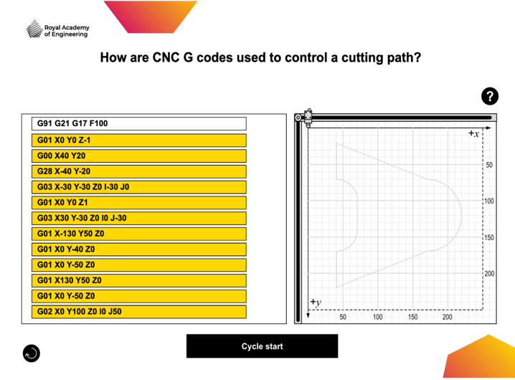
Organise the G-code for correct operation
3. Programming CNC machines
The CNC machinery online interactive tool challenges you to organise the lines of G-code
into their correct order. You will see one of three randomised shapes and sets of code.
1. Click to hold and drag the lines of G-code.
As you explore
the code:
identify what each part of the G02 or G03 command instructs the machine to do.
what do you think the G28 command means?
2. Use the grey outline to help you
reorder the G-code. Look carefully to place the codes for straight lines in the right places. One is shorter than it looks!
3. Press ‘Cycle start’ to test your code. The machine will create a black line as
it cuts. When running, this button becomes 'Abort cycle'. Press
to stop the run if code is still out of order.
Press to restart with
a different shape.
11
Notes:
Practitioner delivery notes
Learners will need internet access to use the CNC machinery online interactive tool.
Activity
Review how to use the online interactive tool.
Note how the shape to be cut is always the same, but in three different orientations.
Can learners explain why the interactive does this?
Learners can click on the reset button (bottom left) to reload a new orientation.
Note that for reasons of space certain codes (the %, O program name, M, and S codes) are omitted.
The code includes G02 and G03 which learners did not need to use in the paper activity. Identify some lines with G02 and G03 and discuss what each part might mean.
Learners use the interactive, testing their code and restarting if cutting goes awry or a warning appears.
Example answers
The shape can be drawn in different orientations as this reflects how an operator might set up work to make best use of a sheet of material when producing many parts - this is important for speed, cost and sustainability.
Please also see the next slide.
Assessment
Ability to reorder code correctly and interpret G02 and G03 code lines.

Slide 12
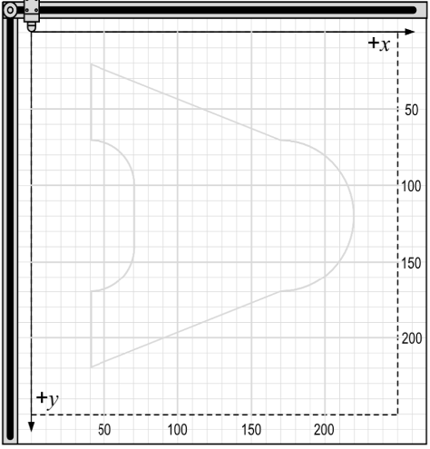
Organise the G-code for correct operation
3. Programming CNC machines
J0
G02
Y0
I50
X100
G02
Like any G-code movement command,
a G02 or G03 circular movement starts
at the current position of the tool.
G28 instructs the CNC machine to return the tool to its home position.
I50 J0
The command defines the end point of the circular movement. Using G91 this
is relative to the starting point but in G90 this would be an absolute coordinate.
X100 Y0
The pivot point is always defined relative to the starting point, using I and J coordinates.
12
Notes:
Practitioner delivery notes
Activity
Discuss learners’ experiences when using the interactive tool. What mistakes did any lines placed in the wrong order create? (These tend to be of three sorts - an incorrect shape, the tool being programmed to move out of the working area of the machine, or the tool rapidly moving through material, risking a breakage.)
Review the syntax and correct interpretation for G02 and G03 (note that an alternative G-code syntax uses R to define radius, but the I and J syntax used in the interactive lets learners check the start and end point more easily).
G02 starts the curve at the current position of the tool
The code then specifies the end point, which can be any point around the circumference of the circle
The code finally defines the centre of the circle. Note that this uses the start point of the curve and so is a relative coordinate, even if the program is set at G90 to use absolute coordinates in general. I = relative position in the X direction, J = relative position in the Y direction.
Extension
Learners write G02 and G03 codes for a partner to copy to create a shape or line.

Slide 13
Optimising G-code for safety and efficiency
3. Programming CNC machines
A CNC programmer or operator has the responsibility to ensure the process is as safe and efficient as possible.
Sketch out the following G-code for a CNC router.
Discuss how you would correct any mistakes and/or
omissions to make the program more efficient.
G90
S1000 F100
G01 X2 Y1
G01 Z-5
G01 X6 Y1
G01 Z 5
G01 X4 Y4
G01 Z-5
G01 X6 Y1
G01 Z5
G01 X4 Y4
G01 X2 Y1
Things to think about:
What information is missing?
What information is repeated?
Can you improve the order?
13
Notes:
Practitioner delivery notes
This quick activity reviews learners’ basic understanding of G-code and what instructions are necessary to include.
Activity
Review the brief example code, which contains a number of mistakes or inefficient instructions.
Learners use the questions on the slide to help them to interpret the instructions and identify improvements.
Learners can use another copy of CNC machinery - Activity sheet 5 to sketch the code, or create their own sketch graphs on plain paper.
Learners discuss in pairs how they would improve and correct this code, then share as a class.
Example answers
Please see the next slide.
Extension
Learners could write their own ‘inefficient’ code for a partner to improve.

Slide 14
Optimising G-code for safety and efficiency – answer
3. Programming CNC machines
The G-code cuts a simple equilateral triangle.
G21 unit code needed
G90
G21
M03 S100 F100
G00 X2 Y1
G01 Z-5
G01 X6 Y1
G01 X4 Y4
G01 X2 Y1
G01 Z5
M05
Z instruction only needed once to set tool at working depth
M03 turns motor on
G00 takes tool to starting point without cutting
Cleaner, faster instructions
Z5 needed to raise tool
M05 turns motor off
14
Notes:
Practitioner delivery notes
Activity
Review the annotated, improved code on the slide.
Hand out the G-code reference sheet for learners' future use, if you have not already done so.
Extension
Several, more comprehensive, G-code reference sheets are available online, which learners can research.

Slide 15
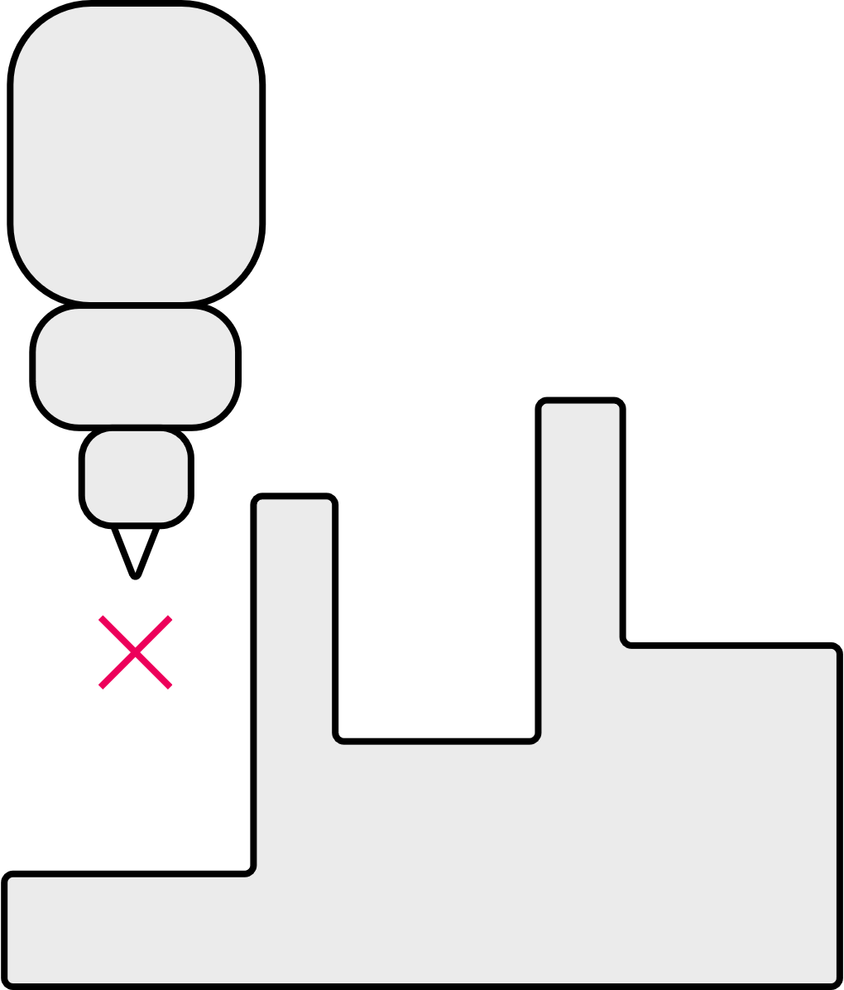
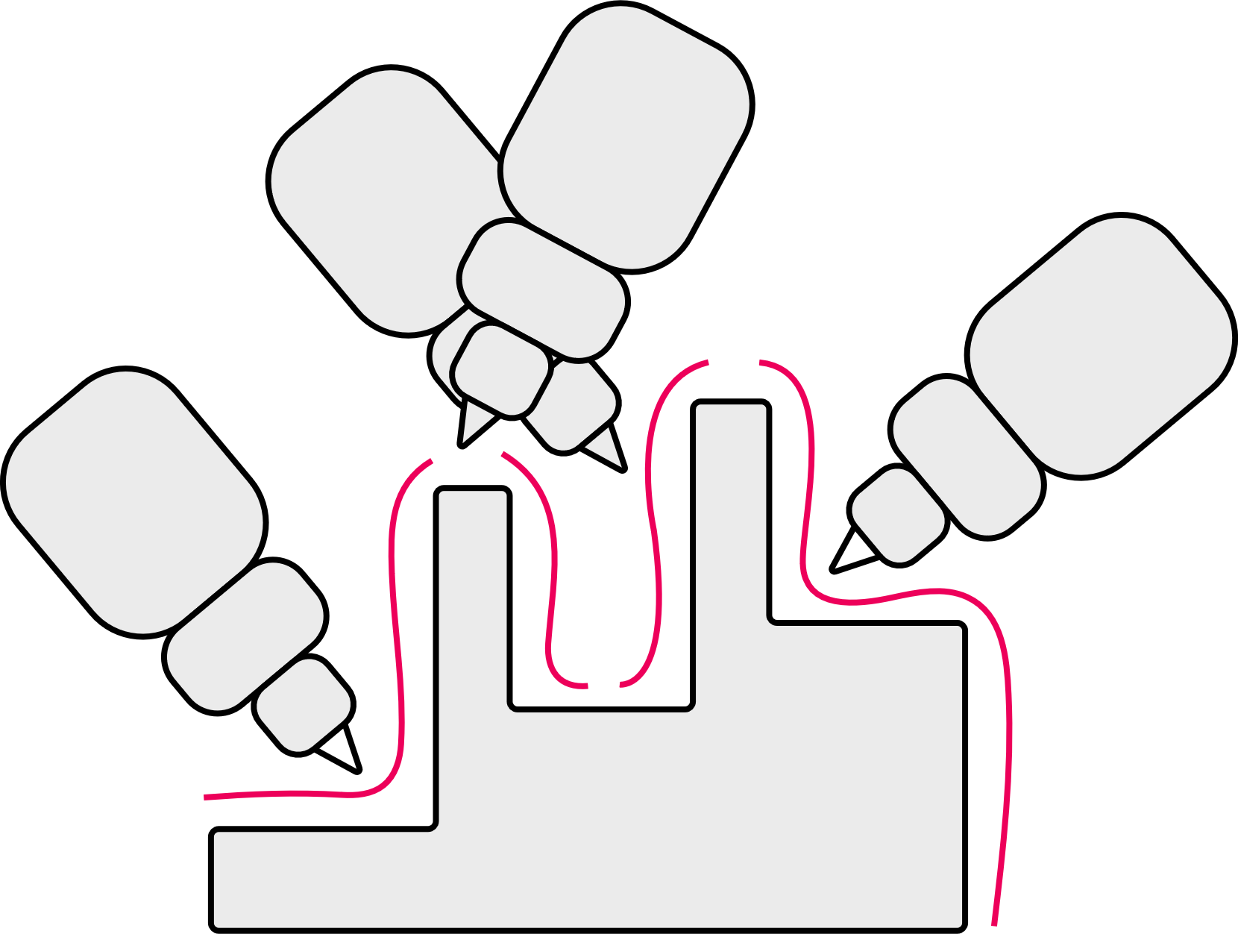

More axes overcome the limitations of three-axis CNC
3. Programming CNC machines
Three-axis CNC machines have limitations:
The tool is unable to form complex
parts with deep or narrow cavities,
or overhangs.
The part may therefore need to be repositioned to machine other faces, causing long machine times.
More axes of motion let the tool head complete more complex movements from different angles.
Indexed five-axis (three- plus two-axis) machines
rotate and tilt the part in between tool motions.
The part is machined in many short movements.
In continuous five-axis machines,
all axes can move at the same time.
The part is machined in fewer long movements.
Discuss what movements these two additional axes allow.
What parts of the CNC machine might move to create one or both of these additional axes of motion?
15
Notes:
Practitioner delivery notes
This final activity introduces learners to multi-axis CNC machines.
Activity
Explore the part cross-section on the slide, starting with the three-axis tool on the left. Discuss what limitations are caused by how the tool (and its mount) is always facing in the same direction. Can learners identify how the machine and tool would be unable to form this shape without changing the tool for other shapes? Highlight how such tool changes might increase cycle times and reduce productivity, or cause imperfections in the machined surfaces.
Use the centre and right-hand images to help learners to explore indexed and continuous -axis machining.
Highlight that with indexed machines, the part can be moved between tool motions. Hence this type of machine works through a series of alternating tool movements and part movements. While the diagram shows a stationary part, it’s more likely that the tool head will remain at the same orientation while the part is moved. This results in many short movements that can give rise to small imperfections, for example in a face that is machined in several movements.
With continuous machines, the tool and part can move at the same time allowing for longer, extended machining actions. This enables better surface finishes and working to more exact tolerances, as well as shorter overall machine cycles.
Example answers
Please see the next slide.
Extension
Learners can observe 3-axis CNC machines within your workshop to identify real examples of their limitations. This can also be demonstrated with a manual mill, lathe or pillar drill.

Slide 16

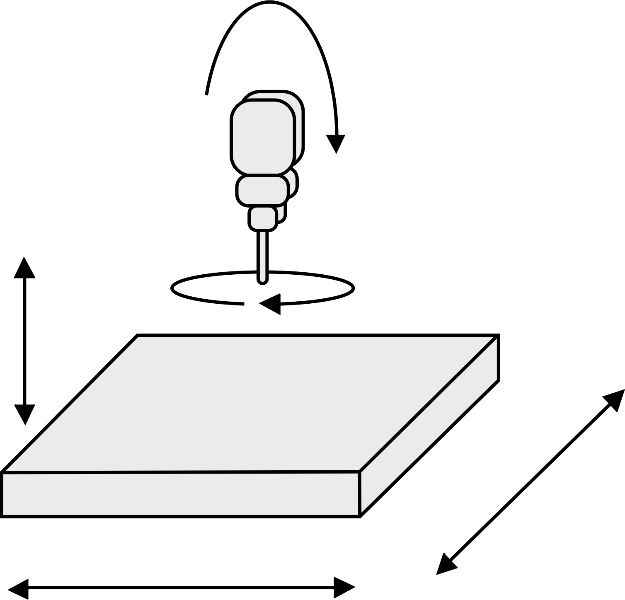
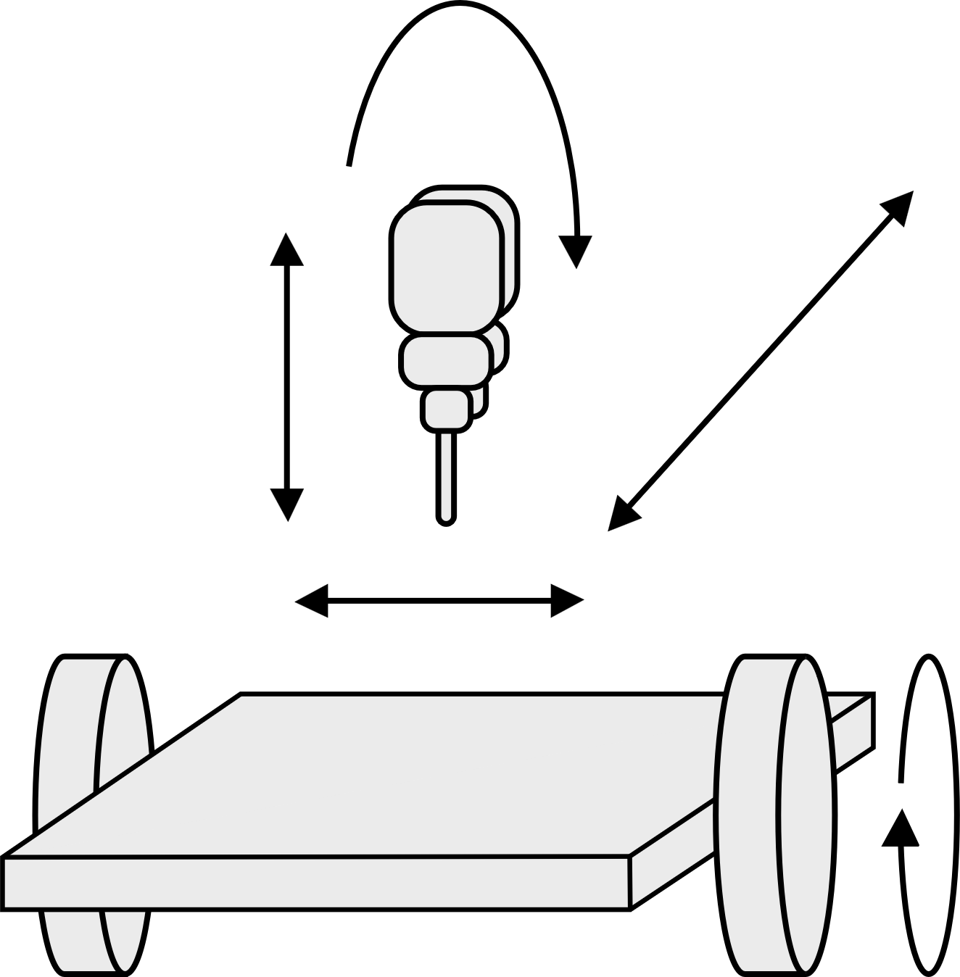
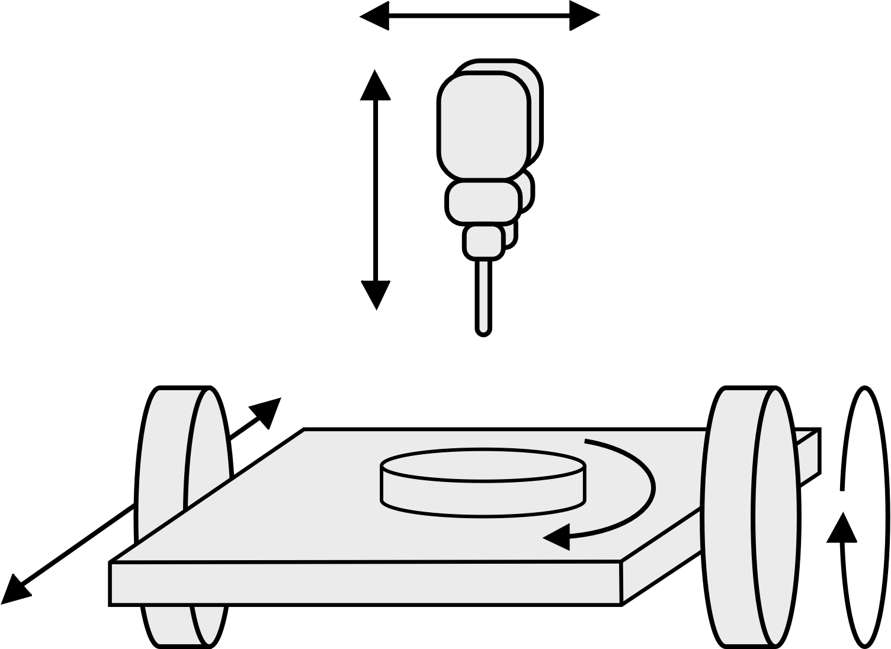
Table and head rotation in multi-axis CNC machines
3. Programming CNC machines
There are many types of multi-axis CNC machine, which may have up to nine axes of motion. They can be
broadly grouped by whether the table, head or both provide rotation. One approach is not better than the
others. The different configurations support a wide range of machining requirements and part dimensions.
Table/Table (trunnion) Head/Head (swivel head) Table/Head
X
B
B
Z
Y
C
Z
Z
X
Y
A
Y
A
C
X
C
Visualise how each type of five-axis CNC might move to machine a part.
Suggest some advantages of using each type of five-axis machine.
Then, list some broad advantages of multi-axis CNC machining.
16
Notes:
Practitioner delivery notes
Activity
Explain the main differences between the three types of movement. Note that:
‘A’ movements are rotations about the X axis
‘B’ movements are rotations about the Y axis coming out of the slide
‘C’ movements are rotations about the Z axis
Table/Table machines provide two axes of rotation via the table, while the head moves linearly in the XYZ axes.
Head/Head machines do the opposite: the tool head can rotate in two axes while the table moves in the XYZ axes.
Table/Head machines combine both approaches where the table and head can each rotate in one axis, while X, Y and Z rotations are also shared between the head and table.
Ask learners to discuss in groups some possible advantages of each of the three types, before completing the activity sheet.
Activity sheet
Learners list advantages on CNC machinery - Activity sheet 6.
Example answers
Please see the next slide.
Extension
Learners could write a short case study on the different types and/or undertake a product analysis comparing and contrasting the different multi-axis machines.

Slide 17
Advantages of multi-axis CNC machines – answers
3. Programming CNC machines
Table/Table | Head/Head and Table/Head | Multi-axis in general
Easy to visualise movements/actions during machining. Allows for heavy material removal. Allows full range of XYZ travel. Table tilts further – good for undercuts. | Can machine heavier parts. Very rigid set up for larger parts. More versatile. Can allow multiple vices so multiple pieces can be worked on. Standard tooling can be used as rotating head allows easier access. | Shorter cycle times. Greater accuracy. Less set-up time. Increased capability.
17
Notes:
Practitioner delivery notes
Activity
Review the suggested answers on the slide.

Slide 18
Learning outcomes
3. Programming CNC machines
You will be able to:
List the main G-code instructions and explain their functions.
Suggest
improvements
that help a CNC
operation to be
more efficient.
Use G-code to define how a CNC machine could cut a shape into a sheet of material.
Identify some
advantages of multi-axis CNC machines.
18

