Slide 1
Battery
technologies
2. Cell chemistry

Slide 2
2. Cell chemistry
2

Slide 3


Learning outcomes
2. Cell chemistry
You will be able to:
Describe the parts of
a basic electrical cell.
Describe how a
simple electrical cell produces electricity.
Identify how primary
and secondary cell discharge characteristics vary, linking this to
applications.
Analyse the energy density of different cell types and use this to explain their relative advantages.
Explain the difference between primary and secondary cells.
3

Slide 4



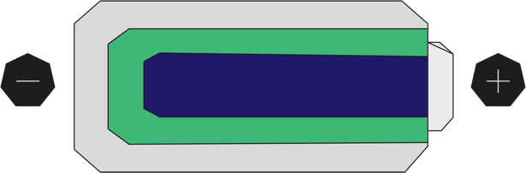
What happens in a cell?
2. Cell chemistry
4
A cell converts stored chemical energy into electrical energy.
Any simple cell includes a cathode, anode and electrolyte.
The cathode and anode are made of different metals, for example manganese and zinc.
The use of different metals creates a potential difference (voltage) across the cell.
The electrolyte is a solution or paste that can conduct electricity.
What happens
when a cell is connected in a complete circuit, for example, to an LED?
Given your answer, what do you think must happen inside the cell?
Can what happens inside the cell continue indefinitely, and what evidence supports your answer?
Anode
Cathode
Electrolyte
4

Slide 5
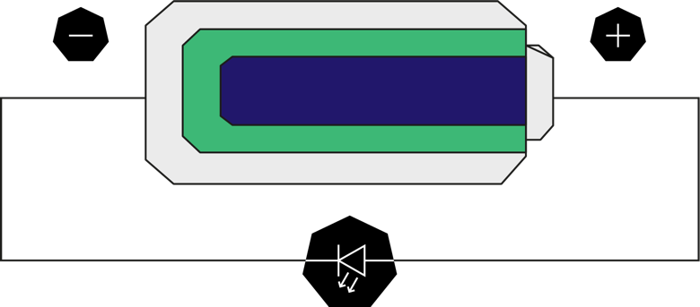
What happens in a cell?
2. Cell chemistry
5
When the cell is connected in a complete circuit a current flows through the wire and the LED lights up.
This means that the current must also flow within the cell. The electrolyte enables this to happen.
A reaction takes place within the cell between the anode and cathode, which releases the cell’s stored chemical energy. This reaction can’t continue indefinitely. The cell only works until the stored chemical energy is used up and the reaction stops.
5

Slide 6


Examples of cells
2. Cell chemistry
6
Zinc
Alkaline
Nickel metal
hydride (NiMH)
Nickel cadmium
(NiCad)
Lithium ion (Li)
Long life
NiCad
NiMH
Li
Which of these cell types are familiar to you?
Can you use your real-life experiences to divide them into two types of cell?
What difference explains your choices?
6

Slide 7
Primary v secondary cells
2. Cell chemistry
The difference is whether the cells are used once or can be recharged.
In any cell a voltage and electric current will be produced until the reaction can no longer continue. The cell is discharged.
When a zinc or alkaline cell is discharged it can’t be recharged: this is
a primary cell. A NiCad, NiMH or lithium ion cell can be recharged: this is a secondary cell.
Zinc or alkaline cells use one-way
chemical reactions to produce electricity. What kind of reaction do you think happens inside secondary cells?
What does it therefore mean to recharge a cell?
What energy source provides this ability to recharge?
7

Slide 8

Characteristics of primary v secondary cells
2. Cell chemistry
An engineer wants to know whether to use a lithium or alkaline cell to power
a handheld measurement device. They carry out an investigation to find out how each type of cell discharges over time. They connect each type of cell to an identical load and measure the voltage across the load every 10 minutes.
The table shows how each cell’s voltage declines over time. Note that this is as a percentage of the maximum value. The engineer knows that rechargeable cells can have a lower terminal voltage, for example rechargeable AA cells are 1.2 V instead of 1.5 V, which can limit certain uses.
Load voltage as % of maximum
Time mins | Lithium % | Alkaline %
10 | 98 | 95
20 | 96 | 82
30 | 92 | 70
40 | 89 | 58
50 | 86 | 45
60 | 82 | 33
70 | 74 | 18
80 | 0 | 0
Plot a line graph to compare how each cell discharges
over time.
Describe the difference and suggest how an engineer might use this information when selecting cells to power a device.
Would you use lithium or alkaline cells to power a TV remote or cordless drill? Justify your answers.
8

Slide 9

Characteristics of primary v secondary cells
2. Cell chemistry
The graph shows that lithium cells retain a much higher working voltage as they discharge, while alkaline cells lose voltage steadily.
Lithium cells are suitable for devices where it is important to always provide as close to the working voltage as possible, for example when powering a DC motor.
Alkaline cells are suitable for non-critical applications like a TV remote.
Lithium cells are more suitable for critical or motor applications like cordless drills, drones, electric vehicles (EVs) or autonomous guided vehicles.
Lithium
Alkaline
100
75
% of maximum Voltage
50
25
0
0 20 40 60 80
EV batteries need to output a consistent voltage
to maintain speed, but what cell factor will affect the
range of the vehicle?
How does this link to the overall design of the vehicle?
Time (mins)
9

Slide 10

Energy densities of secondary cells
2. Cell chemistry
A key innovation in secondary cells has been to increase their energy density, measured as the energy available
per unit of mass or volume.
This matters for EVs as better energy density delivers more range, and more energy-dense battery packs take up less volume within the car.
Lithium polymer
Lithium phosphate
250
200
Nickel cadmium
Lithium ion
150
Describe how the energy density
of lead acid, nickel metal hydride and lithium polymer cells differs.
Why do you think nickel metal hydride cells have replaced nickel cadmium cells?
In total, roughly how much more
energy-dense is a lithium polymer cell per litre, compared with a lead-acid cell?
Watt-hours/kilogram
Lead acid
100
Nickel metal hydride
50
0
0
50
100
150
200
250
300
350
400
450
Watt-hours/litre
10

Slide 11




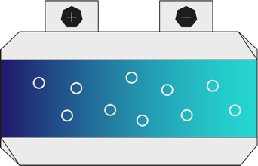
Case study: freeze-thaw cell chemistry
2. Cell chemistry
A new freeze-thaw cell technology may make long-term, seasonal energy storage possible.
The cell’s electrolyte is a type of salt that is liquid at 180 °C but solid at room temperature.
The cell is heated before being charged. When the cell cools the electrolyte solidifies, effectively ‘locking up’ the energy until needed. When needed, the cell is heated to allow
a current to flow.
The technology is at an early stage of development but in laboratory tests
a freeze-thaw cell has retained 92% of its capacity for three months.
What do you think happens to the electrolyte ions during the
freeze-thaw process?
How might this type of cell make renewable energy more available over seasonal periods
of time?
11

Slide 12
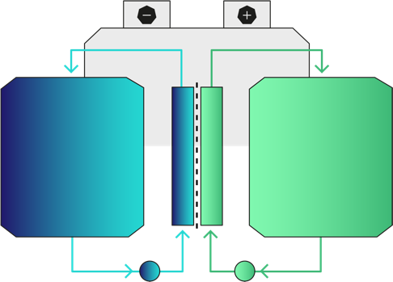
Case study: flow batteries
2. Cell chemistry
Flow batteries store energy in tanks of liquid electrolytes made of iron salts.
To store energy inside the cell, one electrolyte is pumped past a positive electrode, depositing iron, and the other past a negative electrode, gaining electrons. This can store large amounts of chemical energy over long periods.
To produce electricity, the direction of the pumps is reversed so the electrolytes flow in the reverse direction past the electrodes, producing a current.
These cells have low energy density but use much safer chemistry than lithium-ion cells. Because the energy is stored in the electrolyte, to increase a flow battery’s storage capacity, engineers just increase the size of the electrolyte storage.
Anolyte tank
Catholyte tank
What applications might benefit from this
form of energy storage?
Can you suggest how this concept might one day be adapted for electric vehicles?
Pump
Ion-selective membrane
12

Slide 13
New cell technologies and engineering
2. Cell chemistry
Henry
EV technician
I convert classic cars from petrol to EV systems.
Katrina
Maintenance engineer
I maintain the automated warehouse vehicles in a busy warehouse.
How might each engineer’s role be changed
as new cell technologies come to market?
Samira
Power engineer
I design the systems that respond to
short-term peaks
in demand.
Vicky
Recycling engineer
I develop new ways to recycle precious materials, including the rare earth metals used in modern secondary cells.
Jamal
Home renewables
I install home solar power generation and storage.
13

Slide 14
Learning outcomes
2. Cell chemistry
You will be able to:
Describe the parts of
a basic electrical cell.
Describe how a
simple electrical cell produces electricity.
Identify how primary
and secondary cell discharge characteristics vary, linking this to
applications.
Analyse the energy density of different cell types and use this to explain their relative advantages.
Explain the difference between primary and secondary cells.
14

