Slide 1
Microcontroller systems 4. Pulse width modulation

Slide 2
Practitioner guide 4. Pulse width modulation
2

Slide 3

Introduction and overview
4. Pulse width modulation | Practitioner guide
These resources help practitioners to deliver the microcontroller systems components of engineering and manufacturing-related qualifications at levels 2 and 3.. They introduce the topic and stimulate learners to explore and reflect on key concepts and are designed to complement and enhance practitioners’ own lesson materials and schemes of work.
Resources summary
Prerequisites – it is recommended that learners complete 1. Mechatronic systems and control, 2. Sensors and signals and 3. Understanding control processes before starting this resource.
Resource name | Level | PPT slides + notes – practitioner | PPT slides - learner | Activity sheets | Film | Interactive
4. Pulse with modulation | 3 |  |  | 2
Delivery
Delivery suggestions for practitioners, and suggested answers where appropriate, are in the presenter’s notes for each slide. The core activities in each resource provide around 60 mins learning time, though additional suggestions, including independent learning, can extend this time significantly.
Overarching theme/big questions
What is a mechatronics/automated system?
What is the role of programmable logic controllers (PLCs) in mechatronics?
Overview
The Level 2 resource provides a bridge between Level 2 and Level 3. It helps learners to understand the purpose and features of a mechatronic system, identify examples of mechatronic systems in a range of settings, describe in simple terms how the different components in a mechatronic system work together to control a process, and identify some differences between a microcontroller, PLC and microcomputer, suggesting suitable applications for each.
The Level 3 resources develop learners’ understanding of sensors and actuators before using a series of realistic but simple scenarios to provide an introduction to PLCs and PLC programming. We suggest that practitioners adapt the activities to suit the range of sensors, actuators and PLCs available in their place of learning or which relate to learners’ industrial placements. Practical extension suggestions enable learners to practise PLC programming using your preferred tool, software or simulator and to build a complete demonstration system.
3

Slide 4
Learning outcomes and resource links
4. Pulse width modulation | Practitioner guide
Level 3 resource 3
Pulse width modulation
Describe pulse width modulation (PWM).
Identify how PWM can control a range of devices including LEDs, DC motors and servo motors.
Make calculations to generate the right PWM signal to obtain desired results.
Full resource list available for the topic of Microcontroller systems:
1. Mechatronic systems and control (Level 2)
2. Sensors and actuators (Level 3)
3. Understanding control processes (Level 3)
4. Pulse width modulation (Level 3)
Links to other supported topics
Sustainability, Robotics, CNC machinery, Renewable energy, Electric machines.
4

Slide 5
Subject coverage
4. Pulse with modulation | Practitioner guide
Microcontrollers and PLCs
Mechatronics
Sensors and actuators in automation and control
Programmable Logic Controllers (PLCs)
PLC programming
Applications of PLCs
Control system theory
Pulse width modulation
Maths
Using formulas
Percentages
Averages
Patterns and relationships
Communicating
Mathematical diagrams
Including careers
How different engineering sectors use control and automation.
5

Slide 6

4. Pulse width modulation
6

Slide 7

Learning outcomes
You will be able to:
Describe pulse width modulation (PWM).
Identify how PWM can control a range of devices including LEDs, DC motors and servo motors.
Make calculations to generate the right PWM signal to obtain desired results.
Image © This Is Engineering
7

Slide 8

Microcontroller outputs
This CNC machine uses a microcontroller to operate the tool head rotation speed, vertical position and red/amber/green status indicator.
Discuss what output devices might operate each of these three functions?
How would the microcontroller need to change the state of each device?
What output signal might control these changes of state?
8
Notes:
Practitioner delivery notes
This Level 3 resource introduces how a microcontroller can use pulse width modulation (PWM) to control a variety of output devices. While the resource does not include programming, this can enable learners to effectively use the pwmout (PICAXE BASIC), analogWrite (Arduino C) commands or the Pulse Properties window in GENIE when undertaking a microcontroller design or programming project. Learners explore, in simple terms, how PWM works and how it can be used to control LEDs, other on/off devices, DC motors and servo motors in CNC machines or robots.
Activity
Introduce a simple 2-axis CNC machine such as a desktop mill. Explain that it uses a microcontroller to operate different elements of the machine including the tool head, position control and the status indicator.
Explain that the microcontroller has a different job to do in each case. This influences the output device chosen and the type of signal used to change the state of each device.
Learners discuss the questions on the slide and share suggestions.
Example answers
Please see the next slide.
Assessment
Verbal answers
Extension
Learners can examine a CNC machine (while disconnected from the power supply) and identify the different output devices it includes.

Slide 9
Microcontroller outputs
The tool head might use a DC motor. The position might be changed by a servo; one or more LEDs might indicate the status of the machine.
The motor‘s speed will be controlled between a minimum and maximum level, appropriate to the tool and the material.
The servo’s position must be set so the tool rises and descends to the correct machining depth. The LED should change from green to amber and then red if there is a minor or major problem.
To produce these changes, the microcontroller could send a varying signal to the motor and servo, and an on-off signal for different LEDs.
9
Notes:
Practitioner delivery notes
Activity
Review the answers on the slide.

Slide 10
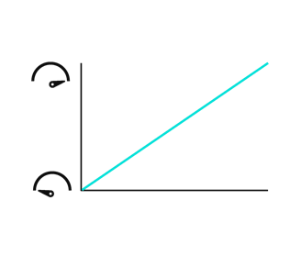
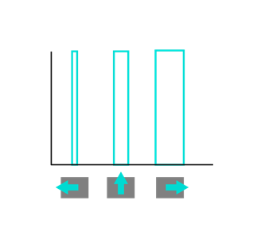
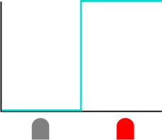
Control signal relationships
The three charts show how a signal from the microcontroller can change the state of a status LED, DC motor speed and servo motor position.
What kind of signal is being used in each case?
What does each axis represent in each chart?
What is the relationship between the signal and the state of each device?
LED off/on
DC motor speed
Servo motor position
10
Notes:
Practitioner delivery notes
Activity
Explain that the charts on the slide illustrate the relationship between the input signal for each device and how each one behaves. Each device uses a different form of input signal variation to produce the desired change.
Learners discuss each chart to answer the questions.
Example answers
LED off/on:
The signal is a simple digital low (0 V) and high (5 V) signal. The x-axis is time and the y-axis is voltage. The LED is illuminated when the output is high.
DC motor speed:
The signal shows linear variation. The x-axis is voltage and the y-axis is speed, hence there is a linear relationship between output voltage and motor speed. However, if the microcontroller has a digital output, this raises the question of how to vary the output voltage.
Servo motor position:
The signal is a regular series of pulses of different durations. The x-axis is time and the y-axis is voltage (the same as for the LED). The rotational position of the servo is related to the duration of the pulse. This final example gives a clue as to how a digital controller can control all three types of device.
Assessment
Discussion
Verbal answers and the ability to interpret the meaning of each chart.
Extension
Learners can investigate the linear relationship between input voltage and speed for a DC motor, and some specifications of commercially-available servo motors.

Slide 11

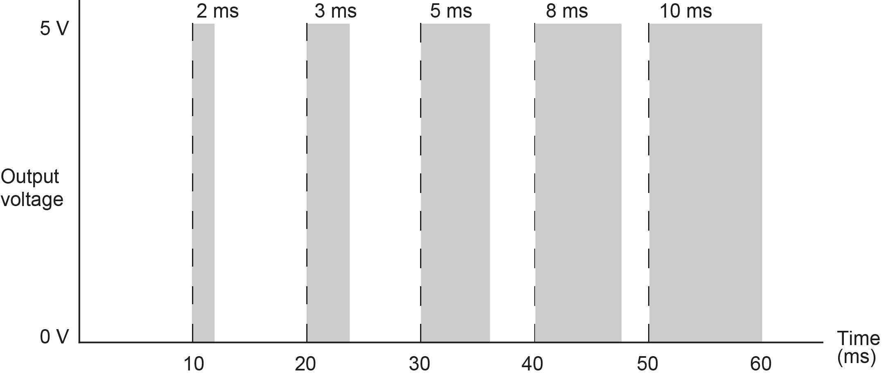
What is pulse width modulation?
What is the frequency of this PWM signal?
Calculate the % duty cycle during each period, and the average voltage this produces each time.
What duty cycle would be needed to create the following average voltages? 1.2 V, 3.5 V, 4.8 V
This controller has 8-bit resolution (0 to 255). What is the resolution of the PWM output, in volts?
Pulse width modulation (PWM) is a form of digital to analogue conversion (DAC).
PWM varies the time for which the output voltage is set high (the duty cycle) in a set frequency.
Output devices like DC motors interpret this as the average voltage during each period.
The bars in the diagram below show how the pulse widths in this signal vary. Each pulse is 10 ms apart, for example, a 1 ms pulse below would be a 10% duty cycle (1 ms/10 ms).
11
Notes:
Practitioner delivery notes
Activity
Explore the slide content to introduce pulse width modulation (PWM). Highlight the axes on the graph, which show how the width of a regular pulse is varied.
The pulses occur at regular intervals – at the frequency of the PWM signal.
The width of each pulse as a percentage of the time interval is the duty cycle of each pulse in the PWM signal.
Work through the questions on the slide in pairs or as a whole class.
Activity sheet
Learners complete their answers on Microcontroller systems - Activity sheet 8.
Example answers
Please see the following slide.
Assessment
Discussion
Verbal answers
Written answers on activity sheet

Slide 12
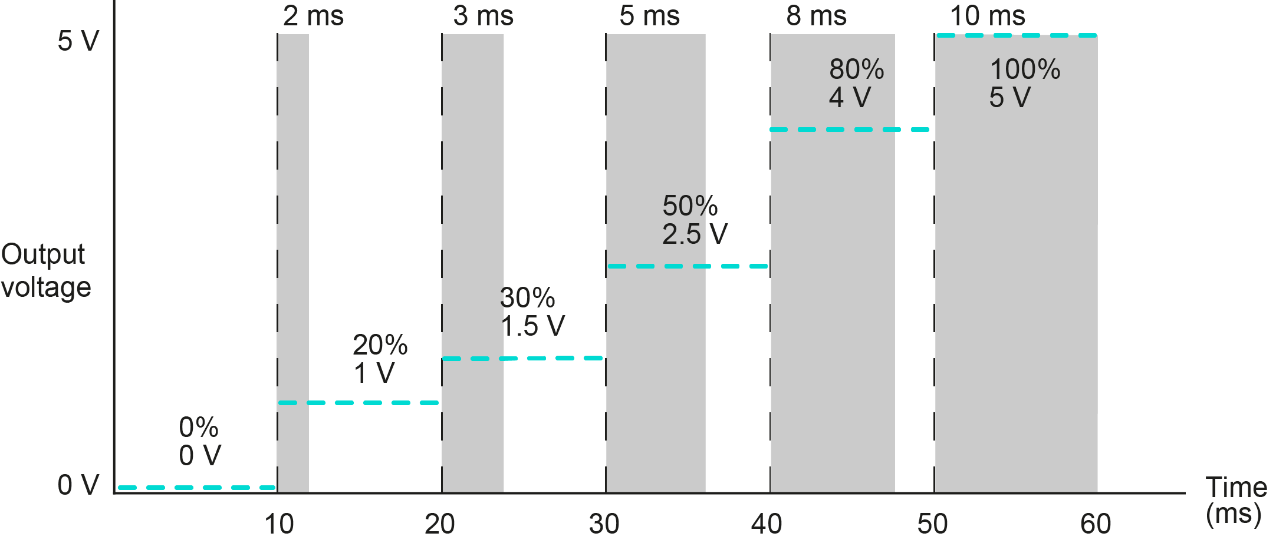
What is pulse width modulation?
What is happening if the duty cycle is set to zero or 100%?
More generally, what is happening if the duty cycle stays the same?
How could PWM control the speed of a motor?
The frequency of the PWM signal is 100 Hz (1/10 ms = 100)
Duty cycles:
1.2 V: 24%, or 2.4 ms (1.2 V/5 V x 100% = 24%)
3.5 V: 70%, or 7 ms
4.8 V: 96%, or 9.6 ms
The resolution of the PWM output is 5 Volts / 256 steps = 0.02 V to 2 decimal places.
12
Notes:
Practitioner delivery notes
Activity
Review the answers on the slide. The blue dotted lines show the average voltage during each time period.
Ask learners how PWM could be used to control the speed of a DC motor.
Example answers
When the duty cycle is zero, this has the effect of a low or grounded (0 V) output.
When the duty cycle is 100%, this is equivalent to the output being permanently high (5 V).
By implication, if every pulse is set at the same duty cycle, this will have the effect of a persistent average voltage output. For example, 50% duty cycles would create an average voltage of 2.5 V. This means that a DC motor’s speed can be controlled by changing the duty cycle of a PWM signal.
Assessment
Written answers
Verbal answer to the slide question

Slide 13

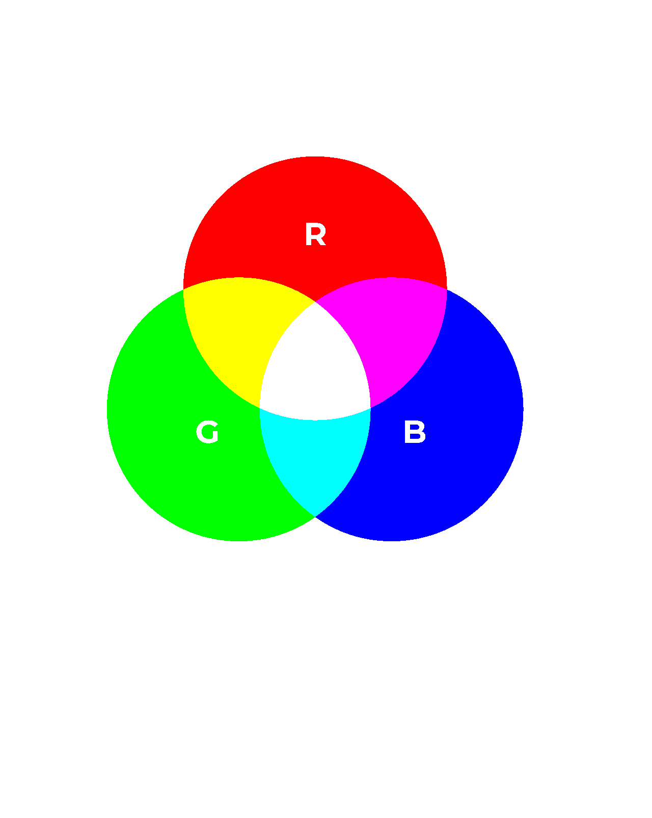

Applying pulse width modulation: RGB LEDs
4. Pulse width modulation
A CNC machine status light can be red, amber or green.
A microcontroller changes the status of the red, green or blue emitters in an RGB LED.
Each emitter can be on, dimmed (50% duty cycle) or off.
First, think about what PWM signal to each emitter will create a red, yellow or green light. Then, consider whether you need to send a 50% duty cycle signal to the red or green emitter, while leaving the other on 100%, to change yellow to amber. Sketch on the activity sheet what PWM signals would make the light cycle through red, amber and green statuses.
13
Notes:
Practitioner delivery notes
Please note – see Extension notes below for link to an interactive to explore the effect of sending different signals to each emitter changes the colour output.
Activity
Return to the example of the microcontroller in the CNC machine.
Explain that this uses a single RGB LED to indicate status; the LED contains three live connections to the red, green and blue emitters and the colours combine as shown in the diagram.
Help learners establish that the microcontroller should use a separate output for each emitter in the RGB LED.
Learners complete the task on the activity sheet. If necessary, discuss how to obtain amber when an equal signal to red and green gives yellow – the answer is to reduce the signal to the green LED.
Activity sheet
Using the information on the slide, learners complete the task on Microcontroller systems - Activity sheet 9: section 9a.
Example answers
Please see the answer slide that follows in three slide’s time.
Assessment
Sketch graphs
Extension
Learners can plan and build a control circuit to change the colour of an RGB LED using breadboard and a microcontroller with PWM output.
They can use the following interactive to explore the effect of sending different signals to each emitter changes the colour output (sliders to control each emitter’s output are below the black rectangle): www.physicsclassroom.com/Physics-Interactives/Light-and-Color/RGB-Color-Addition/RGB-Color-Addition-Interactive

Slide 14

Applying pulse width modulation: DC motors
4. Pulse width modulation
The CNC tool head motor has an operating speed of 0 to 12,000 rpm.
The microcontroller will operate a higher power PWM circuit to control the motor speed.
This PWM circuit will operate at a frequency of 50 kHz.
Complete the table on the activity sheet to show the duty cycles for a range of tool head motor speeds.
14
Notes:
Practitioner delivery notes
This activity to the topic of variable frequency drives, which learners will explore in simple terms in the Electrical machines module.
Activity
Review the specification of the CNC tool head motor. Highlight that the motor’s power requirements mean that it can’t be directly powered by the 5 V, low current output of a microcontroller. Instead, the controller will communicate duty cycle values to a high-power 230 V PWM motor controller.
Learners complete the task on the activity sheet.
Activity sheet
Using the information on the slide, learners complete the task on Microcontroller systems - Activity sheet 9: section 9b.
Example answers
Please see the answer slide which is the slide after next.
Assessment
Written work.

Slide 15

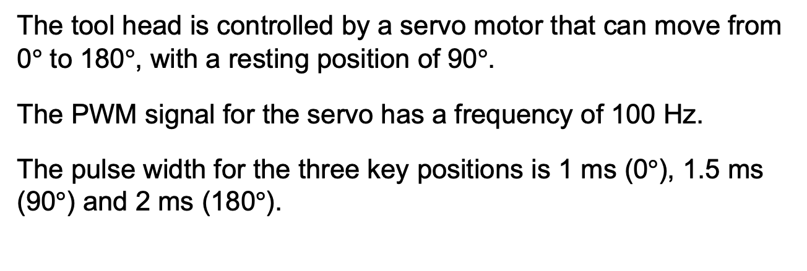
Applying pulse width modulation: servo motors
4. Pulse width modulation
The tool head is controlled by a servo motor that can move from 0$°$ to 180$°$, with a resting position of 90$°$.
The PWM signal for the servo has a frequency of 100 Hz.
The pulse width for the three key positions is 1 ms (0$°$), 1.5 ms (90$°$) and 2 ms (180$°$).
Calculate the pulse width for the intermediate positions listed on the activity sheet.
If the microcontroller has an 8-bit (256 step) resolution, what is in principle the smallest increment by which the servo motor can rotate?
Image © This Is Engineering
15
Notes:
Practitioner delivery notes
Activity
Explain that a servo motor controls the vertical position of the tool head. Help learners to understand how the pulse width varies from 1 to 2 ms to control the position of the servo from 0º to 180º. The servo maintains its position while waiting for the next pulse to provide position data.
Activity sheet
Using the information on the slide, learners complete the task on Microcontroller systems - Activity sheet 9: section 9c.
Example answers
Please see the answer slide which follows.
Assessment
Written work
Extension
Learners can use a microcontroller to control the servos on a desktop robotic arm or create their own simple arm from scratch.

Slide 16
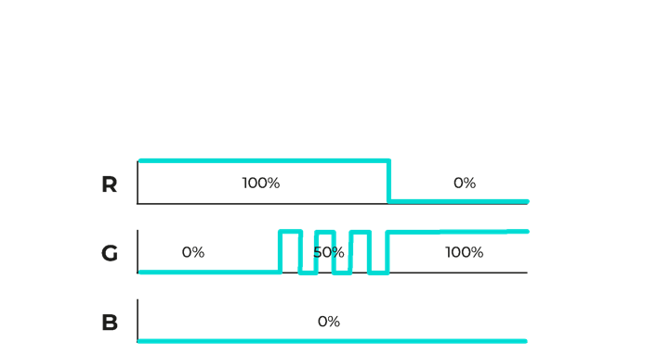
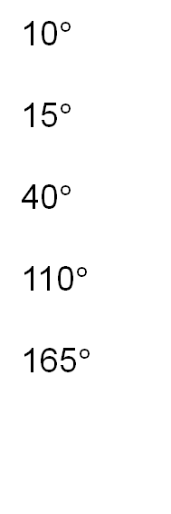
Answers
4. Pulse width modulation
9a. LEDs
9b. Tool head motor
rpm % (2dp) ms (4dp)
9c. Servo motor
Angle Pulse width
ms (4dp)
Speed Duty cycle Pulse width
10$°$
15$°$
40$°$
110$°$
165$°$
1.056
1000
2000
5000
8000
11000
8.33
16.66
41.67
66.67
91.67
0.0017
0.0033
0.0083
0.0133
0.0183
1.083
1.222
1.611
1.917
The maximum theoretical resolution is 90/128 = 0.7 degrees
Example:
(1000/12000) x 100% = 8.33% duty cycle.
(1/50000) x 8.33% = 0.0000017 s = 0.0017 ms
Example:
(10/180) x 1 = 0.056
0.056 + 1 = 1.056 ms
16
Notes:
Practitioner delivery notes
Activity
Review the answers on the slide.
Key points to include:
Amber requires more red than green, so one solution is to provide 50% voltage to the green emitter which will dim it to 50% brightness (as perceived by our eyes).
The blue emitter is not required so this application does not require three output channels.
The range of the pulse width for the servo motor is 2 ms – 1 ms = 1 ms, to which the zero value of 1ms must be added.

Slide 17
Pulse width modulation at work
4. Pulse width modulation
Power engineer
PWM saves energy compared with using transformers to regulate voltage.
Buildings engineer
PWM controls the brightness of my smart lighting system.
Automation engineer
PWM is used in the signals from the Internet of Things (IoT) devices that monitor our automated factory.
You’ve explored how PWM allows microcontrollers to control a variety of output devices.
Where might you come across PWM control in a work environment?
Robotics engineer
PWM signals control the speed and angle of my 6-axis robot arms.
Maintenance engineer
PWM manages the cooling fans on our CNC machines.
Safety engineer
PWM helps to control the drones I use to inspect our sites.
17
Notes:
Practitioner delivery notes
You may wish to link this discussion to learners’ planned industry placements.
Activity
Discuss the examples on the slide and invite learners to suggest other roles and activities where PWM may provide the right control solution.
Assessment
Discussion and suggestions
Extension
Learners can enquire about the use of PWM while on their placement and report back.

