Slide 1
Renewable energy
2. Planning for renewable energy

Slide 2
2. Planning for renewable energy
2

Slide 3

Learning outcomes
2. Planning for renewable energy
You will be able to:
Use data and a simulation to make informed decisions about implementing wind and solar power generation for a manufacturing plant and for the UK.
Make calculations about energy and power, for generation and use.
Explain some key factors that influence the power output of a wind turbine.
3

Slide 4


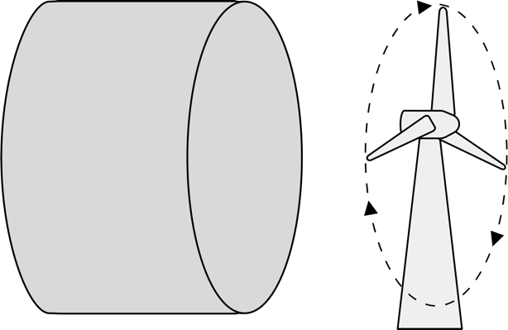
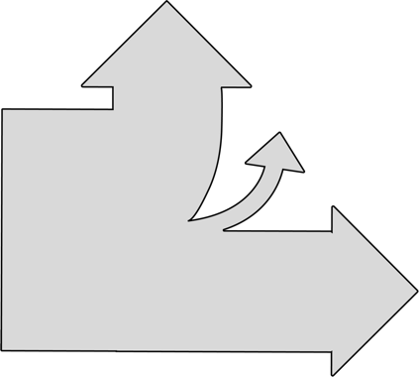
Energy, work and power
2. Planning for renewable energy
What happens to the energy in this cylinder of moving wind?
Energy is the ability to do work or to create heat or light.
The kinetic energy in the wind makes the turbine blades move, but some energy is lost as heat. The kinetic energy in the blades is converted into electrical energy.
How efficient
is the turbine?
Where do you think the heat losses occur?
Heat losses 10%
Wind 40%
Wind 100%
Electrical energy
This Sankey diagram represents
the energy conversion in the wind turbine.
4

Slide 5

Energy, work and power
2. Planning for renewable energy
Power is the rate at which energy is transferred.
The unit of energy is the Joule J.
The unit of power is the Watt W.
1 W = 1 J/s
Energy E = Power P x time t
Power P = Energy E
Time t
What factors
affect the power output of this wind turbine?
5

Slide 6


Calculating available wind power
2. Planning for renewable energy
How can we calculate the potential power available from a wind turbine?
Consider this cylinder of air with area A moving with velocity v.
The kinetic energy of the air is given by E = 1 mv²
2
The mass m of the air is given by its density ρ and volume V: m = ρV where
V = Avt, the area x velocity x time.
Hence E = 1 x ρ x Avt x v² = 1 ρAv³t
2 2
Since power = energy/time this gives P = 1 ρAv³
2
A
v
However, Betz’s Law states that a turbine can’t use more than 59% of the theoretical power available in the wind.
Give a qualitative explanation for why you think Betz’s Law applies. What stops a turbine
from using all of the wind power available?
Complete the questions on your activity sheet to calculate the maximum power a range of wind turbines can produce at low and high wind speeds. Use π = 3.14159.
6

Slide 7
Calculating available wind power - answers
2. Planning for renewable energy
In reality, the maximum output power is limited by the rated output of the generator in the turbine’s nacelle and by the fact that real-world turbine designs can only approach 75-80% of the Betz limit. Real outputs are about ⅓ of those in the upper limit column of the table.
Example:
P = 1 ρAv³
2
ρ = 1.2 kg/m
For 1.2 m dia. blades at 5 m/s:
P = 0.5 x 1.2 x π 1.2 x 5³
2
= 84.823 W (using 3.14159 for π)
Applying Betz’s Law:
0.59 x 84.823 = 50 W at 5 m/s, (rounded)
Diameter | 5 m/s wind (lower limit) | 15 m/s wind (upper limit)
222 m | 1,712,808 W | 46,245,822 W
164 m | 934,739 W | 25,237,960 W
127 m | 560,545 W | 15,134,706 W
24 m | 20,018 W | 540,492 W
3 m | 313 W | 8,445 W
1.2 m | 50 W | 1,351 W
( )
2
7

Slide 8

How much energy or power do we need?
2. Planning for renewable energy
Use E=Pt and P=VI to calculate the answers to these scenarios.
When is this energy most likely to be needed during the day?
What implications does this have for a renewable energy supply?
Mobile phone
How long will it take to charge a mobile phone battery?
V = 3.7 V
Capacity = 3000 mAh
Charger = 18 W
Electric vehicle (EV)
How much energy can an EV battery store?
V = 400 V
Capacity = 90 kWh
CNC machine
How much average current does this CNC process draw?
Energy = 14.9 MJ
Time = 90 mins
Voltage = 230 V
Robot arm
How much energy does this robot arm use?
Time = 16 hrs
Voltage: 230 V
Average current draw: 10 A
8

Slide 9
How much energy or power do we need?
2. Planning for renewable energy
Demand varies with activities, which vary with time (for example EVs might be charged during the day at
the factory) while supply from renewables is intermittent, depending on the weather and time of day.
Mobile phone
The battery’s capacity is:
3.7 V x 3 Ah = 11.1 Wh
Charge time with an 18 W charger is:
11.1 Wh x 60 mins
18 W
= 37 minutes to charge.
Electric vehicle
To turn kWh into Joules:
1 kWh = 1000 W x 3600 s
= 3.6 MJ in each kWh
3.6 MJ x 90 = 324 MJ
Note that the voltage is irrelevant here.
CNC machine
To convert from energy to power:
14,900,000 J = 2759 W
90 x 60 s
Current = 2759 W
230V
= 12 A average current.
Robot arm
To find the energy find the power consumption and multiply by time:
Power = 230 V x 10 A
= 2300 W
2300 W x 16 hrs x 3600 s
= 132.48 MJ.
9

Slide 10

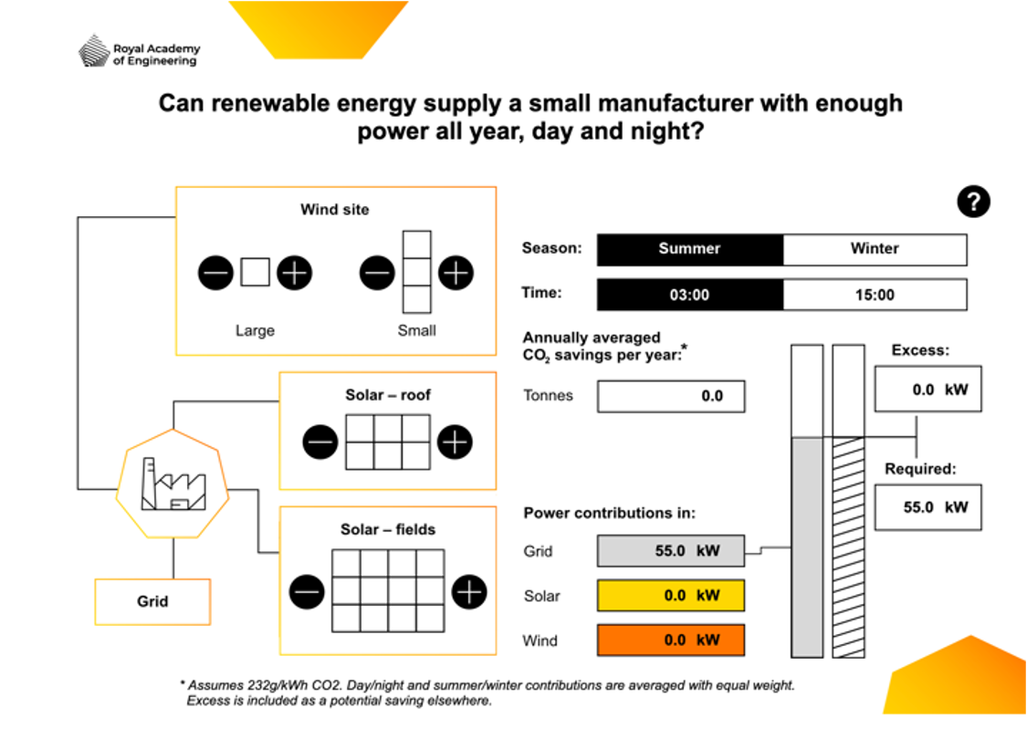
Renewable energy: exploring supply and demand
2. Planning for renewable energy
The owner of this manufacturing plant wants to shift to renewables and is modelling their options.
What can the
model tell you about the opportunities and
limitations for using wind and solar energy for this manufacturing plant?
Add small or
large wind turbines
to the site.
Explore how supply and demand change across the day and seasons.
Add solar generation to the roof or a nearby field. Each box represents
10 x 1.6 m² panels.
Identify when grid supply is needed or when excess energy is available, and how this affects the
plant’s carbon emissions.
10

Slide 11
Renewable energy: finding the optimum mix
2. Planning for renewable energy
Use the Renewable energy interactive tool to answer these questions:
What are the maximum power outputs for each of the following: one large turbine, one small turbine, one group of 10 solar panels (one ‘box’ on the interactive)? Consider what time of day and year to select to identify these values.
What are the annual emissions savings for each of the following: one large turbine, one small turbine, one group of 10 solar panels?
Estimate the total annual emissions that can be saved when the site’s demand is fully met by renewable energy.
When is the peak time for wind energy and for solar energy, within the time and seasonal options available? Consider what time of day and year to select to identify these values.
Why might three small turbines be chosen over one large turbine?*
The site is at the edge of an industrial estate with parking. Where else might the additional solar panels be located instead of in a neighbouring field?*
What is the maximum excess power that can be generated?
What could the site owner do with this excess power when it is available?*
What emissions could be saved by ‘exporting’ this excess power for other users?
*for these questions, use your knowledge to answer rather than the interactive tool.
11

Slide 12
Renewable energy: finding the optimum mix – answers
2. Planning for renewable energy
Maximum power outputs:
  Large turbine: 37 kW
  Small turbine: 11.1 kW
  10 solar panels: 2.5 kW (250 W per 1.6 m² panel, or per 156 Wm⁻²)
Emissions savings:
  Large turbine 55.6 tonnes (the interactive averages outputs rather than using maximums)
  Small turbine 16.7 tonnes
  10 solar panels 1.8 tonnes
Total emissions savings would be about 77 tonnes of CO₂ per year with 100% renewable energy.
The peak time for wind energy is winter at 3pm and for solar energy it is summer at 3pm.
Three small turbines might be chosen over one large turbine due to the visual impact or other planning constraints.
Additional solar panels might be located on parking verges, spare parking or yard space and other unused spaces with good sunlight.
The maximum excess power that can be generated is 15.9 kW, on a summer afternoon.
The site owner could install battery storage for some or all of this excess, or export it to the grid. This would allow carbon savings for the owner or for other electricity customers at times other than when most renewable energy is available.
About 10.7 tonnes of CO₂ emissions (87.7 - 77) could be saved by exporting this excess for other users.
12
Notes:
Practitioner delivery notes
Activity
Review the answers on the slide.

Slide 13

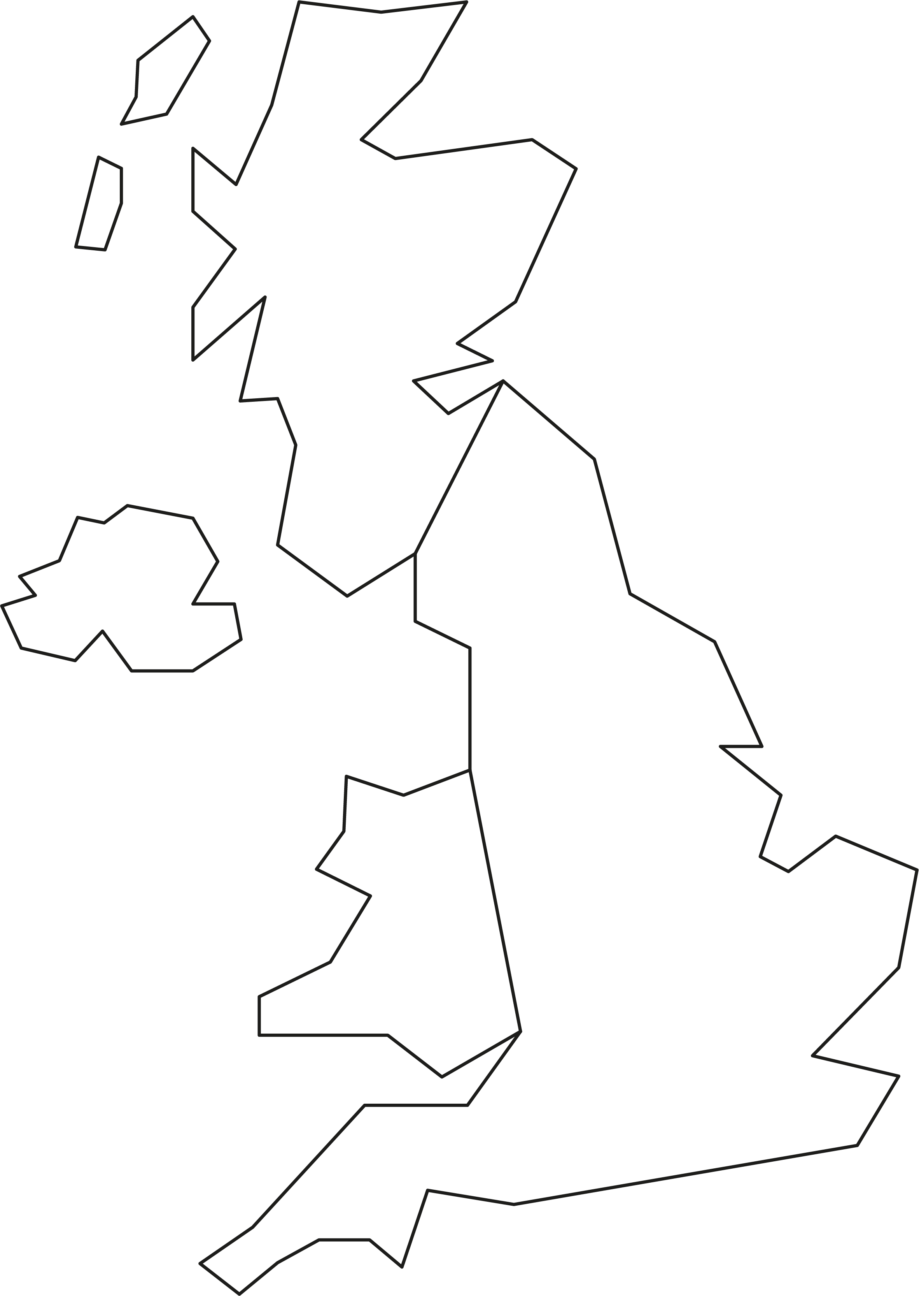
Powering the UK
2. Planning for renewable energy
The transition to EVs and away from fossil fuel use means that electricity will provide almost all of the UK’s energy needs by 2050.
It is anticipated that this will mean an increase in demand from around 300 TWh today to about 610 TWh in 2050, largely supplied by wind and solar generation.
One scenario is to install the following generation by 2050:
430 TWh offshore wind
85 TWh solar
(Nuclear, tidal, hydrogen and ‘clean’ gas could provide the remainder.)
At current values:
1.6 m² solar panel typically provides
250 W per year.
1 kW solar typically produces about
850 kWh per year.
One offshore wind turbine produces 8 MW.
Each 1 MW of wind capacity produces about 500,000 kWh per year.
What area of solar panels
and how many wind turbines will be needed?
13

Slide 14
Powering the UK - answers
2. Planning for renewable energy
Wind generation by 2050
Requirement of 430 TWh = 4.3 x 10¹⁴ Wh
Remember that each 1 MW wind turbine produces typically 500,000 kWh, so 8MW will produce
8 x 500,000 kWh = 4 x 10⁹ Wh per year
Dividing total requirement by output per turbine gives
4.3 x 10¹⁴ Wh = 1.075 x 10⁵
4 x 10⁹ Wh
= 107,500 offshore wind turbines (each 8 MW)
Solar generation by 2050
Requirement of 85 TWh = 8.5 x 10¹³ Wh
Remember that 1 kW of solar produces 850 kWh per year = 8.5 x 10⁵ Wh
Hence required capacity in kw of solar is
8.5 x 10¹³ Wh = 1 x 10⁸ kW
8.5 x 10⁵ Wh
A 1.6m² panel produces 250 W per year or 0.25 kW, so four panels per 1 kW.
Hence 4 x 10⁸ x 1.6 m² of panels are needed
= 640,000,000 m² solar panels
This is 0.003 of the UK’s land area, or about 90,000 Premier League football pitches.
14

Slide 15
Learning outcomes
2. Planning for renewable energy
You will be able to:
Use data and a simulation to make informed decisions about implementing wind and solar power generation for a manufacturing plant and for the UK.
Make calculations about energy and power, for generation and use.
Explain some key factors that influence the power output of a wind turbine.
15

