Slide 1
CNC
machinery
4. The future of CNC

Slide 2
CNC
machinery
4. The future of CNC
2

Slide 3
Learning outcomes
4. The future of CNC
You will be able to:
Give examples
and benefits of additive manufacturing machines.
Suggest how
CNC integrates with
key technologies in
an Industry 4.0
‘smart’ factory.
Reflect on
how changes in
CNC technology
might influence
your career.
3

Slide 4

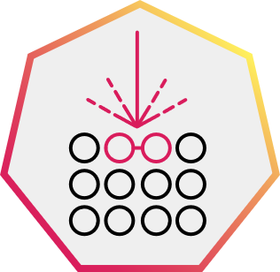

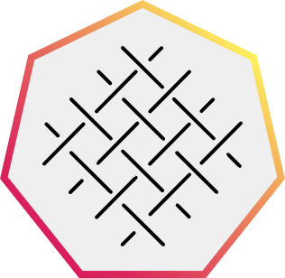
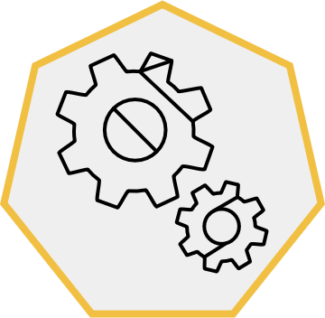
CNC and additive manufacturing
4. The future of CNC
Additive manufacturing processes create objects by laying down successive layers
of material. Additive manufacturing can use CNC processes controlled by digital files.
3D printing
Powder sintering
Composite manufacturing
Weaving
3D printing uses extruded polymer from a heated nozzle.
Powder sintering uses high-
powered lasers to sinter, or bind, finely powdered material, usually
a metal, into a solid structure.
Composite manufacturing mixes
fibre reinforcement with a resin
matrix in an open, closed or cast moulding process.
Weaving creates fabrics or layers with a 2D or 3D structure.
Discuss what you think each of these additive processes may manufacture.
4

Slide 5
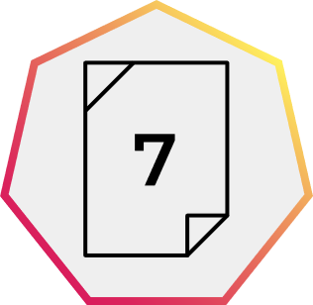
What are the benefits of additive manufacturing?
4. The future of CNC
You work for a company that produces specialised components that need to be very light but strong.
You currently use subtractive manufacturing techniques such as CNC milling.
You are considering what benefits a move to additive manufacturing methods might deliver.
Study the metal part in the image.
What additive manufacturing technique might you use to produce this part?
What subtractive processes might you still need to carry out to finish the part
to a high standard?
What are some benefits of additive manufacturing for a company?
What are some benefits for the company’s customers?
How might additive manufacturing help a company become more sustainable?
5

Slide 6
What are the benefits of additive manufacturing? Answers
4. The future of CNC
Laser sintering would be a suitable process to produce the part.
CNC grinding or milling may be needed to create a fine finish on certain surfaces.
Benefits for company | Benefits for customers | Benefits for sustainability
Short production runs. Faster turnaround times. Simplified manufacture from less tooling and setup. Less material use. Often less energy to produce. Can produce organic shapes optimised via AI-enhanced design and simulation software. | Reduced weight without compromising strength. Lighter components can reduce the energy use of final products. Short production runs. Quick prototyping iterations mean faster time to optimised product. | Less material use. Reduces waste. Often less energy to produce. Lighter components can reduce the energy use of final products.
Discuss what other innovations might work alongside additive manufacturing in the ‘factory of the future’.
6

Slide 7


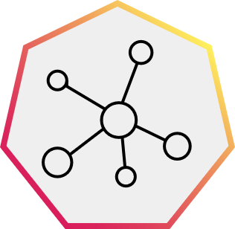
CNC and the smart factory
4. The future of CNC
Industry 4.0 describes how current technologies are already enabling the 'fourth industrial revolution’. They include:
CNC additive manufacturing
Use only what materials are needed.
Big data and artificial intelligence (AI)
Very large datasets with software that can identify patterns and trends for predictive responses.
Cyber-physical systems
Networked algorithm-controlled machines and robots that work together, interact and adapt how they work.
Internet of Things (IoT)
Connected objects with sensors and processing capabilities that can gather and exchange data.
Discuss how
these four
Industry 4.0 technologies can work with additive CNC.
Think of how you could organise your ideas within
a control system, with inputs, processing/control,
outputs and feedback. Where in this system might you find each technology and what would it do?
Together these innovations enable ‘smart factories’. IoT is pivotal as it helps connect the entire
manufacturing ecosystem with real-time data from interconnected machines and robots, optimising
the manufacturing process.
Companies can harness big data and analytics to better organise, analyse, streamline, and apply
information and learning at every stage of production.
7

Slide 8
CNC and the smart factory
4. The future of CNC
One way to think about how these four technologies can work with CNC is to think
of them as a single system with inputs, a control process, outputs and feedback:
Big data and AI
Optimise production, maintenance,
energy use.
IoT
Allow remote manufacture.
Robots
Automate material
flow and maintenance.
Big data and AI
Simulate use and
optimise designs.
Optimise material
planning
and purchasing.
Control system
Additive CNC machines
Finished parts and products
Inputs
Discuss what
benefits these innovations might
deliver together.
Feedback
Sensors
Big data
Shared with other sites or machines can be improved
by adding local data.
IoT
Gather performance, maintenance, energy data.
8

Slide 9
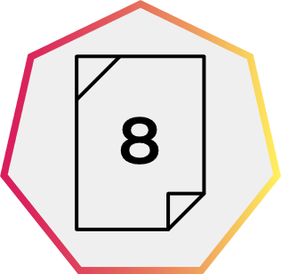
Smart factories and better products
4. The future of CNC
Together these innovations can amplify many of the benefits of additive manufacturing:
Optimise designs and performance.
Minimise weight.
Maximise strength.
Reduce final energy consumption.
Increase factory efficiency and productivity.
Increase safety.
Shorten development time.
Minimise errors in design or manufacturing.
Enable remote manufacturing.
Other innovations such as virtual or augmented reality can also enhance the design, testing, client input and training processes.
For example, remote clients can view designs in 3D or machine operators can be trained away from the real production line.
Think of an existing product that
might be produced through additive
manufacturing and innovative technologies.
How might additive CNC be used to produce this product?
How might these other technologies work alongside additive CNC to produce it?
- Cyber-physical systems​
- Big data and AI​
- IoT
9

Slide 10

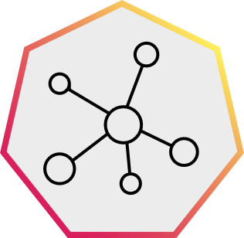
Smart factories and better products – example
4. The future of CNC
Example: made-to-measure woven training shoes
CNC additive manufacturing
3D woven upper.
3D printed midsole and sole.
Plant-based polymers
could make recyclable
and sustainable.
Big data and AI
User feedback on
wear and tear
improves reinforcements
where needed.
Constant improvements to weave and sole structure.
Cyber-physical systems
Robotic yarn and polymer loading, material and product flow, maintenance.
Remote updating of software and production code.
IoT
Sensors gather performance, maintenance and energy data to improve efficiency and sustainability.
Discuss how your roles as engineers might adapt within a future smart factory.
10

Slide 11
CNC and your career opportunities
4. The future of CNC
The CNC industry is constantly growing and allows for an exciting and
rewarding path for those who love to create and have an eye for detail.
What types of industries need CNC operators?
Are there any local to you?
What are the career pathways if you want to follow a career in CNC?
What skills and qualifications might help you now?
What skills and qualifications could you develop in the future?
Image © This Is Engineering
11

Slide 12
Learning outcomes
4. The future of CNC
You will be able to:
Give examples
and benefits of additive manufacturing machines.
Suggest how
CNC integrates with
key technologies in
an Industry 4.0
‘smart’ factory.
Reflect on
how changes in
CNC technology
might influence
your career.
12

