Slide 1
CNC
machinery
2. Using CNC machines

Slide 2
CNC
machinery
2. Using CNC machines
2

Slide 3
Learning outcomes
2. Using CNC machines
You will be able to:
Analyse a requirement
to identify the correct
CNC machine and work sequence to use.
List some
considerations
when purchasing
a CNC machine.
Identify actions that
support smooth and
safe operation of
CNC machines.
3

Slide 4
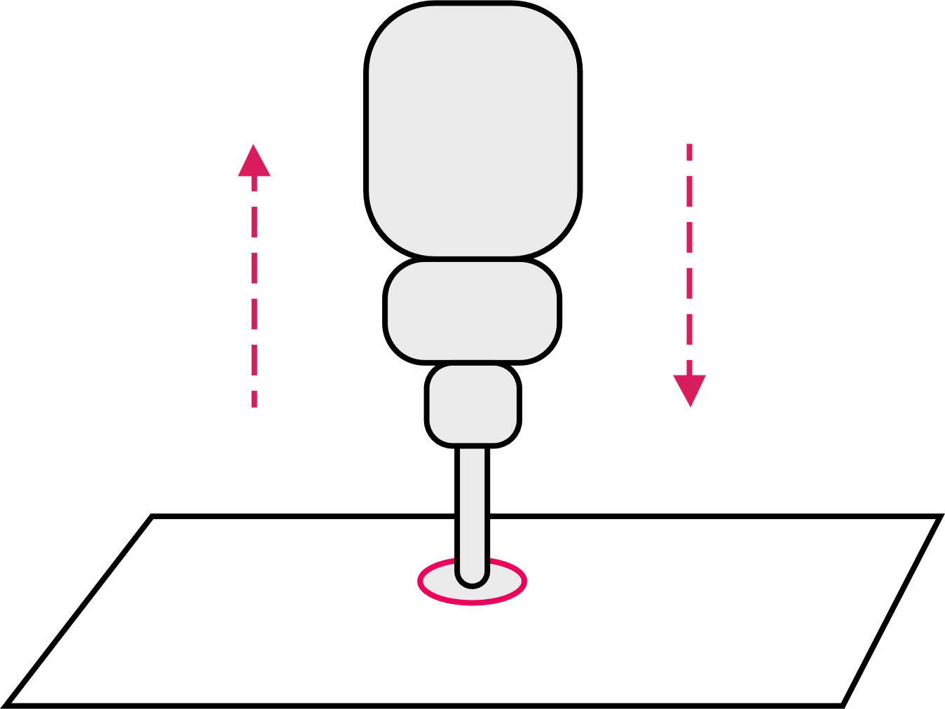
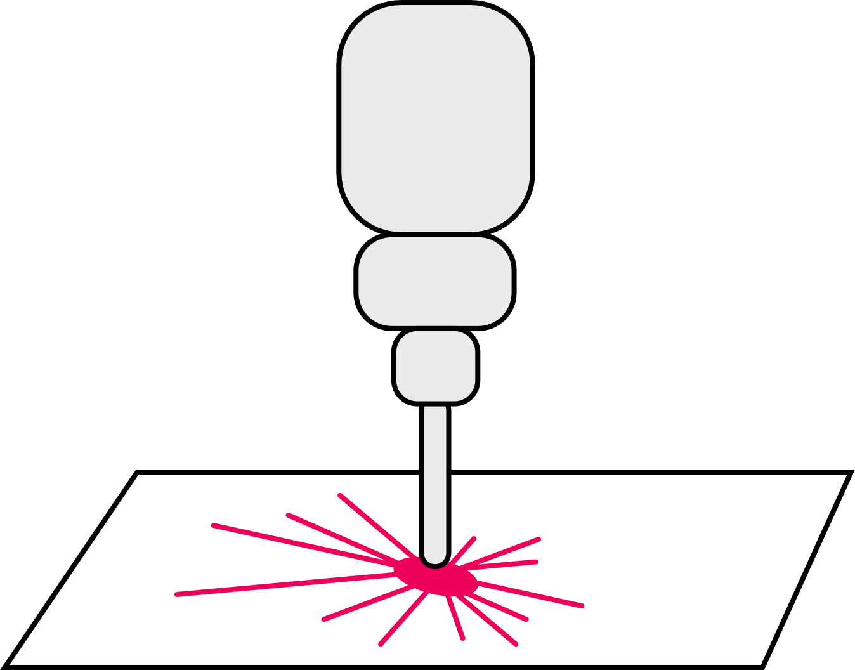

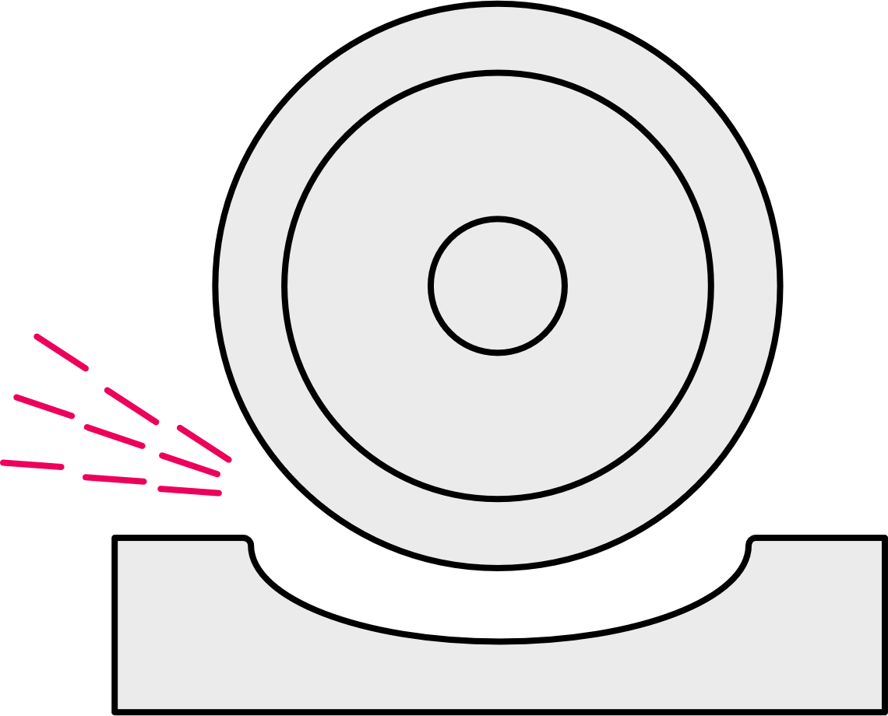
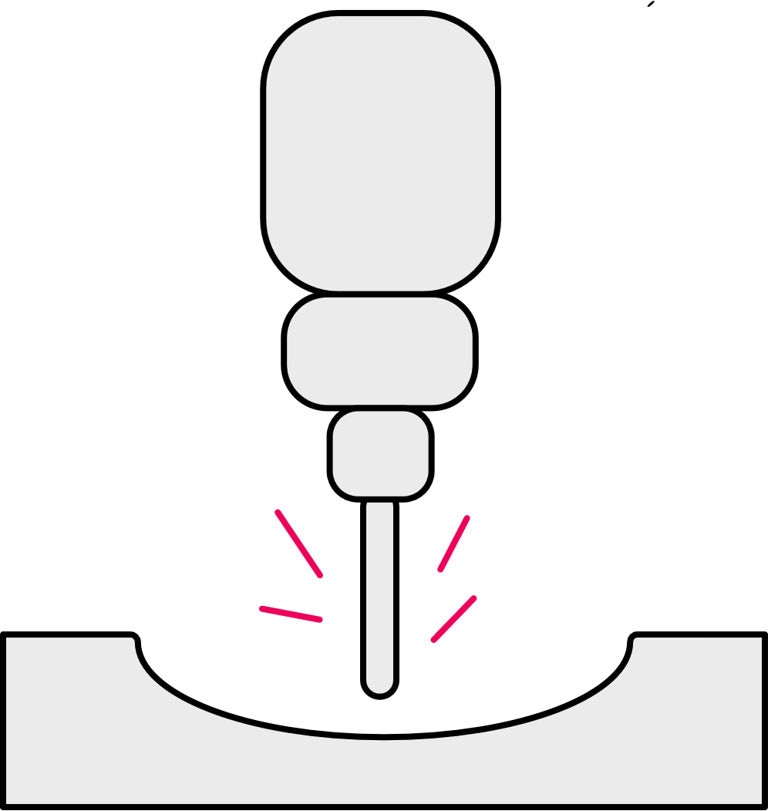
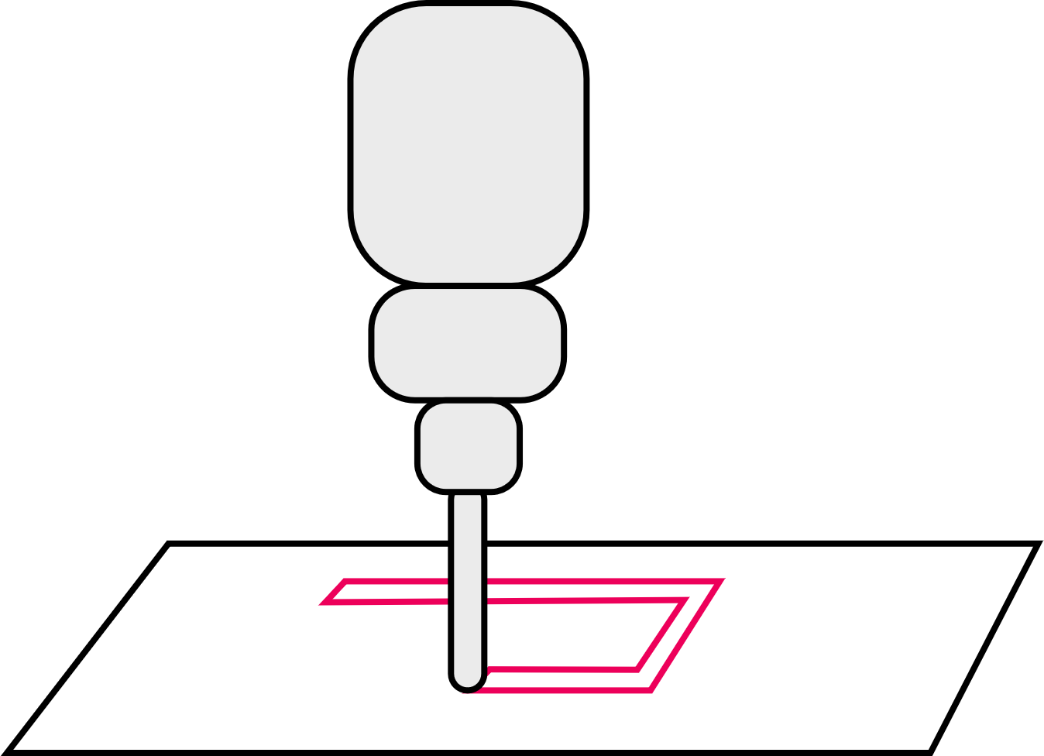
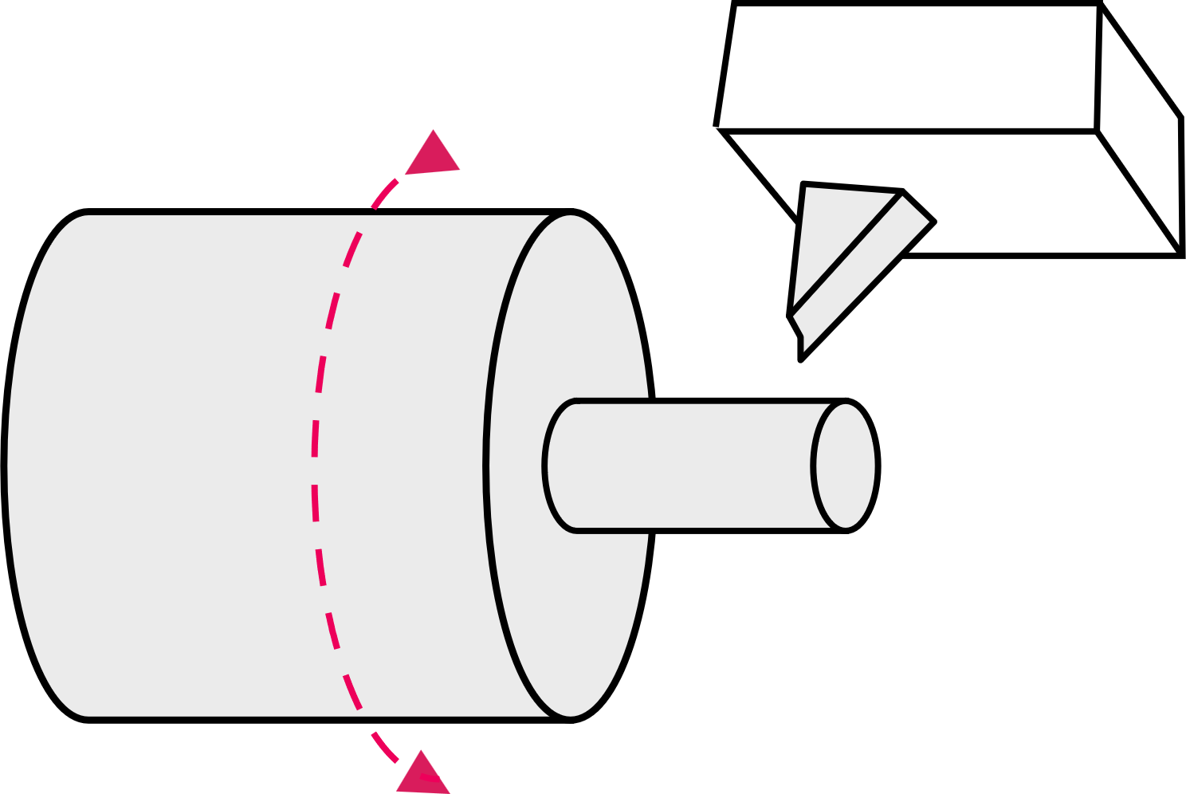
Functions and advantages of CNC
2. Using CNC machines
Identify
and explain the main function of the CNC machine each icon represents.
List some general advantages of using CNC.
4

Slide 5

Functions and advantages of CNC
2. Using CNC machines
These are all examples of subtractive manufacturing, where material is removed to create the finished part.
Advantages of using CNC
Safer – operators are not exposed to material
or cutting tools.
Can run 24 hours a day, for higher productivity.
More accurate control, for higher quality and consistency.
Range of processes (drill, cutting, mill, threading, tapping etc) creates flexibility.
Reduces wastage – lowers overall production costs.
More complex multi-axis machines can produce complex forms.
Feedback systems indicate wear for planned maintenance and less unplanned downtime.
Drilling
Drilling, reaming or
tapping holes of different
depths and diameters.
Grinding
An abrasive wheel or cylinder produces a
fine, accurate finish.
Laser or plasma cutting
Cutting that uses a laser or
plasma to create a cut line
and edge in sheet material.
Lathe
Cutting a cylinder of
material as it spins
on an axis.
Milling
Detailed, precise cutting
of hard materials in 3D.
Router
Simple cutting of softer materials, usually sheet material.
5

Slide 6

Selecting the right CNC
2. Using CNC machines
As production manager you have been tasked with making the component shown using a suitable CNC machine.
State what type of CNC machine
you would use to manufacture the part.​
Outline in the correct sequence the main tasks the CNC machine will have to perform.
20
25
5
20
15
6

Slide 7
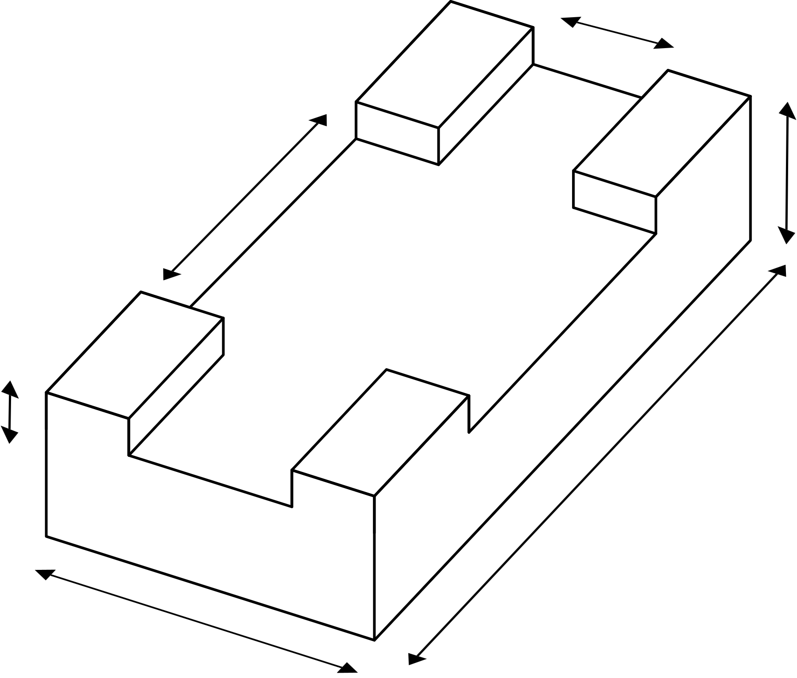
Selecting the right CNC
2. Using CNC machines
Use a CNC lathe for this part.
Correct sequence​​:
1 Secure 20-diameter cylindrical blank in the chuck.
2 Face off (level) the end​​.
3 Parallel cut to diameter 15 and length 20​​.
4 Drill 5 diameter hole​​ to 20 depth.
5 Part off (remove the part) at length of 25.
Now state what type of CNC
machine you would use to manufacture the part below and suggest a tool width.
Outline in the correct sequence the main tasks the CNC machine will have to perform.
3
4
30
2
40
30
10
100
5
60
7

Slide 8

Selecting the right CNC
2. Using CNC machines
Use a CNC mill for this part with a 30mm tool.
Correct sequence​​:
1 Secure 100 x 60 blank in the vice.
2 Face off (level) top to 30 depth
3 Mill channel in one pass to width 30 and depth 10.
4 Mill channel in two passes to width 40 and depth 10.
Now list some general factors to
consider when selecting the right CNC machine to purchase for planned work.
3
2
4 (two passes)
8

Slide 9
Selecting the right CNC
– general factors
2. Using CNC machines
Considerations when selecting a suitable model of CNC machine include:
Is it the correct type of machine?
Will the machine perform the required tasks?
Is the machine the right size for this part?
Does the machine have sufficient power for the cuts required while avoiding the motor overheating?
Does the designed run time of the machine support the productivity needed?
Does the machine include a suitable coolant system, or can this be added?
Is the machine affordable?
Is training and maintenance support available and affordable?
9

Slide 10

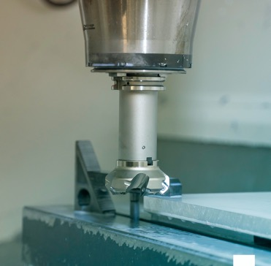
What questions should a safe CNC operator ask?
2. Using CNC machines
Before starting any work, a CNC operator has the
responsibility to ensure everything will work safely and efficiently.
A CNC setup checklist provides a structured way to consider five key areas of safety.
When setting up a CNC machine, what are some safety considerations for the five areas shown?
Organise your ideas into a setup checklist for a CNC operator, writing each one as a question.
Environment/surroundings
CNC machine
Operator
Tools
Material
10

Slide 11
What questions should a safe operator ask?
2. Using CNC machines
1 | Are the surroundings clear of debris, trip hazards, spills etc.?
2 | Are the machine safety guards in place?
3 | Is the machine bed clear of swarf/saw dust?
4 | Is the material the correct type, size and quality?
5 | Is the material fixed in place correctly and will it not interfere with cutting tool pathways?
6 | Does the operator understand the outcome, (eg orthographic drawing, sample)?
7 | Are the right instructions loaded?
8 | Is the right tool fixed securely and is it sharp and undamaged?
9 | Is the tool at the correct height, depth datum set?
10 | Is the operator qualified and trained for this job?
11 | Is the operator wearing the right PPE?
11

Slide 12
How can you become a safe CNC operator?
2. Using CNC machines
Consider a CNC machine in your workshop or one you
might or did use when on your industry placement.
What training do/did you need to use this machine safely?
What general instructions will/did help you to ensure safe operation?
How can you be sure the correct program is/was loaded?
How will/did you fit and check the tool?
What PPE do/did you need to wear when operating this machine?
What questions can you ask to be sure you are safe?
Image © This Is Engineering
12

Slide 13
Learning outcomes
2. Using CNC machines
You will be able to:
Analyse a requirement
to identify the correct
CNC machine and work sequence to use.
List some
considerations
when purchasing
a CNC machine.
Identify actions that
support smooth and
safe operation of
CNC machines.
13

