Slide 1
Renewable energy
1. Sources, advantages
and disadvantages of
renewable energy

Slide 2
1. Sources, advantages and disadvantages of renewable energy
2

Slide 3

Learning outcomes
1. Sources, advantages and disadvantages of renewable energy
You will be able to:
Explain the link between fossil fuel consumption and climate change.
Suggest some advantages and disadvantages of different forms of renewable energy.
Identify some challenges and opportunities related
to a transition to renewable
energy.
Identify engineering career opportunities related to renewable energy.
3

Slide 4

How do we get electricity from fossil fuels?
1. Sources, advantages and disadvantages of renewable energy
Power generation transforms energy from one form into another.
Power station
water
Cooling tower
steam
Combustion
Turbine
Generator
steam
Fossil fuel
Discuss and list how you have used energy today: at home,
to get to college or school, and during the day.
What are the three forms of fossil fuel?
Can you explain how they were formed – and when?
What energy transformations take place in this power station?
What do the solid black arrows represent?
4

Slide 5
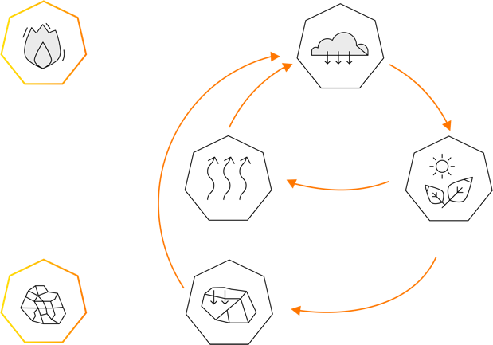
How are fossil fuels changing the Earth’s climate?
1. Sources, advantages and disadvantages of renewable energy
Fossil fuels and power generation
Fossil fuels include coal, oil and gas, formed millions of years ago from the remains of dead plants and animals.
In a fossil fuel power station:
Chemical energy > Heat > Kinetic energy > Electrical energy
The black arrows represent how the carbon stored in fossil fuels is released by combustion into the atmosphere as carbon dioxide.
Combustion
Atmospheric carbon
Respiration
Photosynthesis
What do the orange arrows represent in
this carbon cycle?
What do the black arrows represent?
What is the significance of the black arrows?
Can you explain the meaning of the ‘greenhouse effect’?
Fossil fuel
Decay
The carbon cycle
5

Slide 6
Fossil fuels, energy and climate change – answers
1. Sources, advantages and disadvantages of renewable energy
Fossil fuels and climate change
The orange arrows in the carbon cycle diagram represent natural carbon cycles that change very slowly over time.
The black arrows represent human processes that have rapidly added carbon into the atmosphere.
The ‘greenhouse effect’ is the natural process by which certain gases ‘trap’ the sun’s heat, warming the Earth. The rapid rise in atmospheric carbon has amplified the greenhouse effect, leading to global warming and the current climate crisis.
Combustion
Atmospheric carbon
Respiration
Photosynthesis
Renewable energy sources provide a solution to
the problems of climate change. Can you define
a renewable energy source?
Fossil fuel
Decay
The carbon cycle
6

Slide 7
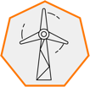


Introducing renewables
1. Sources, advantages and disadvantages of renewable energy
Renewable energy is energy that is collected from resources that are naturally replenished on a human timescale.
Wind
Wind generation converts the kinetic energy of moving wind into electricity.
Wind turbines can be located in onshore or offshore wind farms.
Solar
Solar generation converts radiant energy from the sun into electricity.
Solar panels can be mounted
on roofs or in ground-level
solar farms.
Hydro
Hydro generation converts the kinetic energy in flowing water
into electricity.
This requires water to be stored at altitude, or to be readily available.
7

Slide 8



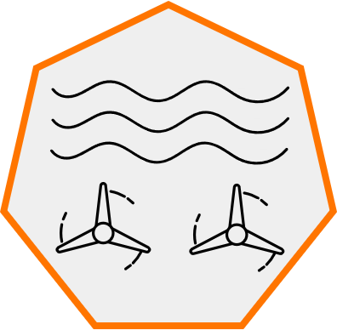
Introducing renewables
1. Sources, advantages and disadvantages of renewable energy
Biofuels
Biofuels are fuels produced from plant materials, including bioethanol, biodiesel and oils.
Fast-growing biofuel crops are grown on farmland.
Geothermal
Geothermal energy extracts
heat stored in deep rocks.
The heat is used directly or to generate electricity.
Tidal
Tidal energy converts the kinetic energy in flowing tidal streams.
This requires fast-flowing, deep tides for a large volume of water.
Think carefully about how each form of renewable energy can
be harnessed and used.
Identify at least one advantage and disadvantage of each form.
List some advantages of combining renewable sources of energy.
8

Slide 9

Advantages and disadvantages of renewables
1. Sources, advantages and disadvantages of renewable energy
Combining renewable energy sources overcomes many limitations. Different areas can make the most of local renewable resources. Different sources can help to balance out differences between supply and demand.
 | Wind | Solar | Hydro | Biofuels | Geothermal | Tidal
Advantages | Easily scaled up Can be offshore | Easily scaled up Can use roofs | Reliable | Portable | Reliable Lots available | Reliable
Disadvantages | Output varies with conditions | Unevenly distributed Output varies with conditions | Unevenly distributed – needs mountains Expensive | Uses land that could be used to grow food | Unevenly distributed | Expensive Marine habitat damage
Which other engineering technologies might help to make
renewables as reliable and dependable as our current energy supply?
9

Slide 10
Renewables and nuclear energy
1. Sources, advantages and
disadvantages of renewable energy
Nuclear energy is non-renewable but is often considered alongside renewable energy.
The heat from fission reactions is used as a replacement for the combustion of fossil fuels.
Nuclear energy can offer significant advantages – but also significant disadvantages:
 | Nuclear
Advantages | No carbon emissions during operation. Enormous amounts of energy from uranium fuel. Uranium supplies are predicted to last well over 200 years.
Disadvantages | Hazardous, long-lasting nuclear waste. Very expensive and slow to build. Very expensive and slow to decommission.
Decide whether you think nuclear energy should form part of a zero
carbon energy system in the future – be ready to justify your position.
10
10

Slide 11

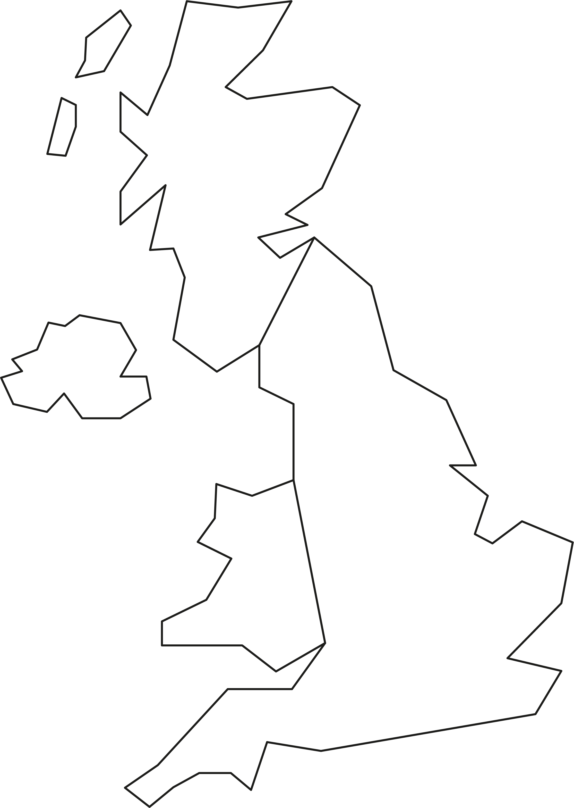
How could we become a renewable UK?
1. Sources, advantages and disadvantages of renewable energy
The UK offers many possibilities for harnessing renewable energy, but these are not evenly distributed.
Public opinion can also play a role in how renewable energy sources can be used.
Consider how different forms of renewable energy
could each contribute to a UK that is 100% powered
by renewables.
Label the map with your ideas about how some or all forms could be more widely implemented across the UK.
Identify some challenges and how these might be overcome.
11

Slide 12
How could we become a renewable UK?
1. Sources, advantages and disadvantages of renewable energy
The UK has some of the world’s best conditions for wind energy, and about half
of Europe’s available tidal energy. Solar energy is most available in southern regions.
Offshore wind around the coast and in the North Sea, but needs expensive maintenance and connection to the mainland.
Tidal energy is available along the west coast and where strong tides occur
but needs to avoid damage
to marine environments
or shipping.
Solar generation – mainly in the south and west, but needs to work alongside farming and food security.
Existing hydro in
mountainous regions –
new forms of energy storage
may be cheaper to build.
Onshore wind in hilly and coastal areas, but needs to overcome visual objections.
12

Slide 13

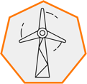



Renewable energy and engineering careers
1. Sources, advantages and disadvantages of renewable energy
Planning and feasibility
Identifying and modelling opportunities for renewable
energy generation.
Design
Designing wind turbines and solar panels, or installations like wind or solar farms.
Construction
Constructing new wind and solar farms, or other forms of renewable generation.
Maintenance
Making sure renewable generation stays safe
and efficient.
Distribution and integration
Linking renewable generation to the national grid.
Energy storage
Designing, building and maintaining new battery grid storage to even out supply to meet demand.
13

Slide 14
Learning outcomes
1. Sources, advantages and disadvantages of renewable energy
You will be able to:
Explain the link between fossil fuel consumption and climate change.
Suggest some advantages and disadvantages of different forms of renewable energy.
Identify some challenges and opportunities related
to a transition to renewable
energy.
Identity engineering career opportunities related to renewable energy.
14

