Slide 1
Robotics
2. Industrial robotics
design principles

Slide 2
2. Industrial robotics design principles
2

Slide 3



Learning outcomes
2. Industrial robotics design principles
You will be able to:
List some common types of industrial robot design, identify key features and work envelopes of
each type.
Describe the operation
of a closed-loop servo control system for
a robot joint.
Identify applications
of each robot type,
using your examples
to contrast robotics
with automation.
Image © This Is Engineering
3

Slide 4


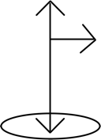
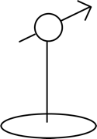
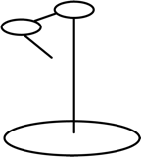
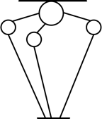

Industrial robot designs
2. Industrial robotics design principles
Different robot designs provide optimal solutions to a wide range of material handling and processing tasks.
The key difference is in how each design uses rotary or linear actuators to create different axes and types of movement.
Articulated arm
Cartesian/
Gantry
Polar/
Cylindrical
Spherical
SCARA
Delta
How would you describe each of these industrial robot designs?
What design features make each one distinctive?
4

Slide 5


Industrial robot designs
2. Industrial robotics design principles
Articulated arm
Base with rotating joint
Two to ten further joints each provide a degree of motion
Cartesian/Gantry
One, two or three dimensions (axes)
High accuracy
Desktop to extremely large
Polar/Cylindrical
Rotating shaft and extendible arm
Cylindrical robots can also move up and down the shaft
Spherical
Two rotary joints control direction
One linear joint controls extension
SCARA
Selective Compliance Assembly
Robot Arm
Rotary joints enable x-y motion
Faster than cartesian
Delta
Three arms control the working end of the robot
Light payloads only
Very fast and precise
Identify one advantage and one limitation of each design.
Suggest some industrial sectors and working environments where each design might be used.
5

Slide 6

Answers
2. Industrial robotics design principles
Articulated
arm
Cartesian/
Gantry
Polar/
Cylindrical
Spherical
SCARA
Delta
+
Almost complete
freedom of movement
Complex to program
Scalability
Large floor
area required
Relatively
simple
Can’t reach
around
objects
Large work space
Restricted
reach within workspace
Fast
Limited to two dimensions
Fast and accurate
Light
payloads
only
-
6

Slide 7
Answers
2. Industrial robotics design principles
Articulated
arm
Cartesian/
Gantry
Polar/
Cylindrical
Spherical
SCARA
Delta
Assembly
Welding
Coating
Picking
Packing
CNC
Milling
Material handling
Assembly
Coating
Machine tending
Material handling
Die casting
Injection moulding
Welding
Material handling
Assembly
Palletising
Pick and place
What information might an engineer want to know when selecting
and placing robots in a work cell?
7

Slide 8





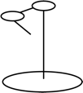

Work envelopes
2. Industrial robotics design principles
Engineers need to understand the volume and shape of the space each type of robot (and specific models) can reach, and any limitations on this. The work envelope is the volume of space that the end of the robot arm can reach. Each type of robot has a distinctive work envelope.
Articulated arm
Cartesian/
Gantry
Polar/
Cylindrical
Spherical
SCARA
Delta
Sketch the work envelope for each type of robot.
Give reasons why a robot arm may not be able to complete all tasks in all parts of its work envelope.
Suggest why the effective work envelope for a robot with a tool may differ slightly.
8

Slide 9
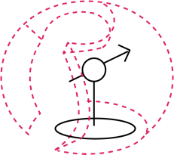
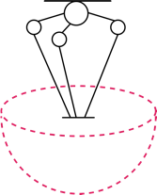
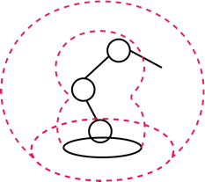
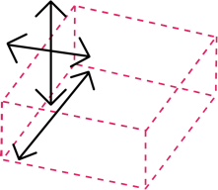
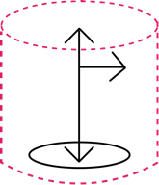
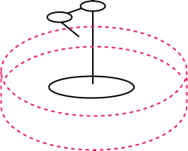
Answers
2. Industrial robotics design principles
A robot may not be able to carry its maximum payload at full extension.
A tool may extend the work envelope (including dead space) by the length of the tool.
A robot needs to accurately and precisely sense its position in its working envelope.
Articulated arm
Cartesian/
Gantry
Polar/
Cylindrical
Spherical
SCARA
Delta
Sketch how a control system can enable precise control.
9

Slide 10

2. Industrial robotics design principles
Closed loop servo control systems
Servo stands for ‘servomechanism’ and describes any system that includes
negative or ‘balancing’ feedback that reduces any error.
A motor is given instructions to rotate a robot arm joint.
A rotary encoder reports the rotary position of the joint 500 times per second.
Discuss how the diagram illustrates negative feedback.
Input
Error
Output
Joint
motion
Motion instructions
Motor controller
Motor
Rotary encoder
Feedback
10

Slide 11
Robotics v automation: what do you think?
2. Industrial robotics design principles
Robotics and automation are closely related and both make use of microprocessors, PLCs and control loops.
Are automation and robotics the same thing?
Is robotics a subset of automation, or can you think of other examples
of robotics that go beyond this? Which Venn diagram best represents your view?
Automation
Automation
Robotics
Robotics
11

