Slide 1
CNC
machinery
1. Understanding CNC machines

Slide 2
Practitioner guide
1. Understanding CNC machines
2

Slide 3

Introduction and overview
1. Understanding CNC machines | Practitioner guide
These resources help practitioners to deliver the CNC machinery components of engineering and manufacturing-related qualifications at levels 2 and 3. They introduce the topic and stimulate learners to explore and reflect on key concepts and are designed to complement and enhance practitioners’ own lesson materials and schemes of work.
Resources summary
Prerequisites – there are no required prerequisites but the Level 2 resource in the Microcontroller systems module introduces learners to the concept of control systems, which is mentioned in these resources.
Resource name | Level | PPT slides + notes - practitioner | PPT slides - learner | Activity sheets | Film | Interactive
1. Understanding CNC machines | 2 |  |  | 2
Delivery
Delivery suggestions for practitioners, and suggested answers where appropriate, are in the presenter’s notes for each slide. The core activities in each resource provide around 60 mins learning time, though additional suggestions, including independent learning, can extend this time significantly.
Overarching theme/big questions
How can CNC machines help us work faster and smarter?
What is the future for CNC machines?
Overview
The Level 2 resource introduces definitions for CAD, CAM and CNC, and common types of CNC machine. It also helps learners to identify advantages of CNC and where manual machining may still be preferable.
The Level 3 resources help learners to select a CNC machine to use and identify wider considerations when selecting CNC machines, reflect on important safe working practices, follow and optimise simple G-code, consider some advantages of indexed and continuous multi-axis CNC. They also support learners to reflect on how additive CNC may work alongside other technologies in ‘smart factories’ and how these developments may shape their career.
3

Slide 4
Learning outcomes and resource links
1. Understanding CNC machines | Practitioner guide
Level 2 resource
Understanding CNC machines
Know what CAD, CAM and CNC stand for and be able to
define each.
Identify and describe common forms of CNC machining.
Identify some advantages and disadvantages of using CNC.
Full resource list available for the topic of
CNC machinery:
1. Understanding CNC machines (Level 2)
2. Using CNC machines (Level 3)
3. Programming CNC machines (Level 3)
4. The future of CNC (Level 3)
Links to other supported topics
Innovation and emerging technologies,
Microcontroller systems, Robotics.
4

Slide 5
Subject coverage
1. Understanding CNC machines | Practitioner guide
CNC machines
Defining CNC
Defining CAD/CAM and their roles within CNC
Highlighting common CNC machines and their different applications/roles
Advantages and benefits of CNC
Including careers
Careers with CNC
5

Slide 6
CNC
machinery
1. Understanding CNC machines
6

Slide 7
Learning outcomes
1. Understanding CNC machines
You will be able to:
Know what CAD, CAM and CNC stand for and be able to define each.
Identify and describe common forms of
CNC machining.
Identify some
advantages and disadvantages
of using CNC.
Image © This Is Engineering
7

Slide 8


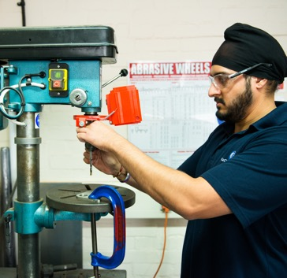
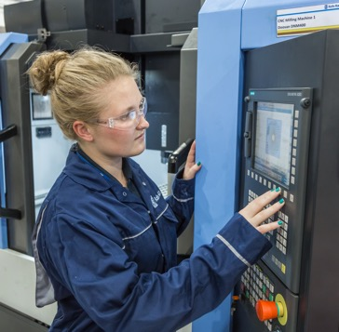

What does CNC mean?
1. Understanding CNC machines
CNC machines are used in a wide range of engineering and manufacturing environments.
Discuss the two images on the left. What is the key difference that helps to explain what CNC means?
Can you expand and define the following terms: CAD, CAM and CNC?
Image © This Is Engineering
8
Notes:
Practitioner delivery notes
This resource helps learners to review and reinforce their current knowledge of CNC and its relationship with CAD/CAM before identifying some advantages of CNC and when manual machining might still be preferable. This introduction allows learners to define CNC in their own words and based on their previous experiences. The examples you use to complement this resource should build on learners’ existing experiences of using machines in your workshop or while on or preparing for their industry placement.
Starter activity
Ask learners to first discuss in groups their current understanding, experiences and ideas of what CNC means and its role within manufacturing, recording their ideas on sticky notes, a concept map or an online tool such as Google Jamboard. Learners should consider the two images on the slide to help guide their thinking.
As a whole class, learners can agree a definition of what CNC stands for and means. What are the key words/vocabulary they are using?
To extend their learning, learners discuss and report back on what they think CAD and CAM stand for and mean and how they are linked to CNC.
Activity sheet
Learners expand and define CAD, CAM and CNC in their own words on CNC machinery - Activity sheet: section 1a.
Film
Before moving to the next slide learners can watch the CNC machinery film.
Example answers
The key difference between the images is that the machine on the right is being controlled by a computer, which suggests that it is following a pre-programmed set of instructions.
Please also see the next slide.
Assessment
Discussion and verbal answers for learners’ current understanding and experiences of CNC applications/machines.
Written definitions of CNC, CAD, CAM.
Ability to suggest examples of CNC.

Slide 9

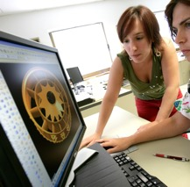


What does CNC mean? Answers
1. Understanding CNC machines
Design code
Tool path code
CAD: computer-aided design
CAD uses computer software to create digital designs for objects or components.
CAM: computer-aided manufacturing
CAM uses computer software to generate tool paths and instructions
to create these designs. (Also known as computer-aided modelling.)
CNC: computer numerical control
CNC codes drive toolhead and machine movements to machine materials and form these designs.
CNC is a form of automation and therefore requires a control system with
inputs, processing, outputs and feedback.
Describe what the input, control, output and feedback elements a CNC machine might be (their type) or do (their function).
Image © This Is Engineering & rawpixel.com on Freepik
9
Notes:
Practitioner delivery notes
Activity
Review the definitions of CAD, CAM and CNC on the slide.
Definition of CNC - computer numerical control is the automated control of machining tools (such as drills, lathes, mills, grinders, routers and 3D printers) by means of a computer.
Learners can discuss how this relates to CAD and CAM.
Definition of CAD – Computer-aided design is the use of computers to aid in the creation, modification and analysis of a design. CAD output is often in the form of electronic files for print, machining, or other manufacturing operations.
Definition of CAM – Computer-aided manufacturing (also known as computer-aided modelling) is the use of software to control machine tools in the manufacturing of work pieces.
A CNC machine is a motorised maneuverable tool and often a motorised maneuverable platform, which are both controlled by a computer, according to specific input instructions. Instructions are delivered to a CNC machine in the form of a sequential program of machine control instructions such as G-code and then executed. The program can be written by a person or generated by graphical computer-aided design (CAD) or computer-aided manufacturing (CAM) software. In the case of 3D printers, the part to be printed is ‘sliced’ before the instructions (or the program) are generated. 3D printers also use G-Code.
Activity sheet
Learners suggest inputs, processing, outputs and feedback elements of a CNC machine on CNC machinery - Activity sheet 1b.
Example answers
Please see the next slide.
Assessment
Written answers.

Slide 10
The CNC control process
1. Understanding CNC machines
CNC is an example of automation and so it is helpful to think of a CNC machine as a control system:
Input
Output
Finished
workpiece
Input
device
Machine control unit
Machine drive system
A display monitor shows
the program and other
control or operating data​.
Computer or microprocessor follows input instructions,
adjusts in response to feedback.
Amplifier circuits drive
motors and ball lead
screws that control the
tool head.
This control
system is
common to all types
of CNC machines.
Can you name or describe some different types of CNC machine?
Feedback
Sensors
Position and speed transducers continuously monitor the tool head.
10
Notes:
Practitioner delivery notes
It’s not essential that learners have prior knowledge and understanding of control systems. However, the Level 2 resource in the Microcontrollers module provides an introduction. You may wish to watch the Microcontrollers film.
Activity
Review the control diagram to explore how a CNC machine uses inputs, a controller, outputs and feedback sensors.
Highlight that while most CNC now uses a computer file, earlier versions of CNC used punched cards or magnetic tape to load instructions.
Learners discuss and suggest examples of specific types of CNC machines they have heard of or think they may encounter.
Example answers
Please see the next two slides.
Assessment
Discussion and verbal answers.

Slide 11
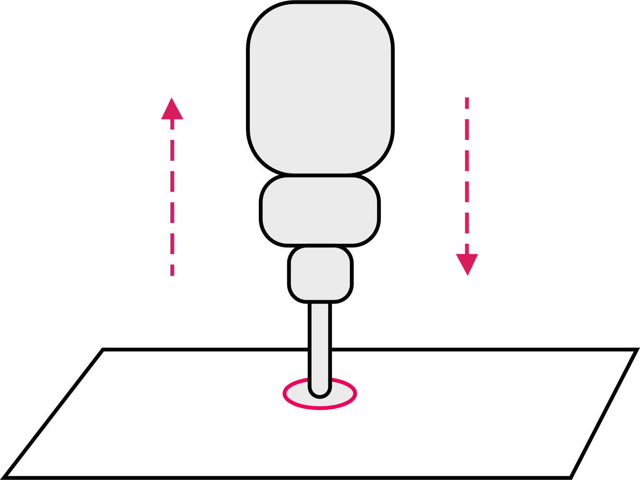
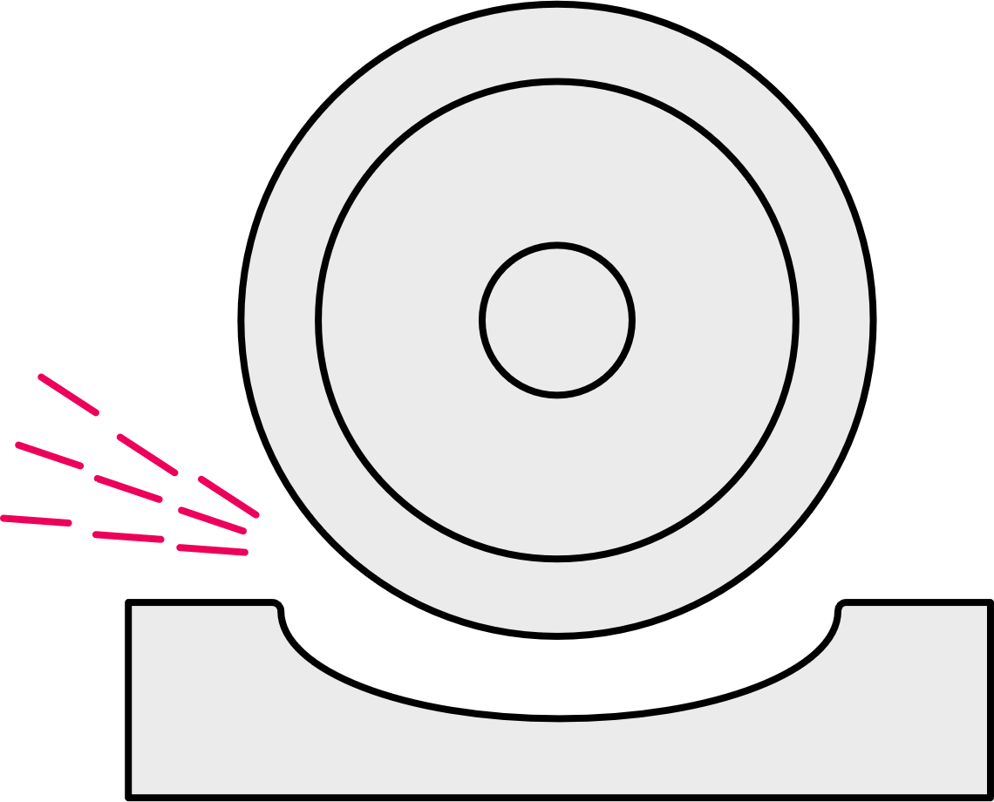
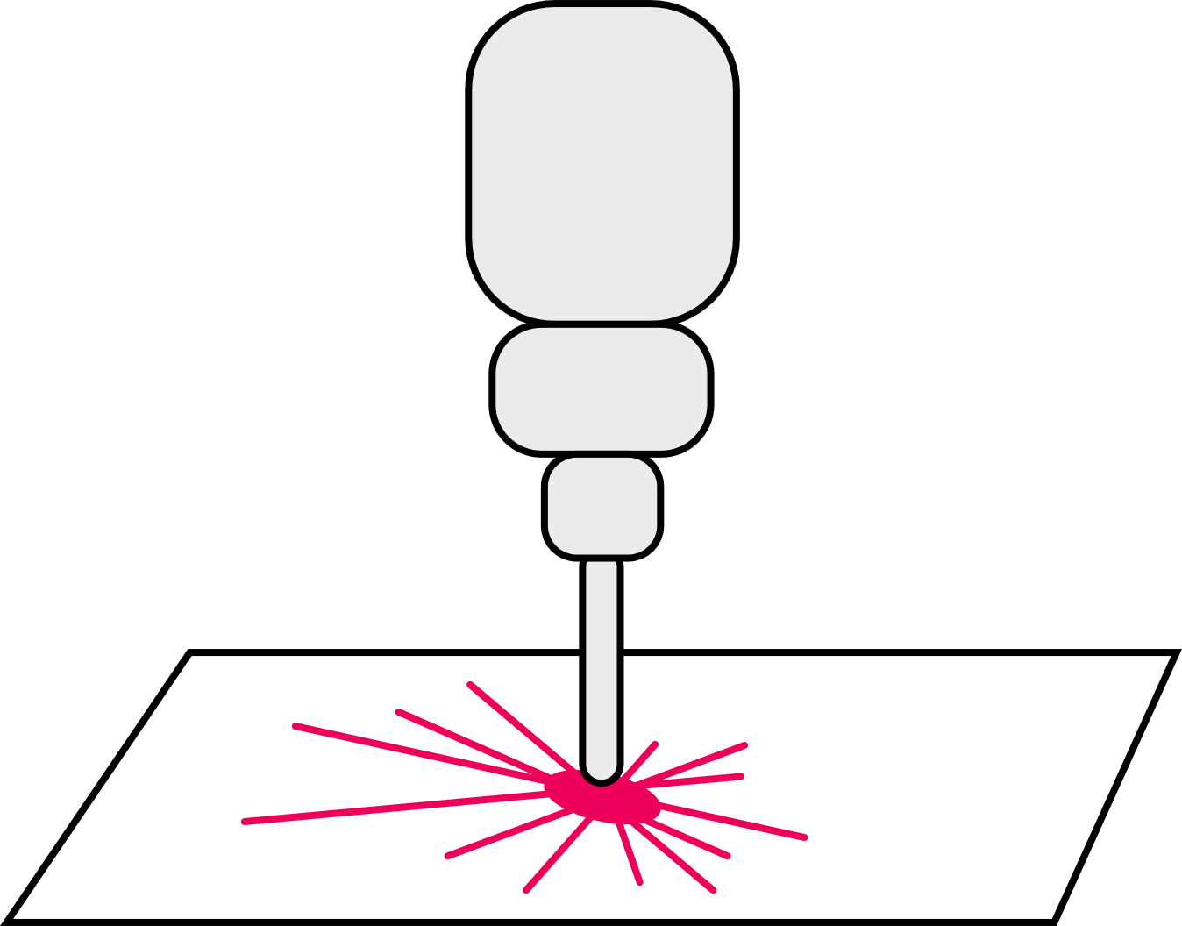
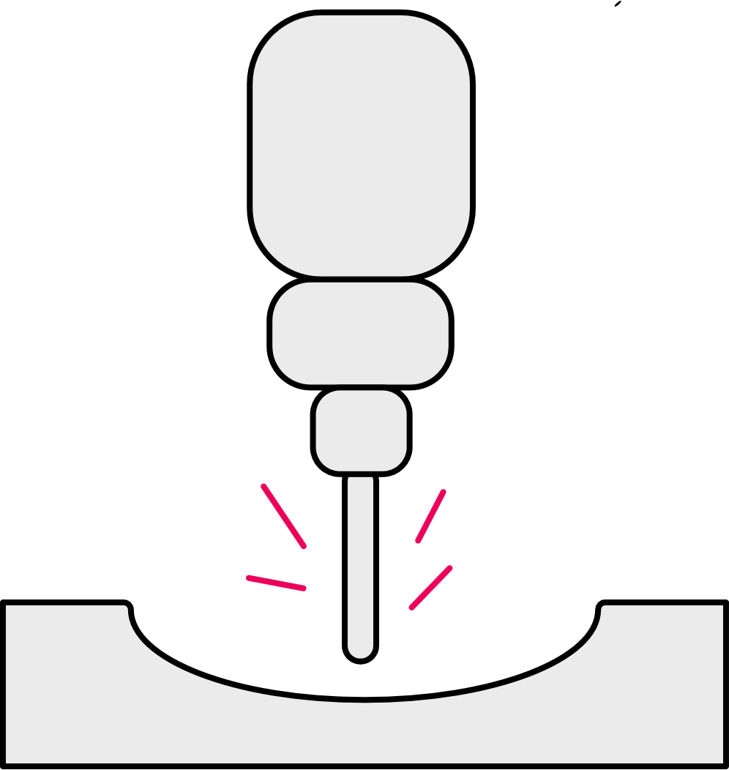
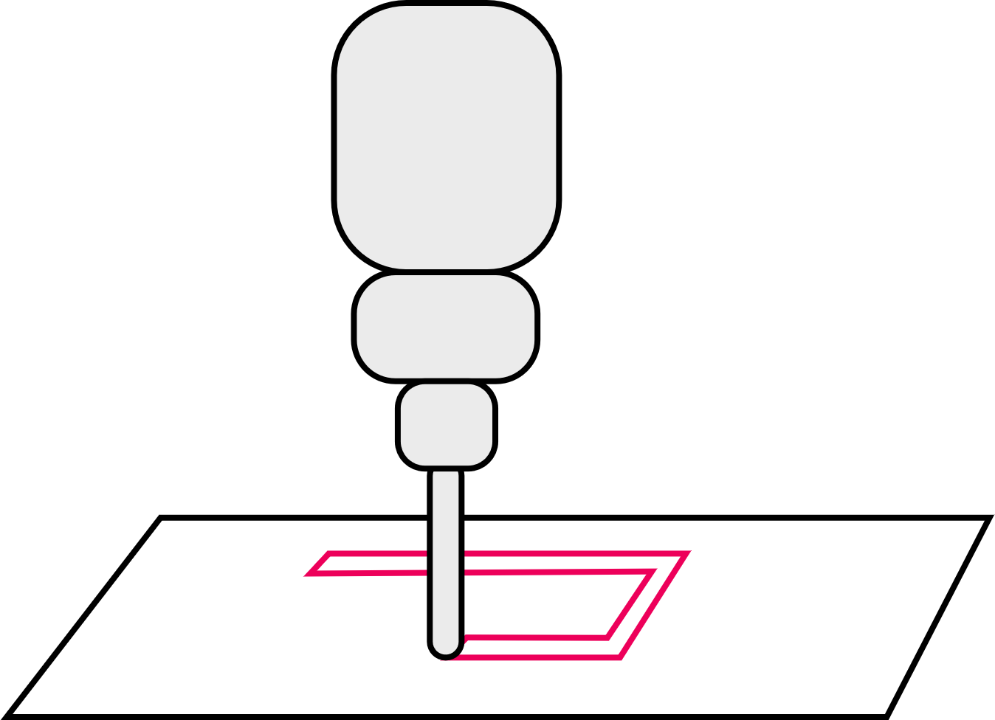
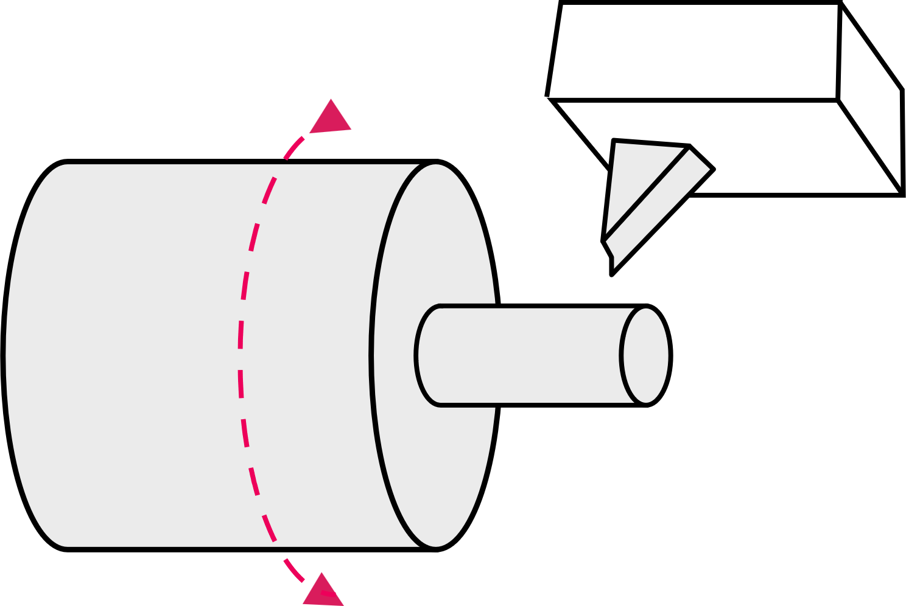
Common CNC machines
1. Understanding CNC machines
Laser or
plasma cutting
Drilling
Grinding
Lathe
Milling
Router
Drilling, reaming
or tapping holes
of different depths
and diameters.
An abrasive
wheel or cylinder produces a fine, accurate finish.
Cutting that uses
a laser or plasma
to create a cut
line and edge in sheet material.
Cutting a cylinder of material as it spins on an axis.
Detailed, precise cutting of hard materials in 3D.
Simple cutting
of softer materials, usually sheet material.
Discuss each type of machine:
What type of components can be produced?
What type of materials can be used?
11
Notes:
Practitioner delivery notes
Activity
Review the types of CNC machine on the slide. (Please note that all examples used in this resource are subtractive - you may wish to see if learners can identify this. Additive CNC machines are covered in the later resource in this module 4. The future of CNC.)
Explain that for the CNC drill, reaming is to widen or finish a hole, and tapping is to create a screw thread in a hole so it can receive a bolt.
Example answers
Please see the next slide.

Slide 12
Common CNC machines
1. Understanding CNC machines
Laser or
plasma cutting
Drilling
Grinding
Latahe
Milling
Router
Adding holes and screw threads to parts in almost any material, shaped using other CNC machines.
Creating a fine finish on parts shaped using other CNC machines.
Cutting shaped parts from sheet metal such
as flat components, lattice or grid parts,
or certain small gears.
Cylindrical parts
in metals or wood
including furniture
parts, axles,
bolts, camshafts.
Any 3D metal part
such as engine blocks, structural parts, bevel, screw or worm
gears, impellers.
Cutting shaped parts from wood, plywood, MDF or laminated composites such as
flat components, furniture parts.
These are all examples of subtractive manufacturing, where material is removed to create the finished part.
12
Notes:
Practitioner delivery notes
Activity
Review the suggested applications for each type of CNC machine.
Highlight how each machine may be used for other materials as well as those listed. For example, a laser cutter might also cut plywood or acrylic, but perhaps in a hobby environment rather than an engineering workshop.
Note that all these examples are of subtractive manufacturing. (In resource 4. The future of CNC, learners will be introduced to some additive manufacturing technologies.)
Assessment
Discussion and verbal answers.
Extension
Learners can discuss the types of component they might or did make while on work placement or in their first job and the types of CNC machines these components might require.

Slide 13
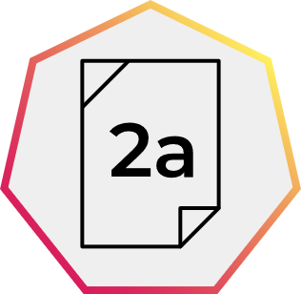
Why is CNC used?
1. Understanding CNC machines
CNC machines, along with CAD/CAM packages, can represent a significant investment cost to buy and overhead cost to maintain. However, this can be offset by the reduced cost of hiring and training skilled labour to manually produce parts.
What broader advantages
might motivate a company to invest in CNC?​
Are there any other disadvantages to investing in CNC that the company might need to consider?
Image © This Is Engineering
13
Notes:
Practitioner delivery notes
The ideas in this activity are extended in resource 4. The future of CNC, which looks at additive CNC manufacturing and smart factories that integrate CNC with robotics, internet of things devices, and large data sets that are analysed using artificial intelligence. It’s important to recognise that increased automation presents risks to traditional engineering or manufacturing jobs, but also creates new and exciting opportunities.
Activity
Highlight that CNC represents a significant investment but may lead to lower labour costs.
Learners discuss and identify other potential advantages of using CNC (you may wish to ask learners to contrast a small and high-volume manufacturer, although this is teased out more in the next slide), as well as any other potential disadvantages.
Activity sheet
Learners write their ideas on CNC machinery - Activity sheet 2a.
Example answers
Please see the next slide.
Assessment
Written work.
Extension
Learners could extend their thinking by considering advantages and disadvantages when installing and when using CNC machines.

Slide 14
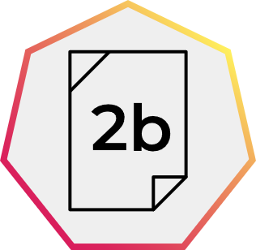
Why is CNC used? Answers
1. Understanding CNC machines
Advantages | Disadvantages
Safer – operators are not exposed to material or cutting tools. Can run 24 hours a day, for higher productivity and large production volumes. Higher degree of control, for higher quality and consistency. Range of processes (drill, cutting, mill, threading, tapping etc.) creates flexibility. Reduces wastage – helps with overall production costs. More complex multi-axis machines can produce complex forms. Feedback systems indicate wear for planned maintenance and less unplanned downtime. | Operators need training, including in simple computer operation. May lead to workforce redundancies. Faults require highly skilled maintenance, usually contracted in. Faults may halt entire production line.
Use your answers
to consider what advice you would give to a small local company that produces a range of bespoke designs.
Are there reasons to use manual machining, or should they also invest in CNC?
14
Notes:
Practitioner delivery notes
Activity
Review the advantages and disadvantages on the slide.
Learners consider the relevance or benefits of CNC for a small, low-volume manufacturer.
Activity sheet
Learners write their ideas on CNC machinery - Activity sheet 2b.
Example answers
Please see the next slide.
Extension
Learners could extend their thinking by writing their answer as an email response with questions and suggestions for the small company to consider.

Slide 15
CNC in small-run settings
1. Understanding CNC machines
Manual machining still has many advantages for a small-run or bespoke engineering company:
Lower set up costs and overheads​.
Responsive: easier to make changes and experiment with ideas.​
Shorter turnaround time to set up machines.
Skilled operators understand machine limitations.
Ideal for simple components, low volume​.
However, even if producing small numbers of parts, these may need to be machined to exacting specifications, in which case customers may be willing to pay the increased cost for precision parts made using CNC.
These customers may include:
aerospace
research and development
scientific research
space exploration
other precision engineering companies who outsource work.
Image © This Is Engineering
15
Notes:
Practitioner delivery notes
Activity
Review the suggested benefits of manual machining on the slide.
Extension
Learners could research local engineering firms and find out how they combine manual with CNC methods. What factors influence these companies’ choices?
Small-run CNC machines can be very large: www.youtube.com/watch?v=u_PFOQSyKBE

Slide 16
CNC in your engineering career
1. Understanding CNC machines
What parts or products are produced in the
engineering or manufacturing sectors of interest to you?
What types of CNC machine will produce these?
A CNC operator is seen as a highly skilled job. What knowledge and skills do you think a CNC operator needs?
Image © This Is Engineering
16
Notes:
Practitioner delivery notes
This open-ended activity helps learners to start thinking about the relevance of CNC machining skills to their possible careers.
Activity
Learners suggest what sectors are of interest to them as a possible career, for example aerospace, light engineering, transport or automotive, health, agriculture etc.
In small groups, learners discuss the questions on the slide and share ideas. Learners can generate a list of things to consider or questions to ask as they research possible entry positions and careers.
Extension
Learners can use online job sites to research various careers involved with CNC machines by looking through job requirements, qualifications and attributes required etc.
Invite local CNC companies to visit and chat with learners about local opportunities.

Slide 17
CNC in your engineering career – example
1. Understanding CNC machines
Sector | Part or product | CNC machines used | Knowledge and skills needed
Motorbike engineering | Brake levers | Mill – to shape Drill – create and tap holes Grinder – finish surface | Machine safety Personal safety and protection Machine operation Machine control (eg program loading) Material properties Required tolerances and quality level
17
Notes:
Practitioner delivery notes
Activity
Review the example answer on the slide.

Slide 18
Learning outcomes
1. Understanding CNC machines
You will be able to:
Know what CAD, CAM and CNC stand for and be able to define each.
Identify and describe common forms of
CNC machining.
Identify some
advantages and disadvantages
of using CNC.
Image © This Is Engineering
18

