Slide 1
Robotics
4. Planning for safety and performance

Slide 2
Practitioner guide
4. Planning for safety and performance
2

Slide 3

Introduction and overview
4. Planning for safety and performance | Practitioner guide
These resources help practitioners to deliver the robotics components of engineering and manufacturing-related qualifications at levels 2 and 3. They introduce the topic and stimulate learners to explore and reflect on key concepts and are designed to complement and enhance practitioners’ own lesson materials and schemes of work.
Resources summary Prerequisites – it is recommended that learners complete all resources in the Microcontroller systems module and 1. Introducing robotics and 2. Industrial robotics design principles and 3. Control and coordinates before starting this resource.
Resource name | Level | Ppt slides + notes - practitioner | Ppt slides - learner | Activity sheets | Film | Interactive
4. Planning for safety and performance | 3 |  |  | 2
Delivery
Delivery suggestions for practitioners, and suggested answers where appropriate, are in the presenter’s notes for each slide. The core activities in each resource provide around 60 mins of learning time, though additional suggestions, including independent learning, can extend this time significantly.
Overarching theme/big questions
What is a robot and how are they controlled?
What advantages do robots provide today and how might new forms of robot help us in the future?
Overview
The Level 2 resource provides a bridge between Level 2 and Level 3. It helps learners to explore the range of robots available and the settings in which they can be found, and from this, to develop a working definition of a robot in engineering terms. From there, learners generate ideas for a robot of the future, defining its purpose and explaining how it might operate.
The Level 3 resources build on the Level 2 introduction to explore three areas of robotics: how robots integrate a range of systems and contribute to process automation, how to control a robot end effector using different sets of coordinates, and how future robots might use innovative materials, forms of movements and artificial intelligence (AI).
3

Slide 4
Learning outcomes and resource links
4. Planning for safety and performance | Practitioner guide
Level 3 resource 3
Planning for safety and performance
Identify safety considerations and human dangers when working alongside robots.
Review the application and effectiveness of safety systems.
Apply your understanding of robotics design principles to plan a simple robot work cell, suggesting effective safety features and practices.
Full resource list available for the topic of Robotics:
1. Introducing robotics (Level 2)
2. Industrial robotics design principles (Level 3)
3. Control and coordinates (Level 3)
4. Planning for safety and performance (Level 3)
Links to other supported topics
CNC machinery, Innovation and emerging technologies, Microcontroller systems.
4

Slide 5
Subject coverage
4. Planning for safety and performance | Practitioner guide
Robotics
Hazards
Safety devices
Safe working
Work cell designs
Material flow
Work cell planning
Health and safety planning
Including careers
Examples of careers that would require or implement robotics solutions.
5

Slide 6
4. Planning for safety and performance
6

Slide 7


Learning outcomes
4. Planning for safety and performance
You will be able to:
Apply your understanding of robotics design principles to plan a simple robot work cell, suggesting effective safety features and practices.
Identify safety considerations and human dangers when working alongside robots.
Review the application and effectiveness of safety systems.
7

Slide 8

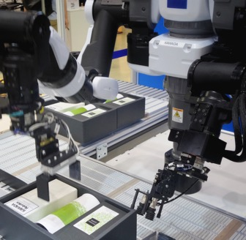

Hazards around industrial robots
4. Planning for safety and performance
Hazards
Impacts
Crushing
Electrical
End effector or tool
Environmental (eg paint spray, swarf)
Mechanical fault
Control fault
Causes
Entry into work envelope or tool area
Mechanical breakdown
Electronic breakdown
Incorrect programming
Incorrect installation
Incorrect operation or change to programmed operation
What safety steps can be taken to mitigate or remove these hazards?
Discuss which of these steps takes place before operation and which might take place once operation begins.
8
Notes:
Practitioner delivery notes
This Level 3 resource introduces learners to some key safety concepts around industrial robotics, and some considerations and design principles when planning robotic work cells. In the main activity learners choose the cell design, robot choice and number to plan a simple work cell before identifying key safety features to include, as well as other safety considerations. Learners should be familiar with the main forms of industrial robot.
You can extend the activities to include the relevant health and safety legislation, and specific maintenance routines, equipment and requirements, linking where possible to learners’ industry placements, work experience or employer visits.
Starter activity
Discuss a typical industrial robot or work cell like the one pictured on the slide. Ask learners to identify how each cause might lead to one or more of the hazards. Learners can discuss in pairs or groups before discussing as a class.
Example answers
Safety steps can be included in the design, programming, operation and maintenance of a robotic work cell and could comprise safety devices, and safe working practices and procedures.
Before operation, appropriate safety devices should be incorporated into the design, installation and commissioning of the plant. Within this process, appropriate safe working practices and procedures should be developed, drawing on the relevant legislation, best practice codes, and manufacturer information and guidance. These should be incorporated into the training given to employees before they use the equipment.
Employees should follow these safe working practices and procedures when operating or maintaining the equipment.
Assessment
Verbal discussion.

Slide 9
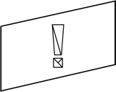
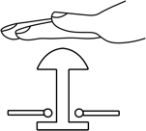



Safety devices and procedures
4. Planning for safety and performance
Safety devices can be designed into the robot work cell (operating area):
Fences and guards
Hold and emergency stop buttons
Presence sensors
Pressure mats
Enabling device/
Dead man’s switch mats
Interlocks
Safety procedures include programming, training and safe standard operating procedures (SOPs) for operation, planned and unplanned maintenance.
Discuss how each device contributes to maximum safety around an industrial robot.
Identify any factors that might influence the effectiveness of each device.
9
Notes:
Practitioner delivery notes
Activity
Introduce the idea of a work cell (learners will explore this in more detail shortly) and ask learners to imagine the layout of a cell in a factory or industrial setting.
Learners suggest the meaning and function of each safety device.
They then identify how each one contributes to a safe working environment and any factors that might influence its effectiveness.
Example answers
Please see the next slide.
Assessment
Verbal answers and discussion.
Extension
Learners identify safety devices in your workshop and when on industry placement, work experience or an employee visit.

Slide 10
Safety devices and procedures
4. Planning for safety and performance
Fences and guards are physical barriers to prevent entry and protect from flying material. | BUT: They need to be closed. Interlocks and microswitches can prevent operation if they are open.
Hold buttons pause or slow operation but don’t provide operator safety. Emergency stop buttons cease operation immediately and completely. | BUT: Buttons need to be correctly wired into the control circuit and used after operator training.
Presence sensors and pressure mats detect when a human is within a certain area or distance and can be mounted on the work cell or on the robot itself. | BUT: To work well they must be located and calibrated to protect the working area.
An enabling switch must be pressed at the same time as the start button. A dead man’s switch must be held at all times to enable operation. | BUT: Both need to be correctly wired into the control circuit and used after operator training.
Interlocks connect two systems to prevent something from happening, for example to detect an open safety fence and prevent operation until closed. | BUT: Interlocks need to be placed to prevent each possible unwanted event and must be included in the safety programming for the robot and work cell.
10
Notes:
Practitioner delivery notes
Activity
Review the answers on the slide.

Slide 11
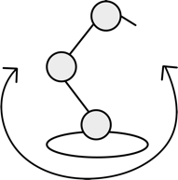
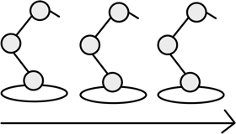
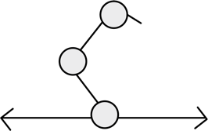
Robotic work cells
4. Planning for safety and performance
Work cells are where robotic systems perform their tasks. The work cell contains the robot(s), control system(s), tool areas and other necessary components. Work cells are optimised to maximise productivity and safety and minimise waste. A work cell can be:
Discuss some advantages and suitable applications for each type of robotic work cell.
How might material flow from one cell to another and within a cell?
Robot-centred
Designed around a single robot.
In-line
Several robots work in a line.
Mobile
One robot moves along a rail.
11
Notes:
Practitioner delivery notes
Activity
Learners have already met the term ‘work cell’ at the start of this resource but review the definition and help learners understand that the work cell includes everything needed for the robot(s) to complete their tasks. For example, this may include a tool storage area where the robot can exchange tools to perform different tasks or machine operations, such as changing a drill bit or milling tool.
Discuss each type of work cell design:
A robot-centred cell is usually designed around a single robot or may include several that work together to complete complex tasks.
In-line work cells are found where material or components flow in and out of the cell.
The robot(s) in a mobile work cell can move from one place to another, usually along a floor or ceiling rail (known as the 7th axis when 6-axis arm robots are employed).
Learners discuss and answer the questions on the slide.
Example answers
Robot-centred: complex operations like milling or drilling. Material flows intermittently into and out of the cell, for example being brought on pallets or in bins, which may be done by a human operator or an autonomous guided material transport robot.
In-line: assembly operations like welding or adding components, such as during car manufacture. Material flows in and out on a conveyor system (belt or floor) - the next slide explores this in more detail.
Mobile cells enable multiple operations using one robot, for example to place components on several machine tools. Material flows intermittently into and out of the cell.
Assessment
Discussion.
Verbal answers.

Slide 12
Material flows
4. Planning for safety and performance
Material flow is an important aspect of work cell design and contributes to the overall efficiency of a design.
Synchronised
Material stops at each robot, at the same time.
Continuous movement
Material always moves, robots must track and follow.
Non-synchronised
Some material moves, while some is processed.
What is the desired outcome when planning material flow within a work cell?
What factors might influence whether material flow is intermittent, continuous or non-synchronised?
12
Notes:
Practitioner delivery notes
Activity
Briefly discuss the three main ways in which material can flow into and out of a work cell.
Example answers
The desired outcome is maximum efficiency or productivity, both in robot use and overall output.
Influencing factors include the number of operations that will take place, their complexity and time. For example, not all tasks take the same or similar time, and non-synchronised movement may be appropriate if the time differences are significant. But when differences are small, synchronised movement (synced to the slower operation) or continuous movement (at a rate that allows the slowest operation to be completed) may be suitable.
Assessment
Discussion.
Verbal answers.

Slide 13
Plan a robotic work cell
4. Planning for safety and performance
An autonomous guided vehicle (AGV) will deposit a bin of stacked metal components to a robotic work cell. Each component needs to be:
Lifted from the bin.
Processed in a CNC mill to shape the top surface.
Processed in a CNC drill to make holes in the top surface (both processes take about the same time).
Stacked in a finished component bin to be collected by another AGV and moved to another work cell.
13
Notes:
Practitioner delivery notes
This task uses a simple work cell scenario that enables a simple solution - this allows plenty of time for learners to focus on the safety aspects of the work cell.
Starter activity
Introduce the main task: learners must apply their knowledge and understanding to plan a robotic work cell.
Review the key information about the cell.
Learners can discuss and list some factors to consider when developing their plan.
Example answers
Please see the final slides.
Assessment
Written work.
Extension
Learners can explore work cell design and layout in your workshop and when on industry placement, work experience or an employee visit.

Slide 14
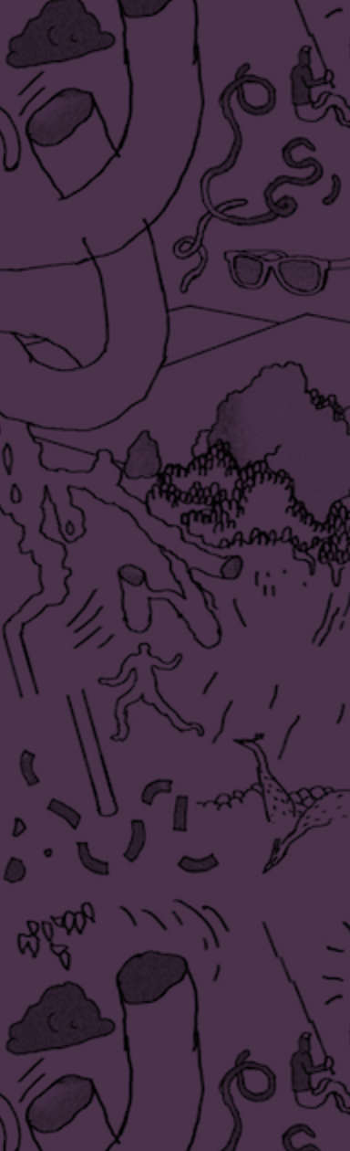

Plan your work cell and material flow
4. Planning for safety and performance
Your cell plan shows how work will enter and leave the cell.
Choose whether your work cell will be robot-centred, in-line or mobile.
Select what type(s) of robot you will include in your work cell: Articulated SCARA Delta Spherical Polar/Cylindrical Cartesian/Gantry
Identify where you will locate the CNC mill and CNC drill.
Sketch the position and size of each robot on the cell plan. Label them to describe the key operational steps.
Sketch a plan view of each robot’s work envelope.
Choose how material will flow through the work cell: Synchronised Continuous Non-synchronised
14
Notes:
Practitioner delivery notes
Starter activity
Review Robotics - Activity sheet 9 with learners, who will add sketches and labels that describe their layout and key operating steps.
Review the instructions on the slide, which are not sequential but must be considered together. Learners can make initial sketches in pencil before producing a final version in pen or using design or presentation software. The size of the CNC machines is not critical but the dimensions given on the activity sheet provide a suitable scale. Learners can choose how large to make their robot(s) depending on where they locate these machines but should bear in mind that larger robots will be more expensive.
Highlight the importance of identifying the simplest effective solution (see extension below).
Activity sheet
Learners will complete their plan on Robotics - Activity sheet 9.
Example answers
Please see the final slides.
Assessment
Written work.
Extension
Learners can consider in qualitative terms some financial considerations of robotic work cell design, for example that the payback time will depend on the initial cost and also on the expected productivity or output of the cell.

Slide 15

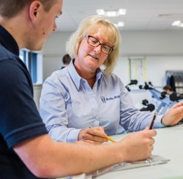
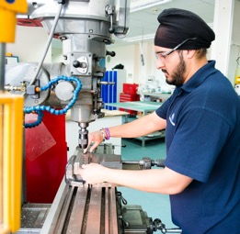
Add safety features and define safe working practices
1. Introducing robotics
On activity sheet 9, add and label safety features that will make your cell a safe working space:
Fences and guards
Hold and emergency stop buttons
Presence sensors
Pressure mats
Enabling device/ dead man’s switch
Interlocks
On activity sheet 10, list some safe working practices that should take place:
when the work cell is in design (being planned and programmed)
when the work cell is in operation.
Image © This Is Engineering
15
Notes:
Practitioner delivery notes
Starter activity
Once learners have established the key features of their work cell, they must ensure that it is safe by adding at least one of each safety device to their plan.
Learners should consider the work envelope of their robot(s) and any human access that might be required.
Learners add and label each device on their plan.
Finally, learners should list some safe working practices to consider during planning and operation. These don’t need to be detailed but can take the form of a checklist of considerations or important actions.
Activity sheet
Learners add safety devices to complete their plan on Robotics - Activity sheet 9 and describe their safe working practices on Robotics - Activity sheet 10.
Example answers
Please see the final slides.
Assessment
Written work.
Extension
Learners can research collaborative robot, or ‘cobot’ safety. Cobots are robots that are designed to work alongside people. Do robots require a different approach to safety or are the same precautions and devices still important to include?

Slide 16
Example solution: activity sheet 9
4. Planning for safety and performance
Fence
Enabler
6-axis arm
Hold/Stop
Hold/Stop
Unprocessed components
Processed components
Interlock
Interlock
Pressure mat in work envelope
Presence sensor
Presence sensor
CNC mill
CNC drill
16
Notes:
Practitioner delivery notes
Activity
Review the example design on the slide. This positions a 6-axis arm and the two CNC machines such that material follows a semicircular route through the cell - the simplest solution. If you would like to talk learners through the process, it is:
Pick unprocessed component and place in CNC mill
Move component from mill to drill
Pick unprocessed component and place in CNC mill
Move component from drill to processed component bin
Move component from mill to drill
Pick unprocessed component and place in CNC mill
Move component from drill to processed component bin
Repeat from b
This is one suitable solution - others will exist and might be better if any factors are different, for example:
The machine tools could be arranged in a line and the arm mounted on a rail for a mobile cell.
More than one robot might be used if one process takes longer than the other or for greater throughput.
Safety devices:
Enabler near control panel
Hold/stop at either end of the cell
Interlocks at access points for material bins
Pressure mat in and around work envelope
Presence sensors cover other areas where an operator could enter
(The arm could have ‘hard’ safety to ensure it does not rotate out of the work area, such as microswitches on the rotating base.)also

Slide 17
Example solution: activity sheet 10
4. Planning for safety and performance
Safe working practices during design:
Follow manufacturer’s guidance
Follow health and safety legislation and codes of practice
Identify all hazards and ways to mitigate or remove them
Design safe operating procedures
Design safety training
Include safety signage
Safe working practices during operation:
Follow manufacturer’s guidance
Follow health and safety legislation and codes of practice
Only authorised employees operate the cell
Only authorised employees maintain the cell
Train all employees to follow safe operating procedures for use and maintenance.
Keep to maintenance schedule to ensure optimum performance.
17
Notes:
Practitioner delivery notes
Activity
Review the safe working practices on the slide. What else can learners think of?
Link learners’ ideas to safe working practices in your workshop and encourage learners to always stay safe when in an industrial or robotic environment by being prudent and always following safe practices. It is always safer to pause and ask when unsure.

