Slide 1
CNC
machinery
2. Using CNC machines

Slide 2
Practitioner guide
2. Using CNC machines
2

Slide 3

Introduction and overview
2. Using CNC machines | Practitioner guide
These resources help practitioners to deliver the CNC machinery components of engineering and manufacturing-related qualifications at levels 2 and 3. They introduce the topic and stimulate learners to explore and reflect on key concepts and are designed to complement and enhance practitioners’ own lesson materials and schemes of work.
Resources summary
Prerequisites – it is recommended that learners complete 1. Understanding CNC machines before starting this resource. There are no other required prerequisites but the Level 2 resource in the Microcontroller systems module introduces learners to the concept of control systems, which is mentioned in these resources.
Resource name | Level | PPT slides + notes - practitioner | PPT slides - learner | Activity sheets | Film | Interactive
2. Using CNC machines | 3 |  |  | 2
Delivery
Delivery suggestions for practitioners, and suggested answers where appropriate, are in the presenter’s notes for each slide. The core activities in each resource provide around 60 mins learning time, though additional suggestions, including independent learning, can extend this time significantly.
Overarching theme/big questions
How can CNC machines help us work faster and smarter?
What is the future for CNC machines?
Overview
The Level 2 resource introduces definitions for CAD, CAM and CNC, and common types
of CNC machine. It helps learners to identify advantages of CNC and where manual machining may still be preferable.
The Level 3 resources help learners to select a CNC machine to use and identify wider considerations when selecting CNC machines, reflect on important safe working practices, follow and optimise simple G-code, consider some advantages of indexed and continuous multi-axis CNC. They also support learners to reflect on how additive CNC may work alongside other technologies in ‘smart factories’ and how these developments may shape their career.
3

Slide 4
Learning outcomes and resource links
2. Using CNC machines | Practitioner guide
Level 3 resource 1
Understanding CNC machines
Analyse a requirement to identify the correct CNC machine and work sequence to use.
List some considerations when purchasing a CNC machine.
Identify actions that support smooth and safe operation of CNC machines.
Full resource list available for the topic of
CNC machinery:
1. Understanding CNC machines (Level 2)
2. Using CNC machines (Level 3)
3. Programming CNC machines (Level 3)
4. The future of CNC (Level 3)
Links to other supported topics
Innovation and emerging technologies,
Microcontroller systems, Robotics.
4

Slide 5
Subject coverage
2. Using CNC machines | Practitioner guide
CNC machines
Advantages and benefits of CNC
Selecting CNC machines
Aspects to consider when setting up and operating CNC including safety and efficiency
Maths
Cartesian coordinates in X, Y and Z
Including careers
Careers with CNC
5

Slide 6
CNC
machinery
2. Using CNC machines
6

Slide 7
Learning outcomes
2. Using CNC machines
You will be able to:
Analyse a requirement
to identify the correct
CNC machine and work sequence to use.
List some
considerations
when purchasing
a CNC machine.
Identify actions that
support smooth and
safe operation of
CNC machines.
7

Slide 8
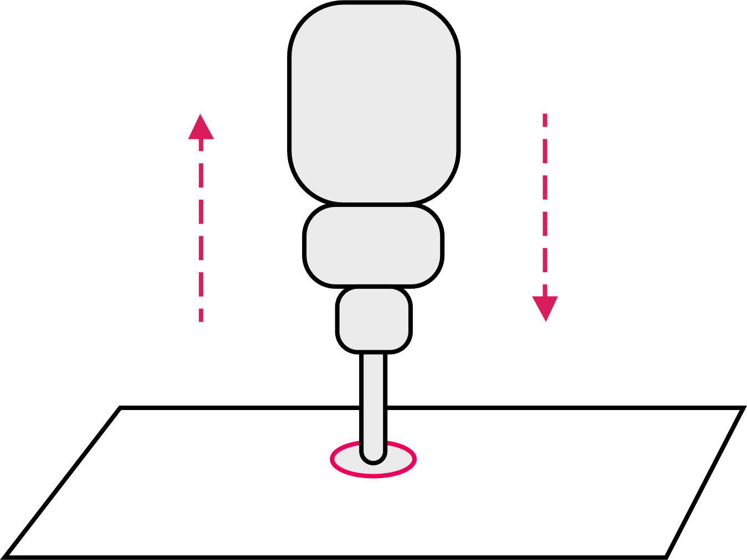
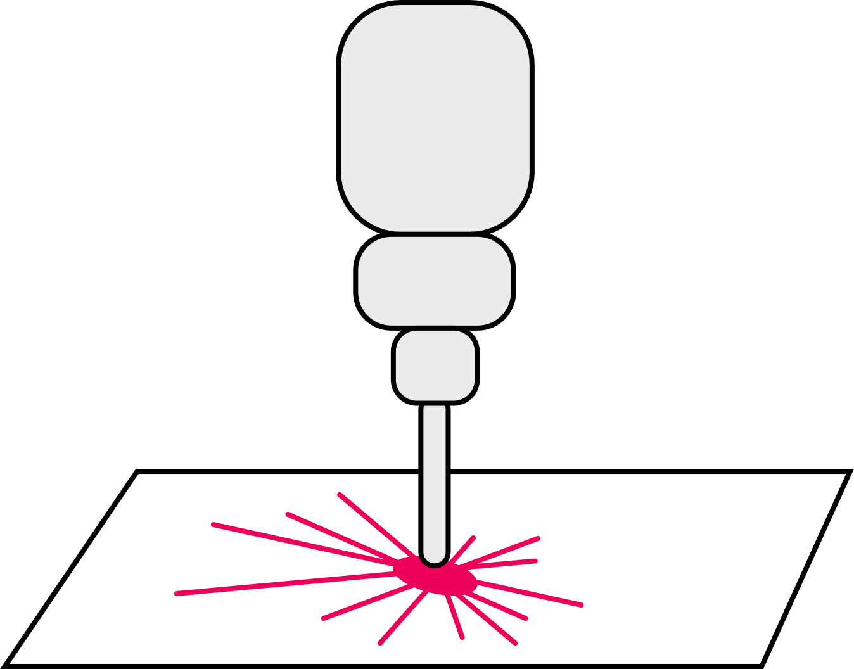

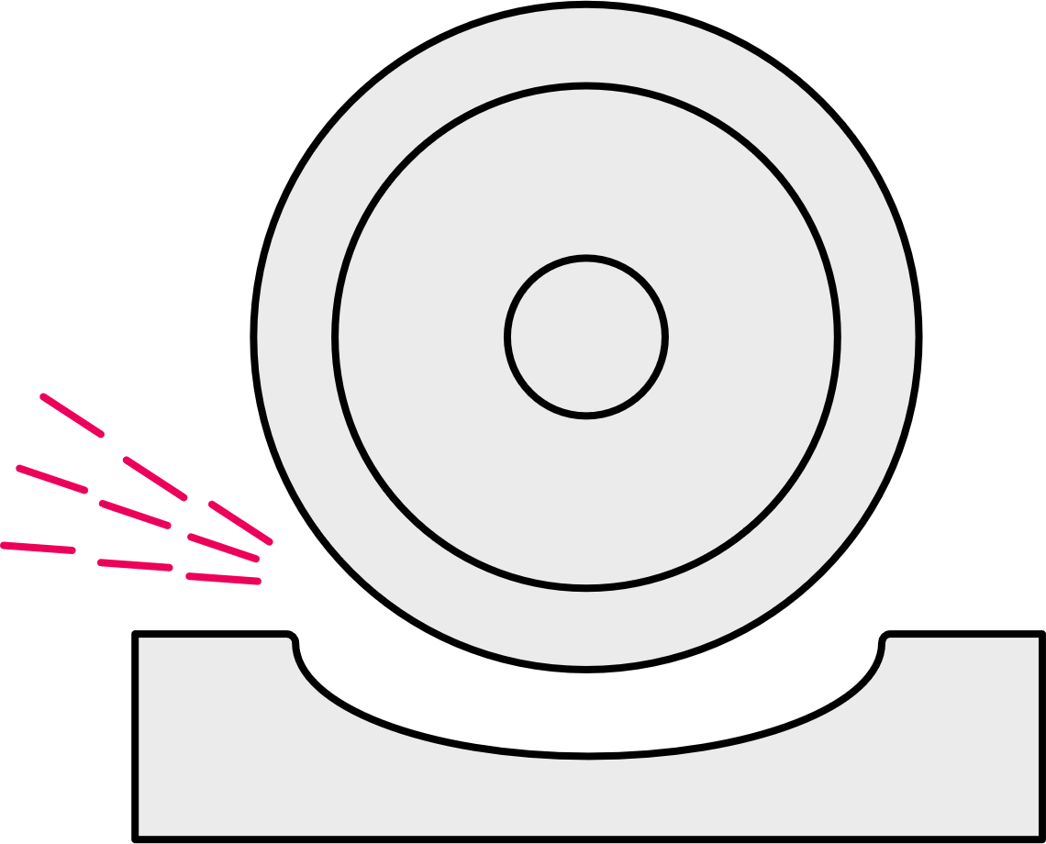
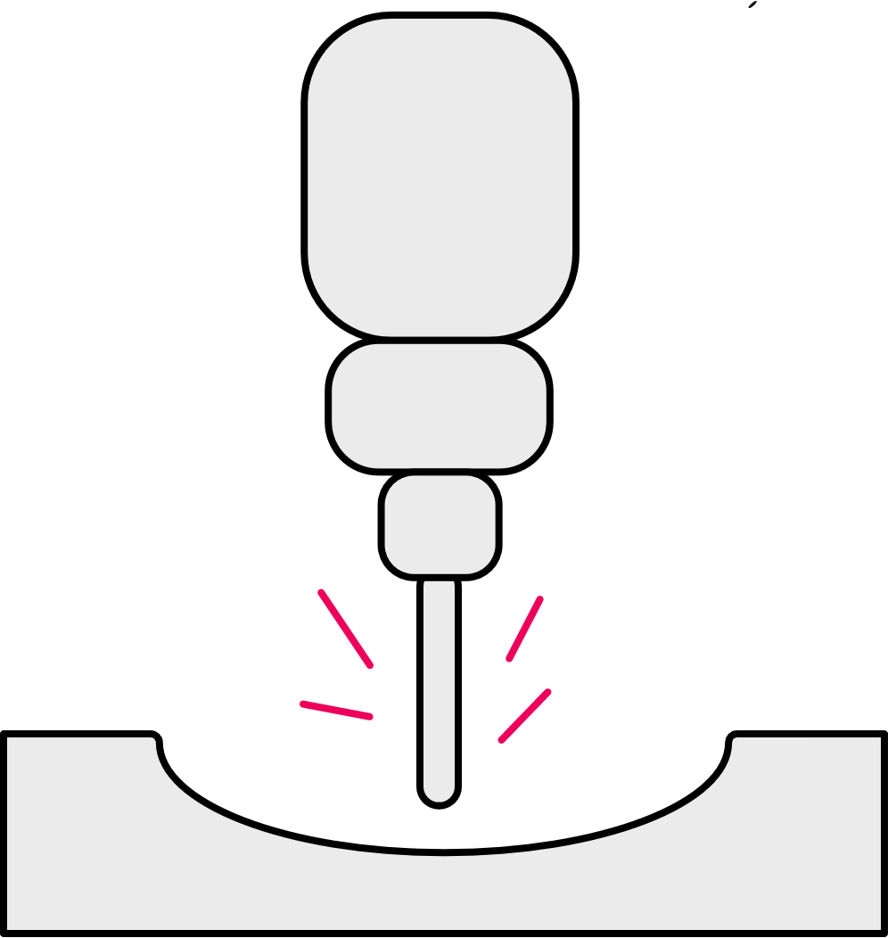
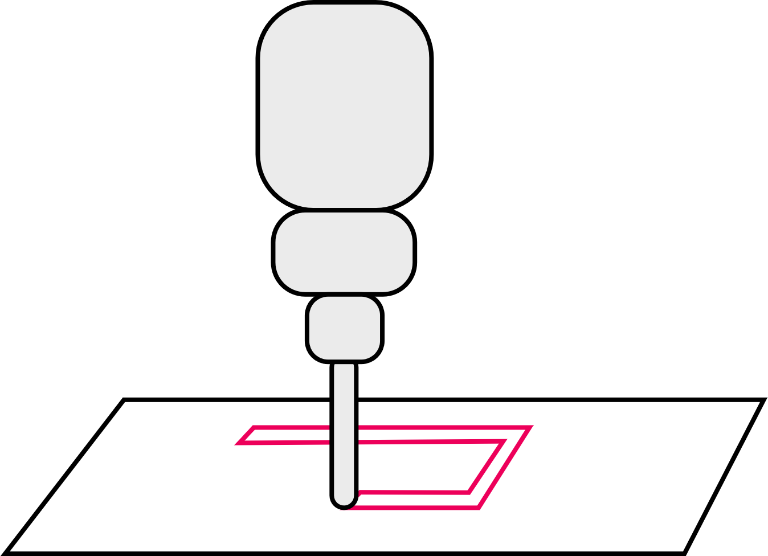
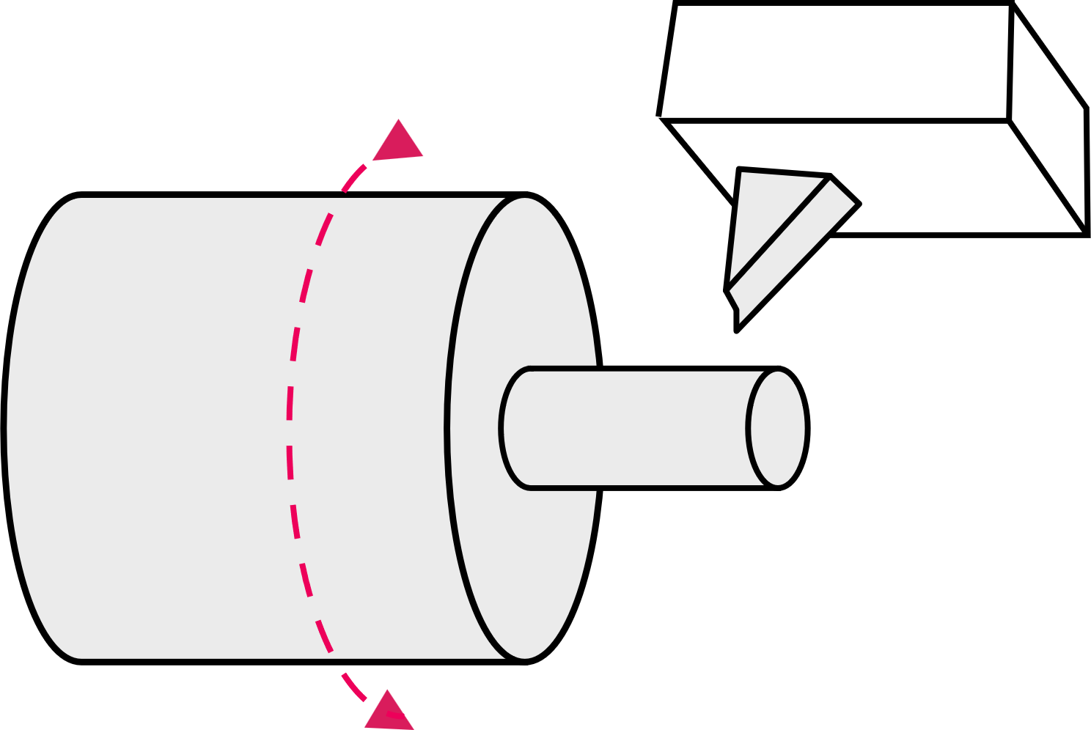
Functions and advantages of CNC
2. Using CNC machines
Identify
and explain the main function of the CNC machine each icon represents.
List some general advantages of using CNC.
8
Notes:
Practitioner delivery notes
This resource introduces learners to some of the practical considerations for using CNC, from selecting the right CNC machine for the job, to setting up the machine and putting safety at the heart of engineering practice. The initial activity reviews learners’ recall from the Level 2 resource or other prior introductory learning about CNC machines. Learners then review two simple ‘jobs’ to select the right CNC machine and plan how each job might be worked. They identify safety and other practical questions to consider and generate a setup checklist before broadening their exploration of how to be a safe CNC operator.
Activity
Learners identify and discuss each of the types of CNC machine.
Example answers
Please see the next slide.
Assessment
Recall of types and applications.
Discussion and verbal answers.
Extension
Click on the links above to find out more.

Slide 9

Functions and advantages of CNC
2. Using CNC machines
These are all examples of subtractive manufacturing, where material is removed to create the finished part.
Advantages of using CNC
Safer – operators are not exposed to material
or cutting tools.
Can run 24 hours a day, for higher productivity.
More accurate control, for higher quality and consistency.
Range of processes (drill, cutting, mill, threading, tapping etc) creates flexibility.
Reduces wastage – lowers overall production costs.
More complex multi-axis machines can produce complex forms.
Feedback systems indicate wear for planned maintenance and less unplanned downtime.
Drilling
Drilling, reaming or
tapping holes of different
depths and diameters.
Grinding
An abrasive wheel or cylinder produces a
fine, accurate finish.
Laser or plasma cutting
Cutting that uses a laser or
plasma to create a cut line
and edge in sheet material.
Lathe
Cutting a cylinder of
material as it spins
on an axis.
Milling
Detailed, precise cutting
of hard materials in 3D.
Router
Simple cutting of softer materials, usually sheet material.
9
Notes:
Practitioner delivery notes
Activity
Review the applications and advantages on the slide.
Film
Before moving to the next slide learners can watch the CNC machinery film.

Slide 10

Selecting the right CNC
2. Using CNC machines
As production manager you have been tasked with making the component shown using a suitable CNC machine.
State what type of CNC machine
you would use to manufacture the part.​
Outline in the correct sequence the main tasks the CNC machine will have to perform.
20
25
5
20
15
10
Notes:
Practitioner delivery notes
The tasks on this and the next slide help learners to plan work sequences for CNC machines. Learners do not need to implement G-code for these activities, which resource 3. Programming CNC machines explores. You may wish to supplement or replace the examples on the following slides with real example parts that learners can measure, draw and plan how to copy.
Activity
Learners discuss/read the simple orthographic drawing and identify the correct CNC machine and how the shape/features could be made. Learners don’t need to specify the type of tool, but may do so if they wish or if you wish to link to workshop practice.
Activity sheet
Learners write their answers on CNC machinery - Activity sheet: section 3a.
Example answers
Please see the slide that follows.
Assessment
Written work.
Extension
Learners could program and machine a real part on a CNC lathe.

Slide 11
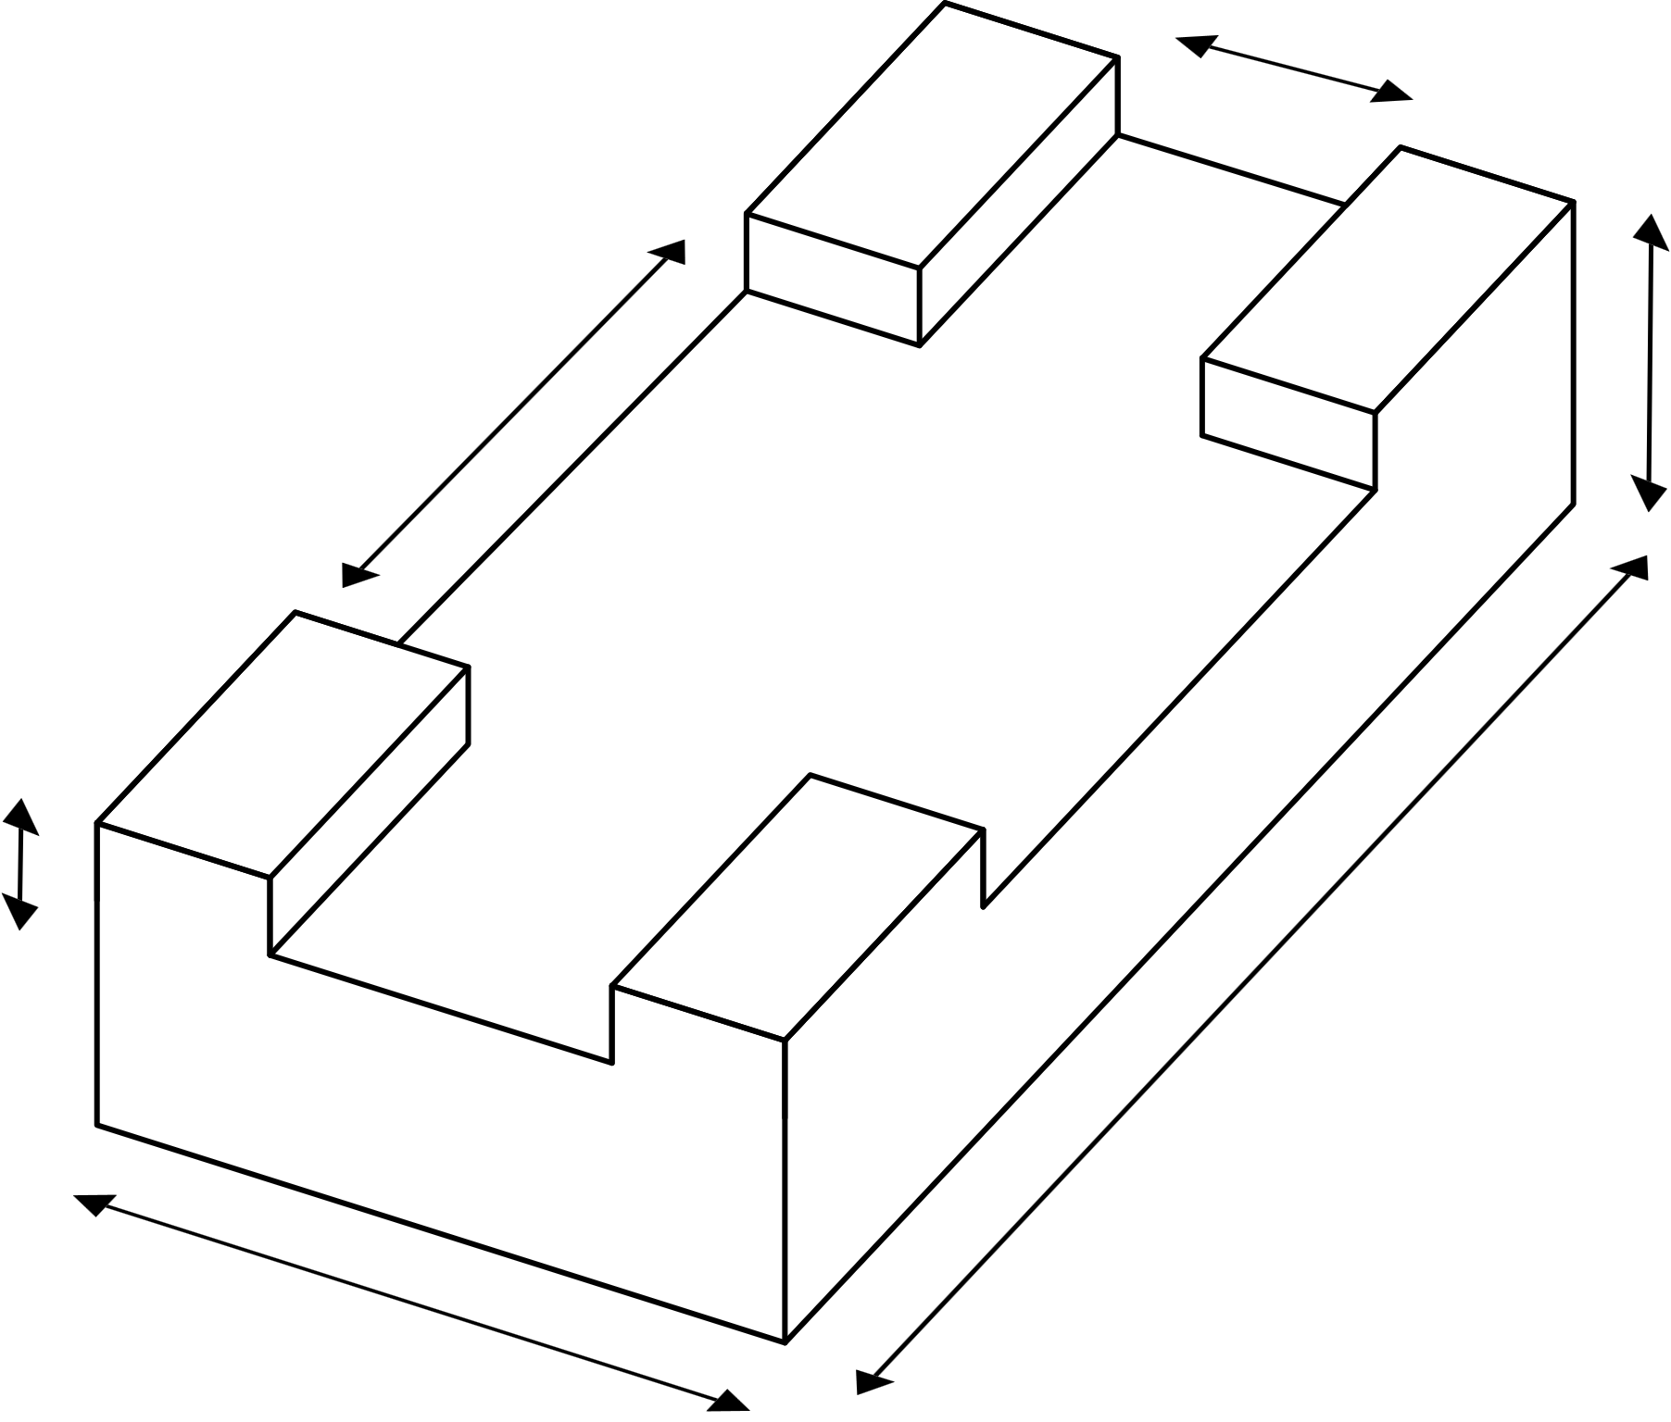
Selecting the right CNC
2. Using CNC machines
Use a CNC lathe for this part.
Correct sequence​​:
1 Secure 20-diameter cylindrical blank in the chuck.
2 Face off (level) the end​​.
3 Parallel cut to diameter 15 and length 20​​.
4 Drill 5 diameter hole​​ to 20 depth.
5 Part off (remove the part) at length of 25.
Now state what type of CNC
machine you would use to manufacture the part below and suggest a tool width.
Outline in the correct sequence the main tasks the CNC machine will have to perform.
3
4
30
2
40
30
10
100
5
60
11
Notes:
Practitioner delivery notes
Activity
Learners discuss/read the simple orthographic drawing and identify the correct CNC machine and how the shape/features could be made. Learners don’t need to specify the type of tool, but may do so if they wish or if you wish to link to workshop practice.
Activity sheet
Learners write their answers on CNC machinery - Activity sheet: section 3a.
Example answers
Please see the slide that follows.
Assessment
Written work.
Extension
Learners could program and machine a real part on a CNC mill.

Slide 12

Selecting the right CNC
2. Using CNC machines
Use a CNC mill for this part with a 30mm tool.
Correct sequence​​:
1 Secure 100 x 60 blank in the vice.
2 Face off (level) top to 30 depth
3 Mill channel in one pass to width 30 and depth 10.
4 Mill channel in two passes to width 40 and depth 10.
Now list some general factors to
consider when selecting the right CNC machine to purchase for planned work.
3
2
4 (two passes)
12
Notes:
Practitioner delivery notes
Activity
Review the correct CNC machines and suggested sequences of work for each part.
The sequences assume a correctly dimensioned blank is available, but learners may have chosen to first machine to the outer dimensions, eg to cut to 25 dia on the lathe, or to 100 x 60 on the mill.
The 30 mm tool is not essential for the rectangular part - a smaller diameter tool could be used, with additional passes. Note that the tool needs to be an end mill tool that can cut on the sides and end.
Highlight how the 40mm channel can be milled using two or more passes of a 30mm tool, for example two passes 10mm apart.
Learners discuss and list some general factors to consider when selecting a CNC machine. Broadly speaking, this is to select a machine that is ‘up to the task’ and suitable for the factory’s environment and budget.
Activity sheet
Learners write their consideration ideas as questions on CNC machinery - Activity sheet: section 3b.
Suggested answers
Please see the next slide.
Assessment
Written work.

Slide 13
Selecting the right CNC
– general factors
2. Using CNC machines
Considerations when selecting a suitable model of CNC machine include:
Is it the correct type of machine?
Will the machine perform the required tasks?
Is the machine the right size for this part?
Does the machine have sufficient power for the cuts required while avoiding the motor overheating?
Does the designed run time of the machine support the productivity needed?
Does the machine include a suitable coolant system, or can this be added?
Is the machine affordable?
Is training and maintenance support available and affordable?
13
Notes:
Practitioner delivery notes
Activity
Review the suggested considerations on the slide.
Broadly identify that the machine needs to be sufficient for the load (eg how much material it can cut), workload (eg how long it can run) and environment (size, power draw, cost etc.)
Highlight the long-term cost of CNC operation in training and maintenance (and in tool replacement or refurbishment) - these all need to be costed into the cost of each part of job.

Slide 14

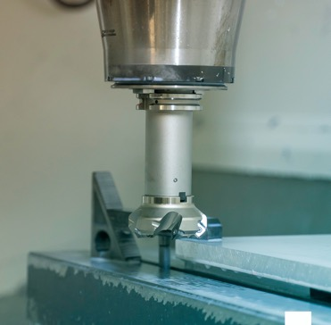
What questions should a safe CNC operator ask?
2. Using CNC machines
Before starting any work, a CNC operator has the
responsibility to ensure everything will work safely and efficiently.
A CNC setup checklist provides a structured way to consider five key areas of safety.
When setting up a CNC machine, what are some safety considerations for the five areas shown?
Organise your ideas into a setup checklist for a CNC operator, writing each one as a question.
Environment/surroundings
CNC machine
Operator
Tools
Material
14
Notes:
Practitioner delivery notes
This activity introduces learners to some of the practical and safety considerations of using CNC machines, including using a checklist to ensure safety before operation. Use it alongside your practical introduction to CNCs and safe workshop practice.
Activity
Ask learners to imagine they are going to use the CNC machine in the image (or one in your workshop). What should they think about in order to be safe?
Learners discuss each heading in turn and list some different factors to consider about each.
Learners then organise their ideas as a generic setup checklist.
Activity sheet
Learners complete CNC machinery - Activity sheet 4.
Example answers
Please see the next slide. Before showing the answers discuss with learners what order and priority they would give each consideration. This will help when writing the checklist.
Assessment
Written work.
Have learners highlighted the main issues associated with safety and efficiency of running machines and looking after personnel and equipment?

Slide 15
What questions should a safe operator ask?
2. Using CNC machines
1 | Are the surroundings clear of debris, trip hazards, spills etc.?
2 | Are the machine safety guards in place?
3 | Is the machine bed clear of swarf/saw dust?
4 | Is the material the correct type, size and quality?
5 | Is the material fixed in place correctly and will it not interfere with cutting tool pathways?
6 | Does the operator understand the outcome, (eg orthographic drawing, sample)?
7 | Are the right instructions loaded?
8 | Is the right tool fixed securely and is it sharp and undamaged?
9 | Is the tool at the correct height, depth datum set?
10 | Is the operator qualified and trained for this job?
11 | Is the operator wearing the right PPE?
15
Notes:
Practitioner delivery notes
Activity
Review each heading from the previous slide’s considerations and identify how these have translated into specific questions in the setup checklist.
Note that the checklist broadly covers the surroundings, machine, material, instructions, tool and operator.
There is no definitive order to the checklist but learners could have a discussion as to the ‘correct’ order and which they feel are more important. Ask the question “what if …”, eg What if the guard is not in place? What would be the consequences?

Slide 16
How can you become a safe CNC operator?
2. Using CNC machines
Consider a CNC machine in your workshop or one you
might or did use when on your industry placement.
What training do/did you need to use this machine safely?
What general instructions will/did help you to ensure safe operation?
How can you be sure the correct program is/was loaded?
How will/did you fit and check the tool?
What PPE do/did you need to wear when operating this machine?
What questions can you ask to be sure you are safe?
Image © This Is Engineering
16
Notes:
Practitioner delivery notes
This final activity supports an open-ended discussion that will help learners to be safe and efficient users of CNC. Adapt the questions and approach to suit how your learners will gain practical CNC experience.
Activity
Use the questions to frame a discussion about becoming safe, efficient CNC operators.
Emphasise both employer and employee responsibility, and the importance of the final question - it is never OK to fail to ask a question when unsure.
Assessment
Discussion and verbal answers.
Extension
Learners present a checklist suitable for use within the workshop – branded to school, company etc.

Slide 17
Learning outcomes
2. Using CNC machines
You will be able to:
Analyse a requirement
to identify the correct
CNC machine and work sequence to use.
List some
considerations
when purchasing
a CNC machine.
Identify actions that
support smooth and
safe operation of
CNC machines.
17

