Slide 1




Future of flight:
Teacher guide

Slide 2
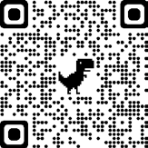
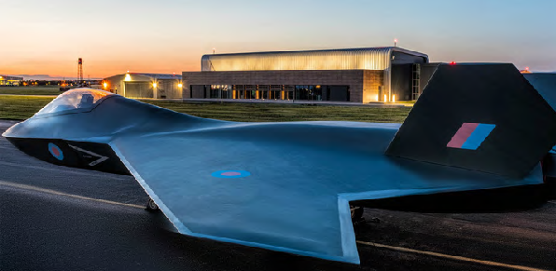
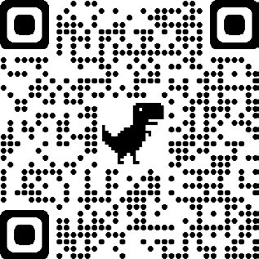
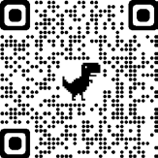
About this resource
Teacher notes
This resource is designed to provide practical and contextualised applications where students and teachers can see the role that STEM-based learning plays in real-world engineering scenarios.
Each of the activities and challenges have links across science, maths and design technology. However, some activities will be more heavily weighted towards one subject.
Don’t worry! Experience or subject knowledge about engineering and STEM subjects is not required. The resource has been designed to allow students to learn independently and at their own pace, with your support as a facilitator, not a subject expert.
What do I need for the activities in this resource?
We want to make this resource as inclusive and accessible as possible.
Although we provide some physical hands-on materials, most of the challenges can be adapted to use items that are easy to find around the house or in most classrooms.
Tempest is one of the UK’s largest ever science and engineering endeavours and will ensure the development of
world-first technologies continues to flourish.
It is a beacon to attract the engineers, manufacturers and technologists of the future and a place for young people to build their careers.
The passionate and ingenious employees are embracing new ways of working and mixing the knowledge of highly experienced
engineers with a young workforce to break new ground.
The challenges in this STEM resource invite learners to explore innovations within flight technology ranging from AI, machine learning, communication, exploring the forces of flight, investigating material science, and the changes happening that are making flight technology more sustainable.
Through a series of creative and collaborative challenges, students will develop enquiring minds
and teamworking skills and are encouraged to find imaginative approaches to problem-solving, understanding the role STEM- based learning plays in real-world engineering scenarios.
We need people to bring the ideas of tomorrow to life:
https://www.baesystems.com/en/product/generation-tempest
Both the student and teacher guide are available online for free: https://stemresources.raeng.org.uk/ future-of-flight/
Any teacher who is part of our Connecting STEM Teachers programme will receive hard copies of the resource and the physical materials that are included for free.
Any teachers, anywhere in the UK can join without any cost at any stage.
Find out more about the programme at: https://stemresources.raeng.org.uk/ connectingstem-Teachers
01
Royal Academy of Engineering

Slide 3

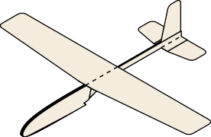
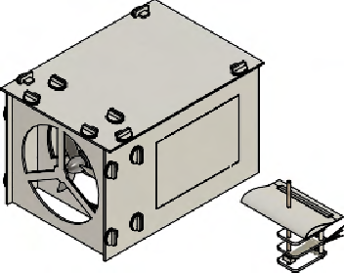
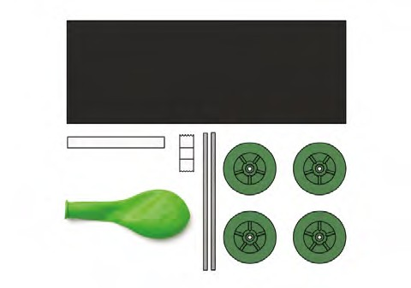
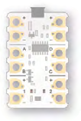








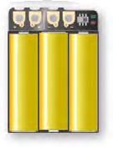
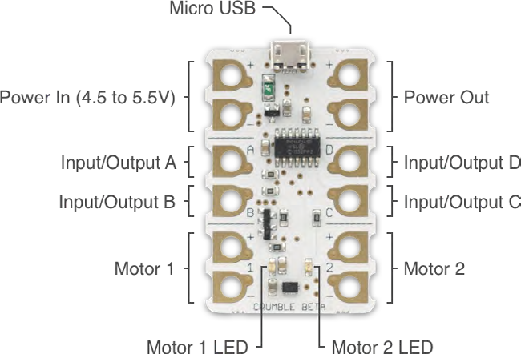
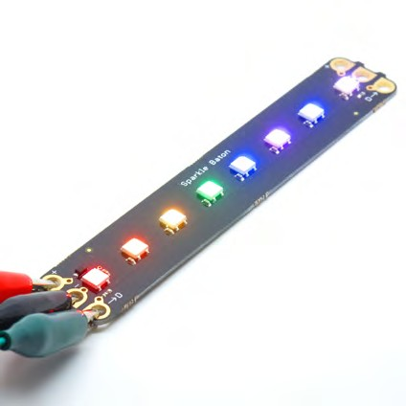




What’s in the box
What is the Crumble?
A
B
C
Some of the challenges in this resource use the ‘Crumble’. All the Crumble activities are designed to be used as group activities, so only one group of pupils need to do the actual programming and all pupils can take part in the associated activity.
You will notice a ‘Plugged in’ symbol next to any activity that uses the Crumble.
The Crumble controller by Redfern Electronics
The Crumble is a programmable controller that can be coded to drive outputs such as motors and lights known as Sparkles. It uses crocodile leads for simple connections and once programmed it can be easily embedded into a design or product. A useful output component is the Sparkle Baton consisting of eight LEDs that can be programmed to display interesting light sequences.
D
E
F
G
10 x Laminated gliders
B 1 x Wind tunnel kit and force sensor jig
C 5 x Hexagon puzzles
D 5 x Fibre optic communications kit
E 10 x Balloon car kit
F 2 x Basic Crumble parts
G 1 x Smart Crumbs: Digits and Force 1 x Thermistor
x Motor
x Sparkle Baton
A
https://redfernelectronics.co.uk/crumble/
The ‘getting started guide’ available from the Redfern website is an excellent starting point for those that haven’t used Crumble before or need a refresher!
Future of flight: Teacher guide
02

Slide 4



The challenges
3. Engines
1. Theory of flight
Balloon craft race
Investigate Newton’s Third Law by designing, building and racing balloon carts
What is a jet engine and how does it work? Use the explanation of a jet engine to order the parts of an engine
Build your own 3D Trent Engine
Build your own paper engine
Growing crystals
Create saturated solutions and use them to grow crystals
Faster than the speed of sound
Speed, distance and time calculations
Flight in nature
Biomimicry and flight technology
Forces of flight
What are the forces of flight? Investigate forces with gliders Investigate forces using a wind tunnel
2. Health monitoring
4. Materials
The wearable cockpit
Design a virtual cockpit
Think like a pilot
Work systematically to move people and medical supplies
Finger on the pulse
Create a program that will test reaction times
Monitoring stress
Create a program that will check stress levels
Temperature check
Create a program that will check the temperature
Pilot training
Put together a pilot training plan based on energy used and consumed
Choosing materials
What materials do you know? How can you group them?
Managing temperatures
What materials could you use to regulate temperature and protect against the cold?
Manufacturing polymers
Make a bouncy ball using a synthetic material
Strength in numbers
Investigate different combinations of composite mixes
Honeycomb structures Investigate tessellations Build a honeycomb structure
03
Royal Academy of Engineering

Slide 5


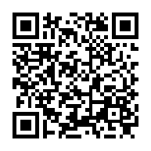

5. Communication
7. Environment
Fibre optic communication
Create a system to send messages using LED signals through fibre optics
Communicating with computers Looking at binary numbers as a form of communication
Sorting machines – parallel algorithms
Create a sorting machine that can order numbers
Ground control communication Communicate in teams to build shapes and puzzles
What’s the damage?
What do we mean by climate change?
What are greenhouse gases?
Match the molecule diagrams to their descriptions.
Modelling the greenhouse effect Investigate rising temperature by setting up mini greenhouses.
Lifecycle of an aircraft
Explore upcycling and the circular economy
Electric travel
What does the future of travel look like? How do we generate electricity?
Every decision counts
Rolls Royce simulation
Factory of the future Designing for light Build a robotic arm
6. Artificial intelligence
Can machines think? What is intelligence?
What do we mean by artificial intelligence?
The Turning Test Where is AI used? Spotting patterns
Continuing patterns and sequences
Smart data
Design a smart watch that will track and monitor a pilot’s health
Drone swarms
Use bearing skills to control drone swarms
Teachers, tell us what you think...
Take our short survey for a chance to win £500 of robotics/coding equipment for your school.
Scan the QR code on your phone, or go to stemresources.raeng.org.uk/teacher-survey
Future of flight: Teacher guide
04

Slide 6
Curriculum links
The activities and challenges bridge several subjects across Science, Technology, Engineering and Mathematics (STEM) curriculum, however for ease of reference, these have been linked to one or two specialisms only.
Age group is given as a guide and activities can be extended or broken down depending on the group.
More information about the National Curriculum in England can be found here. More information about the Scottish Curriculum for Excellence can be found here. More information about the Curriculum for Wales can be found here.
More information about the Northern Ireland Curriculum can be found here.
Booklet | Activity | Subject | Age group | Curriculum links
Theory of flight | Flight in nature | Science | 9 to 14 | I can explore different approaches to design such as biomimicry to generate creative ideas.
 | Investigating forces | Science | 9 to 11 | By investigating forces on different objects, I can predict the effect on the motion of the objects.
 |  |  | 11 to 14 | I can explain forces measured in Newtons.
Health monitoring | Think like a pilot | Maths | 9 to 11 | I can record solutions using a systematic approach. I can develop rules to describe number sequences.
 | Finger on the pulse | Computer science | 9 to 14 | I can create, develop and evaluate computing solutions in response to a design challenge
Engines | Balloon craft race | Design technology | 9 to 11 | I can design and construct models and explain my solutions.
 | Ready steady race | Computer science | 9 to 14 | I can create, develop and evaluate computing solutions in response to a design challenge
Materials | Choosing materials | Design technology | 9 to 14 | I can recognise basic properties and uses for a variety of materials and can discuss which ones are most suitable for a given task.
 | Biomimicry – in materials | Maths | 11 to 14 | Interior/exterior angles
Communication | Fibre optic communication | Maths | 9 to 11 | I can analyse how lifestyles can impact on the environment and Earth’s resources and can make suggestions about how to live in a more sustainable way.
 | Sorting machines | Computer science | 9 to 14 (depending on numbers used) | I understand that algorithms can be used for processing and sorting information.
Artificial Intelligence | Spotting patterns | Maths | 11 to 14 | I can recognise arithmetic sequences and find the nth term.
 | Ordering intelligence /Turing Test | Computer science | 9 to 11 | I understand how computers process information.
Environment | What are greenhouse gases? | Science | 11 to 14 | I can describe molecules based on the atoms that they are made up from.
 | Working with robots | Design technology | 9 to 14 | I can incorporate control systems, such as mechanical, in products and understand how these can be employed to achieve desired effects.
05
Royal Academy of Engineering

Slide 7




Engineering habits of mind
The activities presented in this resource are designed to be interactive, open-ended, encourage discussion and promote the engineering habits of mind (EHoM).
The EHoM encourage the use of a pedagogical approach that cultivates problem-solving skills, creativity, making mistakes, reviewing, and planning.
There is no prescriptive teaching method, and it is up to you as a teacher, educator or STEM club leader to decide on which direction you wish to take each activity and where you may wish to spend more time.
Read the full report Thinking like an engineer here.
Adapting
10
9
8
7
6
5
4
3
2
1
0
Engineering habits quiz Results are not fixed! We
_{In the student booklet,} encourage young learners
we have called the EHoM ^{to complete the quiz}
‘engineering habits’ and have ^{several times.}
included student statements They might find that different
that aim to bring the EHoM to engineering habits are
life for young learners. stronger depending on the _{Students can take the} type of activity or challenge
they are doing.
engineering habits quiz to
identify what engineering We have included all the habits they are using, and EHoM student statements for perhaps ones they would like both you and young learners to work on. for reference and to use in
different lessons and activities.
Once students complete the
quiz, they can see their results Find the engineering habits
on the EHoM spider diagram quiz on the This is Engineering: and can easily pick out their Sustainable Futures page engineering strengths. on our resource hub.
Creative
Problem-finding
problem-solving
Improving
Systems thinking
Visualising
Future of flight: Teacher guide
06

Slide 8





Engineering habits – student statements
I am good at...
Creative problem-solving
Improving
Problem-finding
Adapting
Visualising
Systems thinking
Coming up with lots of new and good ideas
Making what I have done better
Thinking about the world around me and how it could be better
Deciding how something could be done differently
Thinking out loud when I am being imaginative
Spotting patterns and working out what comes next
Working successfully in a group
Experimenting with things just to see what happens
Finding out why something does not work
Explaining how well I am doing to my teachers or friends.
Making a plan before I start work
Using ideas from one subject in another
Taking on board other people’s ideas and using them
Working hard and practising to get better, even when it’s tricky
Practising something in my head before doing it for real
Finding mistakes in mine and other people’s work
Evaluating how good something is
Putting things together to make something new
Making detailed mind maps
Behaving appropriately in different settings
Explaining my ideas to other people so they understand
Working out what I need to do to improve
Checking and checking again until I am happy
Spotting similarities and differences between things
Thinking first before doing something
Asking lots of questions to make sure I understand
Sticking up for what I think when talking with other people
Making models to show my ideas
Sticking at doing something until it’s the best it can be
Working out the possible
consequences of something before they happen
The quiz and student statements are based on EHoM research supported by the Royal Academy of Engineering and published in Hanson, J., Hardman, S., Luke, S., Maunders, P. & Lucas, B. (2018) Engineering the future: training today’s teachers to develop tomorrow’s engineers. London: Royal Academy of Engineering.
07
Royal Academy of Engineering

Slide 9
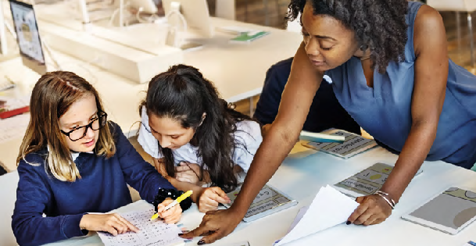





STEM badges
Digital STEM badges reward learners for their commitment to STEM.
The activities in the student booklet require students to demonstrate their engineering habits.
For each activity they complete from this booklet, we want them to think about which engineering habits they think they have been using and mark it on the STEM badge tracker.
Once they have completed enough of the activities and challenges, they can cash them in for STEM badges.
The badges are digital so they can link them to their
online profiles and applications and they won’t lose them!
By completing the ‘Future of Flight’ activities and claiming the badges, your students can quickly progress to Global STEM Awards from STEM Without Borders.
Claiming badges and earning badges is completely free of charge.
More activities, pathways and information on progression at http://globalstemaward.org
How do students collect badges?
For each challenge they are working on, mark up to three engineering habits they have been using on the STEM badge tracker.
Once they have completed three activities, they can come and share what they have been working on with you, their teacher.
Then it’s easy. Visit our online platform where you can tell us what challenges your students have completed and share one or two examples of their work with us.
Visit rae.mindsetsonline.co.uk to submit your students’ work and apply for badges.
Students show you their work.
Fill in the form on the website for each student.
Attach supporting evidence, e.g. photos or presentation. This is optional, however we always like to see student’s work, especially when creative problem solving is involved!
Submit forms for approval. You can submit for several students at the same time.
Once your badges have been approved, we will send them to you via email to share with your students.
:
H
g
r
t
T
e
h
t
:
i
t
A
i
h
h
t
a
ﬂ
:
ﬁ
g
e
h
l
:
c
i
o
t
f
M
t
i
ﬂ
r
g
h
o
a
h
a
y
i
e
t
g
l
f
ﬂ
m
r
e
i
i
o
o
f
o
u
r
ﬂ
n
e
f
o
n
t
i
f
t
r
i
u
a
o
e
ﬂ
e
l
l
u
i
t
F
l
t
g
r
o
s
e
i
u
h
u
r
F
g
r
g
F
t
i
u
n
u
e
F
g
t
u
n
t
i
t
n
u
F
g
u
r
u
c
n
F
g
r
e
F
e
t
i
u
n
e
e
u
r
t
i
n
r
e
u
r
o
i
e
e
r
e
f
g
o
n
e
e
n
i
n
ﬂ
f
g
o
i
i
E
ﬂ
n
f
g
g
f
i
E
ﬂ
n
h
o
g
f
i
E
t
h
g
f
:
y
t
o
R
g
R
g
h
o
R
g
C
m
R
g
:
y
o
n
o
n
t
o
n
o
e
o
n
E
m
y
i
y
i
:
y
y
i
m
d
y
i
n
e
a
r
a
r
E
m
a
r
a
a
r
v
l
e
l
e
n
l
e
m
c
l
e
i
d
A
e
A
e
g
e
A
e
u
A
A
e
r
a
c
n
c
n
i
d
c
n
c
n
o
c
i
i
n
a
i
n
l
i
n
A
a
g
a
g
e
c
a
g
i
a
a
g
m
l
d
n
d
n
s
A
d
n
c
n
y
d
n
a
e
E
e
E
l
e
E
a
o
e
E
e
y
t
R
R
a
i
n
o
m
f
m
f
y
m
f
o
m
f
y
o
y
o
o
y
o
y
o
t
R
Future of flight: Teacher guide
08

Slide 10
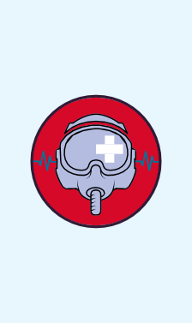

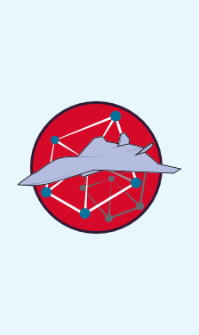


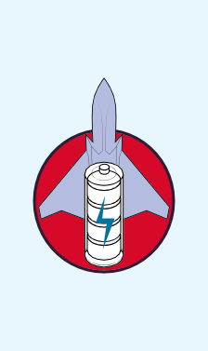

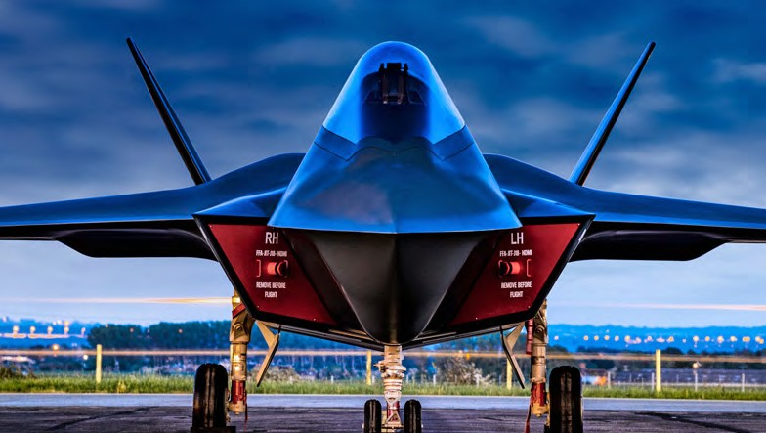
STEM Badge Tracker
Name:
1. Theory of flight
2. Health monitoring
3. Engines
4. Materials
5. Communication
6. Artificial intelligence
7. Environment
Students, tell us what you think...
Take our short survey for a chance to win £500 of robotics/coding equipment for your school.
Scan the QR code on your phone, or go to stemresources.raeng.org.uk/ student-survey
09
Royal Academy of Engineering

Slide 11
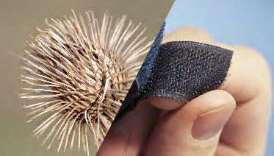
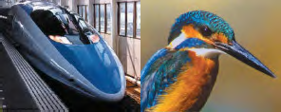
Solutions and further investigation
Theory of flight
Theory of flight
Flight in nature
Forces of flight
Build your own glossary
Flight description | Bird | Aircraft
Speed | Peregrine falcon | Tempest aircraft
Gliding | Albatross | Glider
Manoeuvring | Hawk | Spitfire
Endurance | Godwits | Voyager
Hovering | Hummingbird | Helicopter
Soaring | King vulture | Protector
Thrust | is the force that moves an aircraft through the air. It overcomes the drag and weight of an aircraft. Aircraft engines generate this force through the propulsion system (propeller or jet engine).
Weight | is the force generated by the gravitational attraction of the earth on the aircraft. This is the only force not controlled by the aircraft.
Lift | is the force that directly opposes the weight of an aircraft and holds it in the air. It is generated by every part of the aircraft, but mostly through the wings.
Drag | is a form of friction known as air resistance. This is the force that opposes an aircraft’s motion through the air. Every part of the aircraft generates this force, even the engines. It acts in the opposite direction to the motion of the aircraft.
What is the relationship between the living thing and the technology?
Bullet train inspired by the kingfisher. The old design caused a loud boom when it travelled through
1
1
2
tunnels disturbing wildlife, passengers and people who lived nearby. It was also slowing the train down. Mimicking the long, narrow and streamlined beak of the kingfisher, engineers were able to overcome this problem.
2
Burdock and Velcro®. Burdock produce seeds are covered in tiny hooks. These tiny hooks catch on the fur of passing animals. This inspired the inventor of Velcro® to create the first hook and loop fastener.
This consisted of one surface covered in tin hooks and another with fuzzy loops.
Future of flight: Teacher guide
10

Slide 12
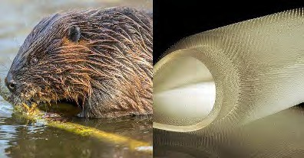


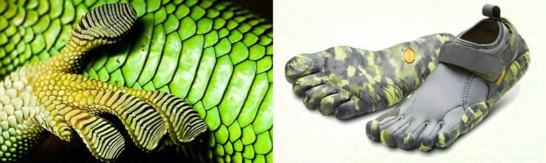

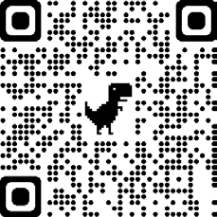
3
Beaver inspired wetsuit. Rubbery hair-lined wetsuits to keep surfers warm.
A gecko’s foot inspired these Vibram shoes. The manufacturer claims they have a natural feel and their grip aids walking, running and climbing.
Theory of flight
Students can use the Crumble to set up a program that will measure force in Newtons using a wind tunnel. Coding blocks and guidance is given in the student guide to support students in writing a program that will do this.
4
3
program start
force crumb on C : set to zero
motor 1 FORWARD at 100 % do forever
let w = afonracleogoune C in mN
digits crumb on C : display w wait 250 milliseconds
loop
4
Example program that will display force on the Digits Smart Crumb.
Students can use the wind tunnel to compare the lift of different style aerofoils as well other objects.
They could also use the wind tunnel to investigate drag.
If you do not have access to the box of materials that comes with the Future of Flight resource, then visit the IET
‘Engineering Open House Day’ for a video by Sophie Harker on how to build your own wind tunnel.
11
Royal Academy of Engineering

Slide 13



Health monitoring
Think like a pilot
To get started, you could get the pupils to physically demonstrate this problem by sitting four pupils on five chairs, two at each end and asking them to swap places. You could also use different colour counters.
We have just provided solutions for an equal number of medical supplies and civilians, but your students might want to extend this further by investigating different combinations. This task has several different directions where you and your students can take it.
This creates the following quadratic sequence: 3, 8, 15, 25, 35…
Finger on the pulse
Students can use the Crumble to write a program that will test the groups reaction times. There are opportunities here for whole class data collection and analysis.
Coding blocks and guidance is given in the student guide to support students in writing a program that will do this.
program start
Example program for a simple reaction timer.
let x = 0
turn all sparkles off
wait random 3 to 6 seconds
do until A is HI or x = 8 set sparkle x to
increase x by 1 wait 50 milliseconds
loop
Medical supplies
 | 1 | 2 | 3 | 4 | 5 | ?
1 | 3
2 |  | 8
3 |  |  | 15
4 |  |  |  | 24
5 |  |  |  |  | 35
?
People
Stretch and challenge
program start
do forever
let x = 0 turn all sparkles off
wait random 3 to 6
Example program with a reaction timer that will automatically restart.
seconds
do until A is HI or x = 8
set sparkle x to
increase x by 1 wait 50 milliseconds
loop loop
With position to term rule:
𝑛² + 2n.
Future of flight: Teacher guide
12

Slide 14

















Monitoring stress
Students can use the Crumble to write a program that will test the groups stress levels. There are opportunities here for whole class data collection and analysis.
Coding blocks and guidance is given in the student guide to support students in writing a program that will do this.
Temperature check
Using the thermistor and the Digits Smart Crumb, students can write a program to measure temperature. If you have enough equipment, you could encourage students to use the sparkle baton within their system to use a light warning system if the temperature is too hot/too cold.
Coding blocks and guidance is given in the student guide to support students in writing a program that will do this.
Example program
for a simple ‘stress’ test.
Example program to show ^{program start} temperature. Other mathematical set A HI arrangements are possible.
do forever
let x = analogue B
What is the temperature?
program start
do forever
let x = analogue C
°C | Analogue
50°C | 203
-10°C | 23
9°C | 80
0°C | 53
if x > 100 then
set all sparkles to else
turn all sparkles off end if
wait 1 seconds loop
let t =
x - 128 ÷ 3 + 25
digits crumb on C : display t
wait 1 seconds loop
The minimum temperature is approximately -18°C. The maximum temperature is approximately 67°C.
Stretch and challenge
Putting your stress to the test
Challenge two – changing formation
1 2 3
Stretch and challenge
Example program to give maximum temperature warning.
Example program where sparkles will flash if ‘x’ goes too high.
program start
set A HI
let maximum = 0 do forever
program start
do forever let x =
analogue C
let x = analogue B
if x > 100 then
set all sparkles to
wait 500 milliseconds turn all sparkles off
wait 500 milliseconds else
turn all sparkles off end if
loop
let t =
x - 128 + 3 ÷ 25
if t > maximum then
let maximum = t end if
digits crumb on C : display maximum wait 1 seconds
loop
4
5
6
7
13
Royal Academy of Engineering

Slide 15

Pilot training
This challenge asks pupils to find the relevant information on the cards provided to answer the questions given.
We suggest that the students split the cards equally between them. Each person in the group is then in charge of their cards and for sharing that information when they think it is relevant. Not all the cards need to be used. And some of the cards will hopefully be points for discussion.
There is no correct way to do this, but see the diagram with the nutrition cards below for an example of how students might work through this challenge.
Time to train
They are preparing for a short training ride.
How much energy will they use during this ride?
A typical short training ride is two hours long
On average, a pilot will cycle at 9 mph on rides that take less than one day
A pilot uses 100 kJ of energy to cycle 1 km (in addition to normal energy use)
In two hours they will have travelled 28 miles.
38 miles ≈ 61 km 61km x 100kJ ≈ 6100 kJ
What on the road snacks will they need to take to minimise the amount of calories they lose?
We know that in a short training ride the pilot uses 6100 kJ.
1 kcal ≈ 4 kJ
1 mile ≈ 1.6 km
6100 kJ / 4 = 1525 kcal
Pilots like to eat a big meal before a short training ride. The energy is released during the ride
An energy bar contains 220 kcal and weighs 65 g
A pack of energy gel contains 110 kcal and weighs 42 g
1525 kcal – 800 kcal
= 725 kcal.
The pilot needs to make up 725 kcal on a short ride.
A big meal contains about 800 kcal
Future of flight: Teacher guide
14

Slide 16
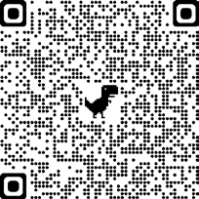

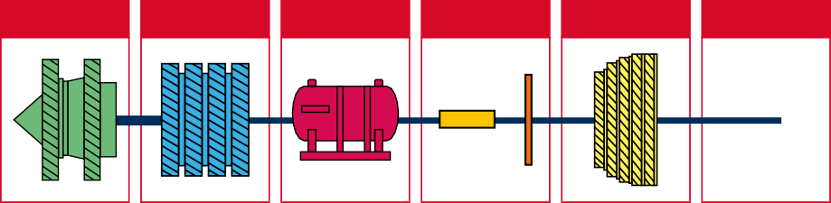




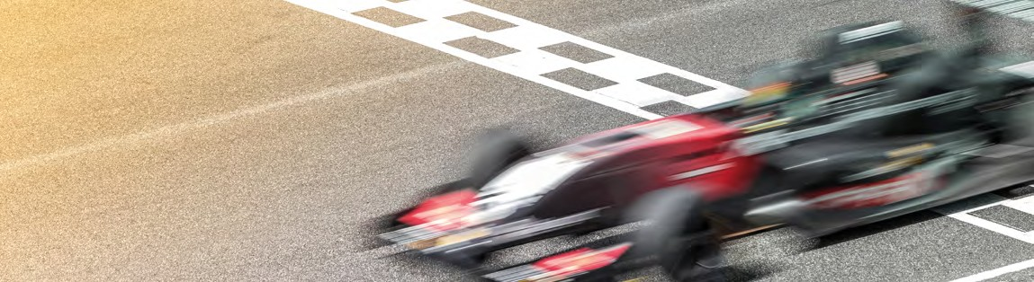


Engines
The Rolls Royce website has some fantastic resources. We have linked to the ones we feel are most relevant to the resource in the student guide.
You can also download a poster for your classroom
which shows how a jet engine works.
Ready, steady, race
Write a program that creates a flashing light sequence activated by a switch to countdown to the start of a race.
program start
do forever wait until
Example program to create a countdown timer using a
Sparkle Baton.
What is a jet engine and how does it work?
Using the information provided, students can place the parts of the engine in the correct order.
A is HI
do 3 times
set all sparkles to
wait 500 milliseconds turn all sparkles off
wait 500 milliseconds loop
set all sparkles to wait 1 seconds turn all sparkles off
loop
Fan
Compressor
Fuel tank
Combustor
Turbine
Nozzle
Axle shaft
Balloon craft race
Students can use the materials provided in the box, as well as another materials they want to use to build their balloon craft car. There is a hand pump in each kit to make it easier and consistent when blowing up the balloons for the race.
There are a couple of group Crumble activities which can be carried out alongside the ‘Balloon craft race’. These are:
And the winner is...
Write a program that will time a race.
Example program that will time a race using a Smart Digits Crumb.
program start
do forever
let t = 0
do until
A is HI or t = 9999
increase t by 1
digits crumb oton tC : display t loop
loop
15
Royal Academy of Engineering

Slide 17

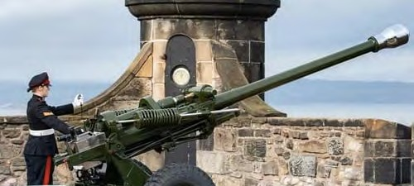
Materials
Faster than the speed of the sound
Students can use the materials provided in the box, as well as another materials they want to use to build their balloon craft car. There is a hand pump in each kit to make it easier and consistent when blowing up the balloons for the race.
Time to calculate
Sound waves travel at approximately 340 metres per second in air.
How fast did the Concorde travel?
2,179 km/h
What is the average speed of a passenger aircraft?
Approx. 900 km/h
Biomimicry – in materials
Regular polygon | Size of each exterior angle | Size of each interior angle | Divide by 360° | Does this polygon tessellate?
Triangle | ³⁶⁰ = 120° 3 | 180 - 120 = 60° | 360 ₌ ₆ 60 | Yes
Square | ³⁶⁰ = 90° 4 | 180 - 90 = 90° | 360 ₌ ₄ 90 | Yes
Pentagon | ³⁶⁰ = 72° 5 | 180 - 72 = 108° | ³⁶⁰ = 3.33 108 | No
Hexagon | ³⁶⁰ = 60° 6 | 180 - 60 = 120° | 360 ₌ ₃ 120 | Yes
Octagon | ³⁶⁰ = 45° 8 | 180 - 45 = 135° | ³⁶⁰ = 2.67 135 | No
When will you hear the One O’Clock Gun?
Use the map to calculate:
The distance between Arthur’s Seat and Edinburgh Castle
Distance = speed × time = 340m/s × 6s = 2040 m
The distance between Port of Leith and Edinburgh Castle
Distance = speed × time = 340m/s × 11s = 14960 m
90° | 90°
90° | 90°
60°
60°
60°
120°
120°
60°
60°
120°
60°
4 × 90° = 360°
6 × 60° = 360°
3 × 120° = 360°
Future of flight: Teacher guide
16

Slide 18


Communication
Fibre optic communication
This challenge asks students to create a code using a LED light, a switch, a fibre optic cable.
We have given them some guidance in the student guide and expanded on the grid system here in the teacher guide. Students are encouraged to not only come up with different systems, but strategies for when they make mistakes.
Check out our resource, Are we connected?, for more ideas for encryption activities.
Communicating with computers
Table 1 – Base 10
10⁴ | 10³ | 10² | 10¹ | 10⁰
10⁴ = 10,000 | 10³ = 1,000 | 10² = 100 | 10¹ = 10 | 10⁰ = 1
 |  | 2 × 10² = 200 | 3 × 10¹ = 30 | 7 × 10⁰ = 7 | 200 + 30 + 7 = 237
 |  | 5 | 7 | 4 | 500 + 70 +4 = 574
 | 3 | 0 | 3 | 6 | 3000 + 0 + 30 + 6 = 3036
7 | 2 | 4 | 0 | 1 | 70000 + 1000 + 100 + 10 + 1 = 72401
 | 1 | 2 | 3 | 4 | 5 | 6
1 | 1-1 A | 2-1 B | 3-1 C | 4-1 D | 5-1 E | 6-1 F
2 | G | H | I | J | K | L
3 | M | N | O | P | Q | R
4 | S | T | U | V | W | X
5 | Y | Z | Yes | No | Repeat | Help
Table 2 – Binary numbers (base 2)
₂4 | ₂3 | ₂2 | ₂1 | ₂0 | Base 2 | Base 10
2⁴ = 16 | 2³ = 8 | 2² = 4 | 2¹ = 2 | 2⁰ = 1
 |  |  |  | 1 × 2⁰ = 1 | 1 | 1
 |  |  | 1 × 2¹ = 2 | 0 × 2⁰ = 0 | 10 | 2
 |  |  | 1 × 2¹ = 2 | 1 × 2⁰ = 1 | 11 | 3
 |  |  | 1 | 0 | 10 | 4
 |  | 1 × 2² = 4 | 1 × 2¹ = 2 | 1 × 2¹ = 1 | 111 | 7
1 × 2⁴ = 16 | 0 × 2³ = 0 | 1 × 2² = 4 | 1 × 2¹ = 2 | 0 × 2¹ = 0 | 10110 | 22
1 × 2⁴ = 16 | 1 × 2³ = 8 | 1 × 2² = 4 | 0 × 2¹ = 2 | 1 × 2¹ = 1 | 11101 | 29
Grid reference: 2-1 = 2 flashes – pause – 1 flash
Using a grid is one way that students could create a more streamlined system to communicate using the fibre optics.
This grid is just an idea to get you started.
There are many ways they could make it more efficient. For example, rearranging the grid so letters/words that are more common are easier to send as signals.
17
Royal Academy of Engineering

Slide 19

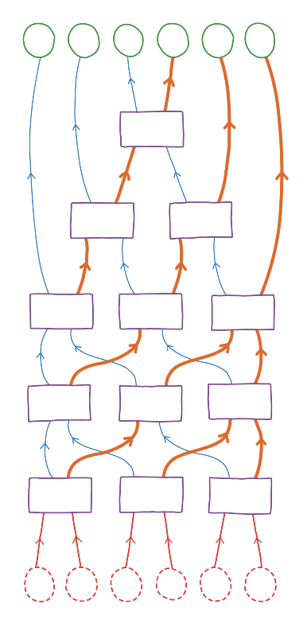
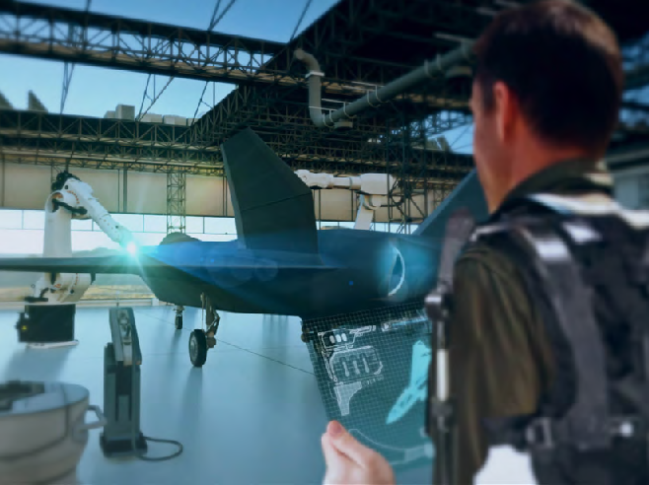
Decode these facts
Ada Lovelace was born on the 10 December 1815. She was a British mathematician and computer engineer whose work is considered to be the first written algorithm.
Mary Jackson became NASA’s first female black engineer in 1958. She analysed data from wind tunnels experiments.
The 16 square foot, 60 thousand horsepower wind tunnel used to study forces on model by generating winds twice the speed of sound.
By 2025, it is predicted that global aircraft passenger traffic will increase by 4%.
The temperature outside an aircraft is -51°C. The average cruising speed for an aircraft is
900 km/h.
 |  |  |  |  | Output
1 2 |  | 4 3 | 5 | 6
 |  | 3 < 4
2 < 3 |  |  | 5 > 4
2 > 1 |  | 5 > 3 |  | 6 > 4
5 > 2 |  | 6 > 1 |  | 3 < 4
6 > 5 |  | 3 > 2 |  | 1 < 4
6 5 |  | 3 2 | 1 | 4
Input
Ground control cards
The ground control cards will fit together to create a hexagon.
Part of the challenge asks the students to work together to recreate this.
Communicating with computers
Activity adapted from Sorting Networks, CS Unplugged
Future of flight: Teacher guide
18

Slide 20


Artificial intelligence
The Turing test
Ideally, the ‘Computer’ and the ‘Human’ should receive each question at the same time, and must answer at the same time. Only the person acting as the ‘Computer’ should see the answers on the computer sheet.
You will find an A5 sheet with both questions as a support sheet on the ‘Future of flight’ page on our resource hub.
Drone swarms
Background information
A misconception that students may have is that autonomous and unmanned can be used interchangeably to mean the same thing.
A fully autonomous vehicle is any vehicle that is capable of driving completely unaided for the
entire journey without any human interaction. An unmanned vehicle, however, refers to any vehicle without a body inside driving it. This could, for example, be a vehicle driven by a remote pilot via radio communication.
There are also levels of autonomy, for example, parking assistance or cruise control. For a vehicle to be truly autonomous, it would have to be able to think for itself. You may like to discuss artificial intelligence with your students.
The word drone tends to refer to unmanned aviation vehicles (UAV); however there are a number of other unmanned vehicles that can travel in or on almost any medium.
For ideas around the use of drones to support society, visit ‘How AI Based Drone Works: Artificial Intelligence Drone Use Cases’
Drone swarms
Time to reflect – where do we use drone swarms?
Some ideas to get your group started as to where drone swarms are used:
Emergency services
  Swarms of drones are used to look for survivors after a flood
  During a fire, swarms of drones can be used to survey the area so firefighters know where best to use their resources
Space exploration
Cleaning oil or chemical spills
Monitor crop
Task two – drone relay Time to program
There are many different options that students could take.
One way that they could write their program is distance followed by the bearing:
One step / 10m – Drop aid
Turn to 090° – Three steps /30m – Drop aid
Turn to 180° – Two steps / 20m – Drop aid
Turn to 270° – One step / 10m – Drop aid
Turn to 180° – One step / 10m – Drop aid
Turn to 270° – Two steps /20m – Drop aid
Turn to 000° – Two steps /20m
19
Royal Academy of Engineering

Slide 21

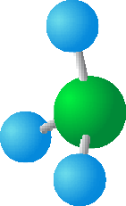

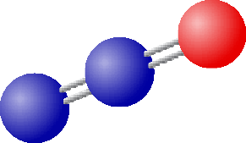






Environment
Base camp
What are greenhouse gases?
Match the molecule diagrams with the description. Can you work out which element each part of the molecule diagram represents?
10m
1cm
𝓧
Time to relay
This activity requires some teacher input to set-up.
Divide students into groups of 3–5.
Have each group queue up relay-style.
Place an identical ‘Drone relay card’ at the other side of the room and a blank piece of paper at the other side of the room.
Have the first student in line dash over to the image, review it, run to the blank piece of paper and write down the first line of the program.
The student then runs back and tags the next person in line, then goes to the back of the queue.
The next person in line dashes to the image, and repeats this process until the group have a complete program.
First group to finish is the winner!
Each group swaps their program with another group and tests it out. Can they recreate the grid map?
You will find the ‘Drone relay cards’ as a support sheet on the ‘Future of flight’ page on our resource hub.
Methane (CH₄)
The main component of natural gas, methane is released from landfills, petroleum industries and agriculture. It does not stay in the atmosphere as long as a molecule of carbon dioxide – about 12 years – but it is at
least 84 times more potent over a decade. It accounts for about 16% of greenhouse gas emissions.
Nitrous Oxide (N₂O)
A powerful greenhouse gas – 264 times
more powerful than carbon dioxide over 20 years – produced by soil cultivation practises, especially
use of fertilisation, fossil fuel combustion and biomass burning. It accounts for about 6% of global greenhouse gas emissions.
Carbon Dioxide (CO₂)
It is responsible for about threequarters of emissions. It can linger in the atmosphere for thousands of years. It is released through respiration, volcanic activity, deforestation, burning fossil
fuels, etc.
Water Vapour (H₂O)
Most abundant greenhouse gas. Water vapour also increases in the atmosphere as
the Earth warms. Water vapour only remains
in the atmosphere for a few days.
Future of flight: Teacher guide
20

Slide 22

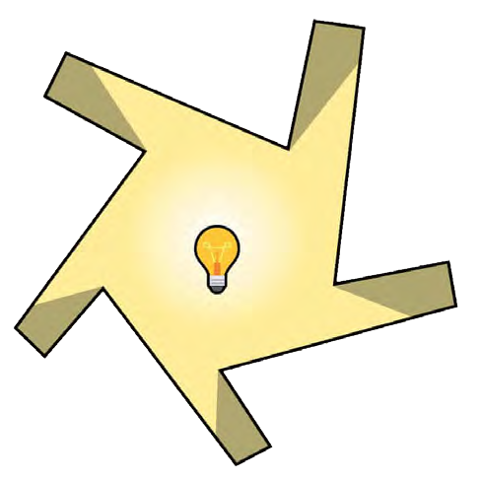
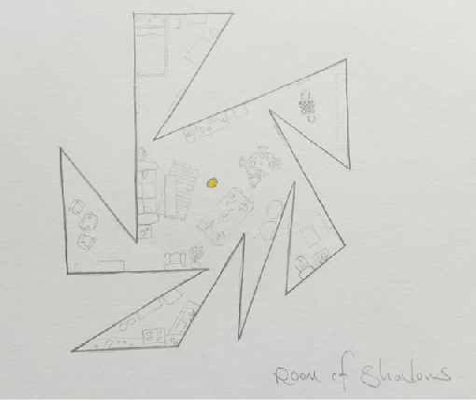
Environment
Modelling the greenhouse effect
Investigation one – vinegar and baking soda
CO₂ is released in the reaction. This models an increase in greenhouse gas. While the jars heat up at about the same rate, the one with CO₂ cools down much more slowly.
Investigation two – hot water
This models how CO₂ and water vapor in the atmosphere affect the rate at which the Earth loses heat (the cling film acts as the CO₂ and water vapor during the experiment).
Investigation three – cold water
This is similar to Investigation #2. This models how CO₂ and water vapor in the atmosphere affect the rate at which the Earth gains and loses heat (the cling film acts as the CO₂ and water vapor during the experiment).
Investigation four – soil
This models how the temperature of the actual Earth changes (as opposed to water in
investigations #2 and #3). The cling film acts as the greenhouse gases.
This challenge has been adapted from Greenhouse effect models: Hot stuff by Teach Engineering.
Check out the resource for more challenges which model the greenhouse effect.
Design for light
There are many different solutions to this problem, however the main thing to consider was creating ‘spikes’ around a central space such as the examples shown.
Illustration by Liam Roberts
Illustration by Andrew White
Both images taken from: https://www.theguardian.com/science/2016/feb/01/ did-you-solve-it-the-shady-puzzle-that-will-keep-you-in-the-dark
21
Royal Academy of Engineering

Slide 23
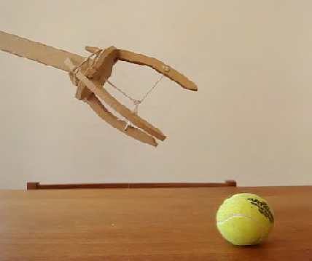
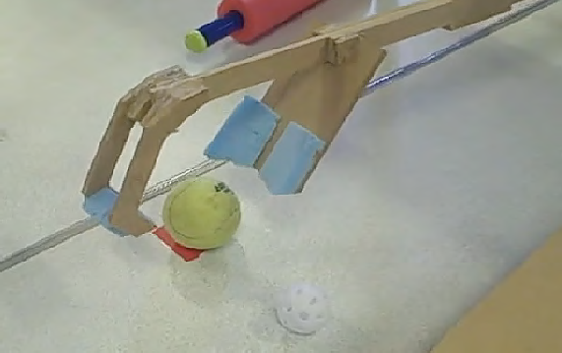
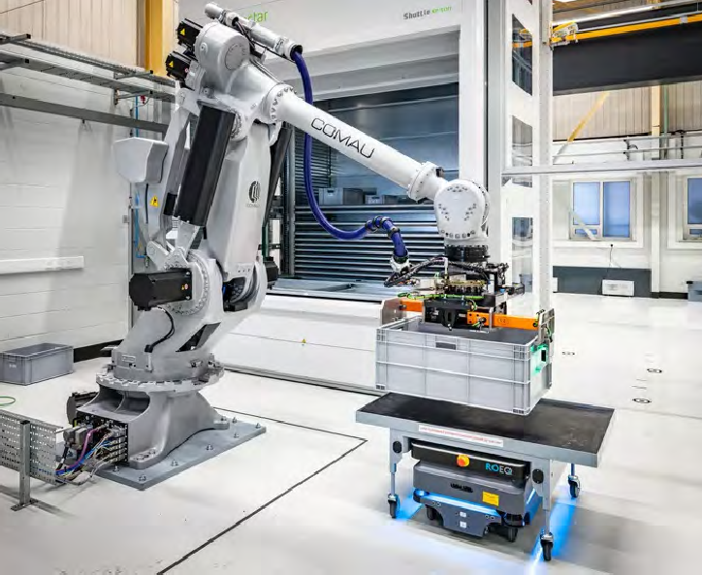





Working with robots
Each team should produce a 2D model of a robot arm from the provided resources.
To do this they will need to sketch the shapes of the parts they need onto the card and cut them out.
These will need to be mounted on a backing board for stability.
Fixed pivots can be created using thumb tacks. Moving pivots can be produced using brass fasteners.
String, fishing line or elastic bands could be used for the control lines to transfer force.
Example gripper designs:
2D card model and gripper designs taken from IET DIY Faraday Challenges
Example of a 2D card model
Moving pivot
Fixed pivot
Control string
Shape cut from card
Elastic band
Support to hold it on to the back board
Future of flight: Teacher guide
22

Slide 24










Thank you
This STEM teaching and learning resource has been developed by the Royal Academy of Engineering for the Royal Air Force to mark the launch of Tempest. Tempest is the RAF’s next generation aircraft, coming into service from 2035 to replace the Typhoon.
The resource has been developed with the support of a creative writing group made up of industry representatives from Team
Tempest, including BAE Systems, Rolls Royce, Leonardo and MBDA.
The Royal Academy of Engineering is grateful to the RAF for their support in allowing physical copies of this resource, and associated kit and equipment, to be disseminated through its Connecting STEM Teachers (CST) programme.
CST is a support network for teachers across all STEM subjects, ensuring they have the knowledge and confidence to engage a greater number and wider spectrum of school students with STEM. The programme operates across all regions of England, and in Scotland, Wales, and Northern Ireland.
The Royal Academy of Engineering is harnessing the power of engineering to build a sustainable society and an inclusive economy that works for everyone.
In collaboration with our Fellows and partners, we’re growing talent and developing skills for the future, driving innovation and building global partnerships, and influencing policy and engaging the public.
Together we’re working to tackle the greatest challenges of our age.
What we do
Talent & diversity
We’re growing talent by training, supporting, mentoring and funding the most talented and creative researchers, innovators and leaders from across the engineering profession.
We’re developing skills for the future by identifying the challenges of an ever- changing world and developing the skills and approaches we need to build a resilient and diverse engineering profession.
We’re building global partnerships
that bring the world’s best engineers from industry, entrepreneurship and academia together to collaborate on creative innovations that address the greatest global challenges of our age.
Policy & engagement
We’re influencing policy through the National Engineering Policy Centre – providing independent expert support to policymakers on issues of importance.
Innovation
We’re driving innovation by investing in some of the country’s most creative and exciting engineering ideas and businesses.
We’re engaging the public by opening their eyes to the wonders of engineering and inspiring young people to become the next generation of engineers.
Royal Academy of Engineering Prince Philip House
3 Carlton House Terrace London SW1Y 5DG
Tel: +44 (0)20 7766 0600
www.raeng.org.uk
Registered charity number 293074

