Slide 1
Renewable energy
1. Sources, advantages
and disadvantages of
renewable energy

Slide 2
Practitioner guide
1. Sources, advantages
and disadvantages of
renewable energy
2

Slide 3


Introduction and overview
1. Sources, advantages and disadvantages of renewable energy | Practitioner guide
These resources help practitioners to deliver the renewable energy components of engineering and manufacturing-related qualifications at levels 2 and 3. They introduce the topic and stimulate learners to explore and reflect on key concepts and are designed to complement and enhance practitioners’ own lesson materials and schemes of work.
Resources summary
Resource name | Level | PPT slides + notes – practitioner | PPT slides – learner | Activity sheets | Film | Interactive
1. Sources, advantages and disadvantages of renewable energy | 2 |  |  | 2
Delivery
Delivery suggestions for practitioners, and suggested answers where appropriate, are in the presenter’s notes for each slide. The core activities in each resource provide around 60 mins of learning time, though additional suggestions, including independent learning, can extend this time significantly.
Overarching theme/big questions
How can renewable energy meet current and future demand?
Overview
The Level 2 resource reviews the need for renewable energy as an alternative to fossil fuels that contribute to climate change and helps learners to consider some advantages and disadvantages of each form, and how they might help to power the UK.
The Level 3 resources explore making energy and power calculations and consider how solar and wind power can be combined to provide low-carbon power for a manufacturing plant, exploring seasonal variations, before making ballpark calculations for the UK. They explore how other emerging technologies can be implemented alongside renewables to create a smart distributed grid that is responsive to dynamic changes in supply and demand, and how learners’ engineering careers can contribute to the transition to a net zero economy.
3

Slide 4
Learning outcomes and resource links
1. Sources, advantages and disadvantages of renewable energy | Practitioner guide
Level 2 resource
Sources, advantages and disadvantages of renewable energy
Explain the link between fossil fuel consumption
and climate change.
Suggest some advantages and disadvantages of different forms of renewable energy.
Identify some challenges and opportunities related to a transition to renewable energy.
Identify engineering career opportunities related to renewable energy.
Full resource list available for the topic of Renewable energy:
1. Sources, advantages and disadvantages of renewable energy (Level 2)
2. Planning for renewable energy (Level 3)
3. Delivering renewable energy (Level 3)
Links to other supported topics
Battery technologies, Electrical machines, Innovation and emerging technologies, Sustainability.
4

Slide 5
Subject coverage
1. Sources, advantages and disadvantages of renewable energy | Practitioner guide
Renewable energy
Energy from fossil fuels
Fossil fuels and climate change
Forms of renewable energy
Advantages and disadvantages of renewable energy
Nuclear energy
Sources of renewable energy in the UK
Including careers
Examples of career opportunities related
to renewable energy and net zero technologies
5

Slide 6
1. Sources, advantages and disadvantages of renewable energy
6

Slide 7

Learning outcomes
1. Sources, advantages and disadvantages of renewable energy
You will be able to:
Explain the link between fossil fuel consumption and climate change.
Suggest some advantages and disadvantages of different forms of renewable energy.
Identify some challenges and opportunities related
to a transition to renewable
energy.
Identify engineering career opportunities related to renewable energy.
7

Slide 8

How do we get electricity from fossil fuels?
1. Sources, advantages and disadvantages of renewable energy
Power generation transforms energy from one form into another.
Power station
water
Cooling tower
steam
Combustion
Turbine
Generator
steam
Fossil fuel
Discuss and list how you have used energy today: at home,
to get to college or school, and during the day.
What are the three forms of fossil fuel?
Can you explain how they were formed – and when?
What energy transformations take place in this power station?
What do the solid black arrows represent?
8
Notes:
Practitioner delivery suggestions
This Level 2 resource reviews and reinforces learners’ understanding of fossil fuel power generation and energy use and their connection to climate change, before asking them to identify and consider some advantages and disadvantages of each of the main forms of renewable energy. Learners then formulate general ideas about how renewable energy might be harnessed across the UK and whether this energy mix should include nuclear generation.
Starter activity
Discuss the opening question on the slide.
Identify that one common source for the energy learners have used today will have been fossil fuels, which may have been used to generate electricity, or to power a car or bus to get to college.
Review the schematic on the slide, which represents how fossil fuels (most commonly gas in the UK) are used to generate electrical power. Ask learners to identify the energy transformations taking place and what the black arrows represent.
Example answers
Please see the next slide.
Assessment
Discussion and verbal answers.

Slide 9
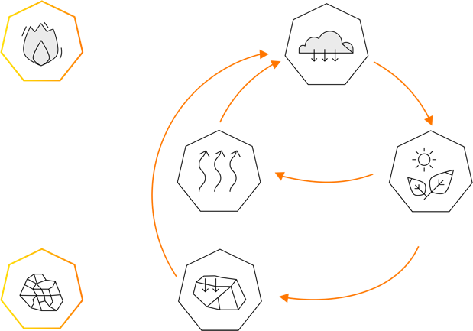
How are fossil fuels changing the Earth’s climate?
1. Sources, advantages and disadvantages of renewable energy
Fossil fuels and power generation
Fossil fuels include coal, oil and gas, formed millions of years ago from the remains of dead plants and animals.
In a fossil fuel power station:
Chemical energy > Heat > Kinetic energy > Electrical energy
The black arrows represent how the carbon stored in fossil fuels is released by combustion into the atmosphere as carbon dioxide.
Combustion
Atmospheric carbon
Respiration
Photosynthesis
What do the orange arrows represent in
this carbon cycle?
What do the black arrows represent?
What is the significance of the black arrows?
Can you explain the meaning of the ‘greenhouse effect’?
Fossil fuel
Decay
The carbon cycle
9
Notes:
Practitioner delivery suggestions
Please note that this is a simplified representation of the carbon cycle that for clarity omits other natural processes that include volcanic activity, rock weathering, and soil and oceanic carbon exchange with the atmosphere.
Activity
Explain that carbon naturally cycles through the earth’s atmosphere, biomass (plants and animals), soil, rocks and ocean.
Review the schematic on the slide, which has two parts: a circular element with orange arrows, and a linear addition shown with black arrows (which represent the same process as the black arrows on the previous slide). (Note that for simplicity the schematic omits animals, which ‘consume’ the carbon captured via photosynthesising plants and contribute carbon via respiration and eventual decay.)
Ask learners to suggest the key features or characteristics of the orange cycle and then the significance of what the black arrows represent.
Example answers
Please see the next slide.
Assessment
Discussion and verbal answers.
Extension
Learners can research historical and predicted levels of atmospheric carbon, for example at:
www.climate.gov/news-features/understanding-climate/climate-change-atmospheric-carbon-dioxide
climate.nasa.gov/climate_resources/24/graphic-the-relentless-rise-of-carbon-dioxide/

Slide 10
Fossil fuels, energy and climate change – answers
1. Sources, advantages and disadvantages of renewable energy
Fossil fuels and climate change
The orange arrows in the carbon cycle diagram represent natural carbon cycles that change very slowly over time.
The black arrows represent human processes that have rapidly added carbon into the atmosphere.
The ‘greenhouse effect’ is the natural process by which certain gases ‘trap’ the sun’s heat, warming the Earth. The rapid rise in atmospheric carbon has amplified the greenhouse effect, leading to global warming and the current climate crisis.
Combustion
Atmospheric carbon
Respiration
Photosynthesis
Renewable energy sources provide a solution to
the problems of climate change. Can you define
a renewable energy source?
Fossil fuel
Decay
The carbon cycle
10
Notes:
Practitioner delivery suggestions
Activity
Review the answers on the slide.
You may wish to explore learners’ attitudes towards climate change, for example by asking them to rate its importance and severity from 1-10 or by using a show of hands.
Assessment
Discussion.
Extension
Learners can watch this ‘Climate change 101’ video: www.youtube.com/watch?v=EtW2rrLHs08

Slide 11



Introducing renewables
1. Sources, advantages and disadvantages of renewable energy
Renewable energy is energy that is collected from resources that are naturally replenished on a human timescale.
Wind
Wind generation converts the kinetic energy of moving wind into electricity.
Wind turbines can be located in onshore or offshore wind farms.
Solar
Solar generation converts radiant energy from the sun into electricity.
Solar panels can be mounted
on roofs or in ground-level
solar farms.
Hydro
Hydro generation converts the kinetic energy in flowing water
into electricity.
This requires water to be stored at altitude, or to be readily available.
11
Notes:
Practitioner delivery suggestions
Activity
Explain that renewable energy comes from sources that, unlike fossil fuels, won’t run out one day. While any renewable energy project needs materials and energy to construct (which is known as the ‘embodied carbon’), they also emit little or no carbon during operation.
The next two slides briefly introduce six main types of renewable energy. Three are on this slide and three are on the next.
Extension
Learners can research more about wind, solar and hydro generation or use the following links:
Onshore and offshore wind energy: www.nationalgrid.com/stories/energy-explained/onshore-vs-offshore-wind-energy
How does a wind turbine work: www.nationalgrid.com/stories/energy-explained/how-does-wind-turbine-work
How does solar power work: www.nationalgrid.com/stories/energy-explained/how-does-solar-power-work
Hydro power in the UK: www.hydropower.org/country-profiles/united-kingdom#:~:text=Today%20the%20UK%20has%20a,of%20Wales%20and%20northwest%20Scotland.
How does hydro power work: www.hydropower.org/iha/discover-types-of-hydropower

Slide 12




Introducing renewables
1. Sources, advantages and disadvantages of renewable energy
Biofuels
Biofuels are fuels produced from plant materials, including bioethanol, biodiesel and oils.
Fast-growing biofuel crops are grown on farmland.
Geothermal
Geothermal energy extracts
heat stored in deep rocks.
The heat is used directly or to generate electricity.
Tidal
Tidal energy converts the kinetic energy in flowing tidal streams.
This requires fast-flowing, deep tides for a large volume of water.
Think carefully about how each form of renewable energy can
be harnessed and used.
Identify at least one advantage and disadvantage of each form.
List some advantages of combining renewable sources of energy.
12
Notes:
Practitioner delivery suggestions
Activity
Once all six of the main renewable energy types have been shown, ask learners to review each one and identify at least one advantage and disadvantage of each type.
Activity sheet
Learners write their answers on Renewable energy - Activity sheet 1.
Example answers
Please see the next slide.
Extension
Learners can research more about biofuels, geothermal power and tidal power generation or use the following links:
Biofuels information: biofuel.org.uk/
Geothermal energy at the Eden Project, Cornwall: www.edenproject.com/mission/our-projects/eden-geothermal-energy-project
Swansea Bay tidal lagoon project: www.tidallagoonpower.com/projects/swansea-bay/
O2 tidal turbine, Orkney: orbitalmarine.com/o2/

Slide 13

Advantages and disadvantages of renewables
1. Sources, advantages and disadvantages of renewable energy
Combining renewable energy sources overcomes many limitations. Different areas can make the most of local renewable resources. Different sources can help to balance out differences between supply and demand.
 | Wind | Solar | Hydro | Biofuels | Geothermal | Tidal
Advantages | Easily scaled up Can be offshore | Easily scaled up Can use roofs | Reliable | Portable | Reliable Lots available | Reliable
Disadvantages | Output varies with conditions | Unevenly distributed Output varies with conditions | Unevenly distributed – needs mountains Expensive | Uses land that could be used to grow food | Unevenly distributed | Expensive Marine habitat damage
Which other engineering technologies might help to make
renewables as reliable and dependable as our current energy supply?
13
Notes:
Practitioner delivery suggestions
Activity
Review the suggested advantages and disadvantages on the slide and invite learners to include additional suggestions of their own.
Example answers
Disadvantages may also include local objections to having visible renewable generation in a local environment. Opinions vary widely about, for example, the visual impact of onshore wind farms.
Other engineering technologies that will be important include smart grids that support widely distributed generation, along with battery grid storage that can store surplus renewable energy to meet peak demand.
Assessment
Discussion and verbal answers.
Film
Learners can watch the Renewable energy film after completing this activity.

Slide 14
Renewables and nuclear energy
1. Sources, advantages and
disadvantages of renewable energy
Nuclear energy is non-renewable but is often considered alongside renewable energy.
The heat from fission reactions is used as a replacement for the combustion of fossil fuels.
Nuclear energy can offer significant advantages – but also significant disadvantages:
 | Nuclear
Advantages | No carbon emissions during operation. Enormous amounts of energy from uranium fuel. Uranium supplies are predicted to last well over 200 years.
Disadvantages | Hazardous, long-lasting nuclear waste. Very expensive and slow to build. Very expensive and slow to decommission.
Decide whether you think nuclear energy should form part of a zero
carbon energy system in the future – be ready to justify your position.
14
14
Notes:
Practitioner delivery suggestions
Activity
Some learners may have previously mentioned nuclear energy as a renewable energy source. Clarify that nuclear energy is non-renewable because it relies on a supply of suitable fissile material. Even though small amounts of nuclear fuel can release significant amounts of energy, nuclear fuel is still a finite resource, just over a long timescale.
Review the advantages and disadvantages of nuclear energy on the slide. Ask learners to reflect individually on whether nuclear energy should play a role in the UK’s future and then discuss this with a partner or table group. Share points of view and then hold a class vote.
Assessment
Discussion.
Verbal arguments for and against nuclear power.
Verbal answers.
Extension
Summary of nuclear energy in the UK: world-nuclear.org/information-library/country-profiles/countries-t-z/united-kingdom.aspx
Learners could research more about nuclear energy plans for the UK before holding a more formal debate with a motion for or against expanding nuclear power in the UK.

Slide 15

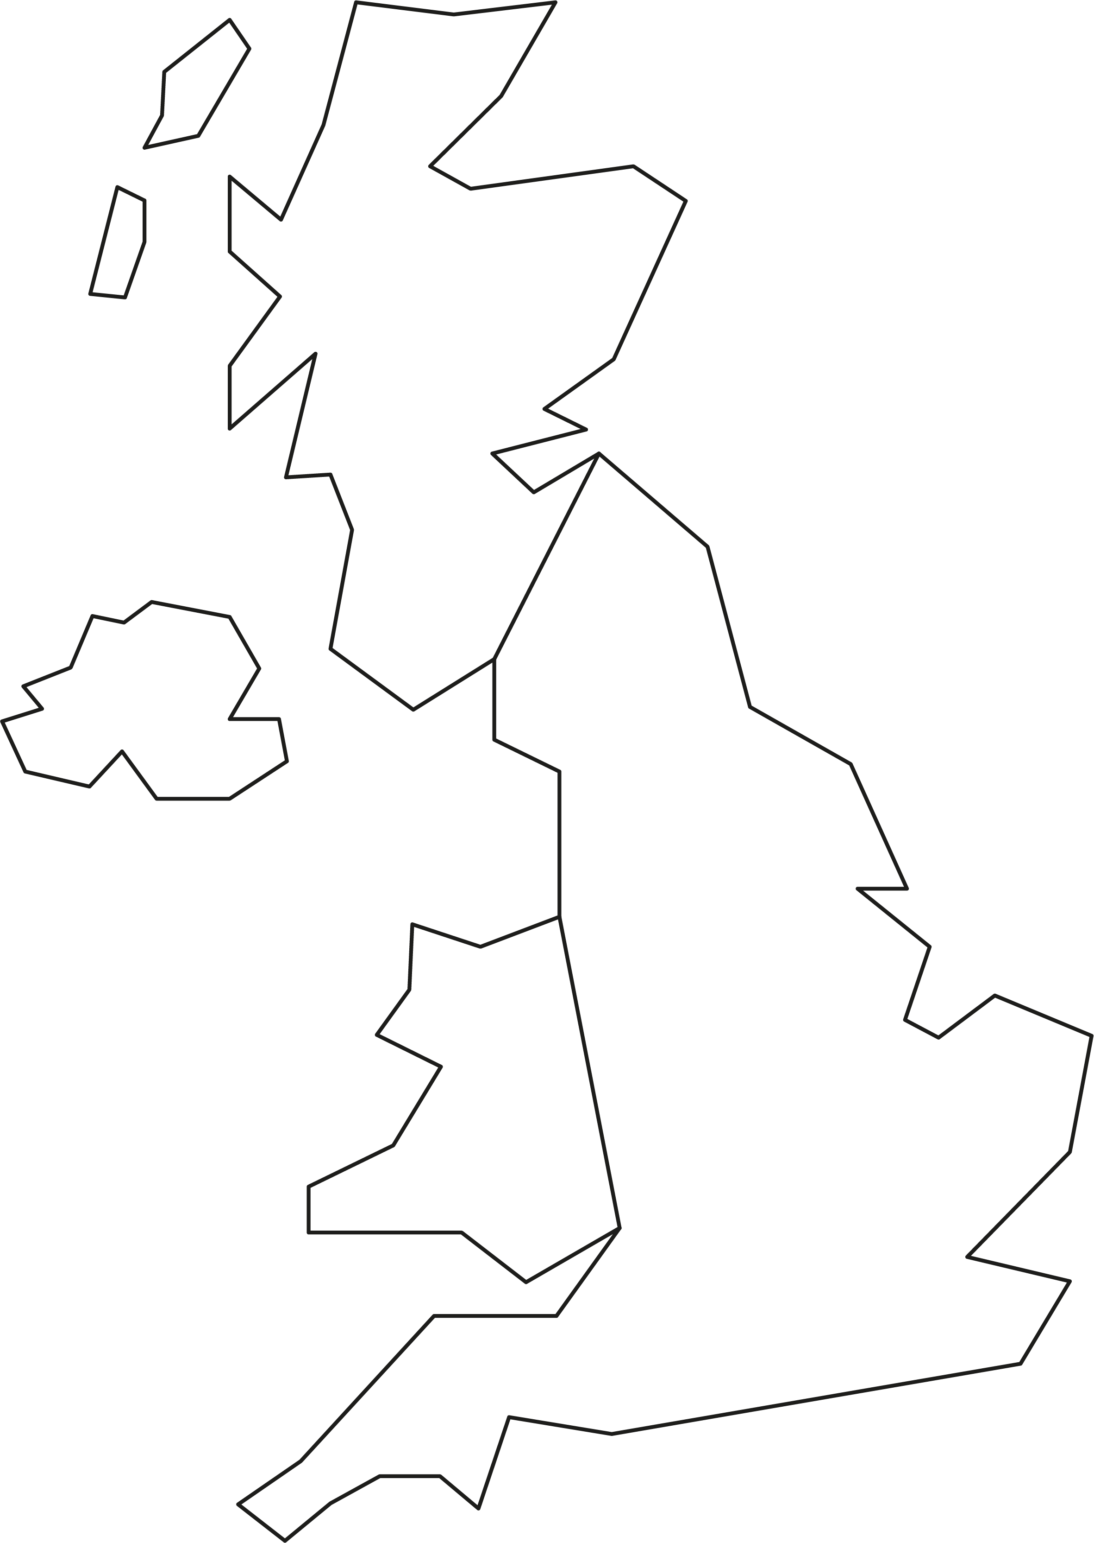
How could we become a renewable UK?
1. Sources, advantages and disadvantages of renewable energy
The UK offers many possibilities for harnessing renewable energy, but these are not evenly distributed.
Public opinion can also play a role in how renewable energy sources can be used.
Consider how different forms of renewable energy
could each contribute to a UK that is 100% powered
by renewables.
Label the map with your ideas about how some or all forms could be more widely implemented across the UK.
Identify some challenges and how these might be overcome.
15
Notes:
Practitioner delivery suggestions
This activity prepares learners for a more quantitative version of the activity in the Level 3 resource 2. Planning for renewable energy in this Renewable energy module.
Activity
Explain that learners now need to apply their understanding and ideas to suggest, in broad terms, how renewable energy could be harnessed more fully across the UK.
Discuss the map, and identify areas of high, mountainous ground (learners can also use the additional links in ‘Extension’, below). How might wind, solar, hydro and tidal energy sources be distributed across the UK? What would the local implications be for dramatically scaling up these forms of energy generation?
In groups, learners discuss some broad approaches for increasing renewable generation and label the map on the activity sheet with their ideas. Learners can add more detail or suggest what policies or guidelines would facilitate an increase in each type of renewable generation.
Activity sheet
Learners annotate the UK map on Renewable energy - Activity sheet 2.
Example answers
Please see the next slide.
Assessment
Discussion and verbal answers.
Written answers.
Extension
The Royal Academy of Engineering has led the production of a framework of decisions that will have a significant, positive impact on a transition to renewable energy: raeng.org.uk/news/academy-outlines-low-regrets-framework-to-support-urgent-climate-change-action
Additional resources to aid decision-making:
Existing generation (click to select a type, eg hydro, to see current distribution): www.carbonbrief.org/mapped-how-the-uk-generates-its-electricity/
Solar energy map: solargis.com/maps-and-gis-data/download/united-kingdom
Wind energy map: www.ms1energy.co.uk/uk-wind-map/
Tidal energy map: severnestuarycoastalgroup.org.uk/about/tidal-energy/

Slide 16
How could we become a renewable UK?
1. Sources, advantages and disadvantages of renewable energy
The UK has some of the world’s best conditions for wind energy, and about half
of Europe’s available tidal energy. Solar energy is most available in southern regions.
Offshore wind around the coast and in the North Sea, but needs expensive maintenance and connection to the mainland.
Tidal energy is available along the west coast and where strong tides occur
but needs to avoid damage
to marine environments
or shipping.
Solar generation – mainly in the south and west, but needs to work alongside farming and food security.
Existing hydro in
mountainous regions –
new forms of energy storage
may be cheaper to build.
Onshore wind in hilly and coastal areas, but needs to overcome visual objections.
16
Notes:
Practitioner delivery suggestions
This answer slide provides broad suggestions based on energy availability. It does not represent a formal recommendation or policy of the Royal Academy of Engineering and should not be interpreted as such.
Activity
Highlight that in general terms renewable generation needs to take place where each form of energy is most available. Integration into the national grid can then distribute this energy to where it is needed most.
Tidal energy is best harnessed where the tidal range is greatest. Outside of the English channel, an extremely busy shipping route, this is found at points on the west coast of the UK including the Bristol channel and western Irish sea.
Large-scale hydro energy needs altitude and must therefore be sited in mountainous regions, although development may be limited due to environmental considerations.
Solar energy is most available along the south coast, although useful amounts of solar energy can still be found across the southern half of the UK, and solar can still make a helpful contribution in more northerly locations.
Wind energy is most available in the northern and more mountainous areas onshore, but most scope for development is in offshore wind farms out at sea, including in the North Sea.
Example answers
Environmental considerations need to be taken into account, for example any installation’s effects on the local ecosystem and its inhabitants. Suitable mitigation plans may enable large-scale projects to go ahead.
However, planning laws may need to change to make it easier to construct new capacity, for example onshore wind is at the time of writing almost impossible to gain approval for.
Extension
Learners could work in teams to create a formal presentation of their ideas and could compete to present the most compelling strategy for increasing renewable generation across the UK.

Slide 17





Renewable energy and engineering careers
1. Sources, advantages and disadvantages of renewable energy
Planning and feasibility
Identifying and modelling opportunities for renewable
energy generation.
Design
Designing wind turbines and solar panels, or installations like wind or solar farms.
Construction
Constructing new wind and solar farms, or other forms of renewable generation.
Maintenance
Making sure renewable generation stays safe
and efficient.
Distribution and integration
Linking renewable generation to the national grid.
Energy storage
Designing, building and maintaining new battery grid storage to even out supply to meet demand.
17
Notes:
Practitioner delivery suggestions
This final activity supports an open-ended discussion of career opportunities related to renewable energy.
Activity
Discuss what learners have found interesting or exciting about the need to transition to renewable energy generation.
Review the broad career areas on the slide. Which career areas do they think might suit them best? How could they find out more?
Discuss possible qualification routes, and local or national opportunities.
Assessment
Discussion.
Extension
Learners can explore career opportunities in renewable energy using the RenewableUK career mapping tool: www.renewableuk.com/Page/CareerMapping

Slide 18
Learning outcomes
1. Sources, advantages and disadvantages of renewable energy
You will be able to:
Explain the link between fossil fuel consumption and climate change.
Suggest some advantages and disadvantages of different forms of renewable energy.
Identify some challenges and opportunities related
to a transition to renewable
energy.
Identity engineering career opportunities related to renewable energy.
18

